Slide 1
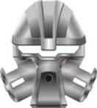

Inakko Combos
Great Kenalgi
Pehkui [Norik’s]
Mahiki

