Slide 1


Sir.Gordonblixt’s custom
LEGO Mandalorians

Slide 2
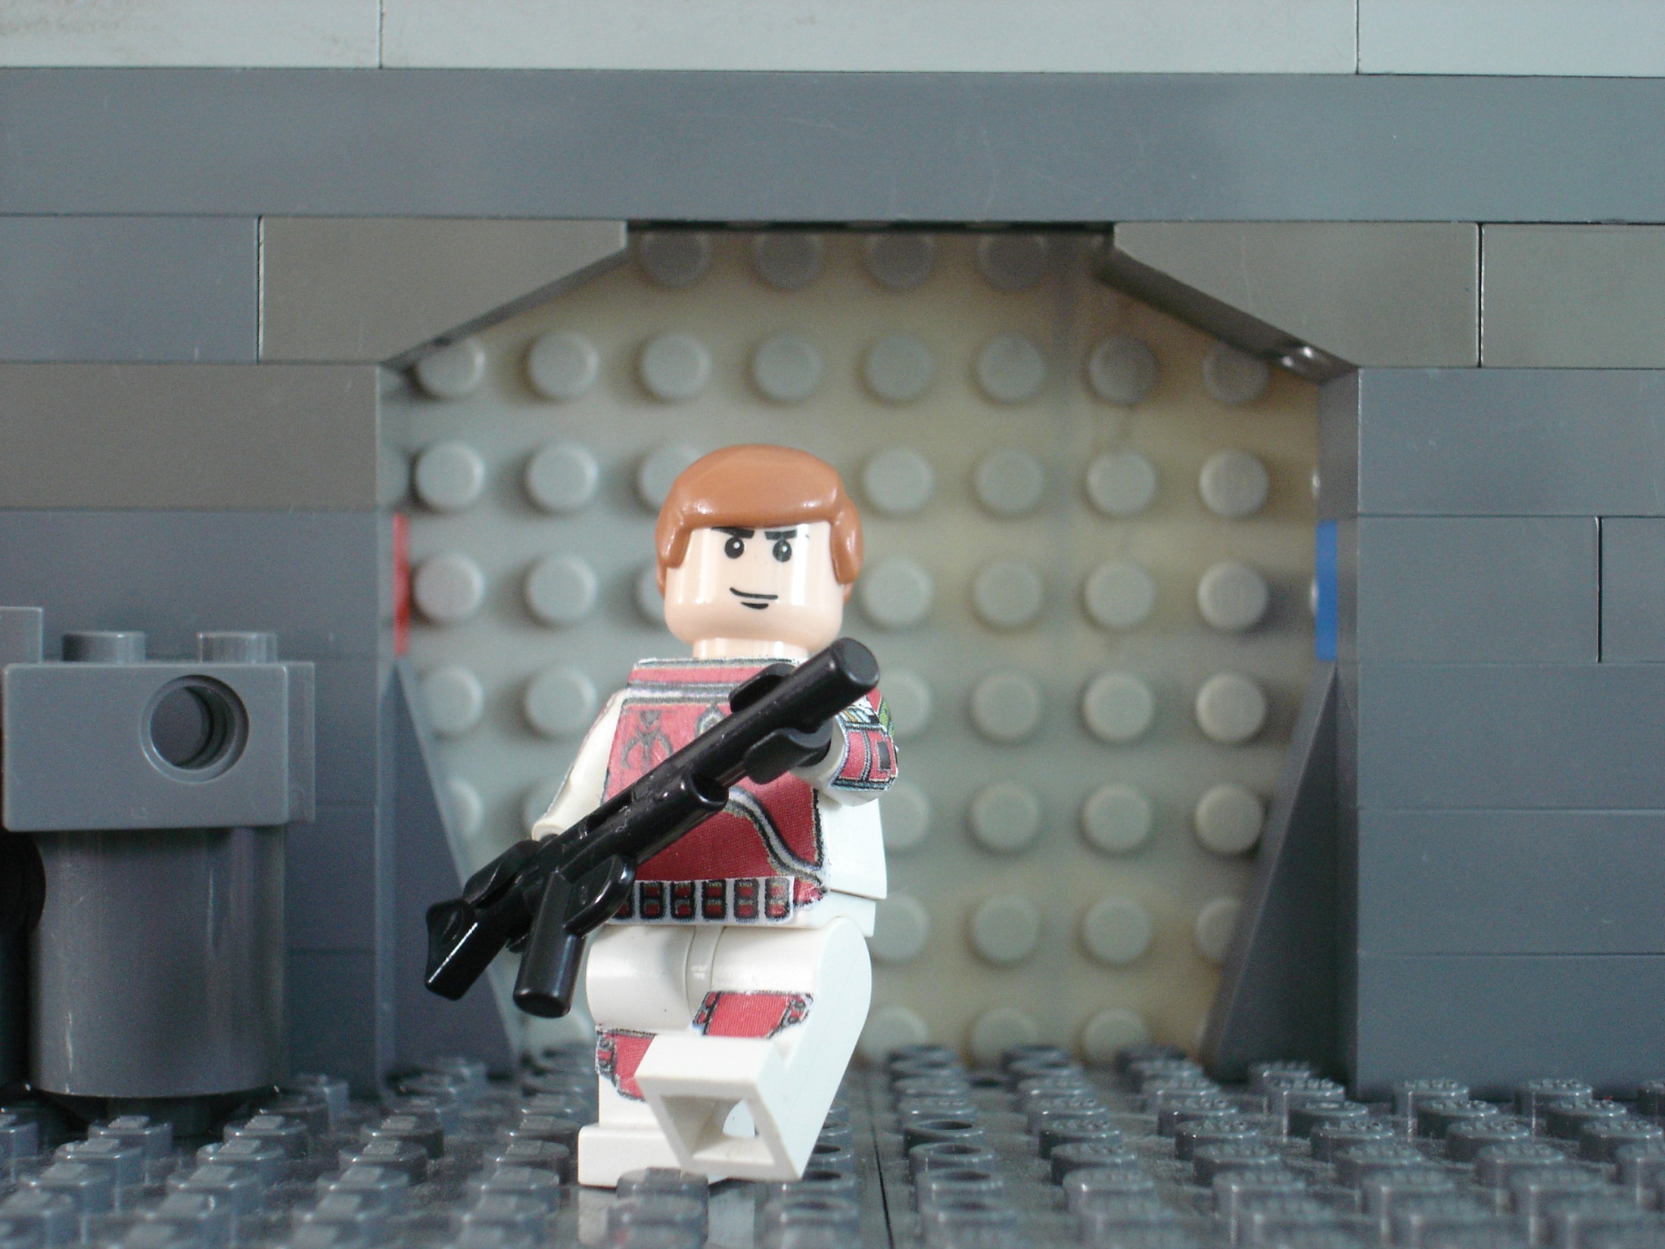
Blixt

Slide 3
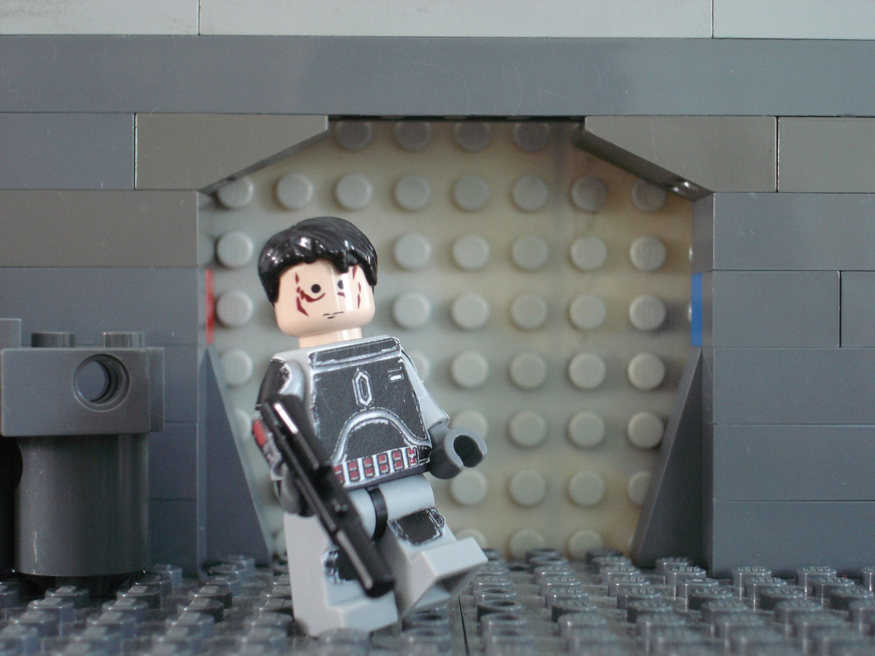
Atin

Slide 4
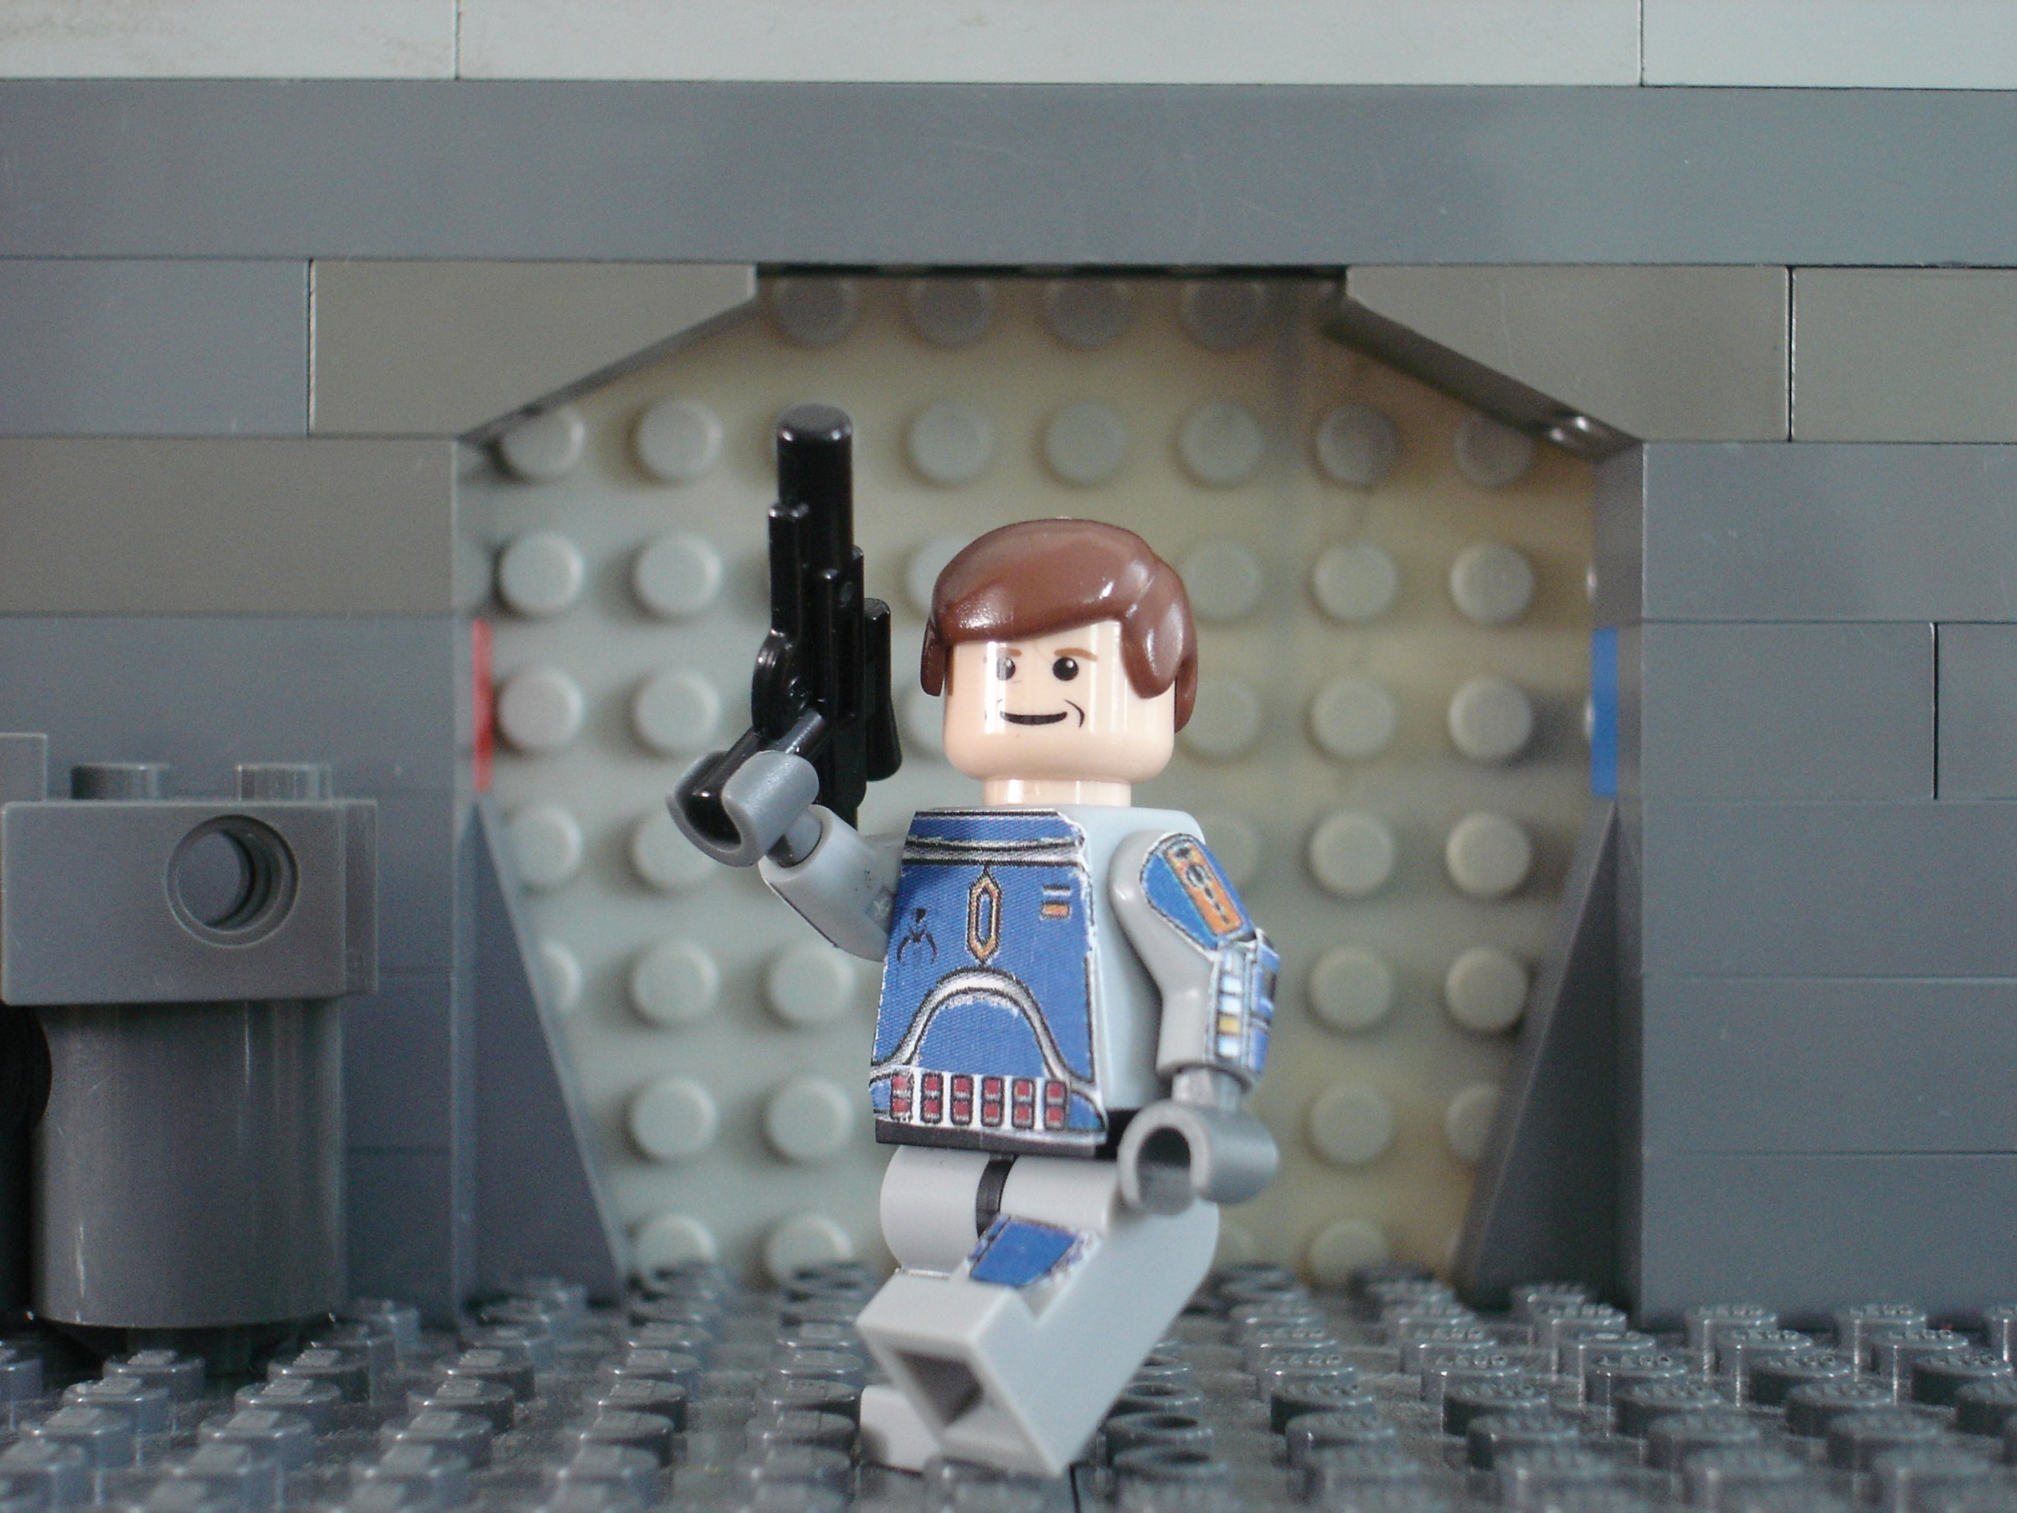
Ordo

Slide 5
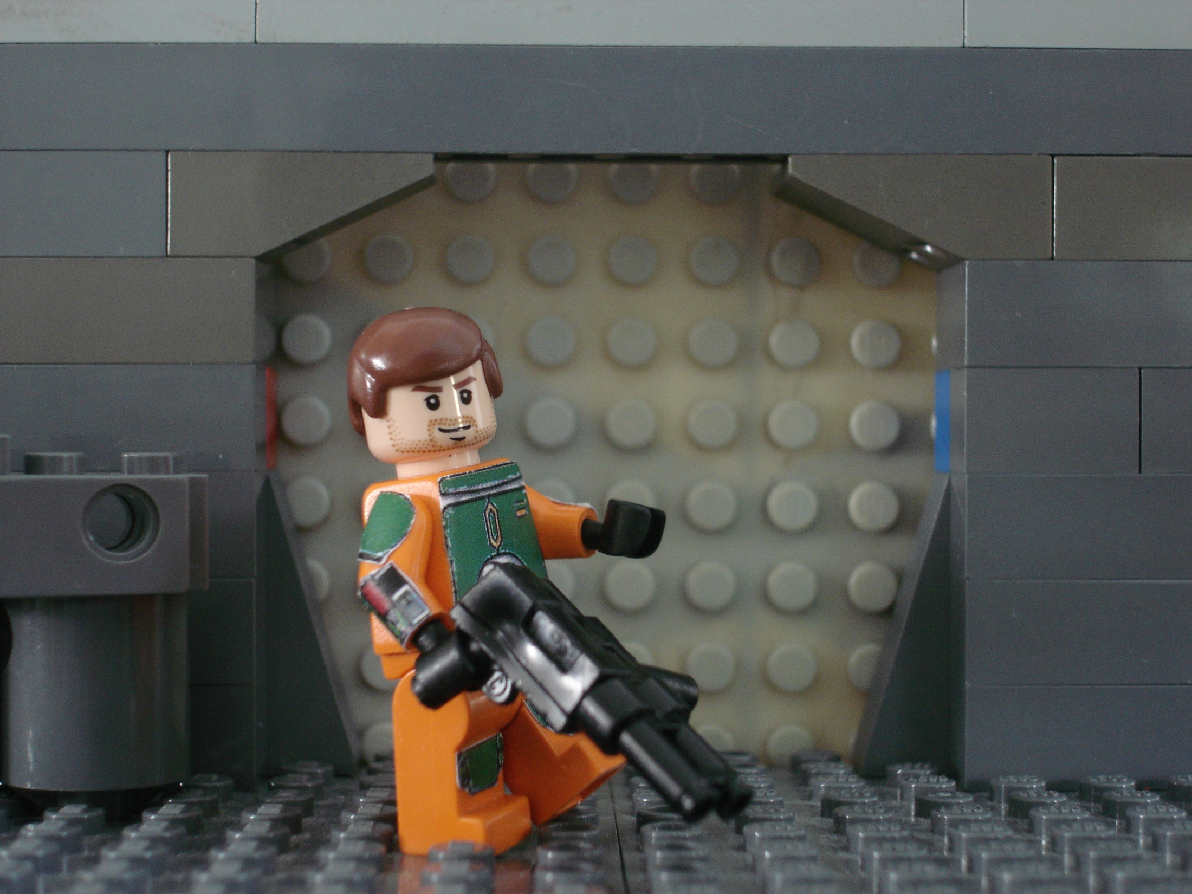
Jaster

Slide 6
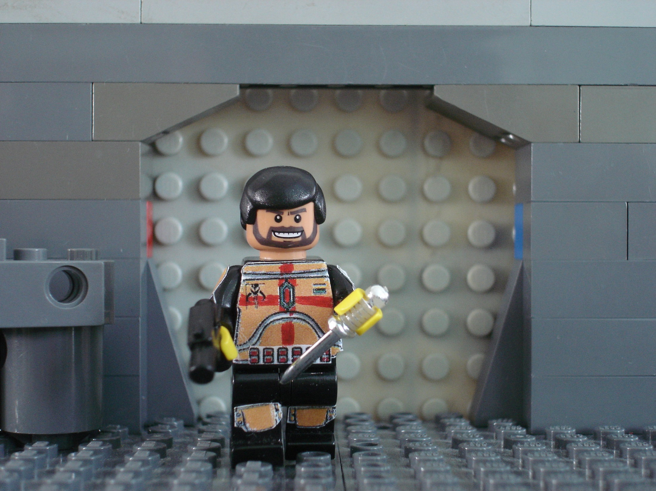
Venku

Slide 7
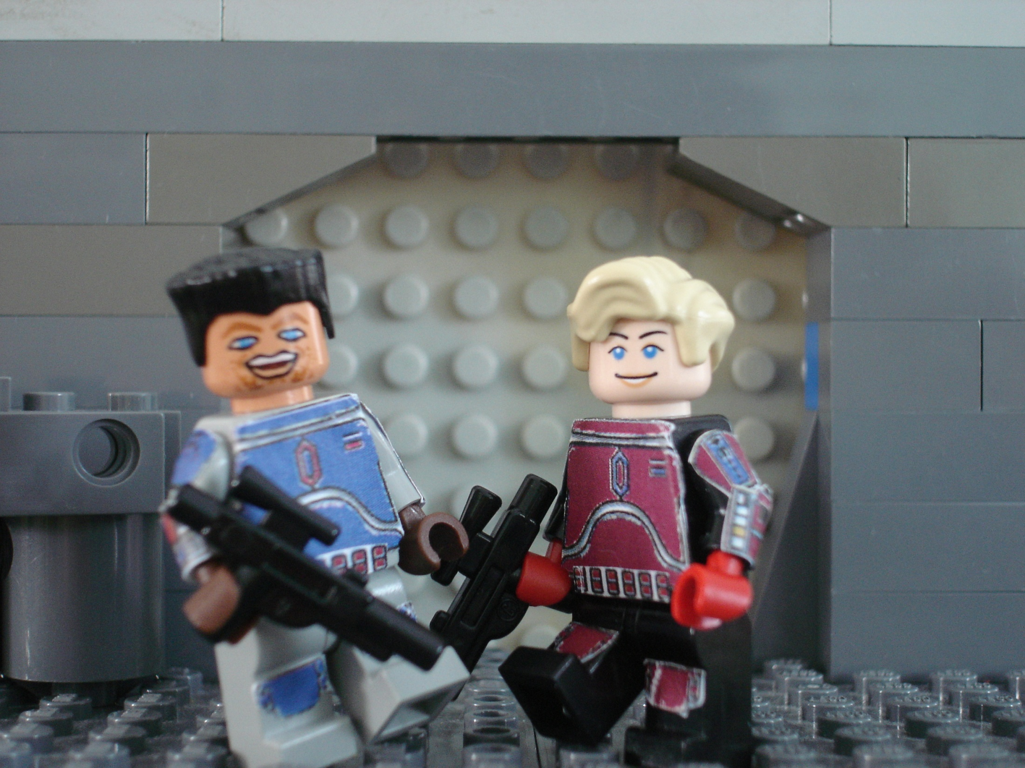
Kad and Parja

Slide 8
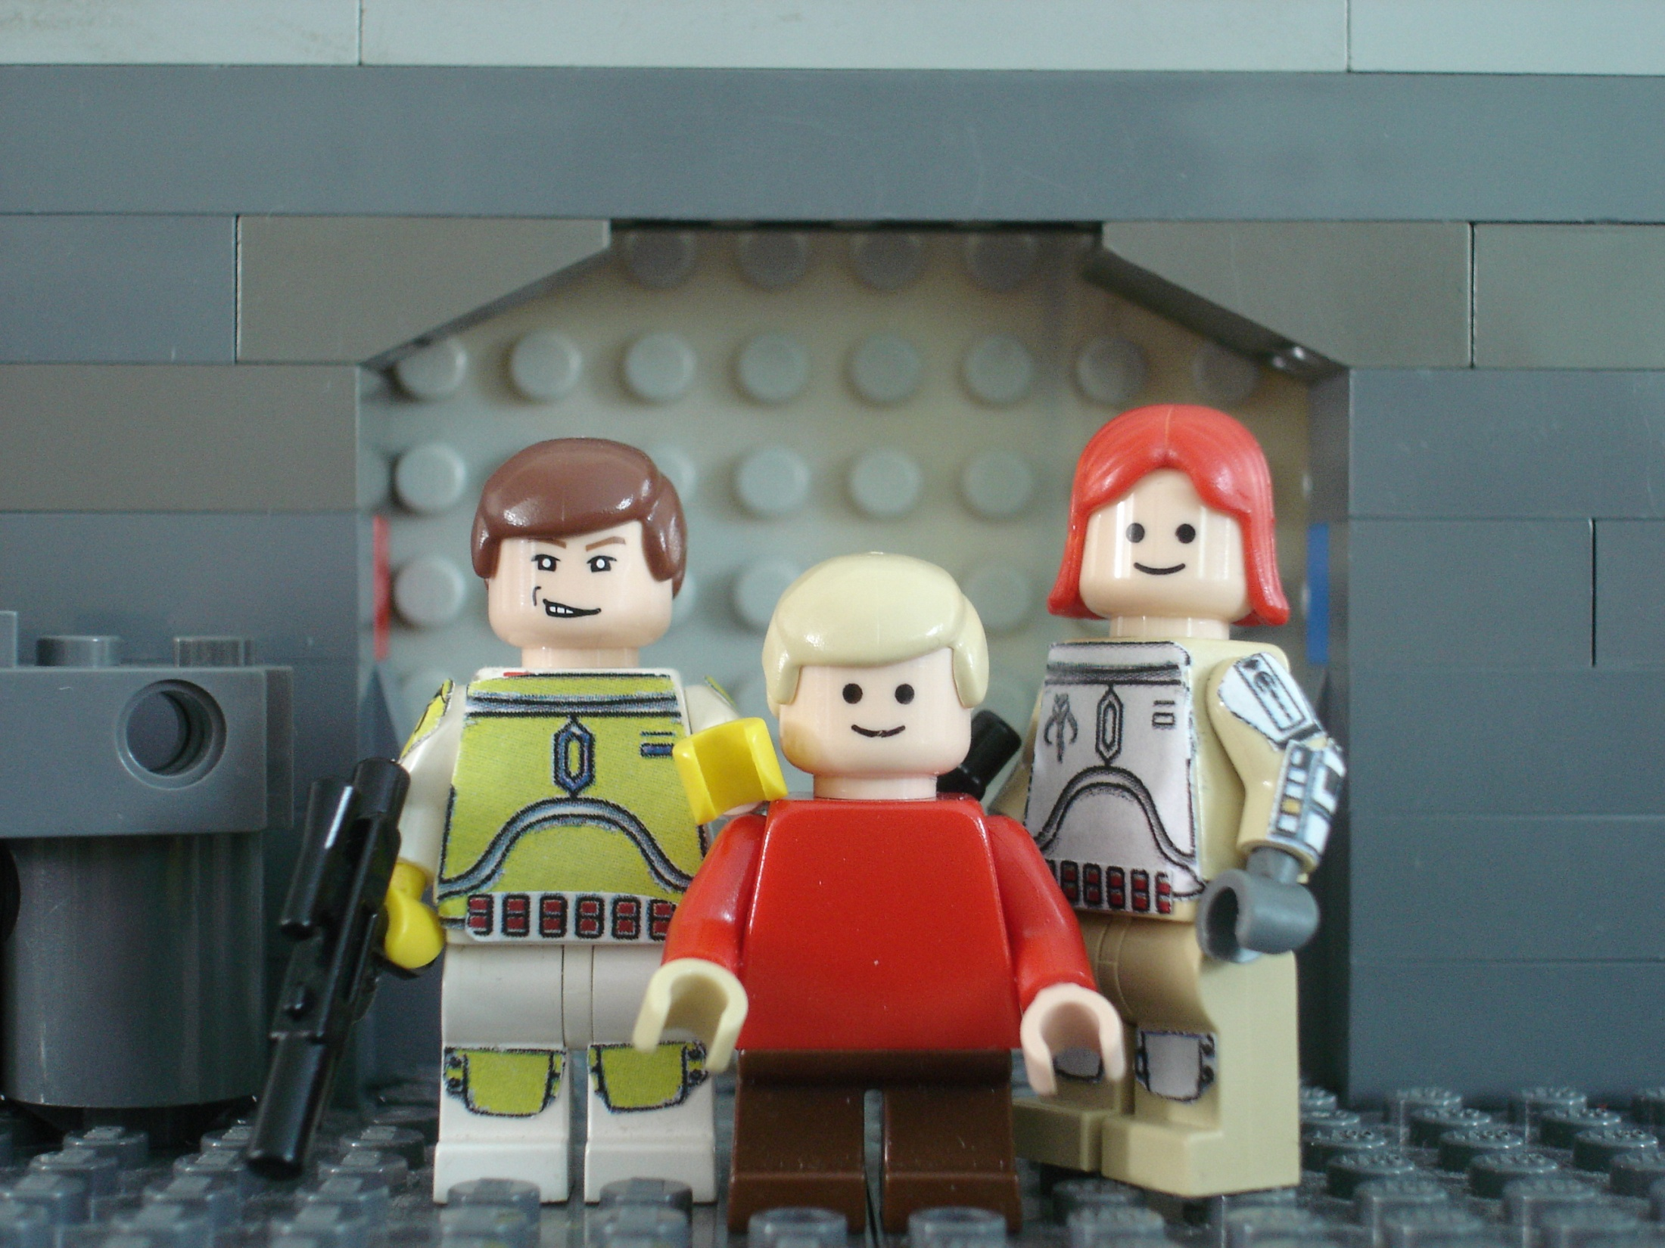
Sev, Jilka and their son Corr

Slide 9
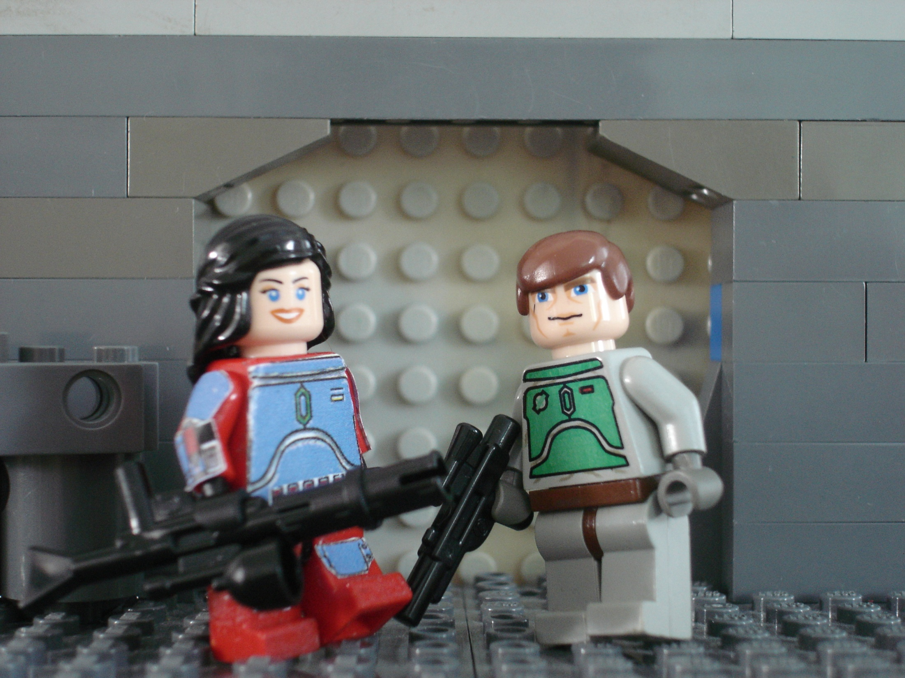
Besany and A'den

Slide 10
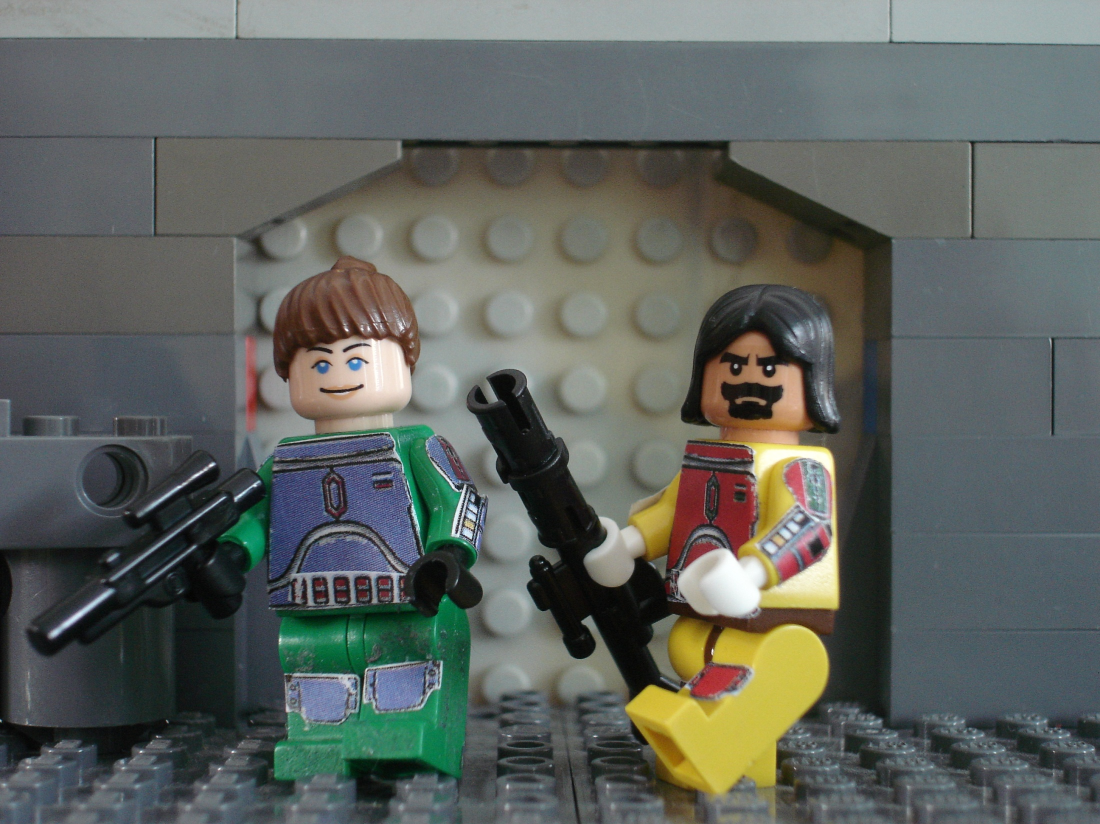
Arla and Rede

Slide 11
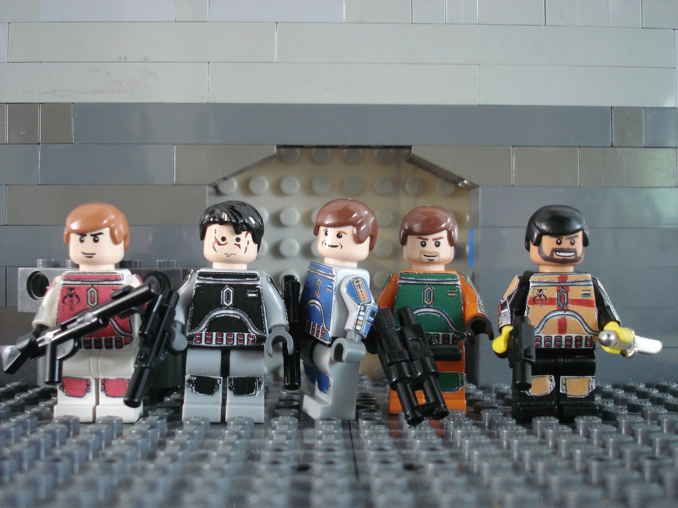
Blixt, Atin, Ordo, Jaster, Venku

Slide 12
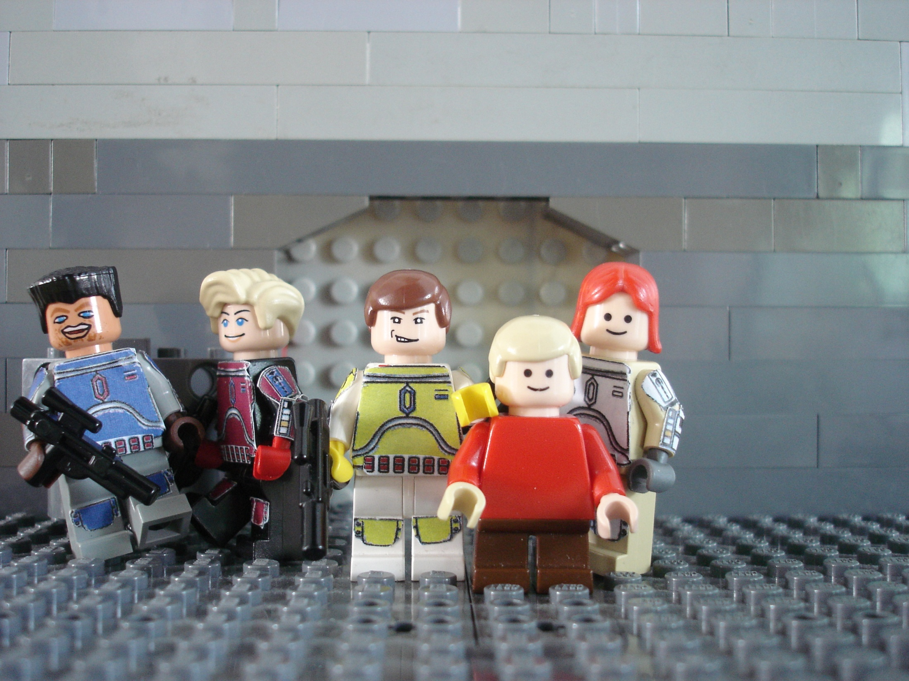
Kad, Parja, Sev, Jilka
and their son Corr

Slide 13
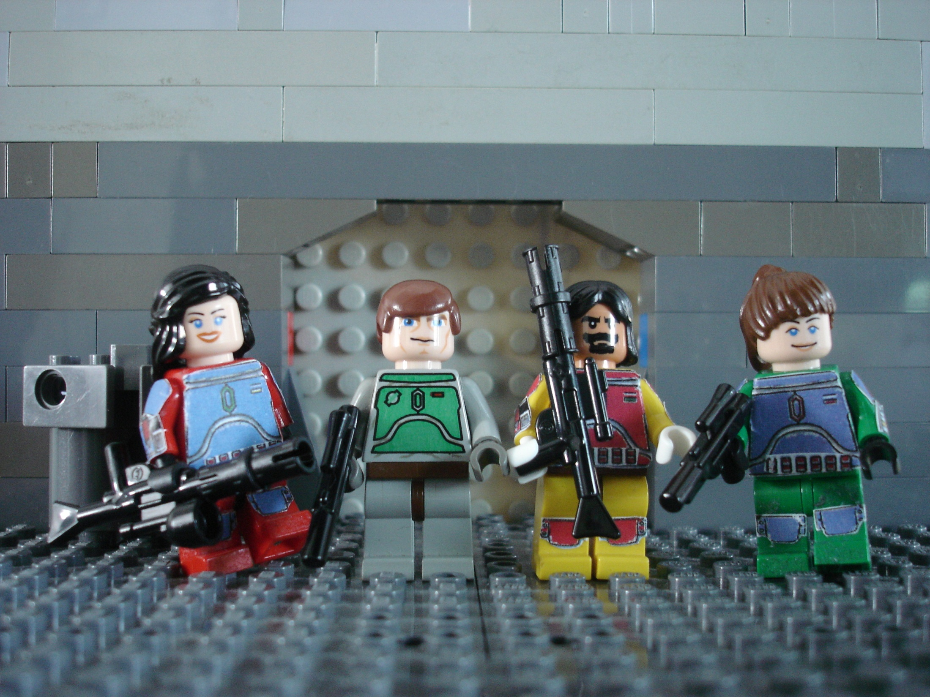
Besany, A'den, Rede and Arla

Slide 14
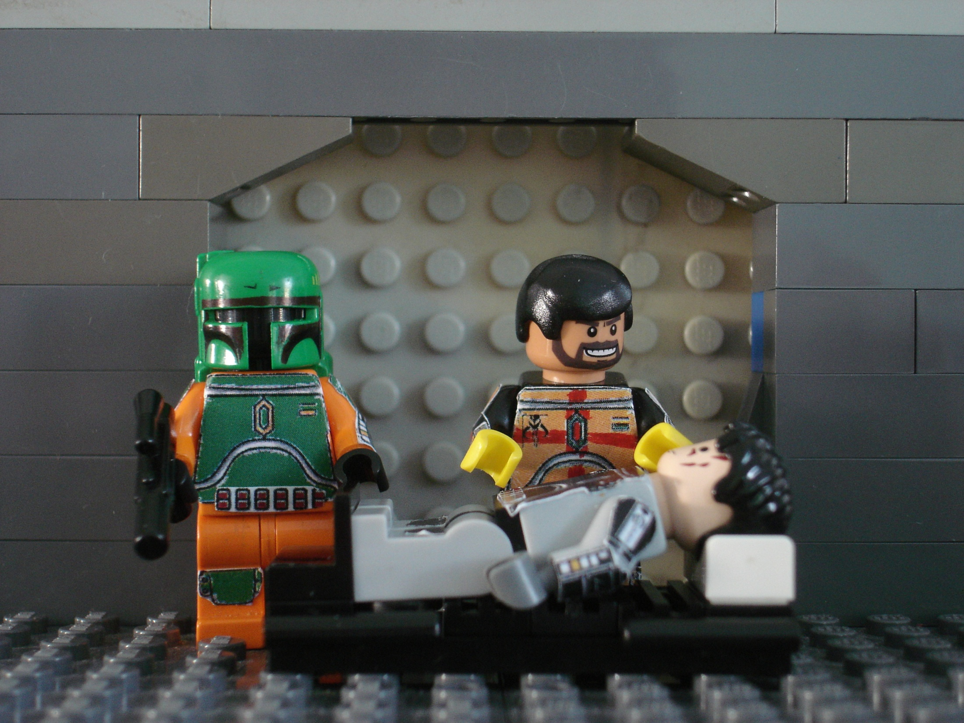
Jaster and Venku
Attenting to an injured Atin

Slide 15

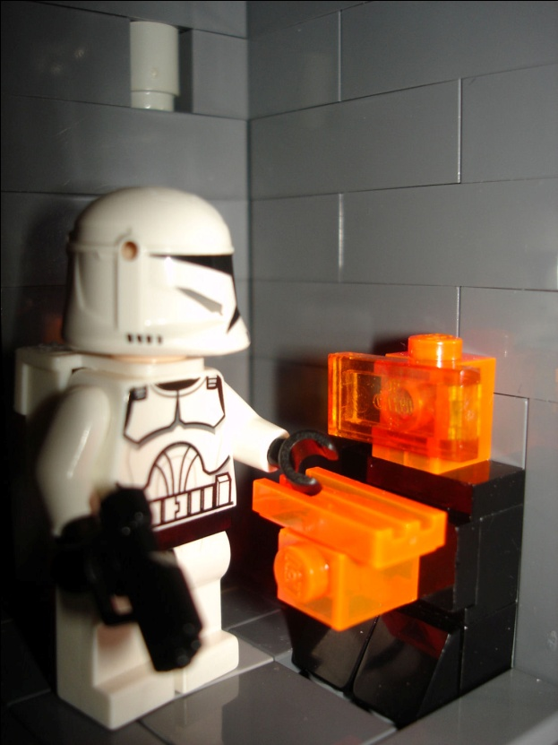


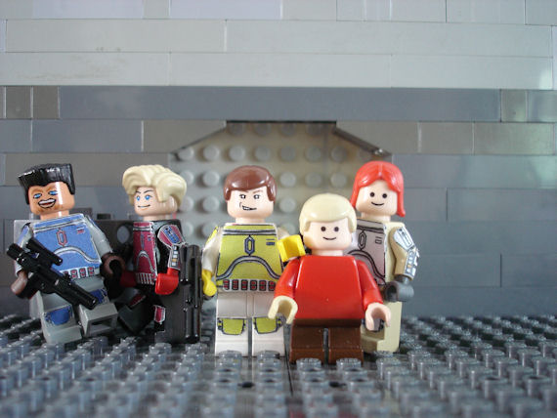

Hope you enjoyed!

