Slide 1
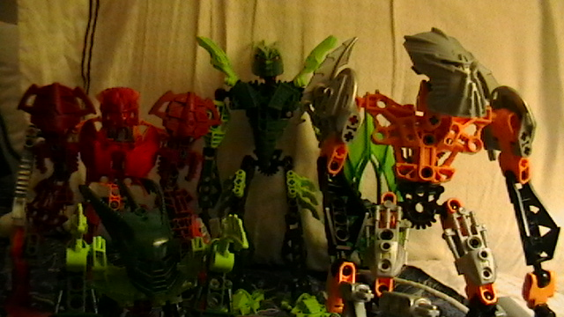
No, you didn’t miss an issue. (Unless, of course, you did). These are our heroes, out on a mission given to them by Raanu.

Slide 2
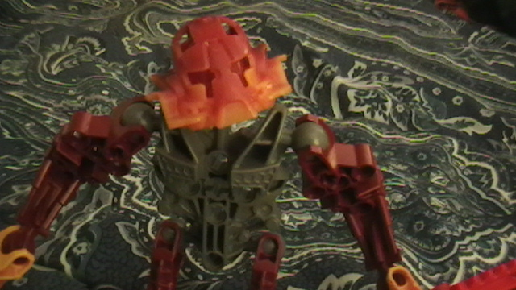
You must go and destroy the elite Skrall warrior Stronius. Cuz I said to.

Slide 3
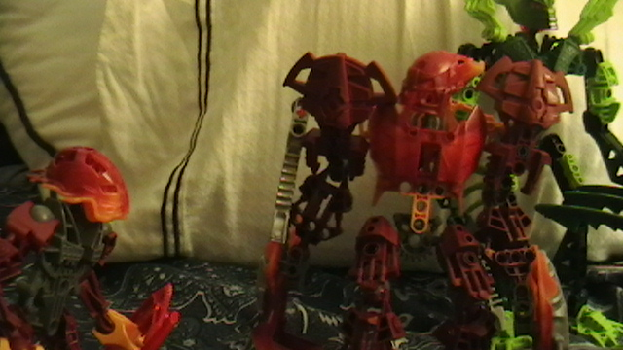

Raanu, if you’re going to follow us repeating our instructions you could’ve just done it yourself.
You’re just jealous because I’m in The Legend Reborn and you’re not.

Slide 4
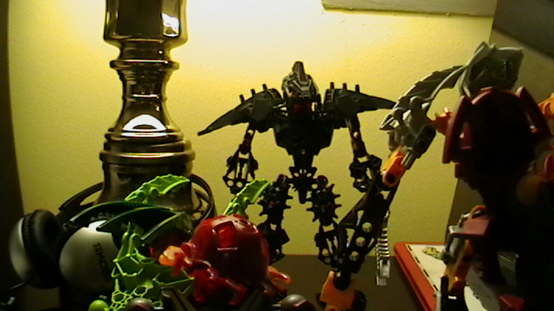
Now the heroes—and Raanu, who doesn’t count as a hero—seem to found their target.

Slide 5
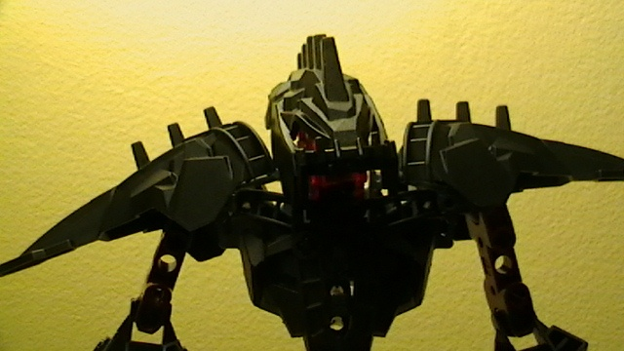
I am Stronius, of the mightiest elite order of the Skrall army: customer service. I’d be happy to help you…..if you have an appointment. Heh heh.

Slide 6
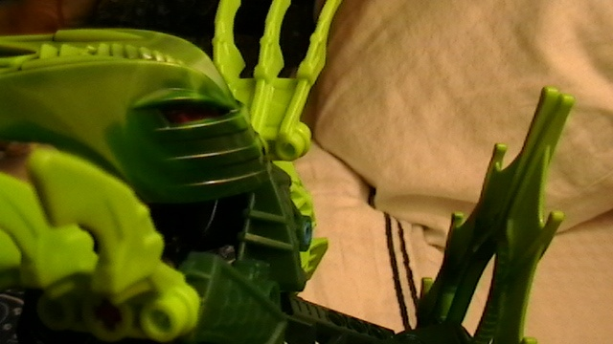
Of course we have an appointment. It’s under…………Abe Fromen.

Slide 7
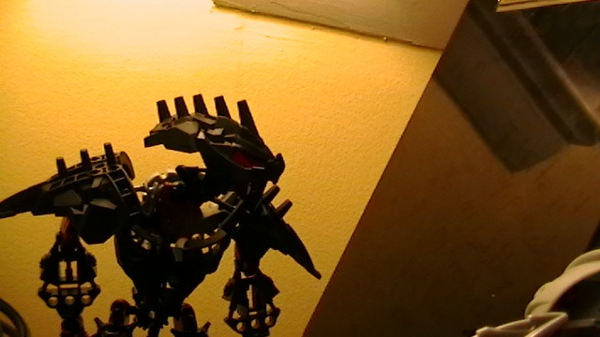
Hmm….let me check my clipboard.

Slide 8
1:00 | 2:00 | 3:00 | 4:00 | 5:00 | 6:00 | 7:00 | Never
Traitor visits | Random Execution | Morale Boost | Traitor | Taco Day @ Cafeteria | Silent Crying | Hug-a-Bone-Hunter | LET ABE FROMEN IN

Slide 9
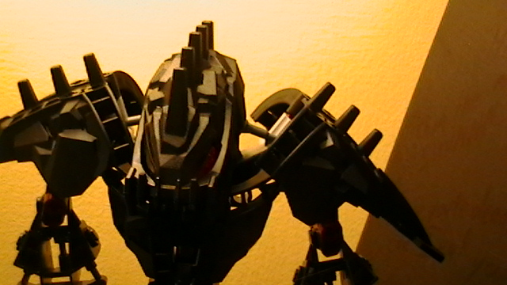
I’m sorry, but you’re written in under NEVER. And I highly doubt you’re Abe Fromen, the Sausage King of New York.

Slide 10
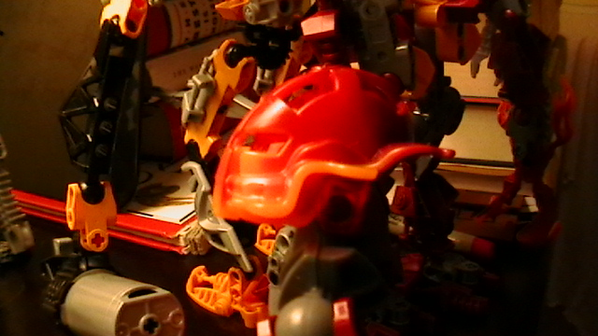
But being written in as never does mean we’re written in, right?

Slide 11
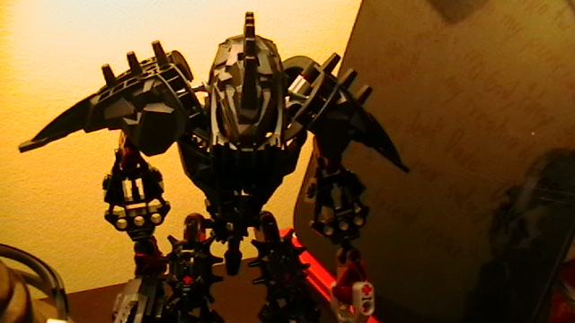
I’m not in the mood to joke, Raanu. It may be that the oversize headphones I have to use are giving me ear infections, but Tuma won’t switch because giant items are cheaper.

Slide 12
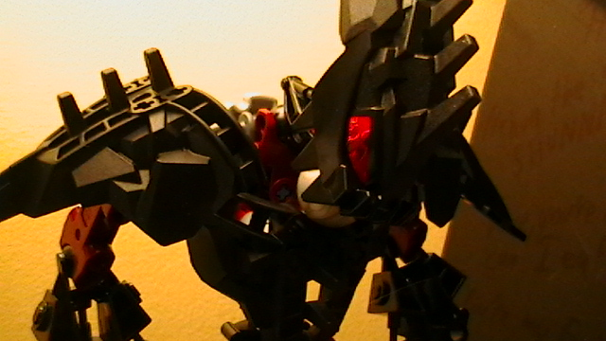
But no matter the reason, the point is---ungh!

Slide 13
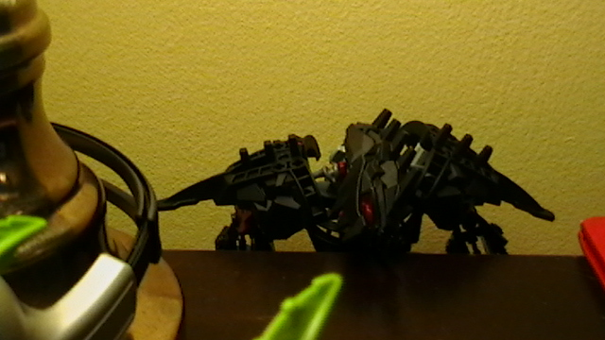

Slide 14
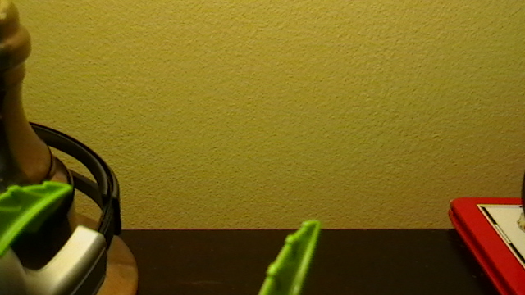

Slide 15
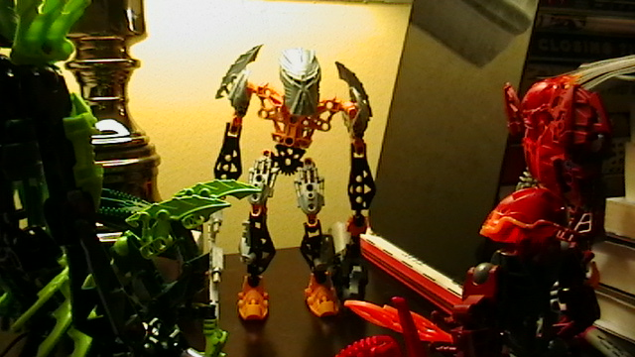
Hav canin, wil battl.
Harsh, but thorough.

