Slide 1
How To Build Round Shapes
Li Li

Slide 2










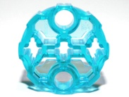
Existing Bricks
Perfect circles
Technic circles
2x2
4x4
6x6
8x8
12x12
20x20
2x2
3x3
3x3
3x3
3x3

Slide 3






Existing Bricks
Rings
Various Wheels
Various Dishes

Slide 4
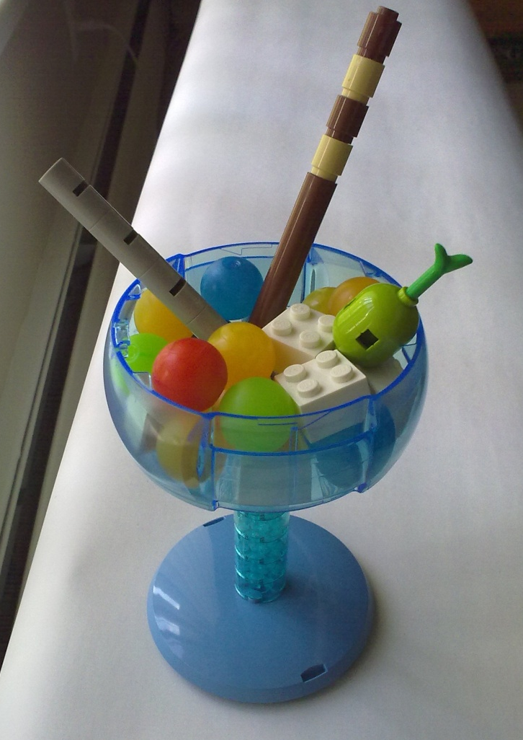
Example

Slide 5
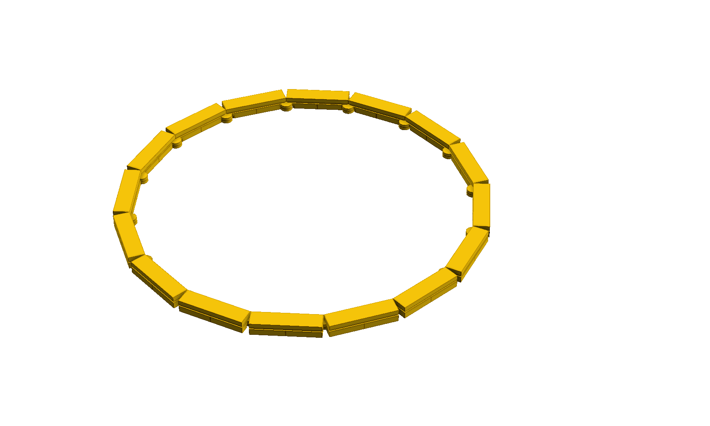
Hinge Plate Circle

Slide 6
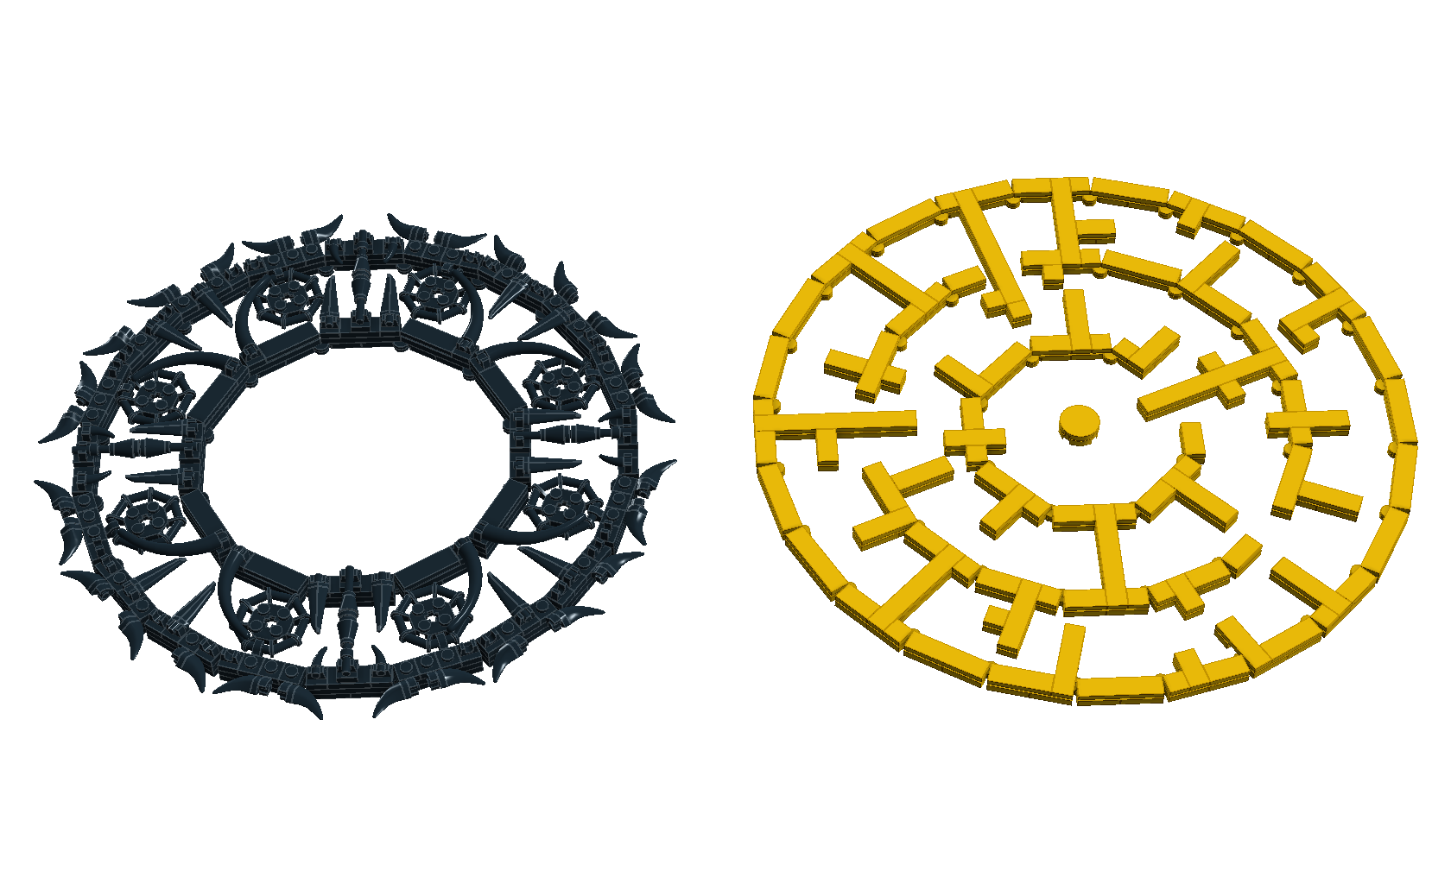
Examples

Slide 7
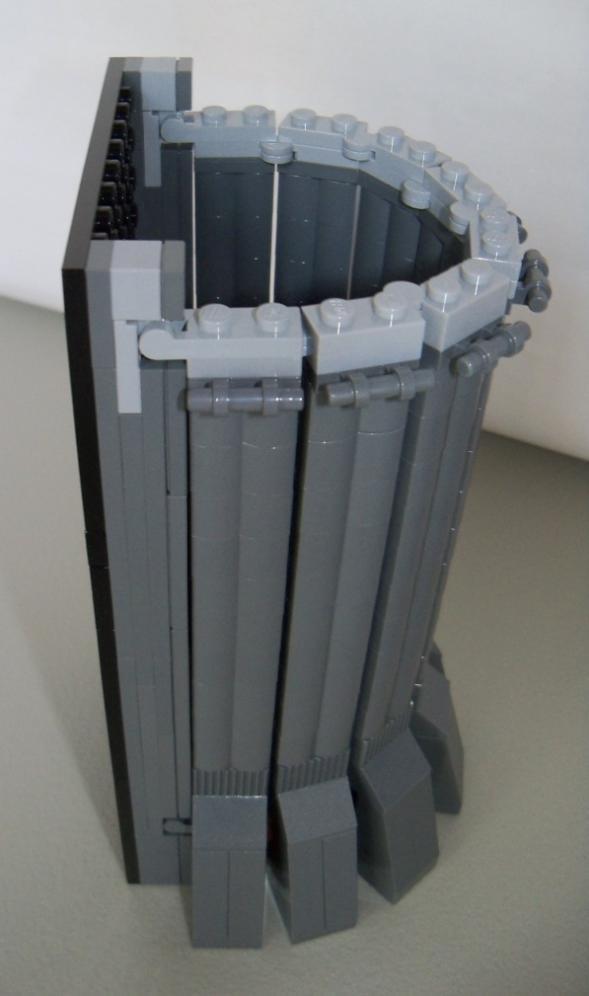
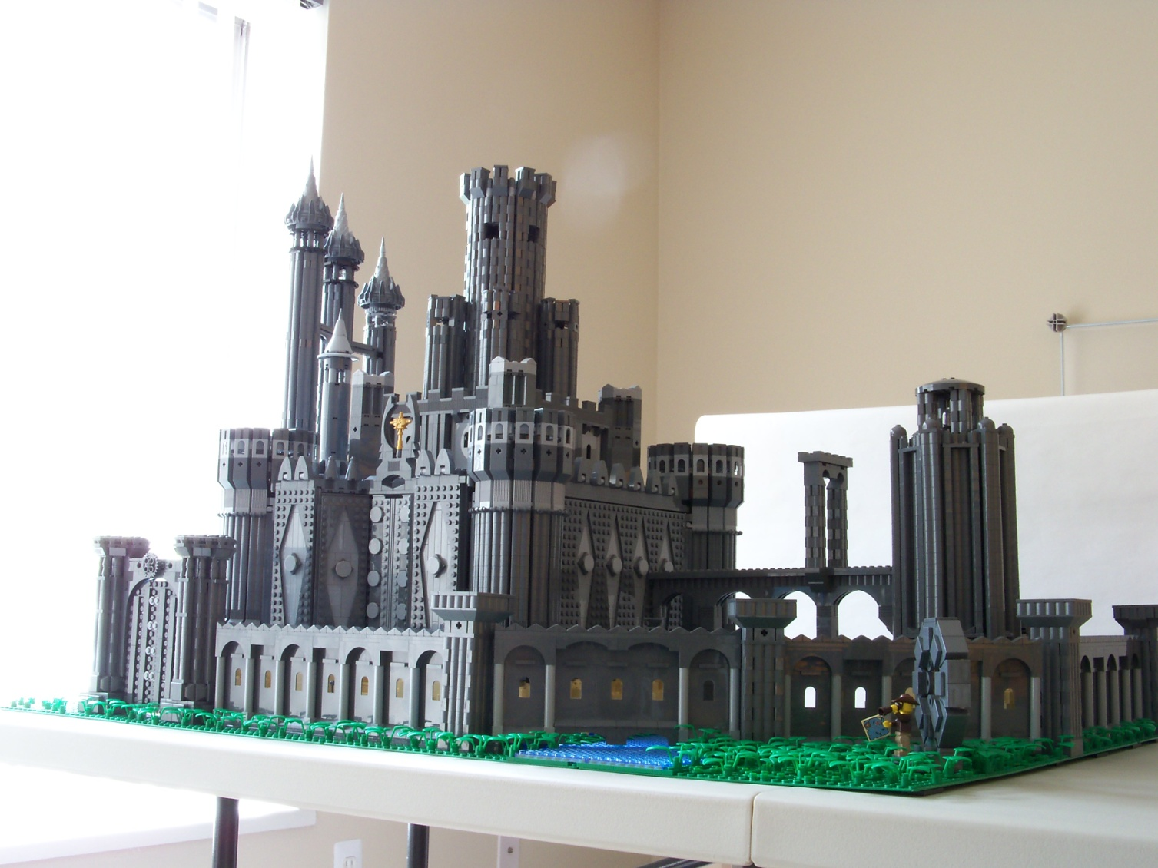
Example

Slide 8
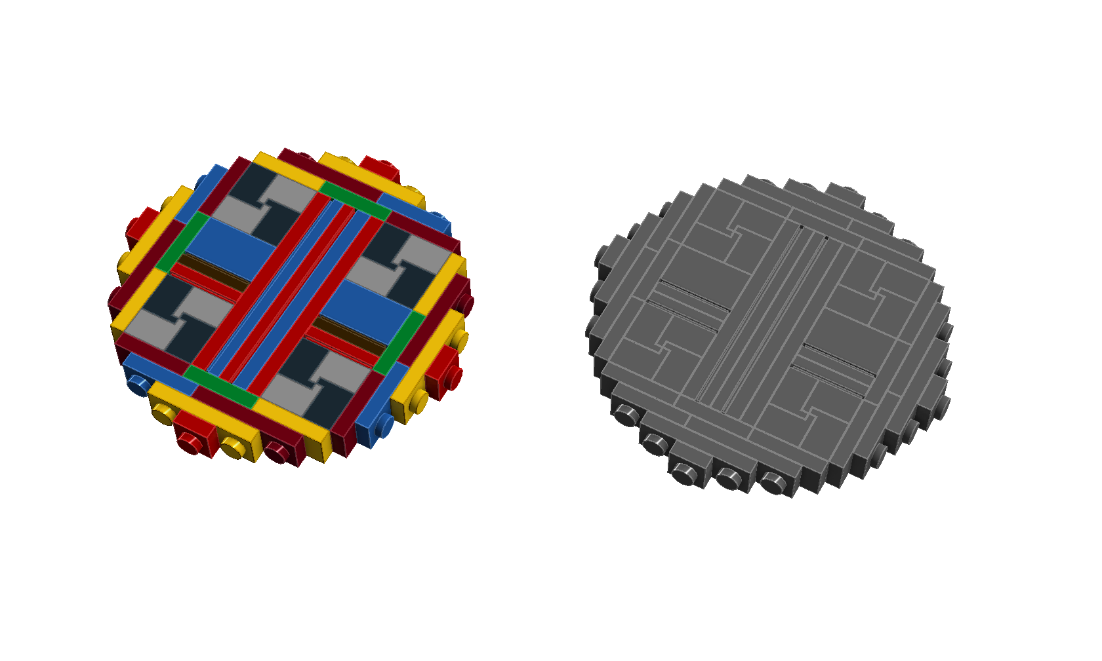
SNOT Circles

Slide 9
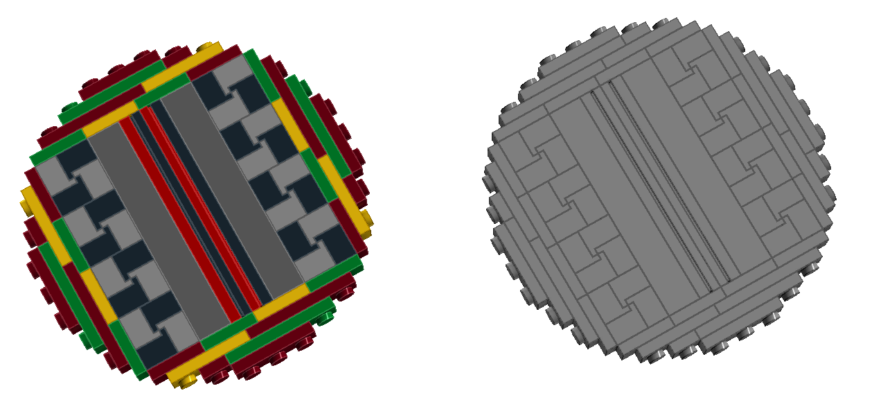
SNOT Circles

Slide 10
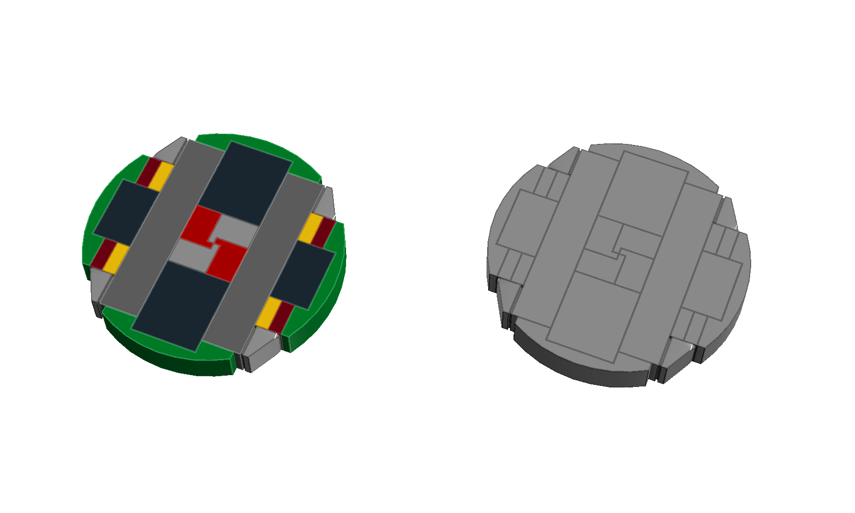
SNOT w/ Slopes

Slide 11
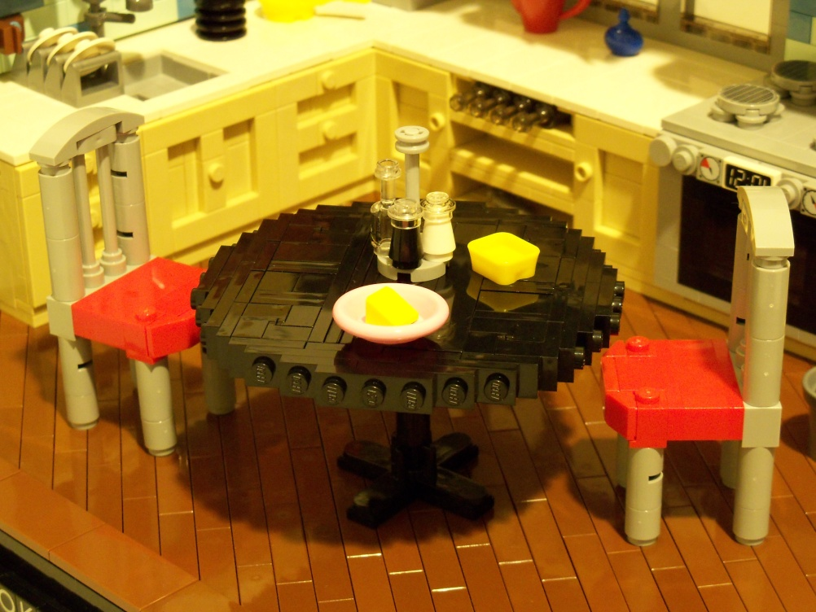
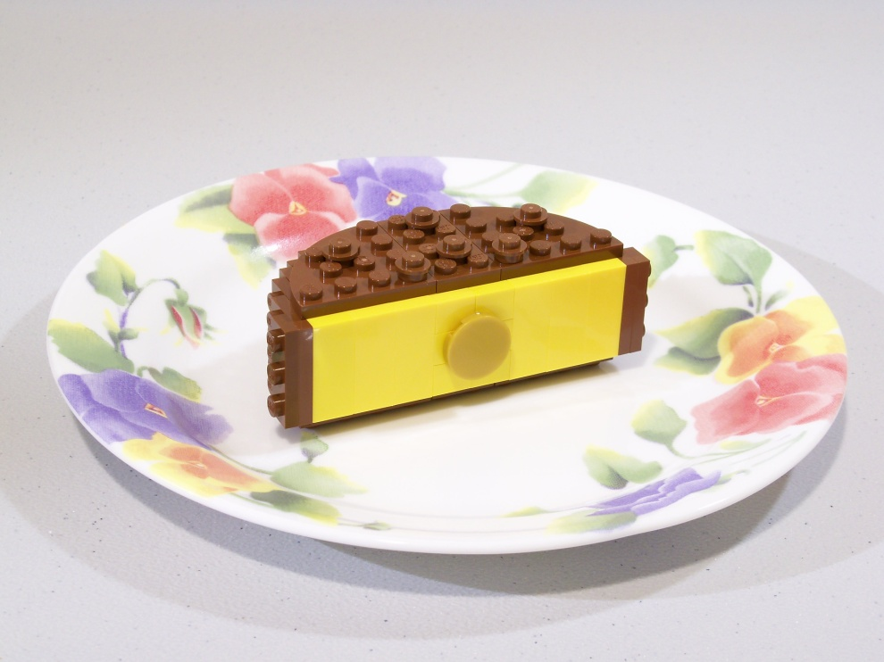
Examples

Slide 12
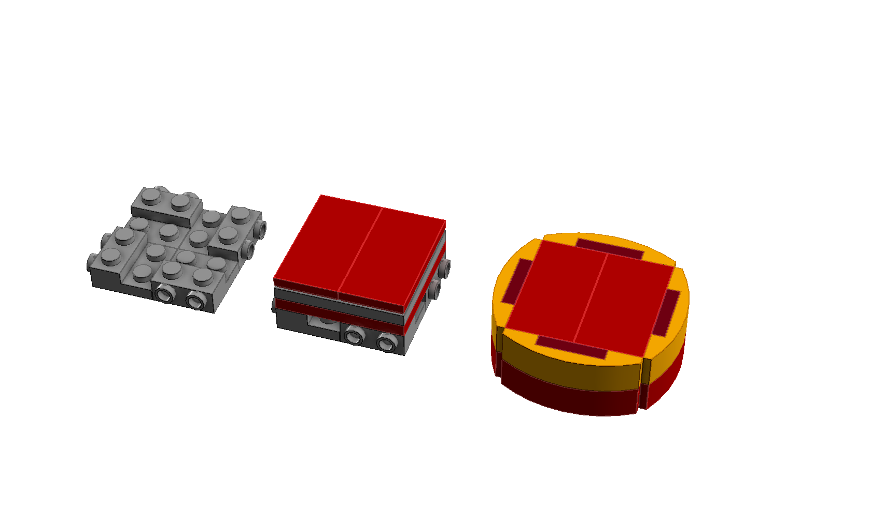
SNOT Cylinder

Slide 13
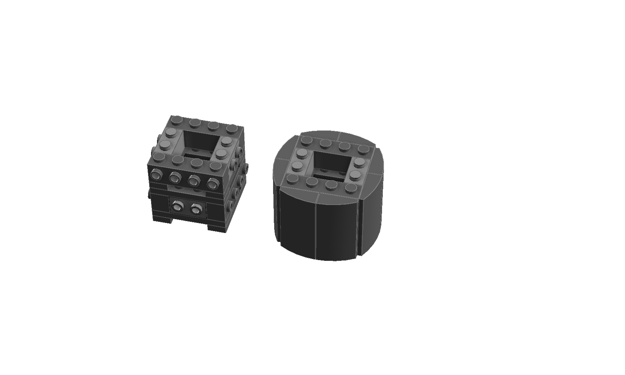
SNOT Cylinder

Slide 14
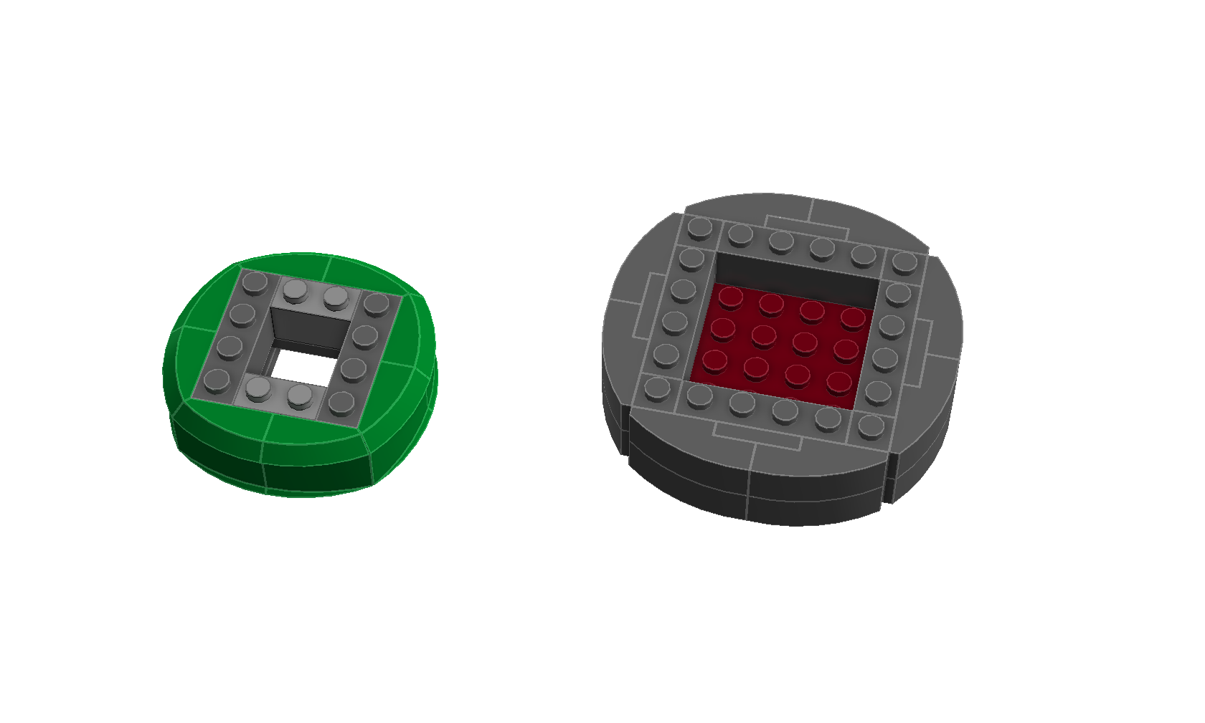
SNOT Cylinder

Slide 15
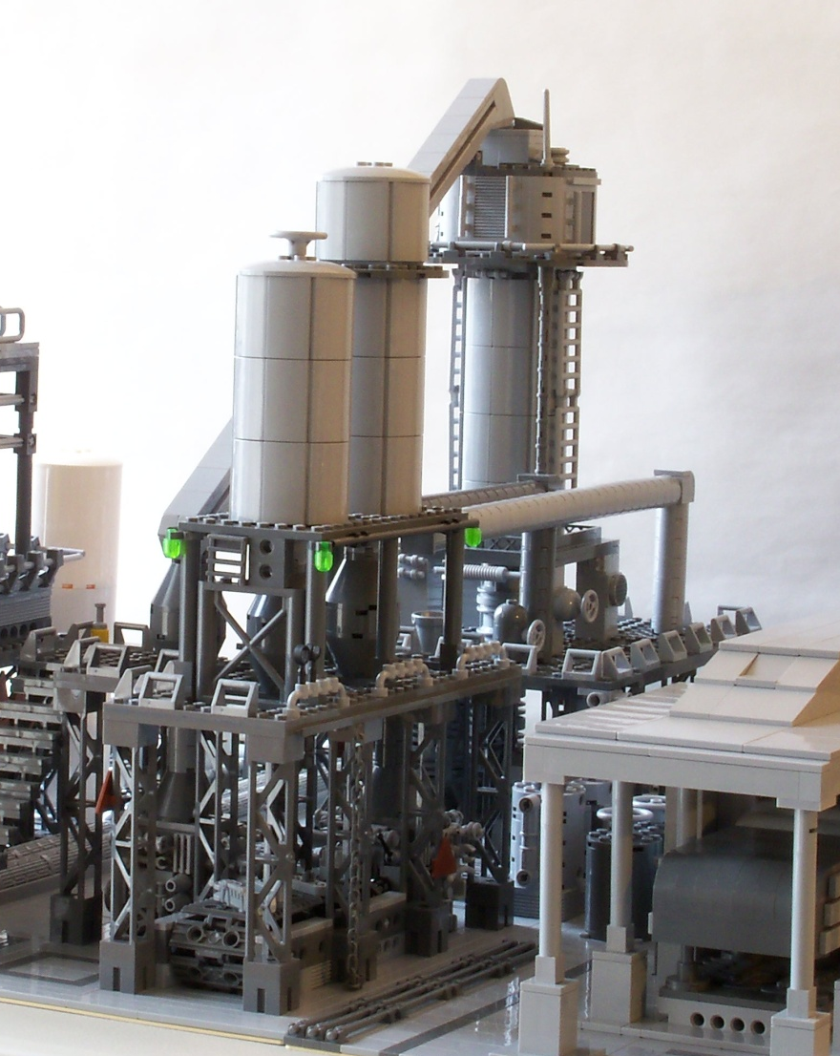
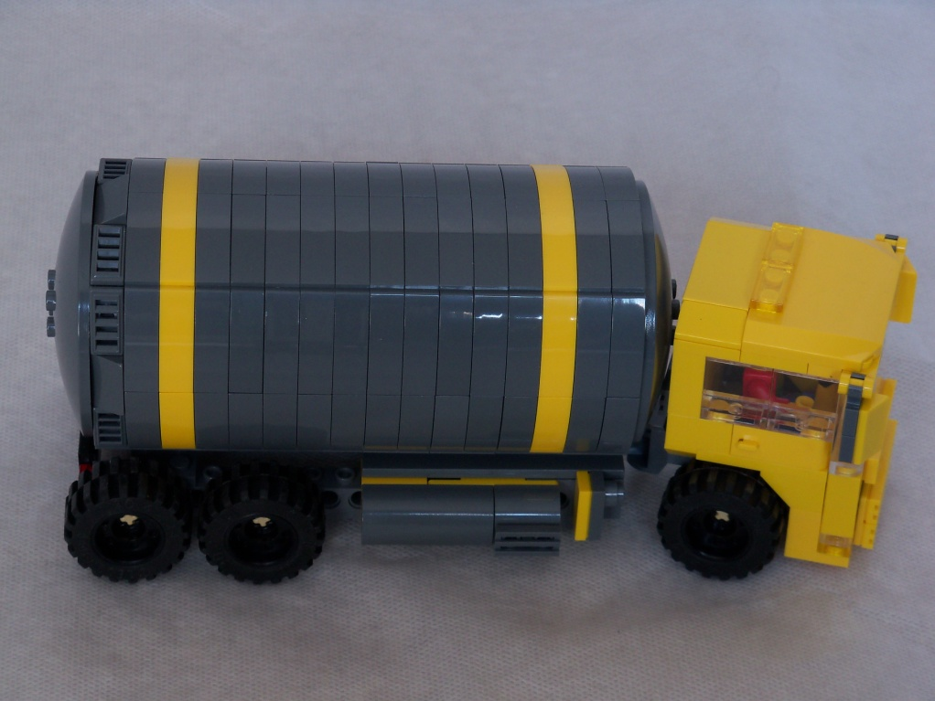
Example

Slide 16
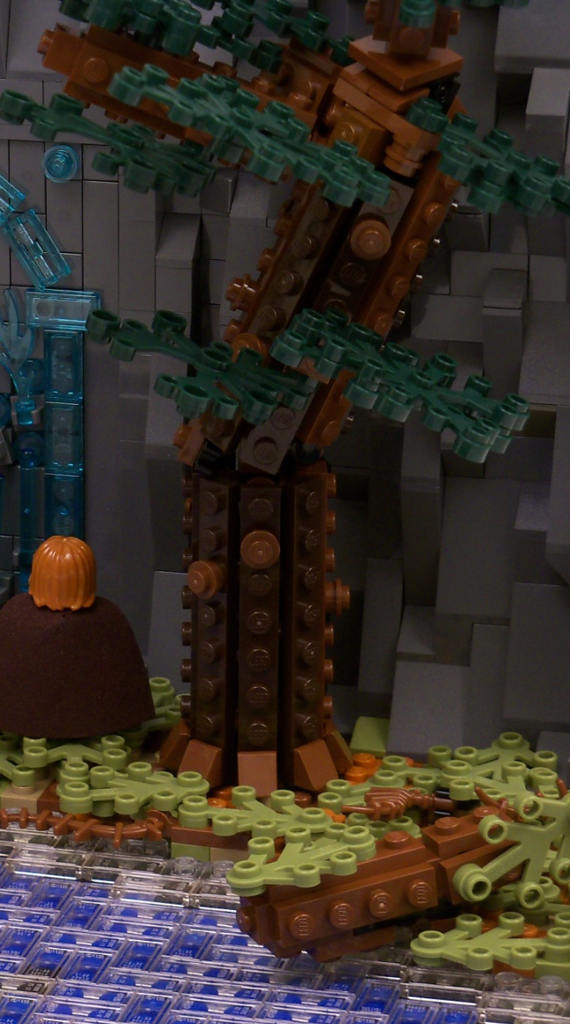
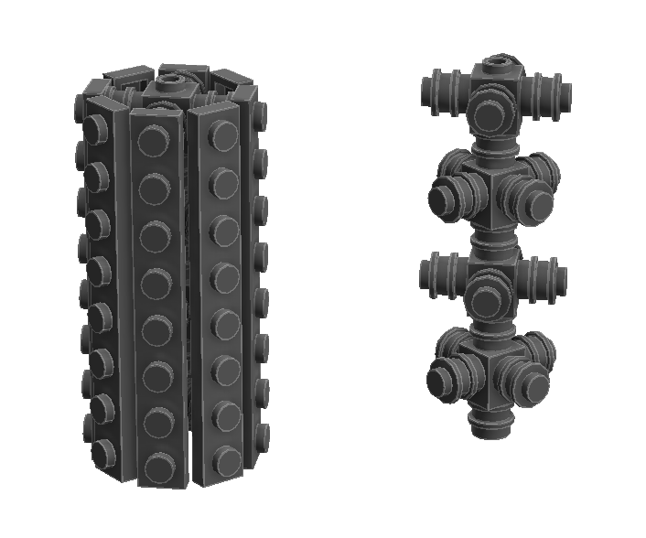
Round Columns

Slide 17
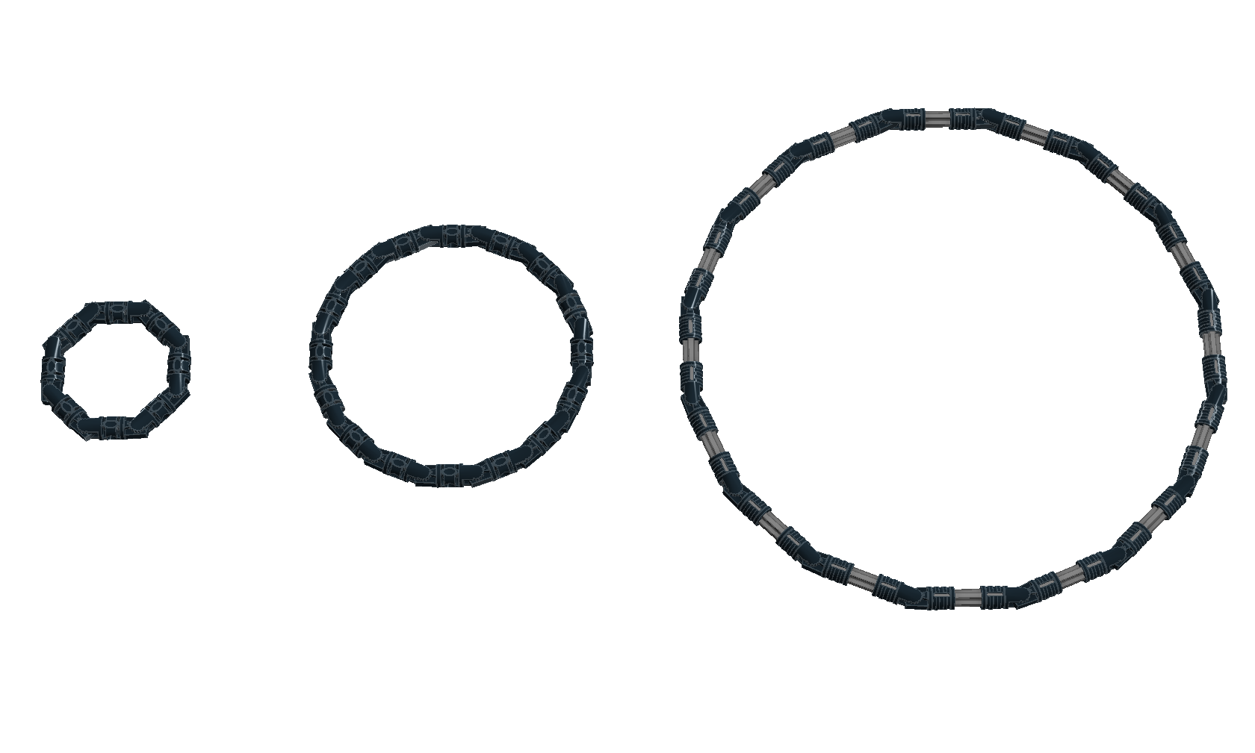
Hinge Rings

Slide 18
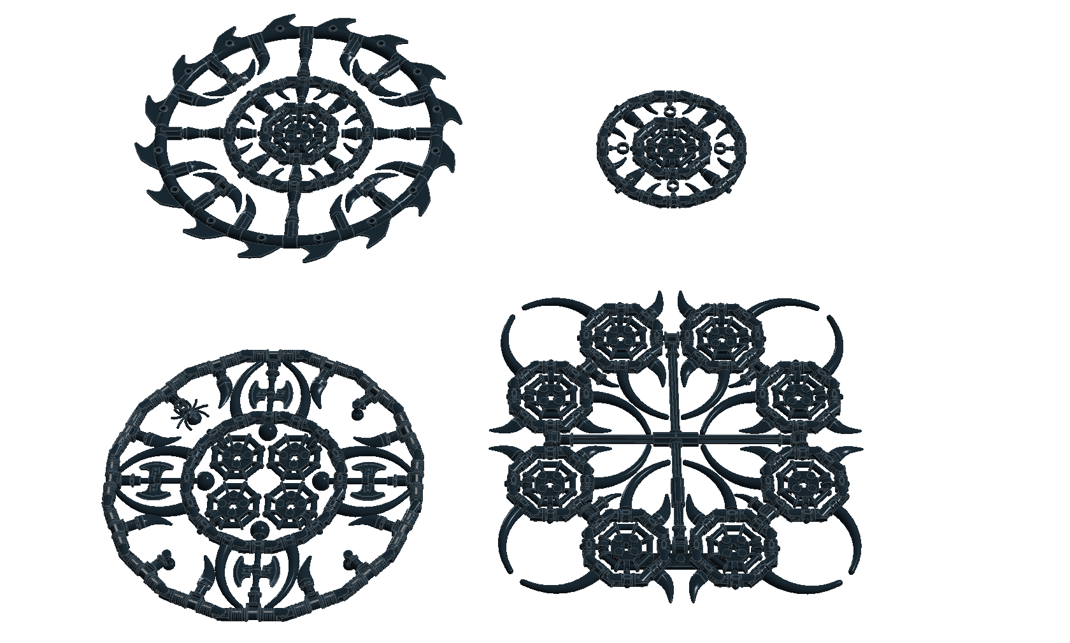
Examples

Slide 19
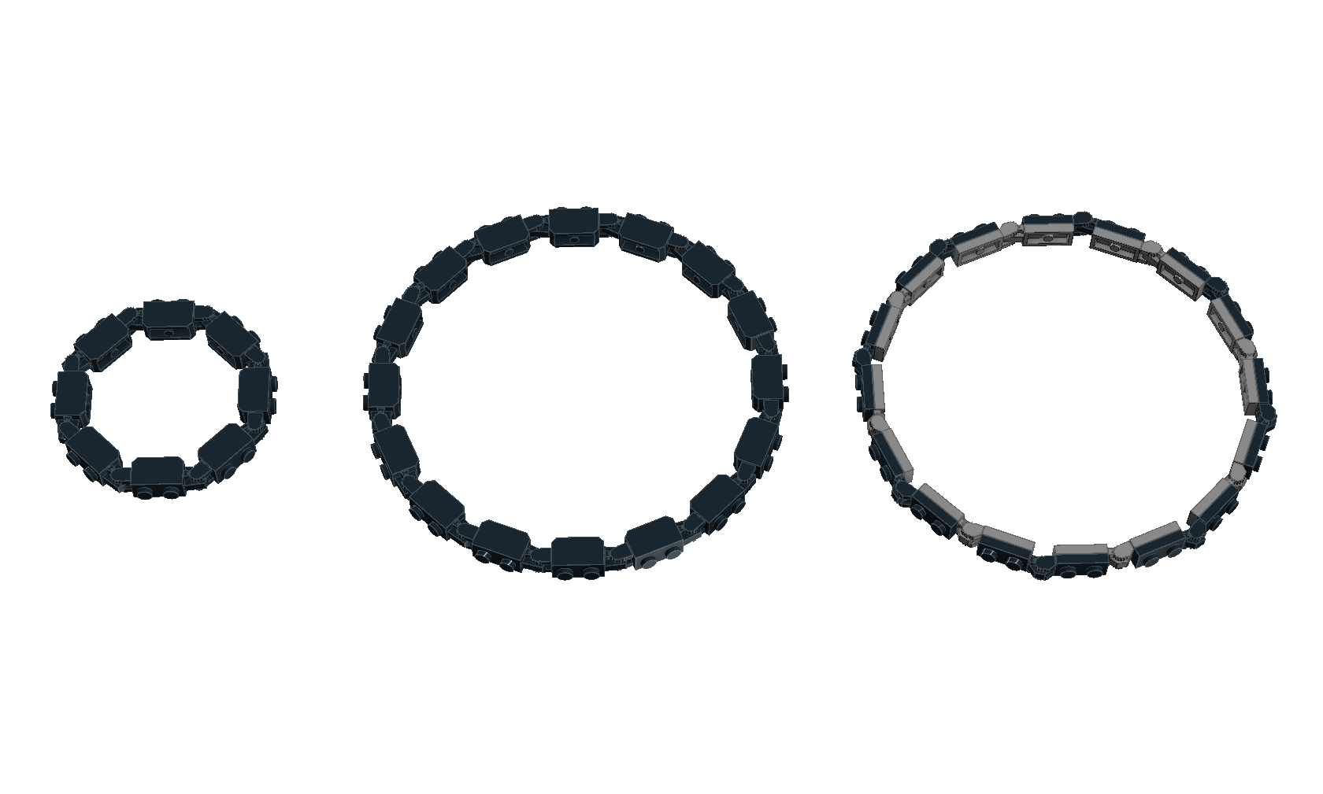
Hinge Rings

Slide 20
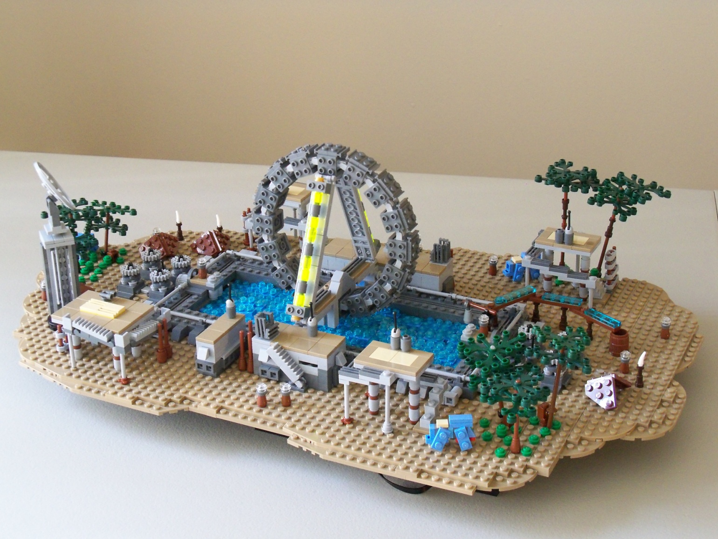
Examples

Slide 21
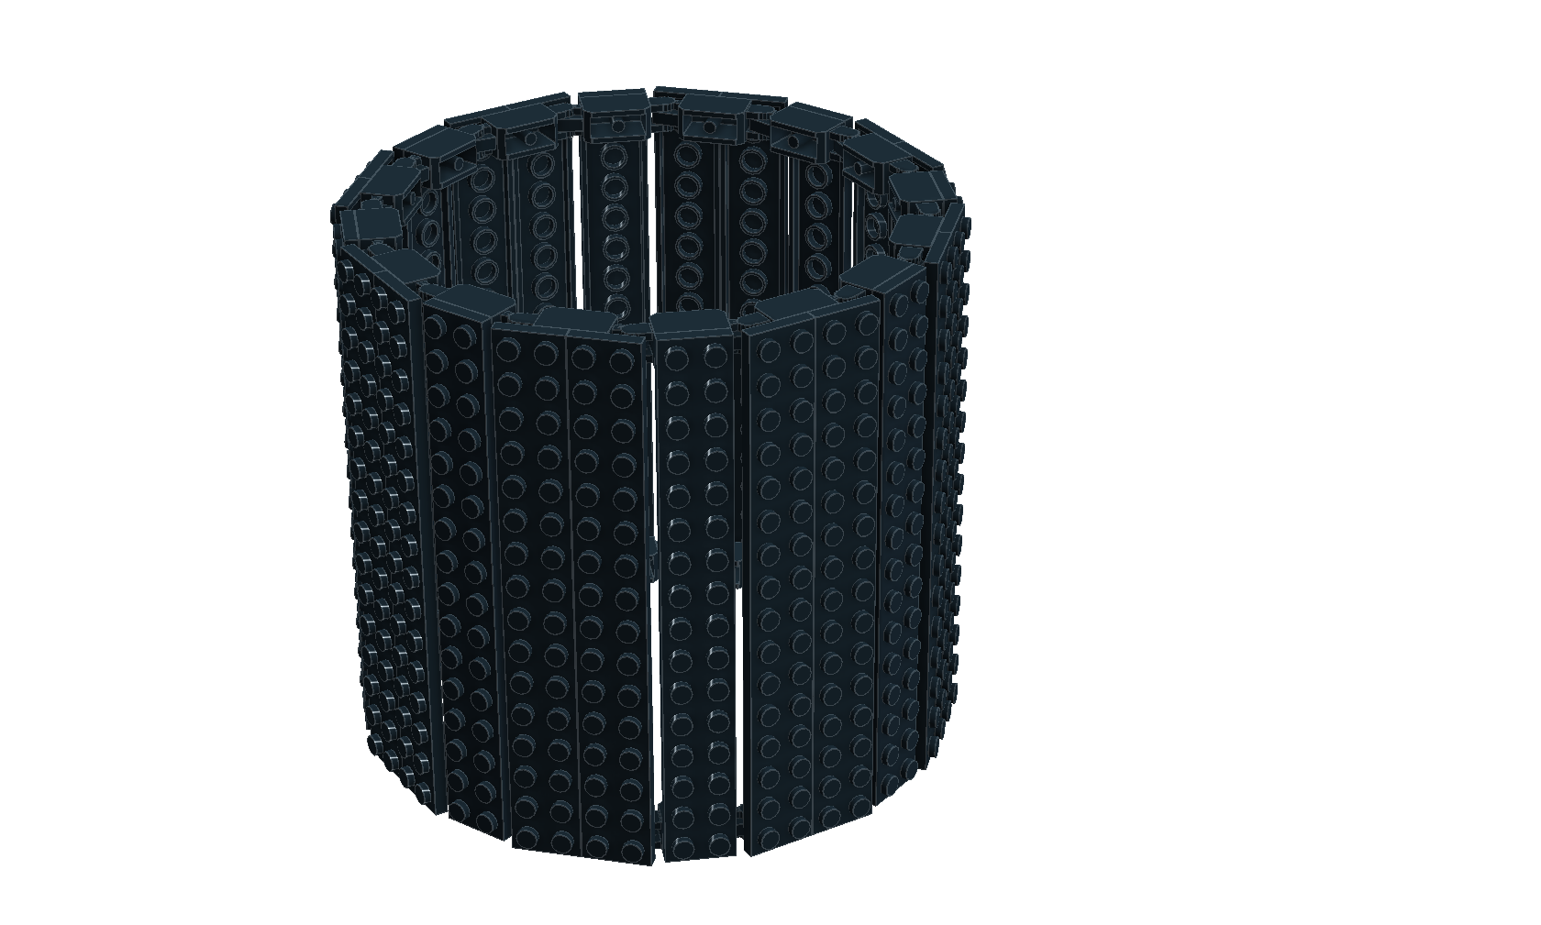
Hinge Cylinders

Slide 22
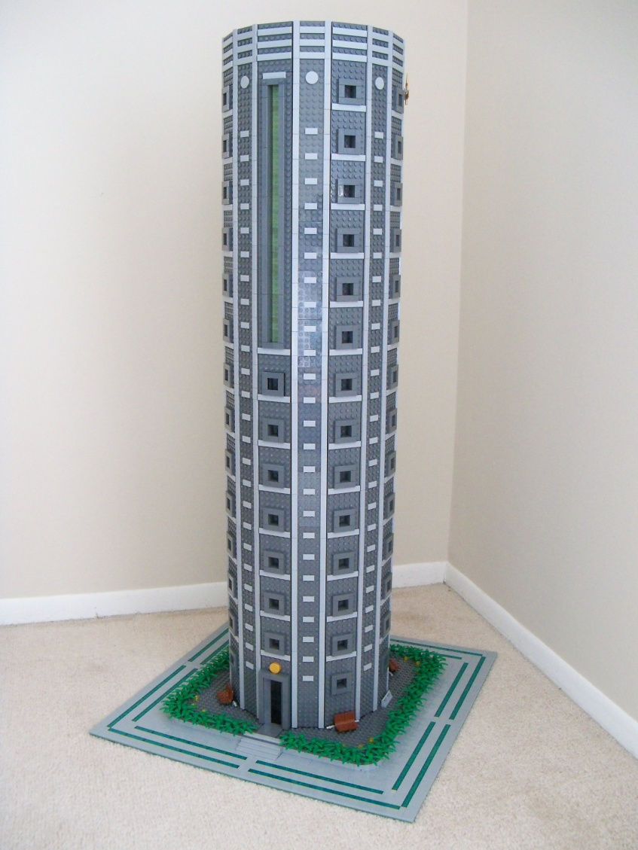
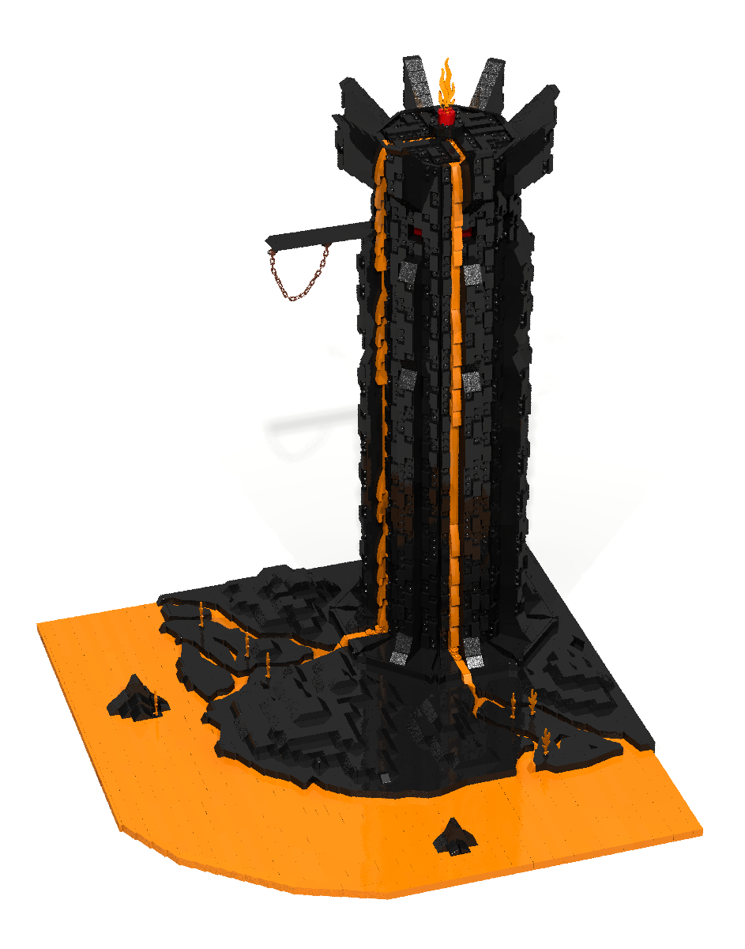
Examples

Slide 23
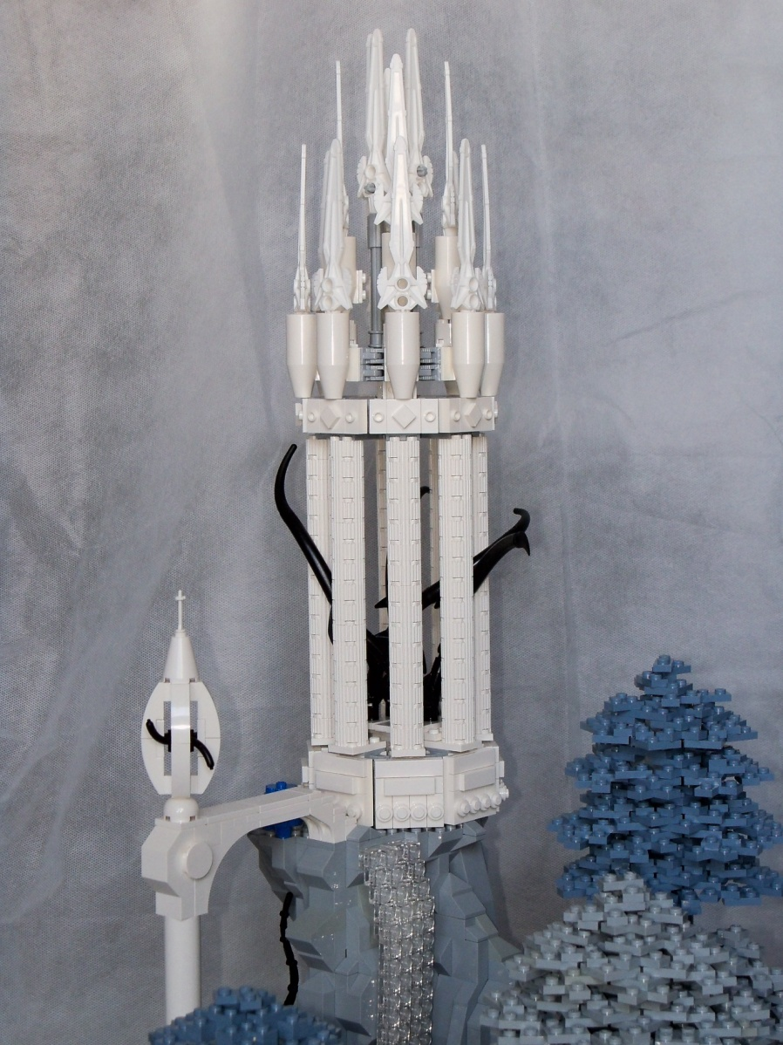
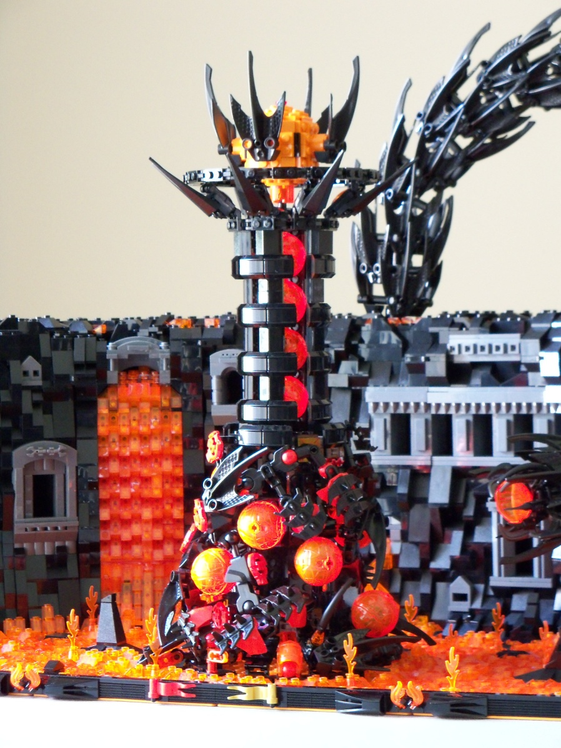
Examples

Slide 24
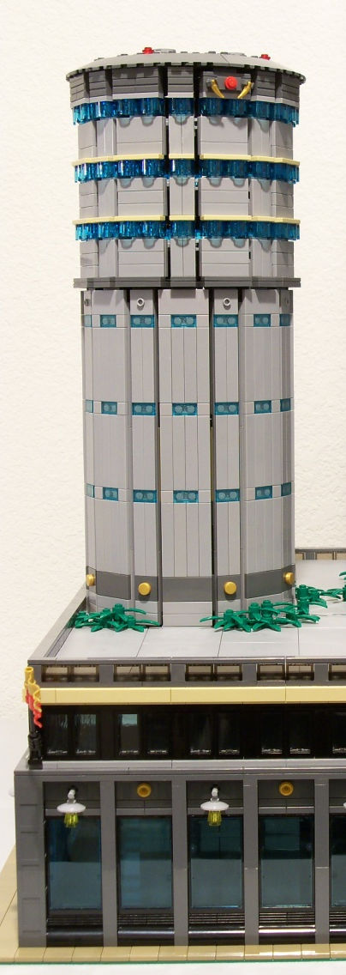
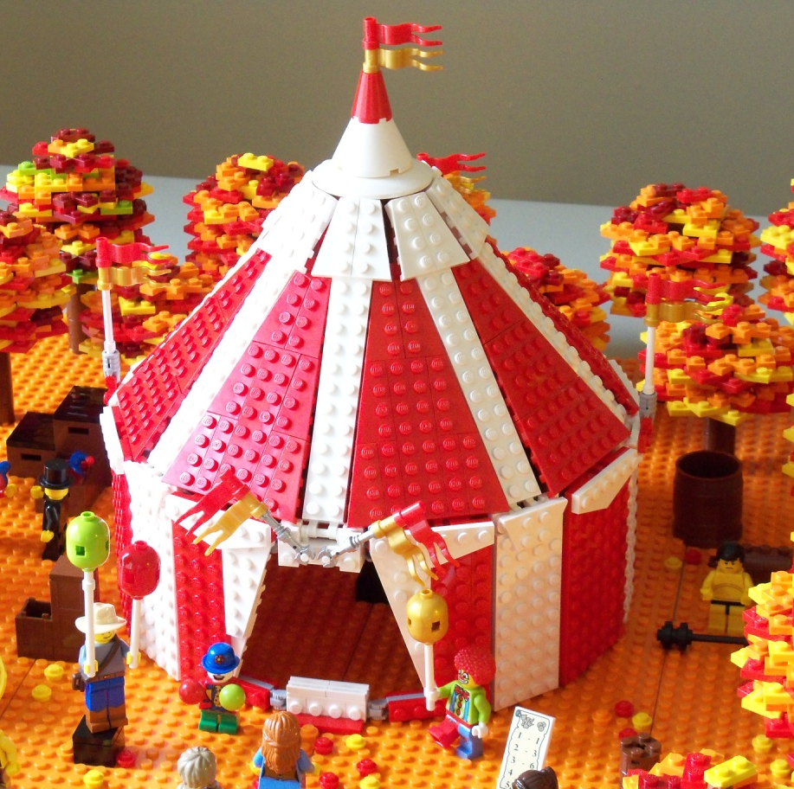
Example

Slide 25
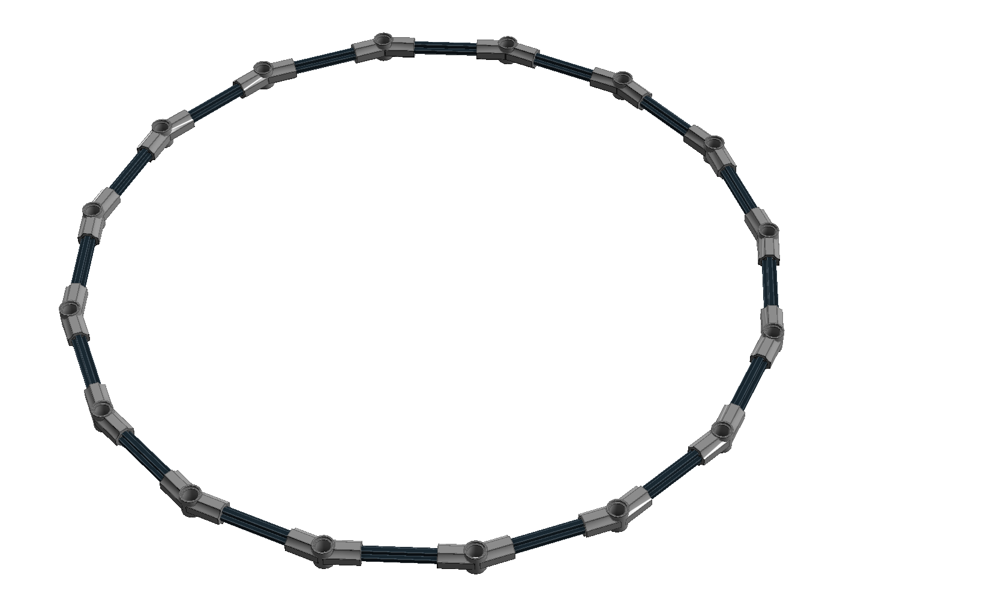
Technic Circle

Slide 26
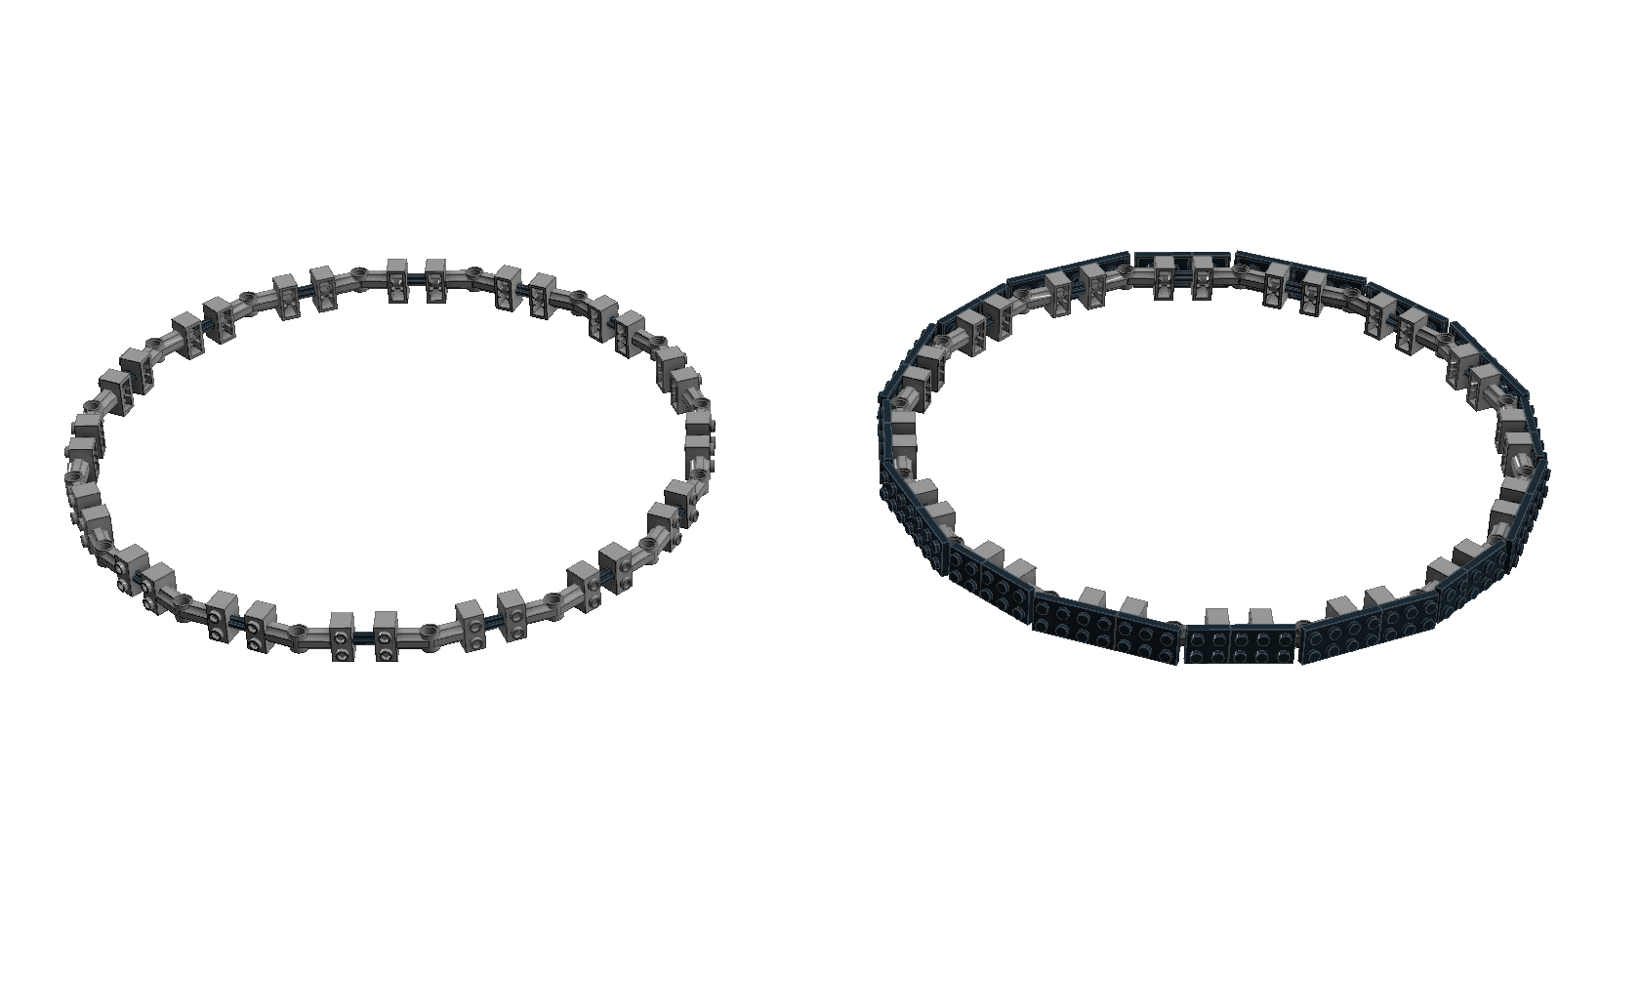
Technic Circle

Slide 27
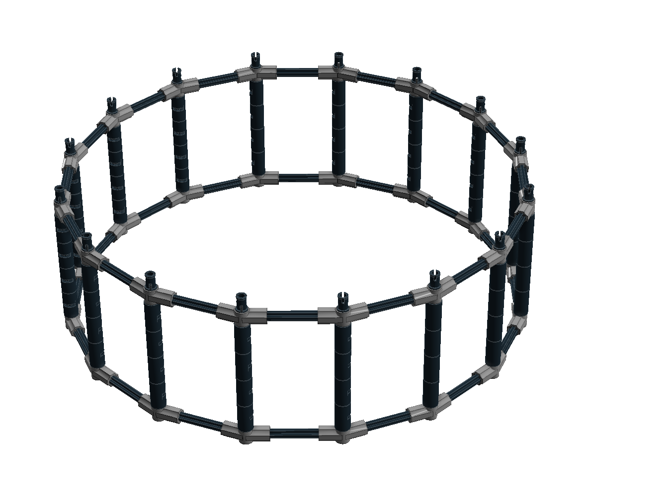
Technic Cylinder

Slide 28
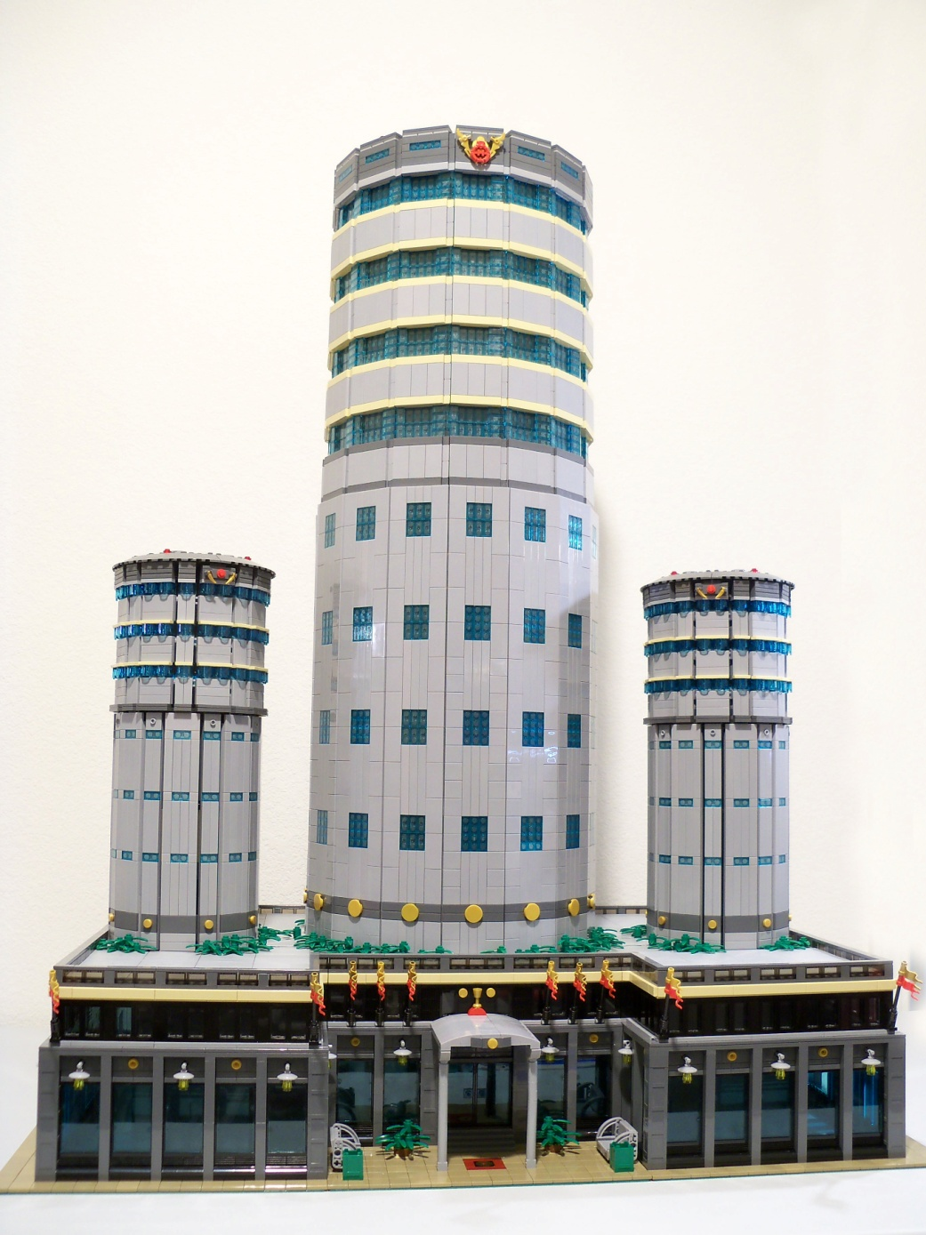
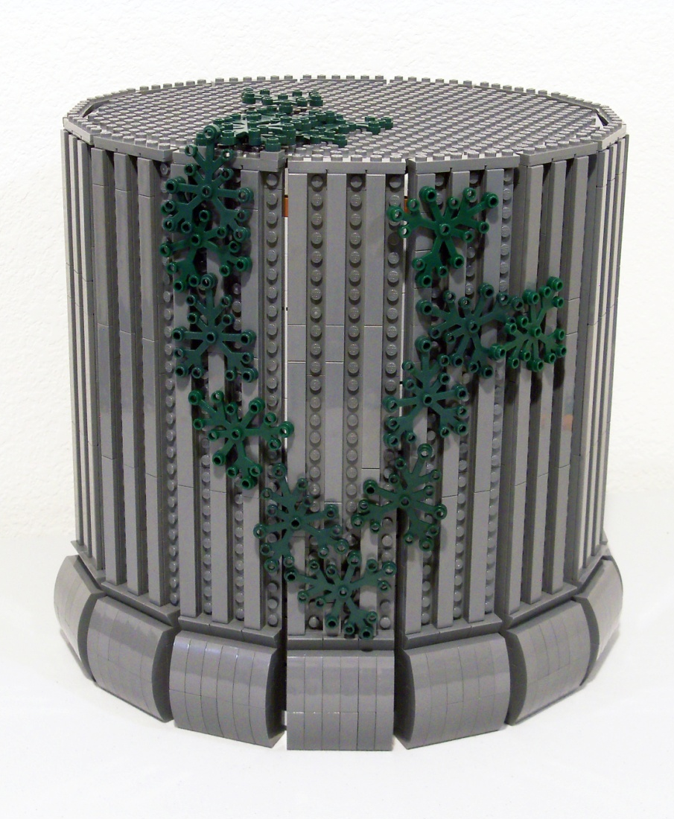
Example

Slide 29
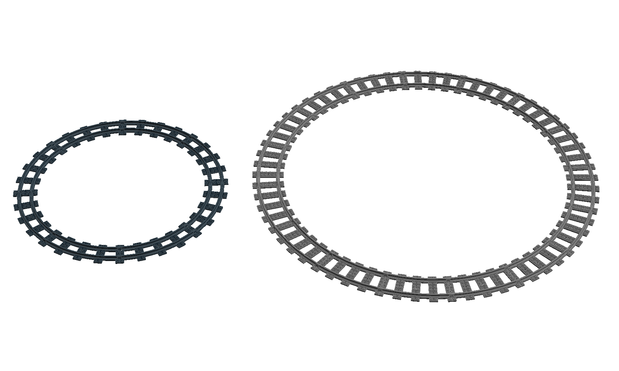
Train Track Circle

Slide 30
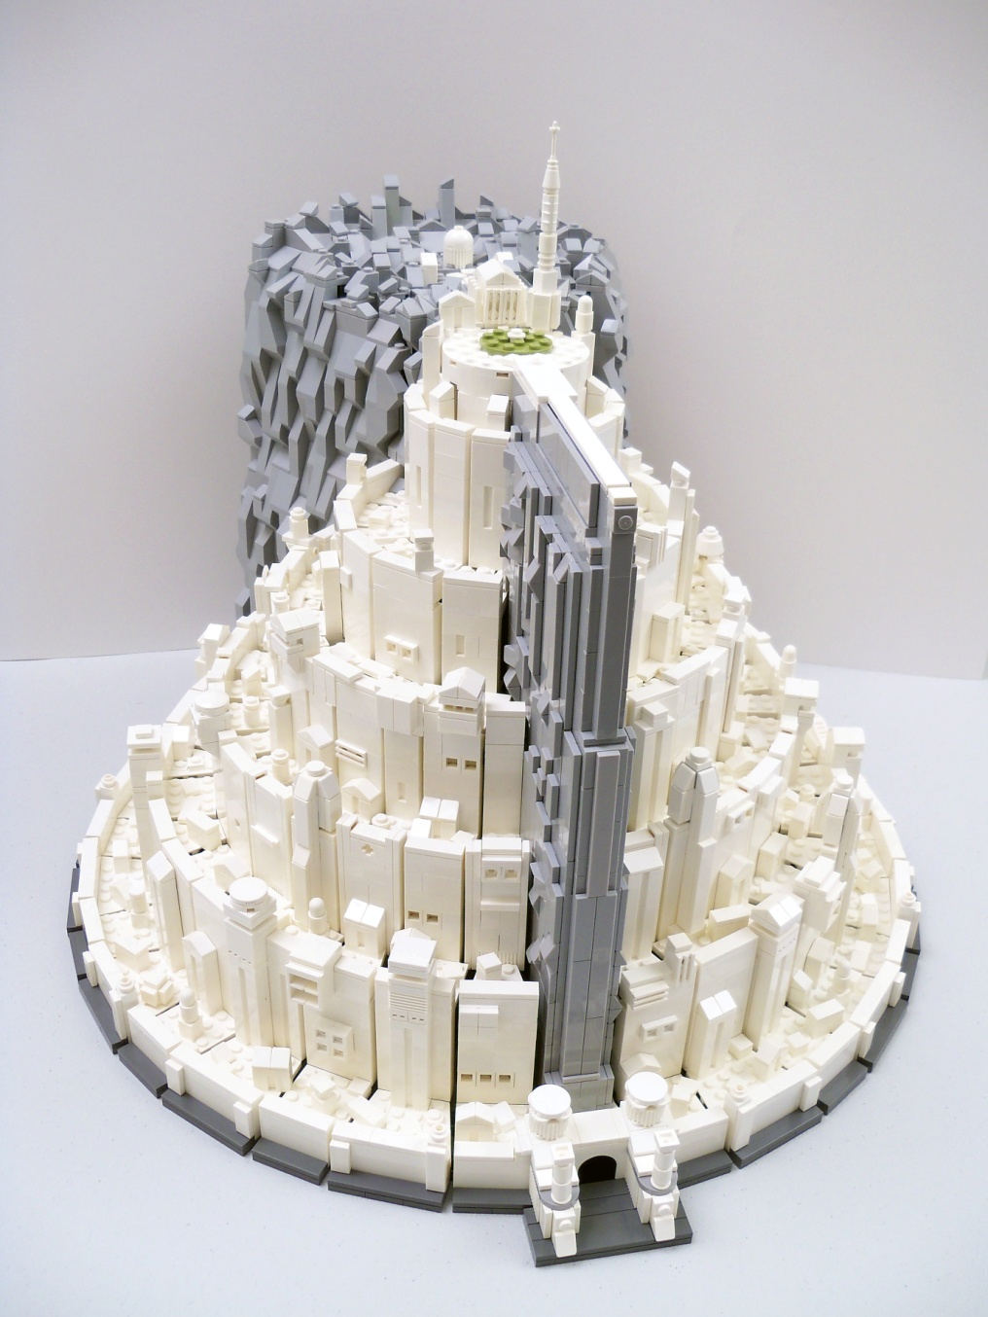
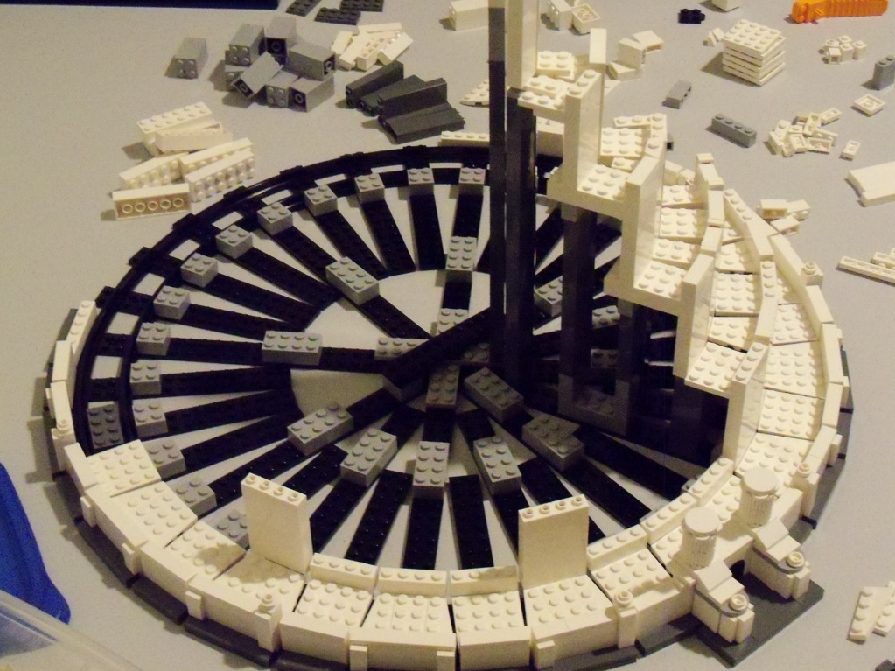
Example

Slide 31
Sphere

Slide 32












Existing Bricks
parts with stud connection
windshield parts
uncommon parts
Bionicle Tridax Pod Half
Cylinder Hemisphere 2 x 2 with Cutout
Container, Alien Pod Section 2 x 4 x 2
Cylinder Hemisphere 11 x 11, Studs on Top - Death Star Half (9676)

Slide 33
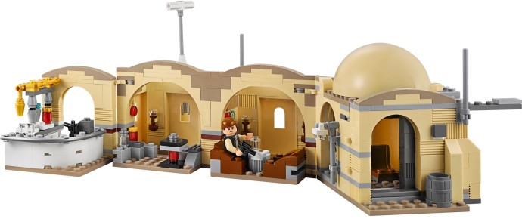
Example
75052: Mos Eisley Cantina

Slide 34
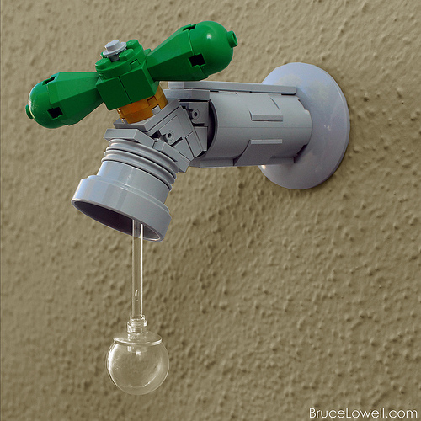
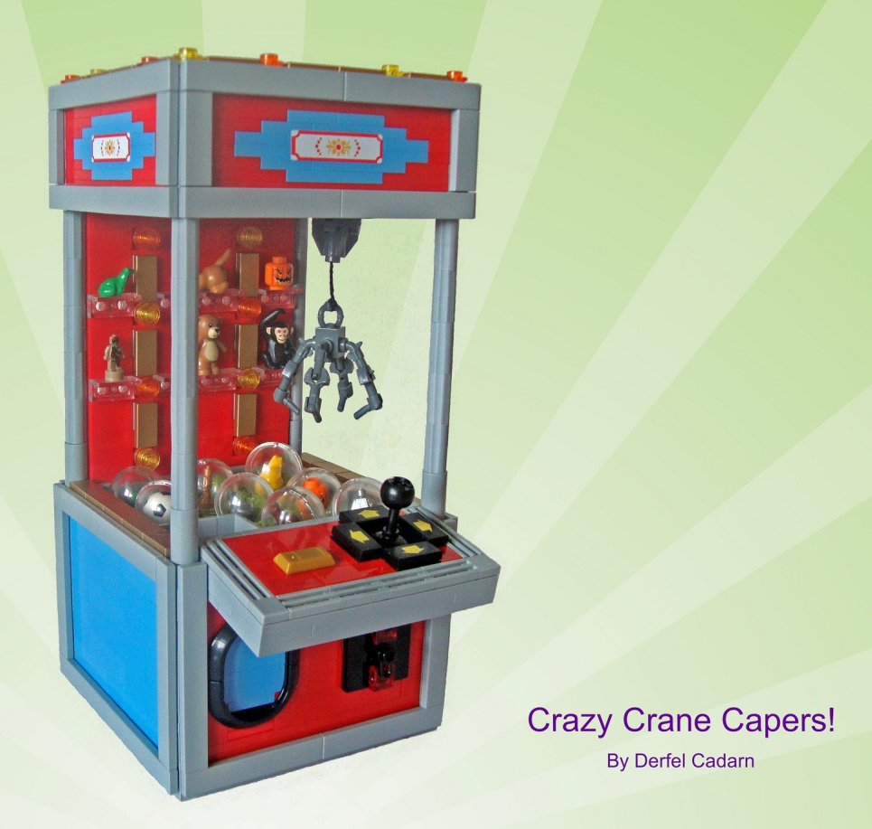
Examples
By Derfel Cadam
By Bruce Lowell

Slide 35
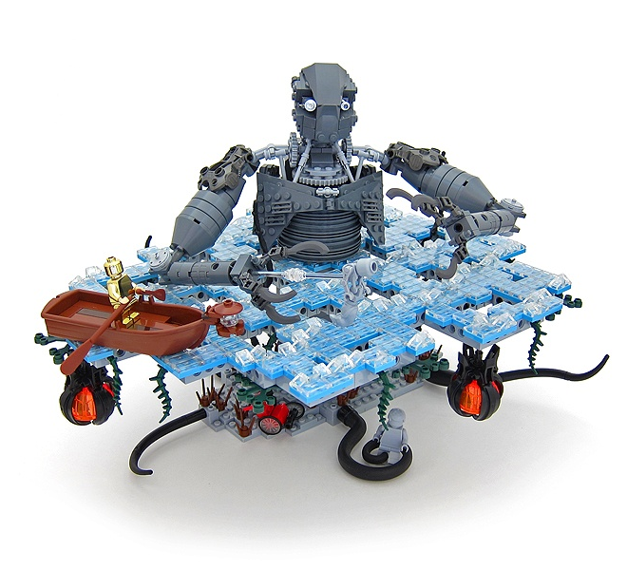
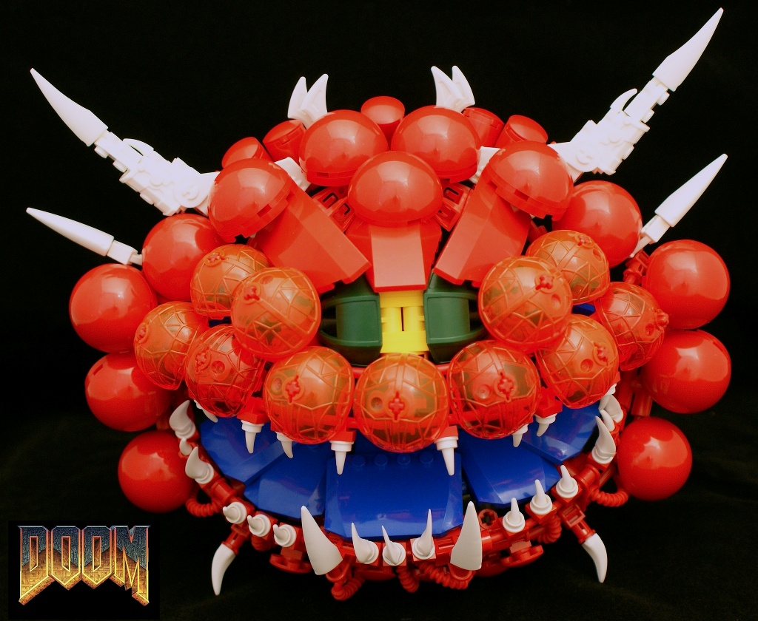
Examples
By Bart De Dobbelaer
By Nannan Z.

Slide 36
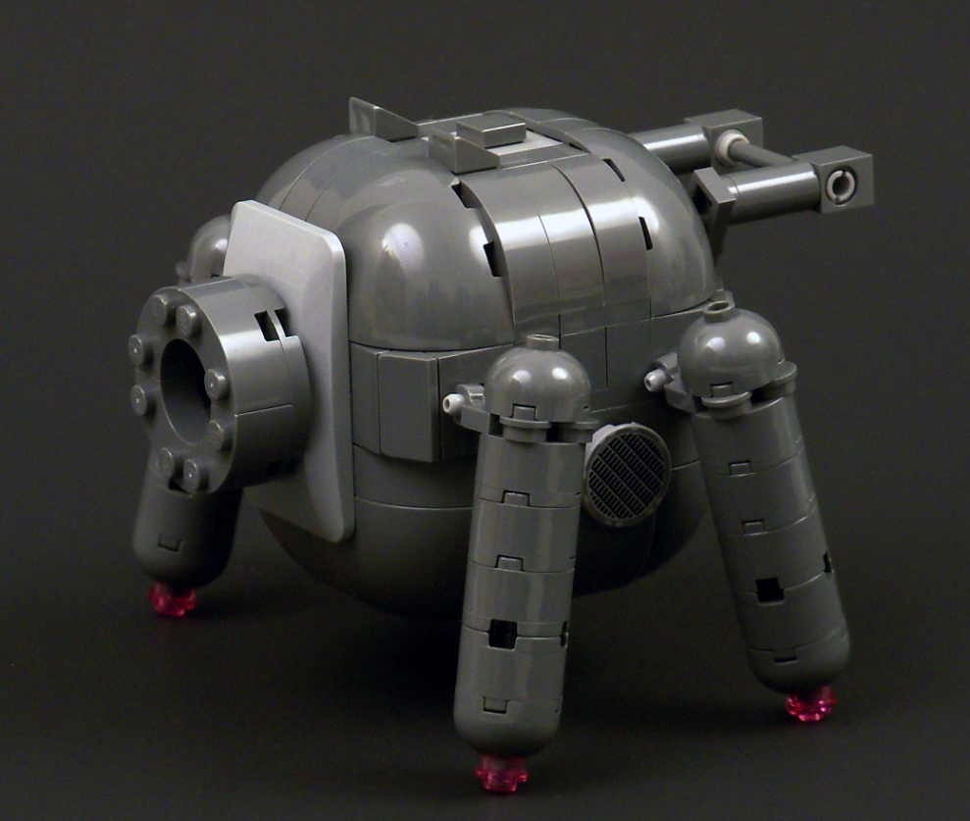
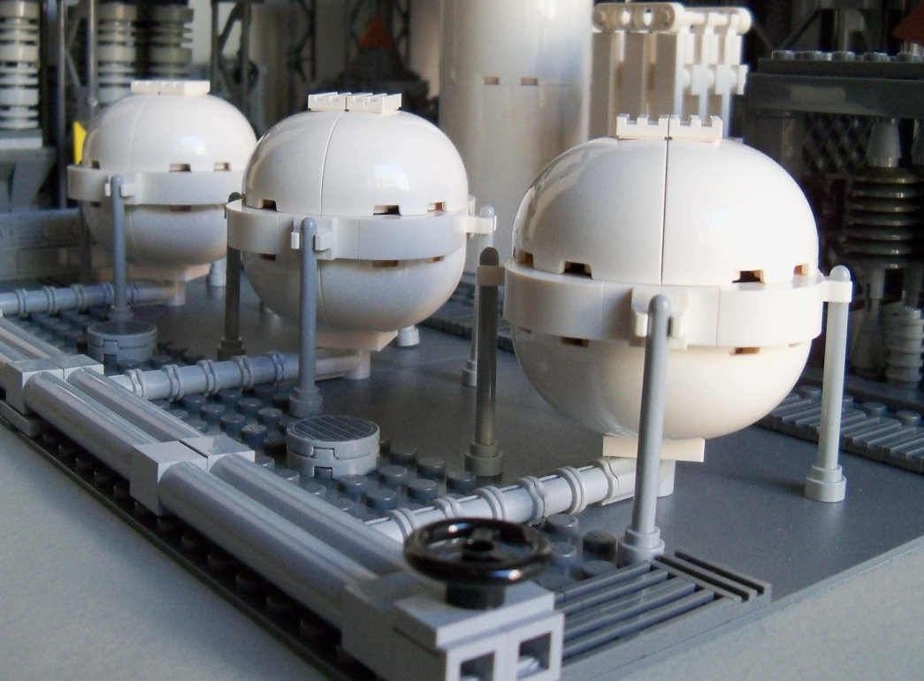
Example

Slide 37
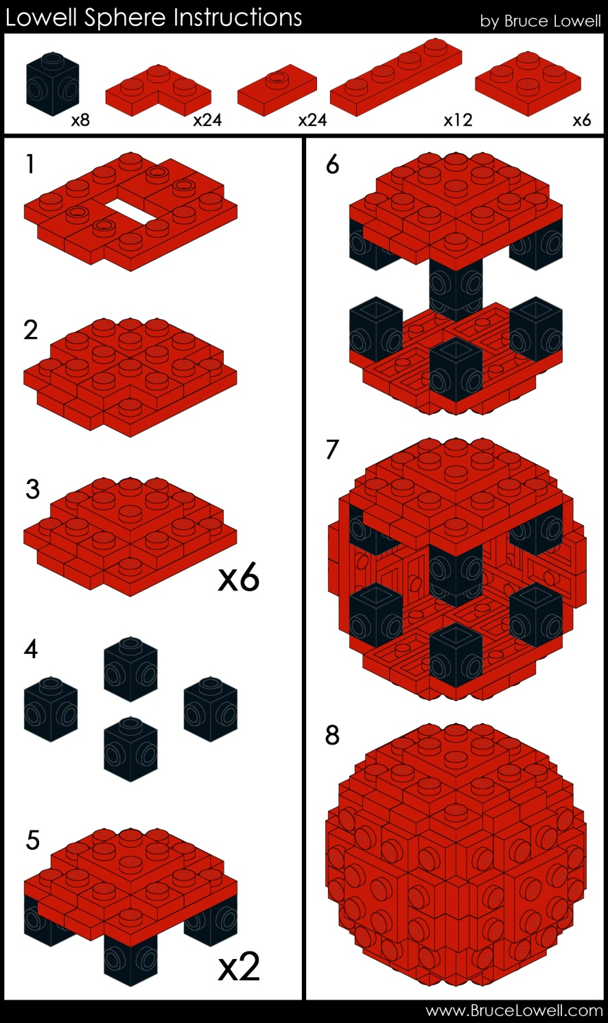
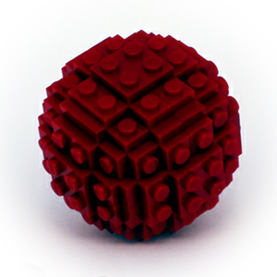
Lowell Sphere
Bruce Lowell’s sphere:
http://www.brucelowell.com/lowell-sphere/
Bram’s sphere generator:
http://lego.bldesign.org/sphere/

Slide 38

Oval shapes

Slide 39
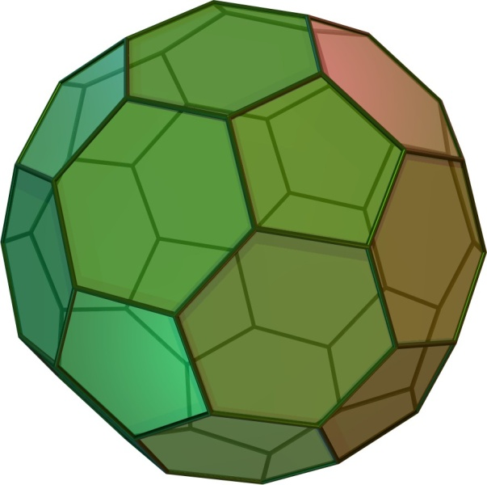
Buckyball
Truncated icosahedron
12 regular pentagonal faces
20 regular hexagonal faces
60 vertices and 90 edges
Dihedral Angle
  6-6:138.189685°
  6-5:142.62°
Need to build Hexagons with hinges on the edges
  Do you build the pentagons?
  Do hexagons/pentagons share edges?
  Do you want to connect anything to the surfaces?

Slide 40
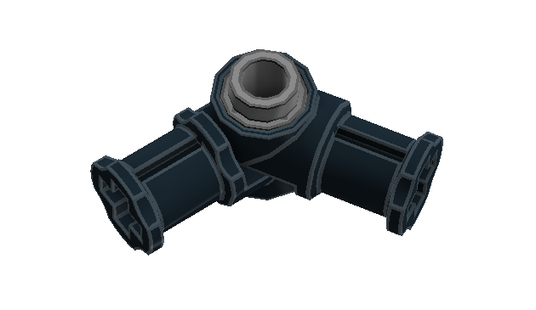
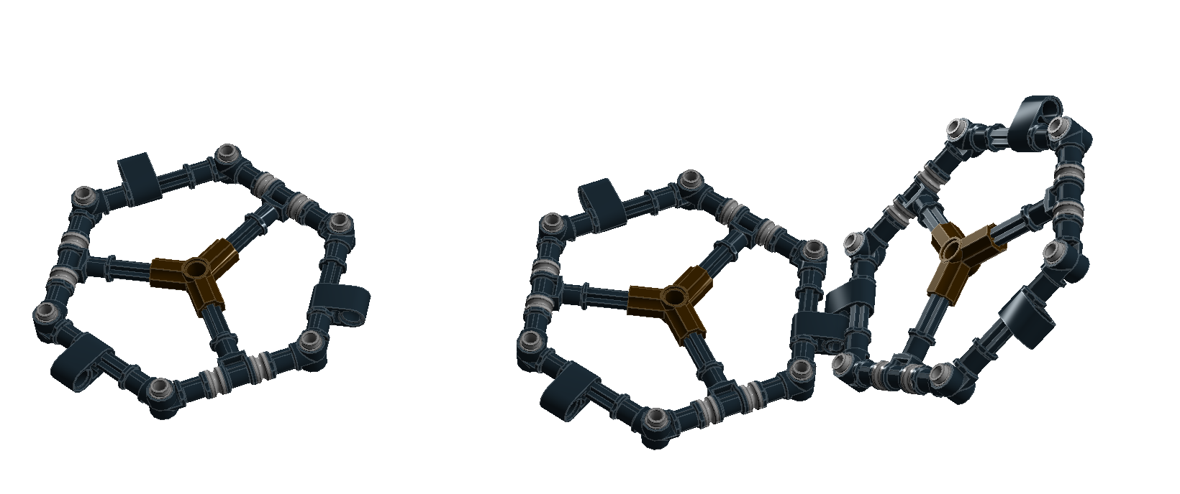
Method 1
Step1: Build hexagons
Step2: Add hinges to the hexagon

Slide 41
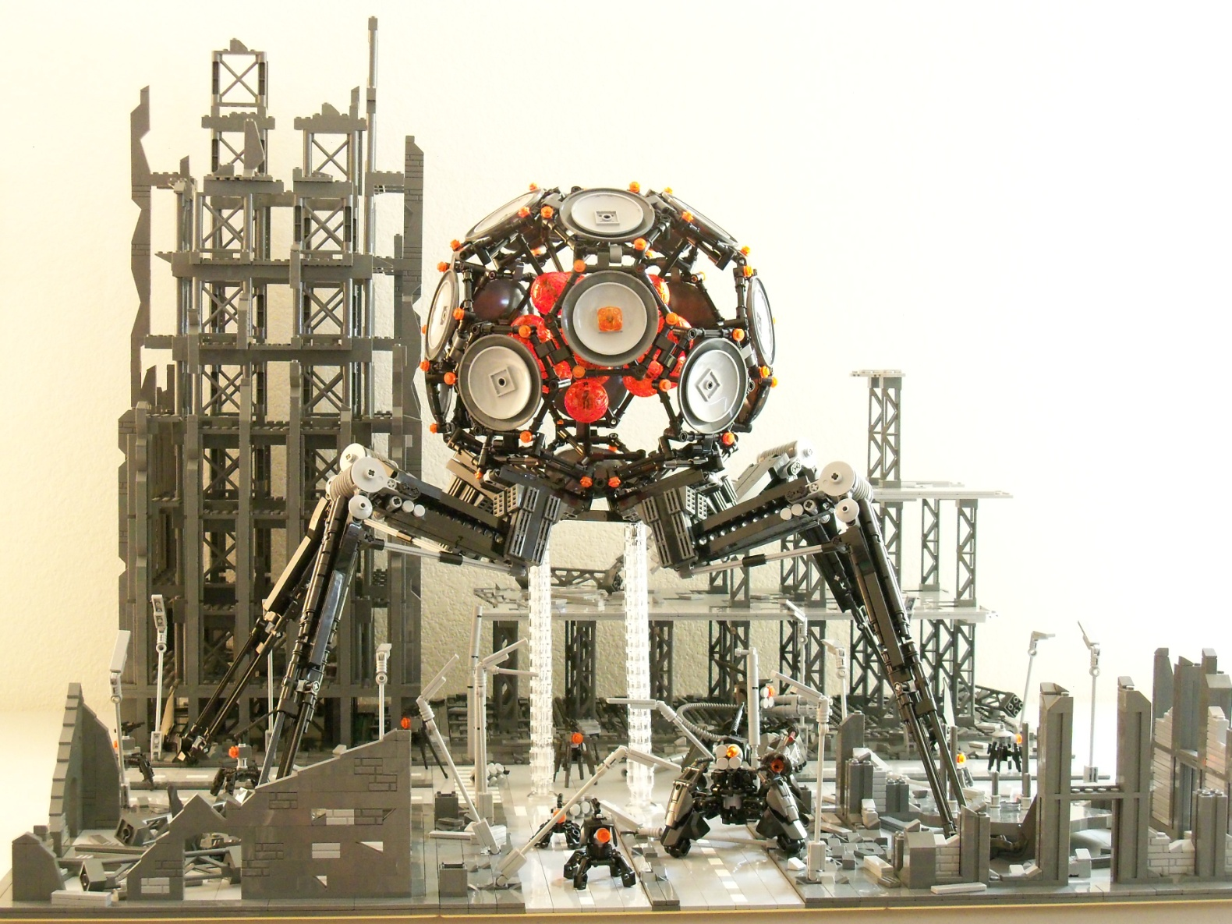
Buckyball

Slide 42

Buckyball

Slide 43

Buckyball

Slide 44


Method 2
Step1: Build hexagons
Step2: Add hinges to the hexagon

Slide 45



Buckyball with Hero Factory limbs
Build Hex and no Pentagon
Hexagon
Pentagon
Hinge

Slide 46

Buckyball with Hero Factory limbs
Build pentagon and no hex
Smaller ball
By Dylan Mievis

Slide 47

Method 3

Slide 48

Hinge plates method
By Stuart Kahler

Slide 49

Method 4

Slide 50

Event kit alternative model

