Slide 1
Lego Landscape
Li Li

Slide 2
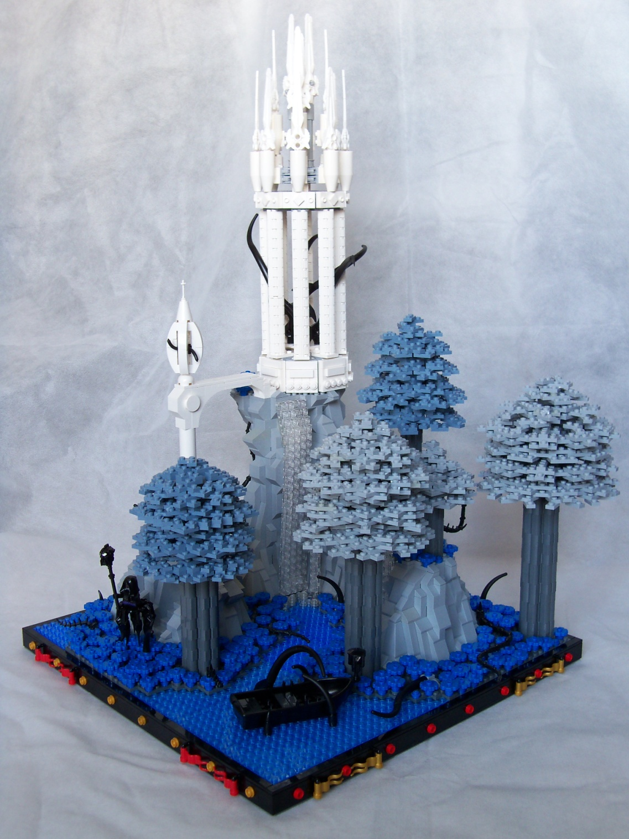
Overview
Mountain/Rock
Water
Terrain
Tree
* Un-credited mocs are mine

Slide 3
Mountain/Rock
Burp style
Slope style
Snot style
Other

Slide 4
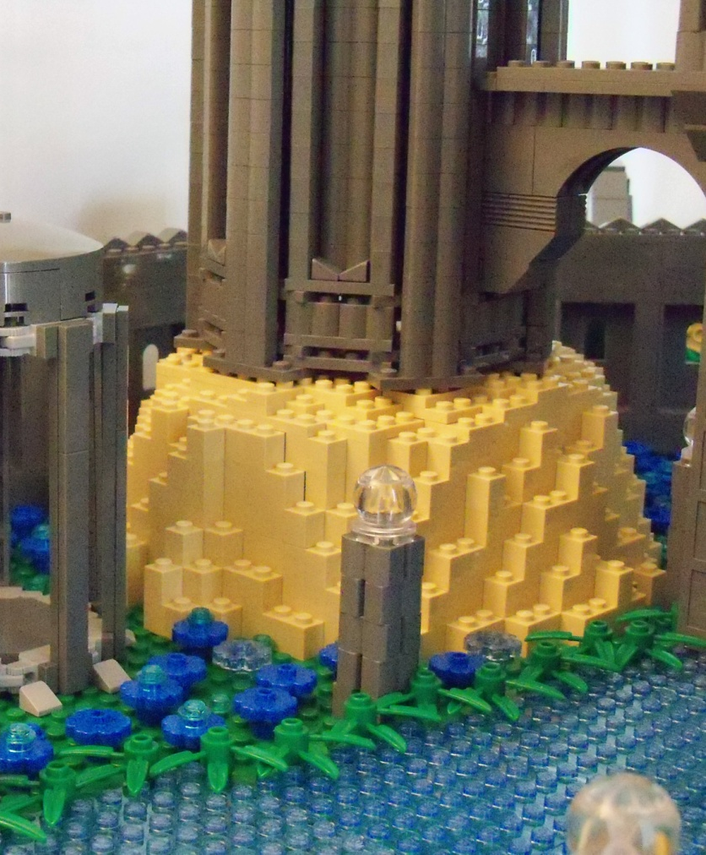
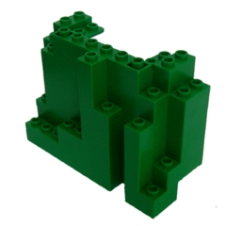
BURP Style
Has the same effect as BURP
  Big Ugly Rock Piece

Slide 5
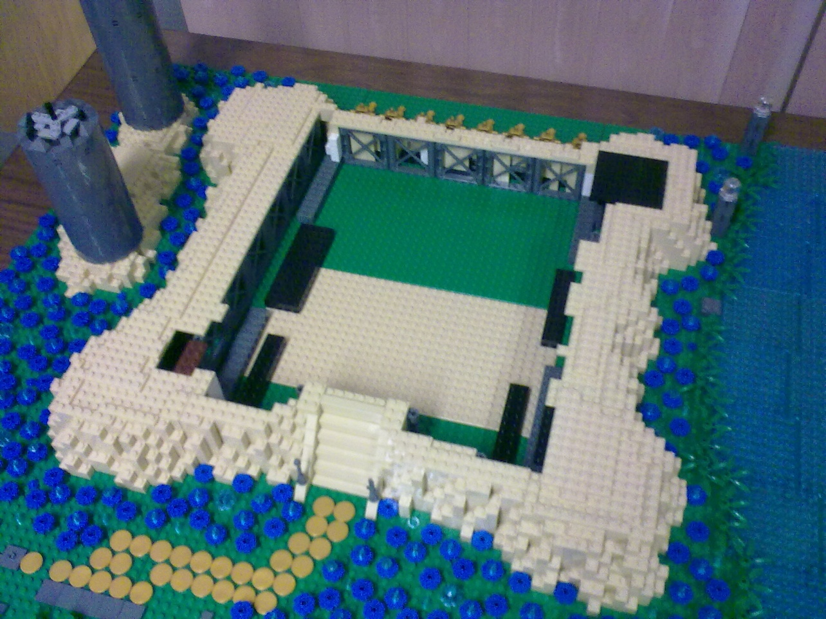
Burp Style
Use large support pieces inside to reduce pieces required

Slide 6
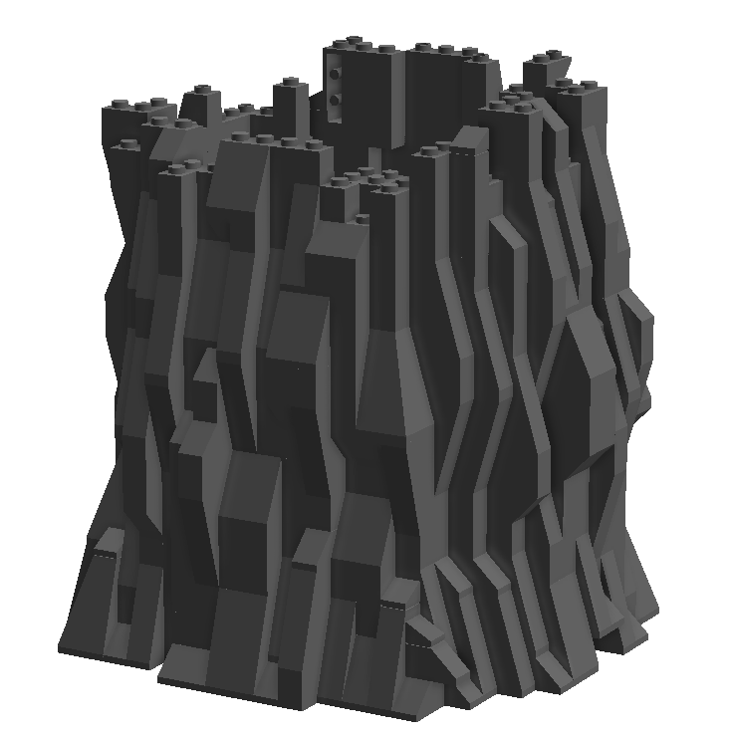















Slope Style
Use slope pieces

Slide 7
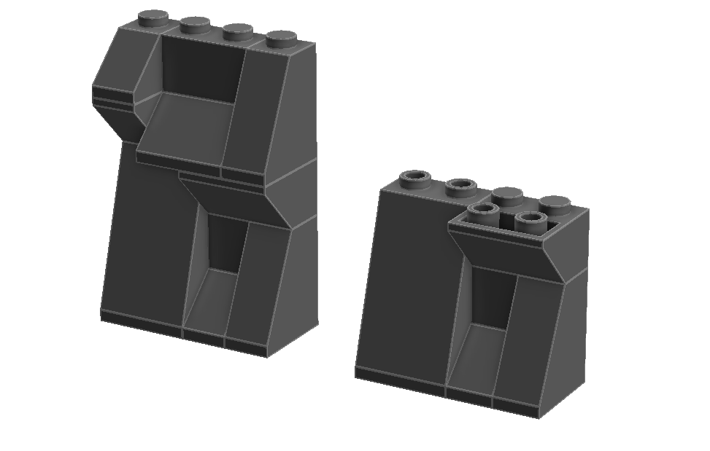
Slope Style
Alternate between 1x and 2x
Key is to make it look messy

Slide 8
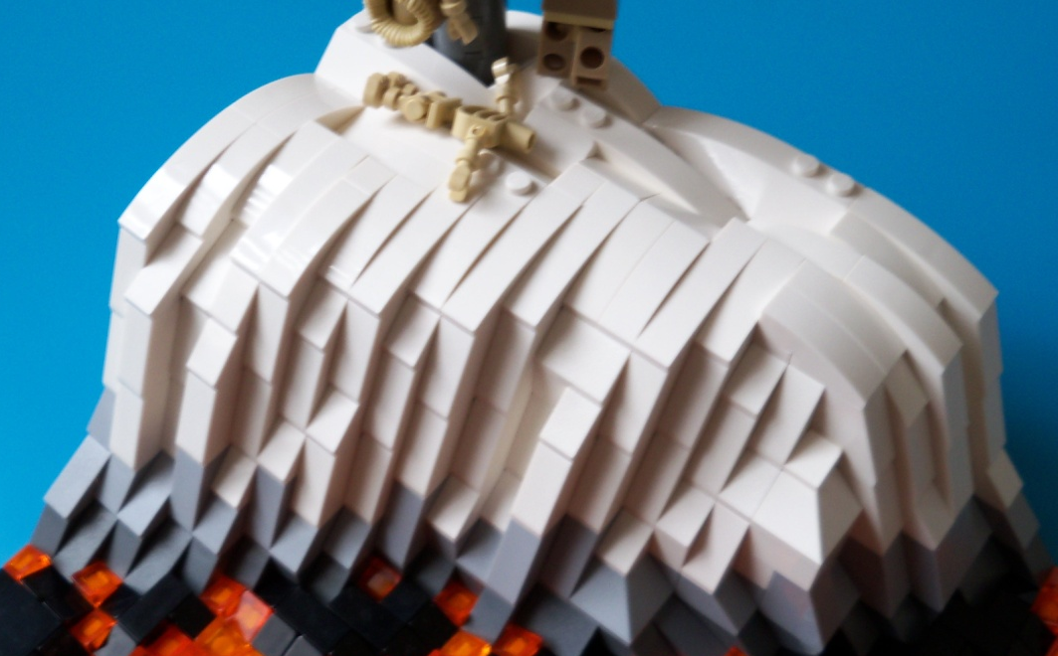
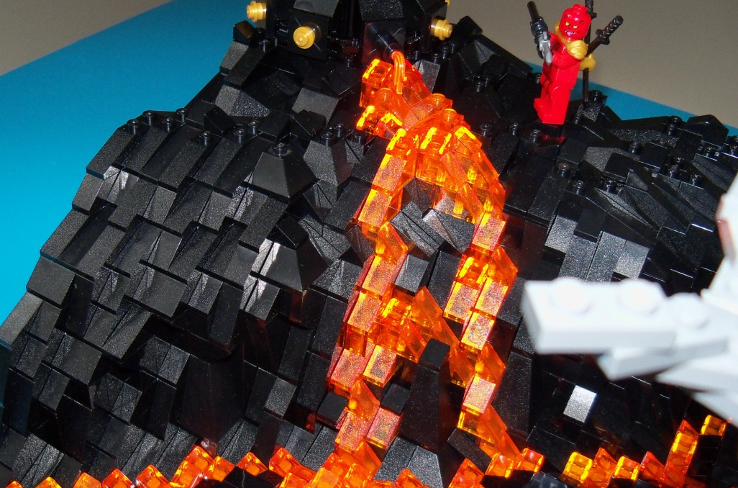
Slope Style Terrains
Use different colors to achieve different terrains
lava
snow

Slide 9
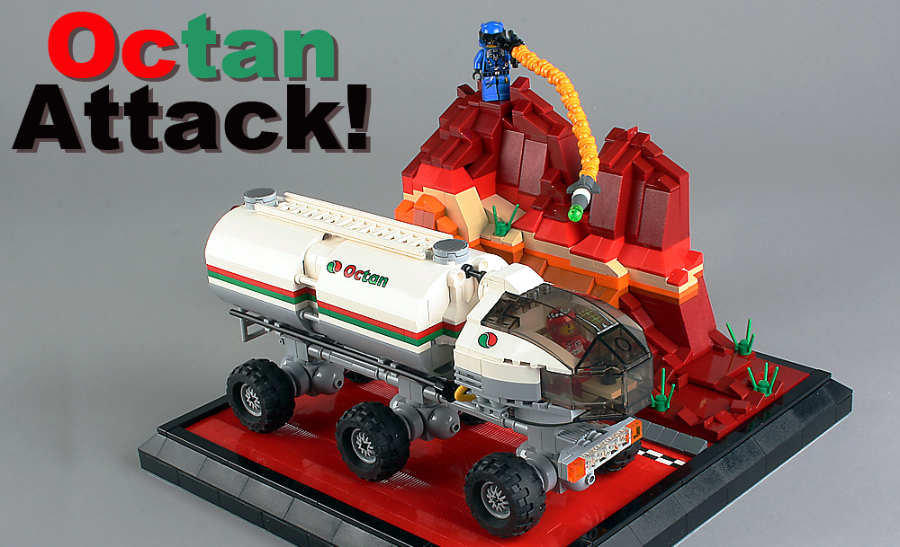
Slope Style Terrains
Mars - By lego_nabii

Slide 10
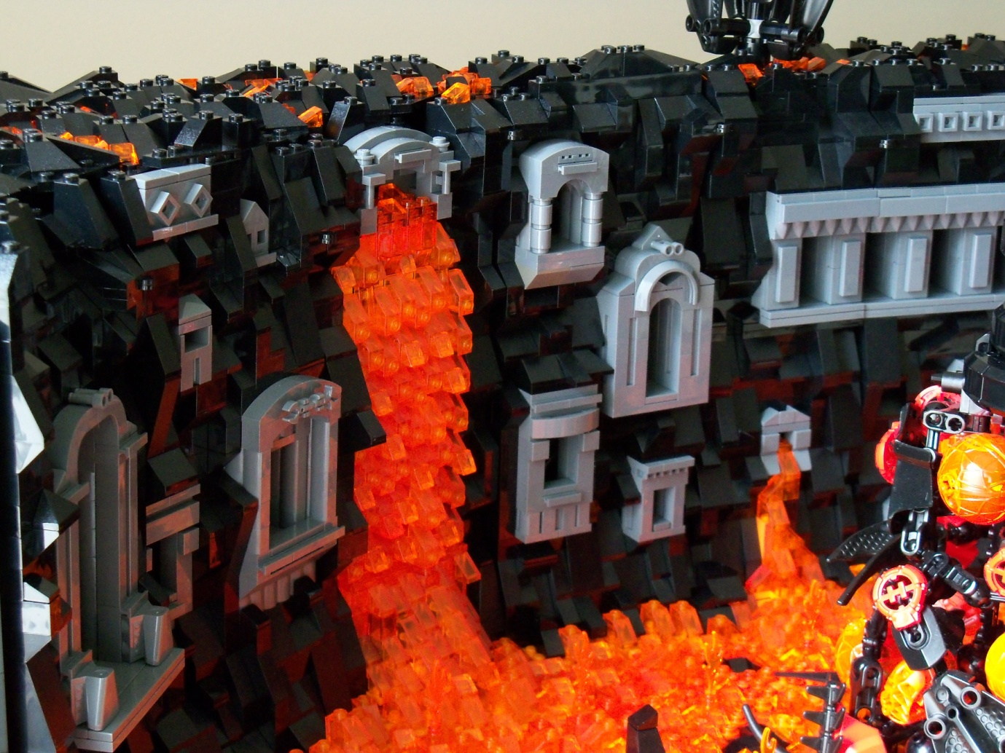
Insert Features
You can insert other features in the rocks

Slide 11
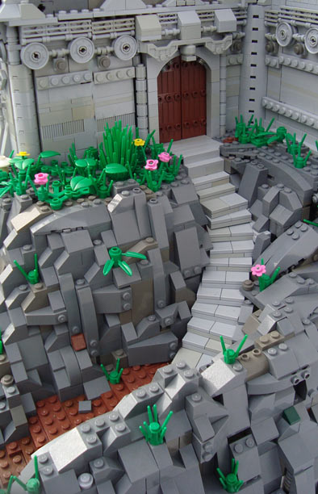






SNOT Style
SNOT slope pieces
By Glory Forever

Slide 12
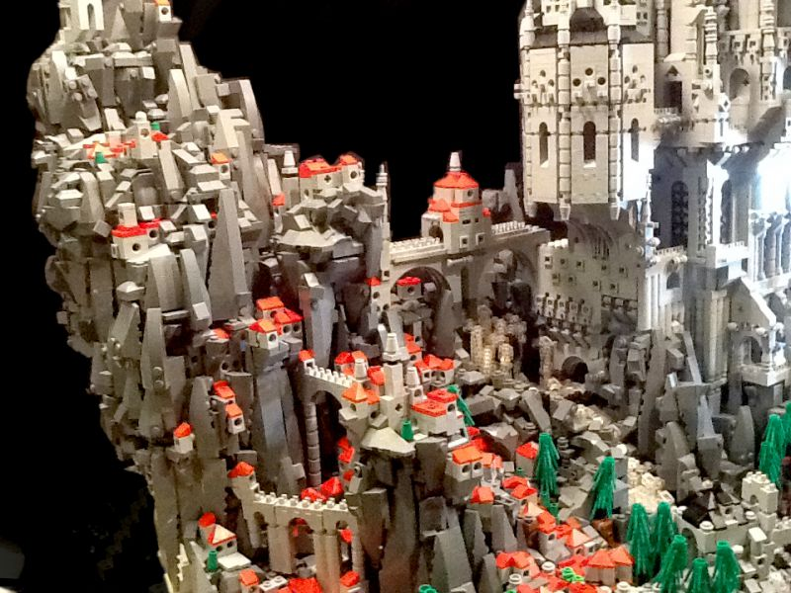
SNOT Style
By mike doyle

Slide 13
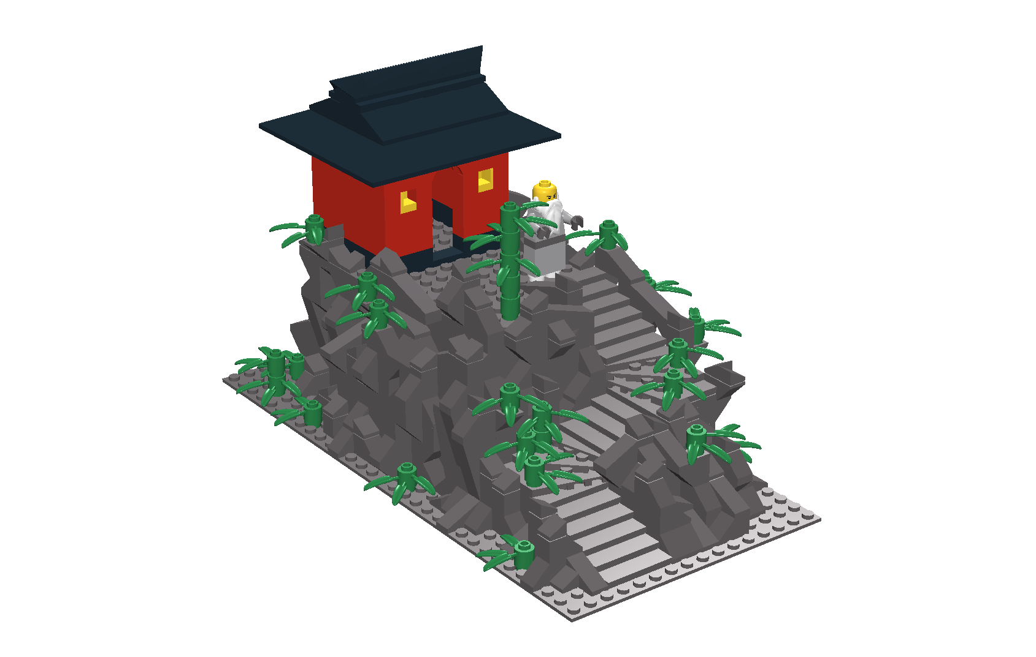
Add Green
For all styles, add vegetation to make it look more realistic

Slide 14
Other Mountain Techniques

Slide 15
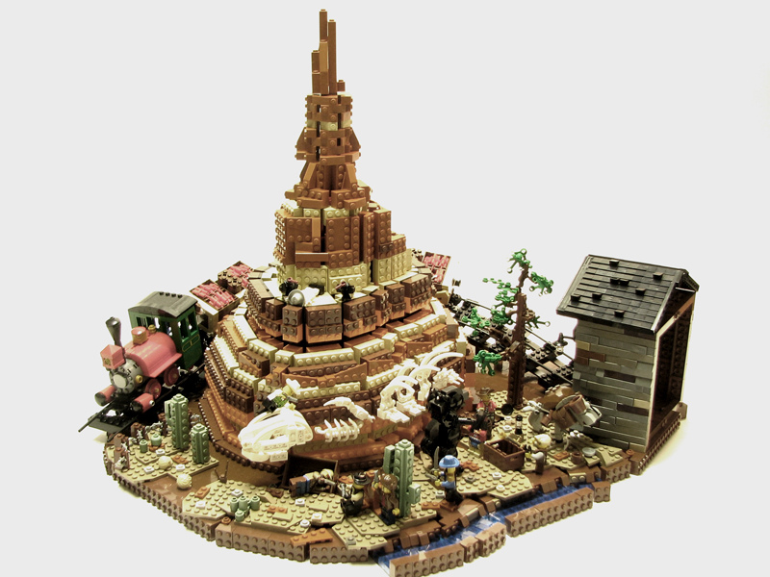
Big Thunder Mountain
By Fat Tony 1138

Slide 16
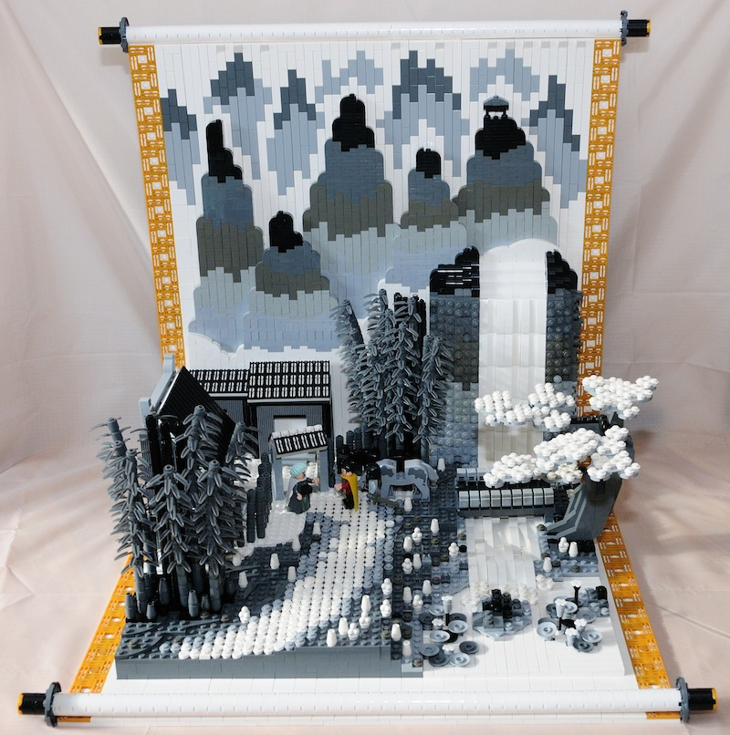
Chinese Landscape Painting
By Ericmok

Slide 17
Water
Flat Surface
Wave

Slide 18
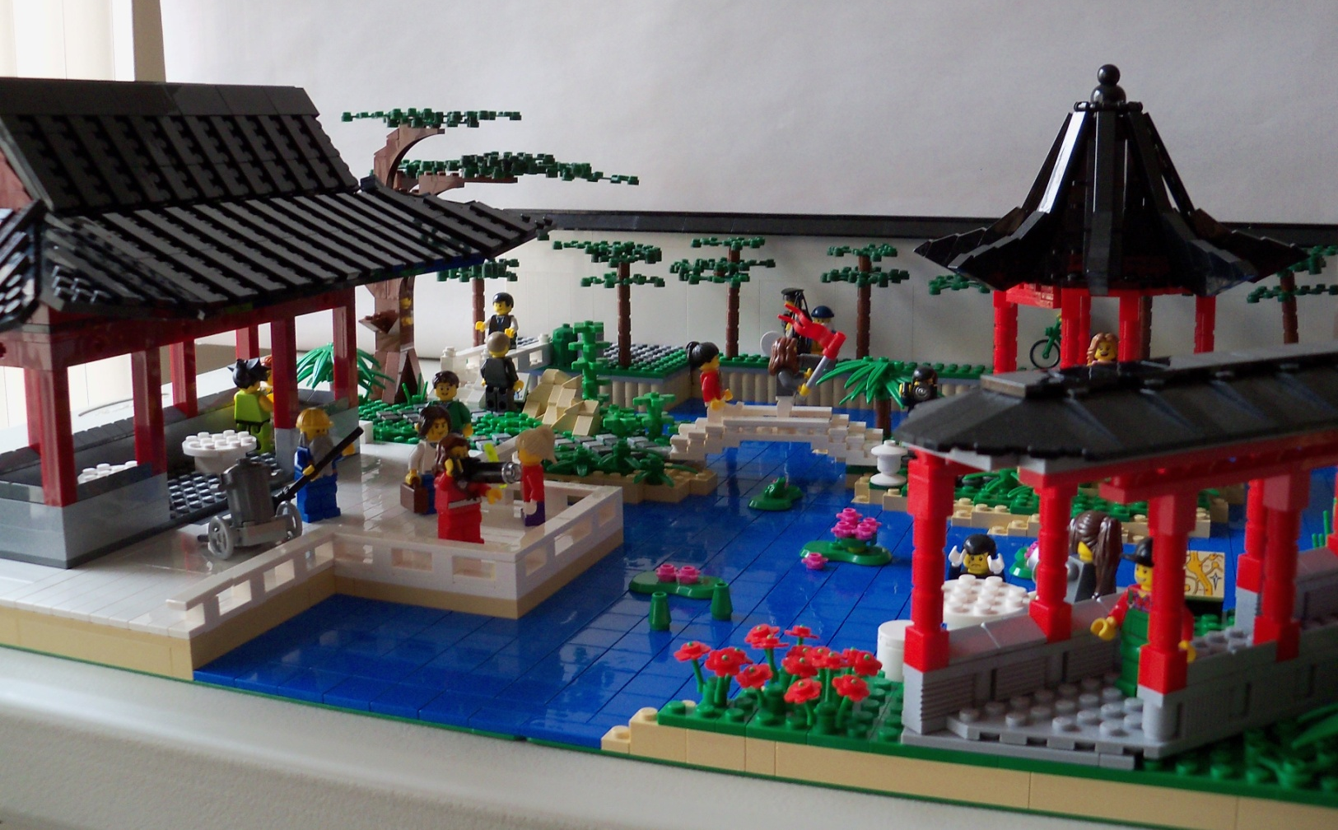
Flat Water Surface
Blue plate/tile/brick

Slide 19
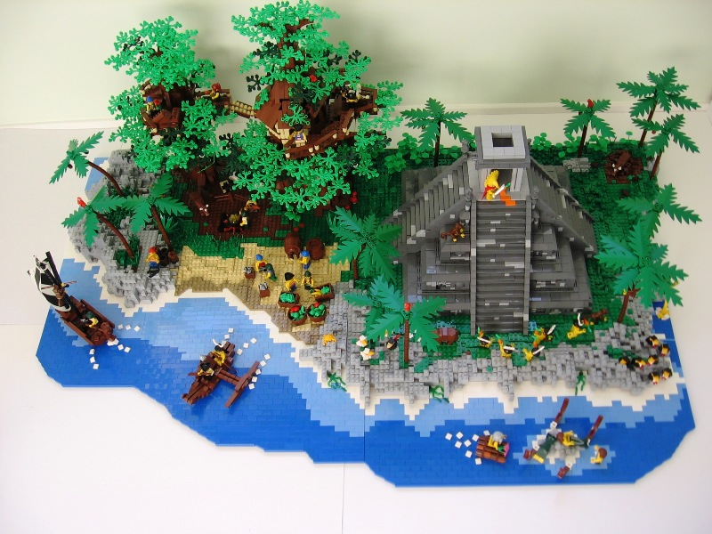
Color Gradient
Light to dark from the coast to deep water
By I Scream Clone

Slide 20

Color Gradient
Light to dark
Lego has produced plenty of blue colors

Slide 21
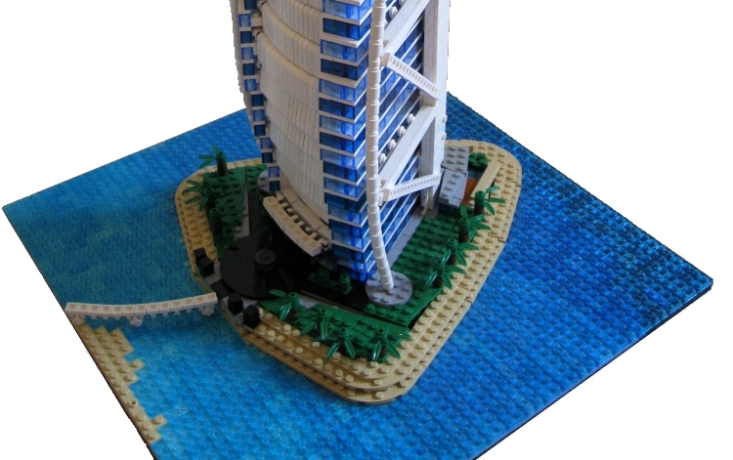
More Color Gradient
Combine trans and non-trans plate for more colors
By Spencer R.

Slide 22
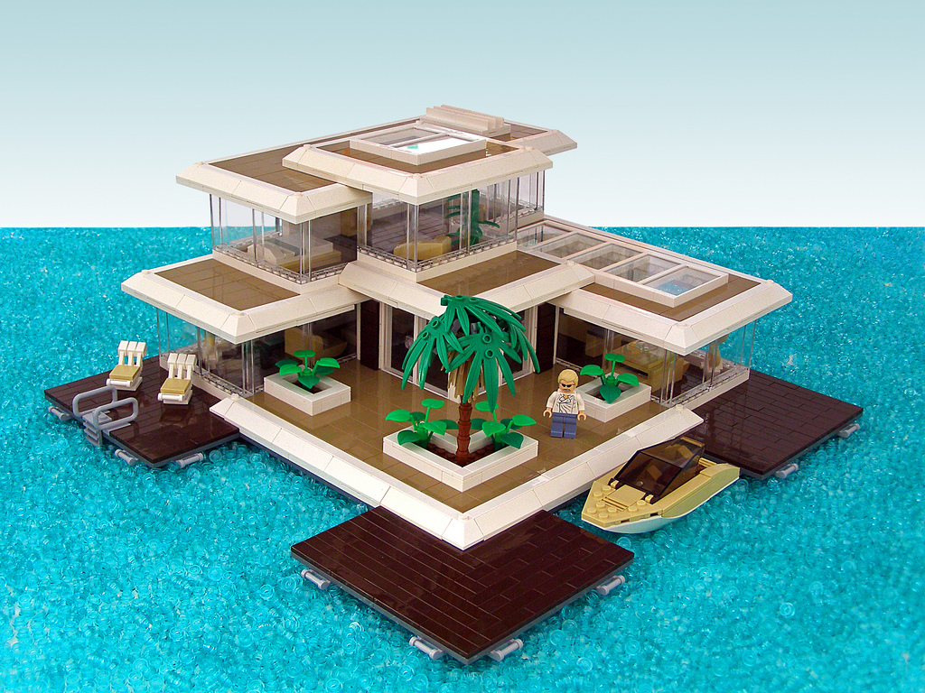
Spreading Technique
Spread around anything 1x1
by Legohaulic

Slide 23
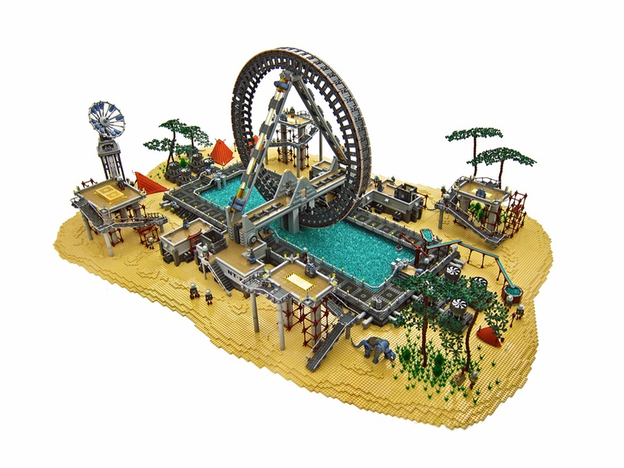
Moving Water
Moving water with 1x1 round plates
by Nannan Z & Legohaulic
Video: http://www.mocpages.com/moc.php/274909

Slide 24
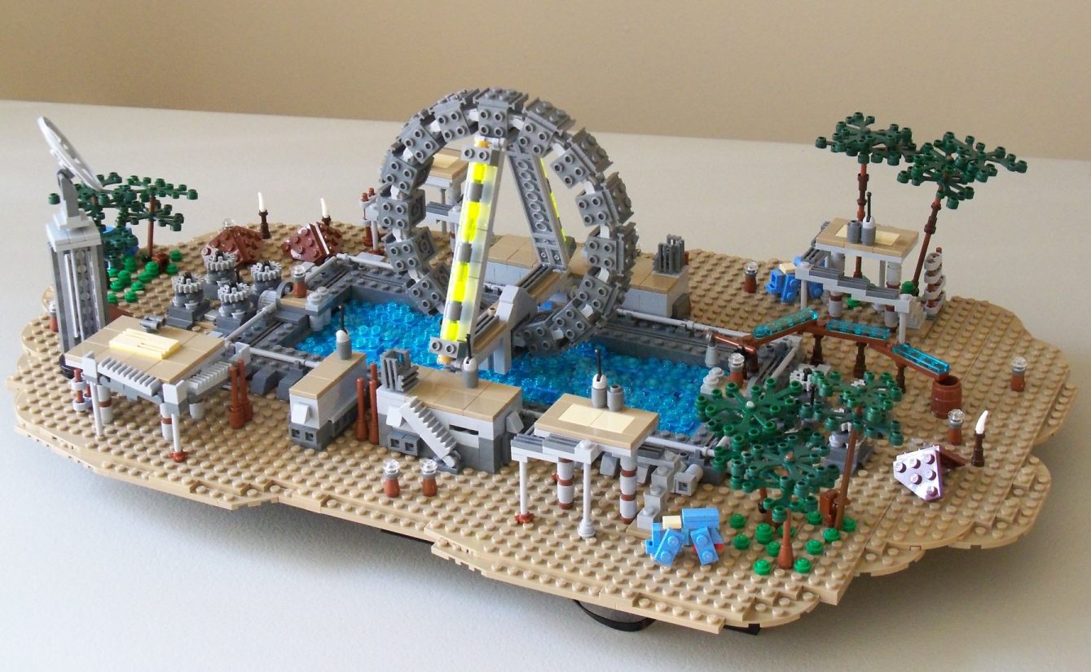
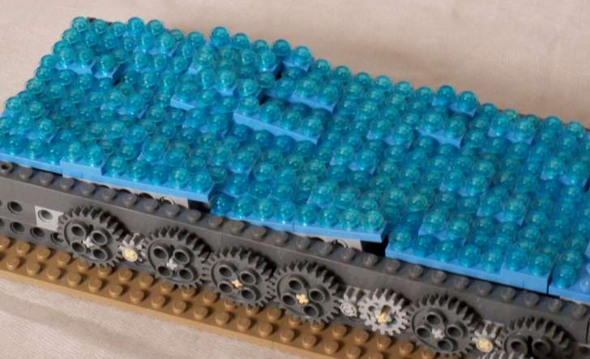
Micro Moving Water
Video: http://www.mocpages.com/moc.php/314142

Slide 25
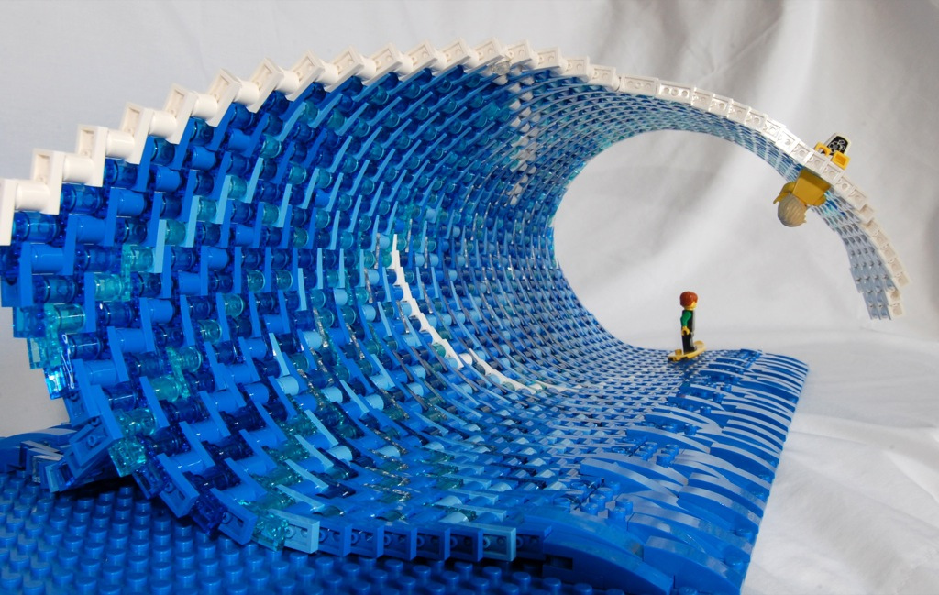



Curve Wave
Use curve building techniques
by brickmodified

Slide 26
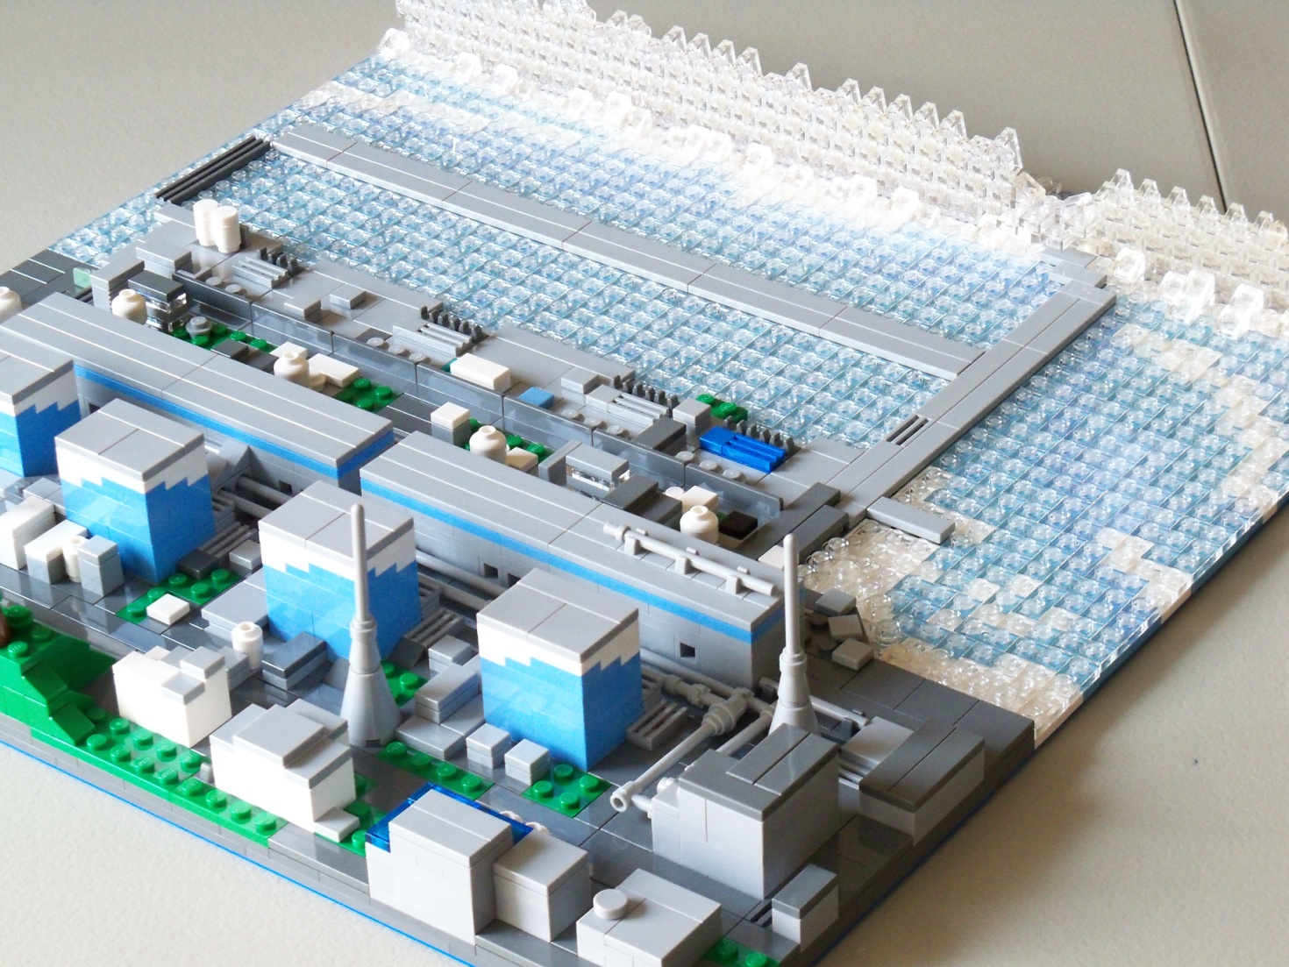
Curve Wave

Slide 27
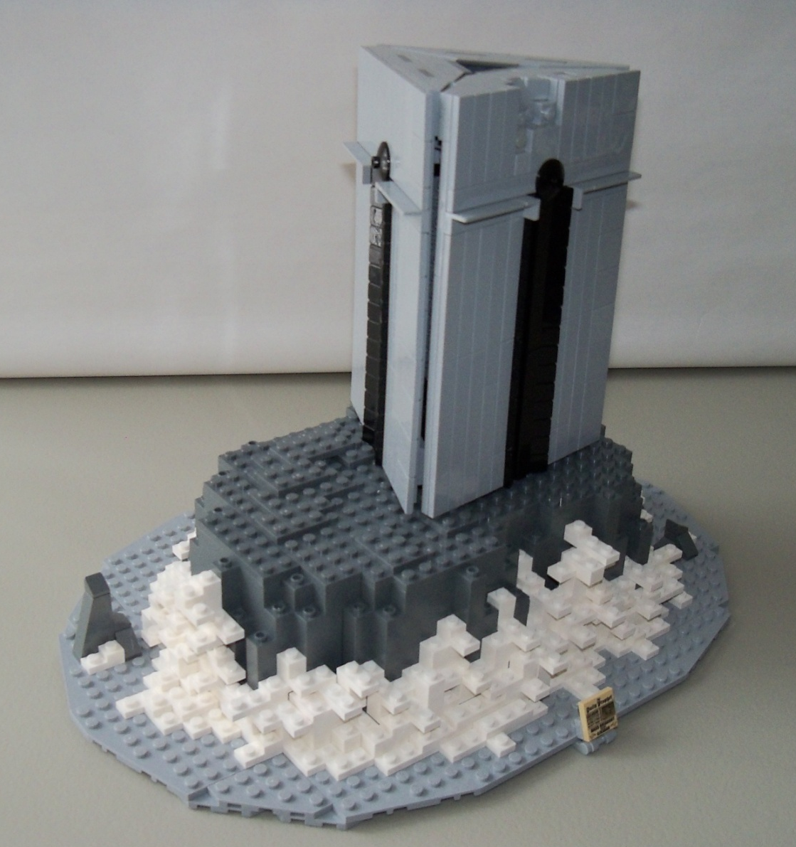
Brick-built Wave
stacking plates

Slide 28
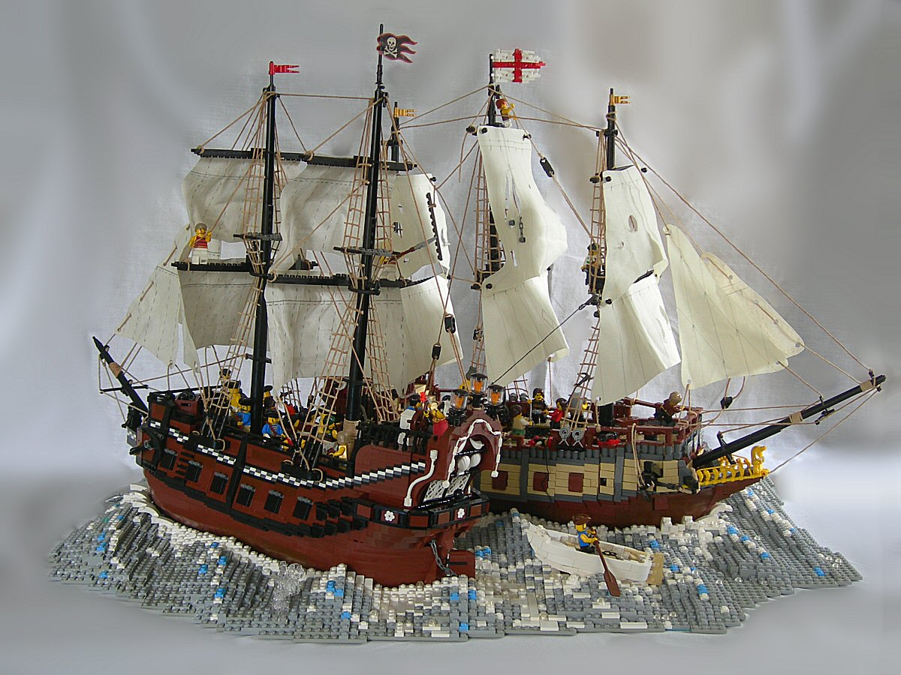
Brick-built Wave
By SlyOwl

Slide 29
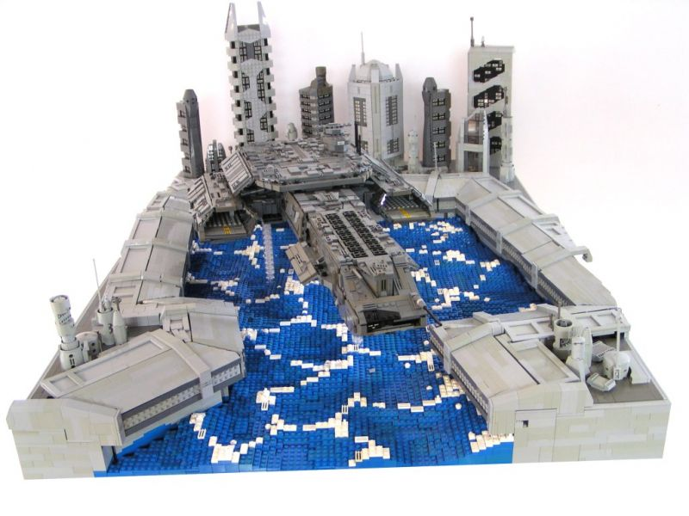
Brick-built Wave
By Sven Junga

Slide 30
Terrain
Grassland
Flower field
Rocky terrain & Lava

Slide 31
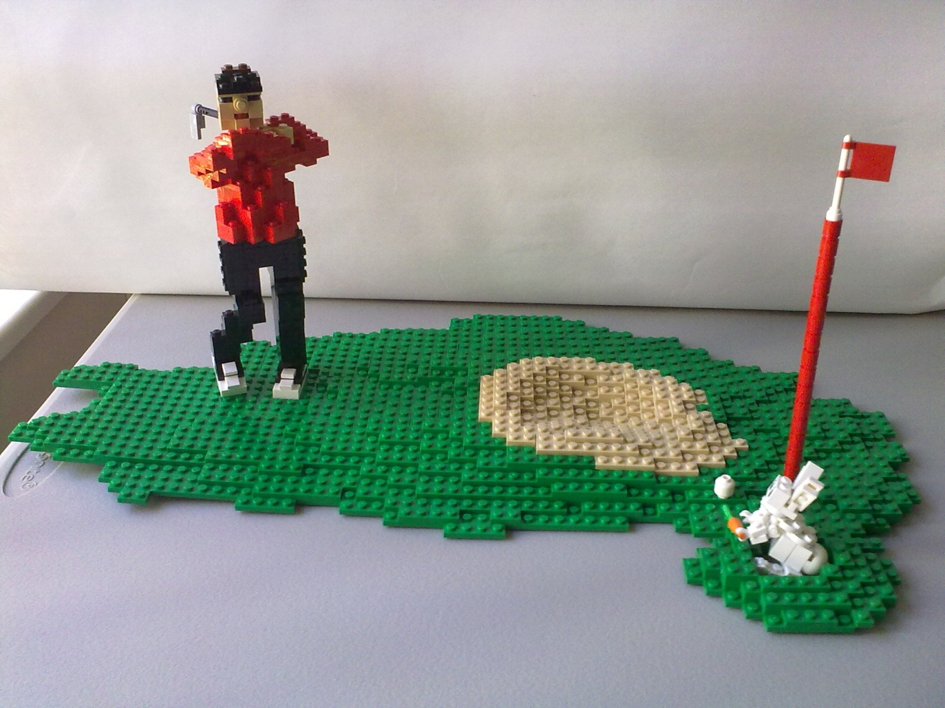
Grassland
Plate gradient
Lego store ribbon model

Slide 32
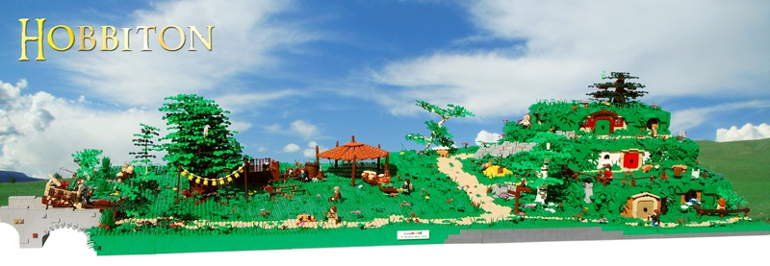
Grassland
By Legopard

Slide 33
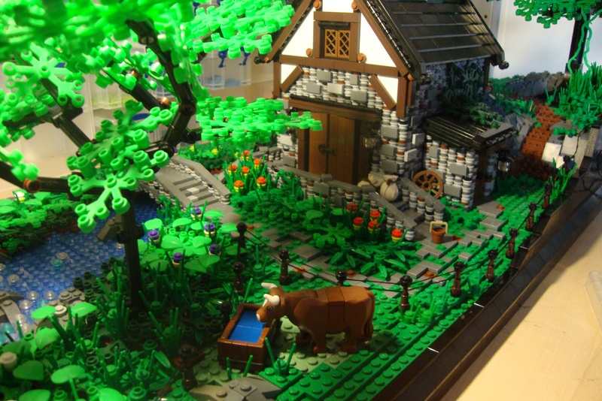
Grassland
Read the “Guide To Building A Medieval Village”
By Luke Watkins
http://www.mocpages.com/moc.php/297660

Slide 34
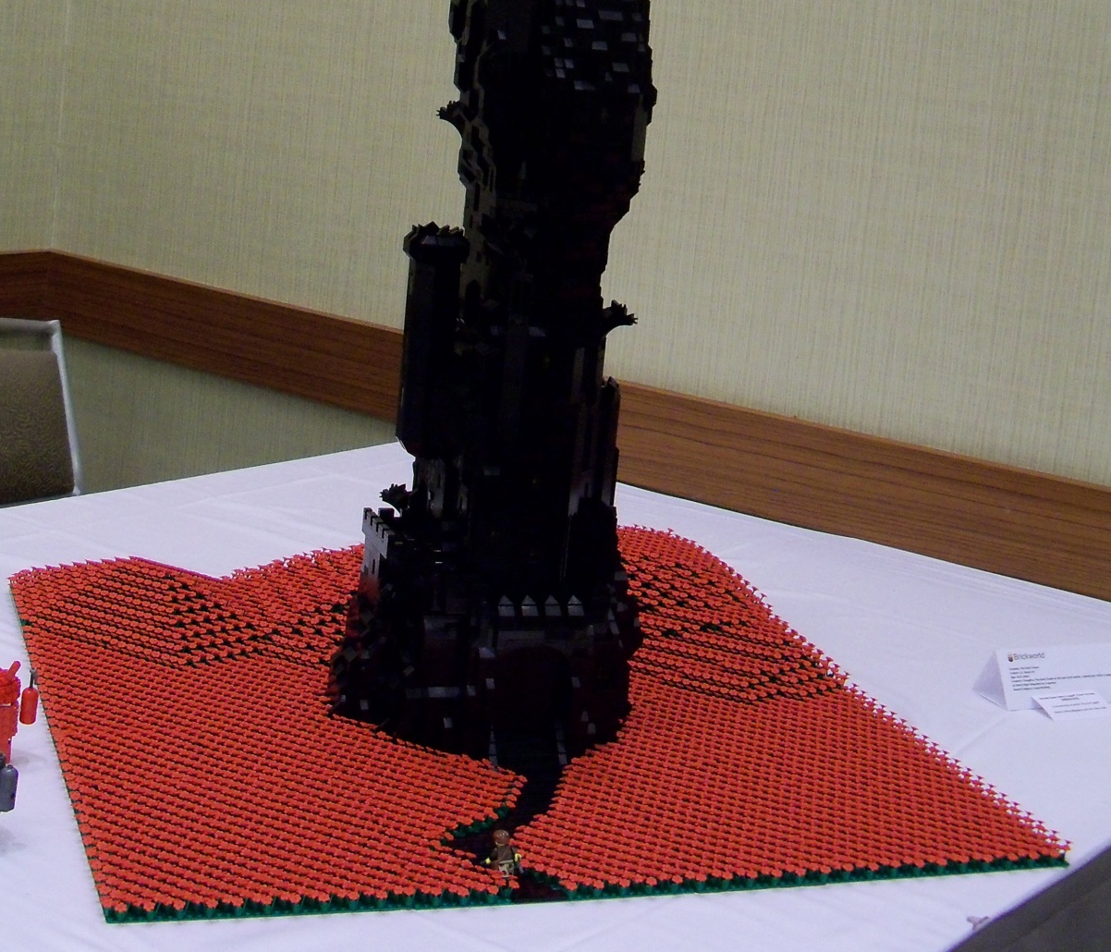
Flower Field
Just like grassland but with flower on top
By Stephen King

Slide 35
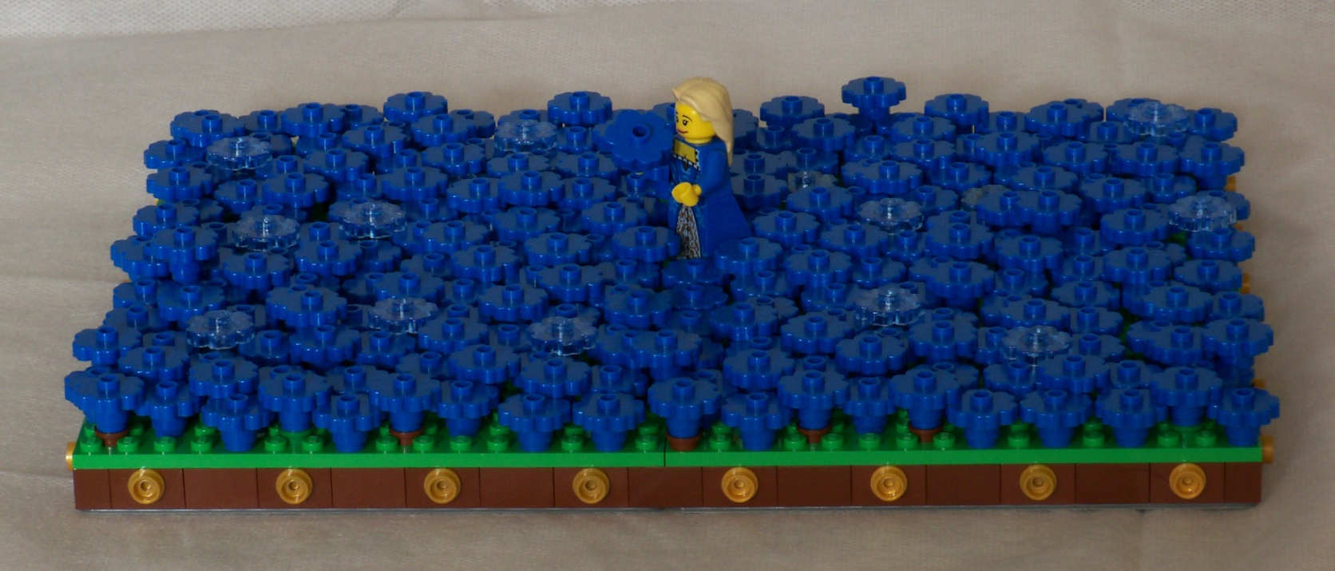
Flower Field
Overlap flower pieces to create a dense field

Slide 36
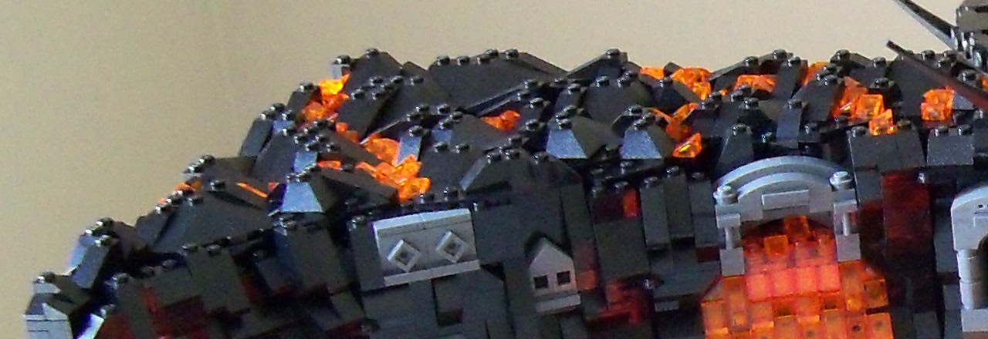
Rocky Terrain
Use various slopes and wedges

Slide 37
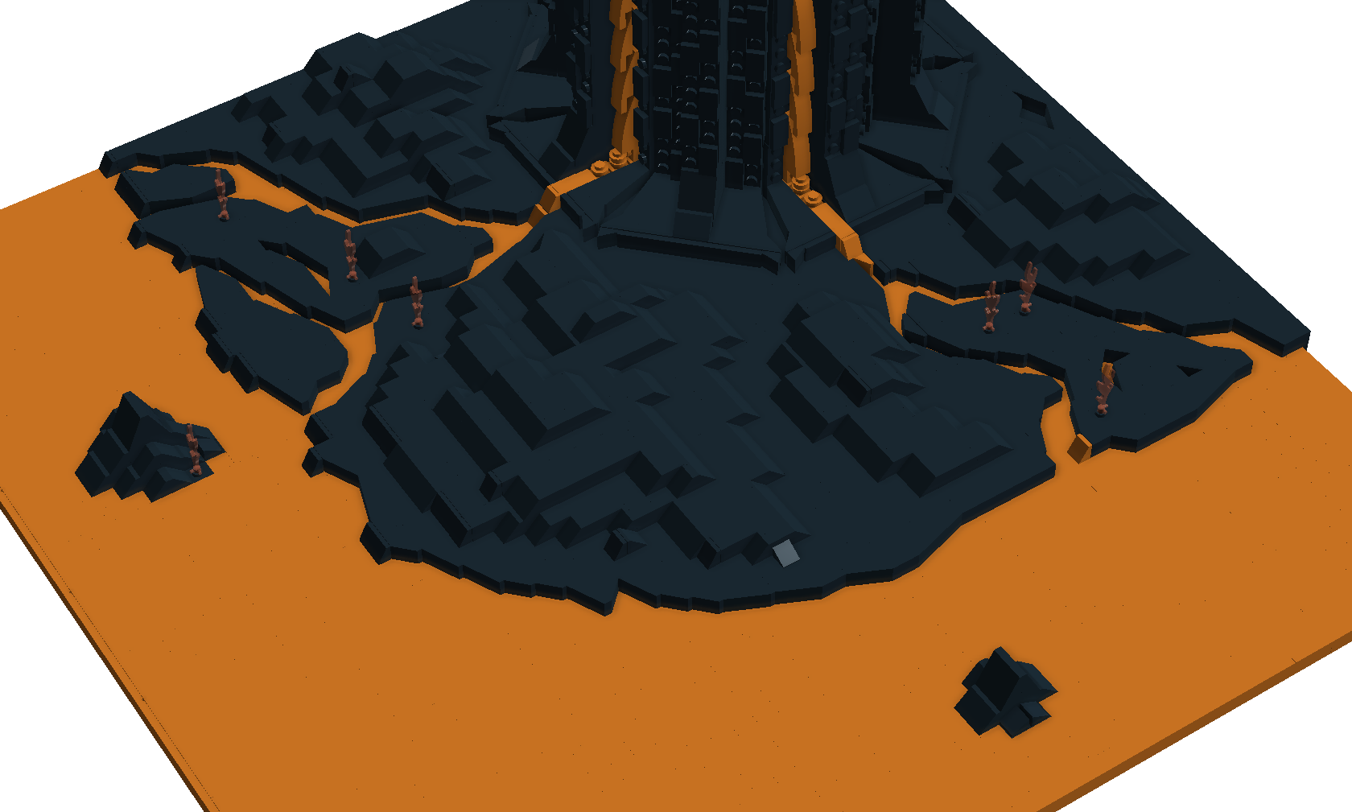
Rocky Terrain & Lava
Build slope side ways

Slide 38
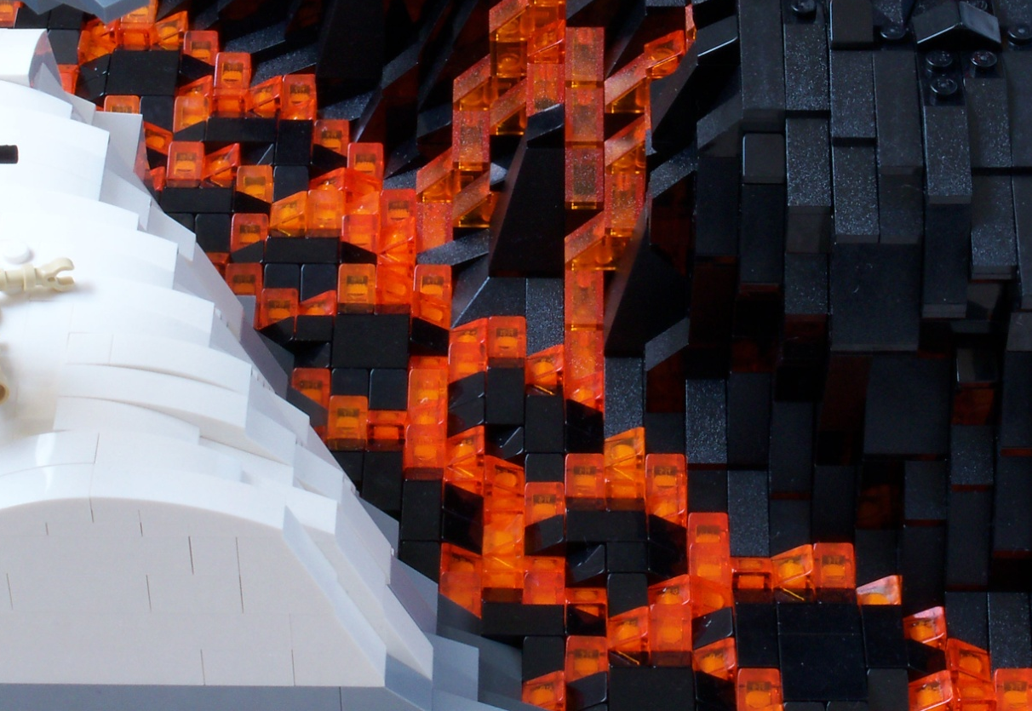
Lava
Build black bumps first
Then fill the gap with trans-orange slopes

Slide 39
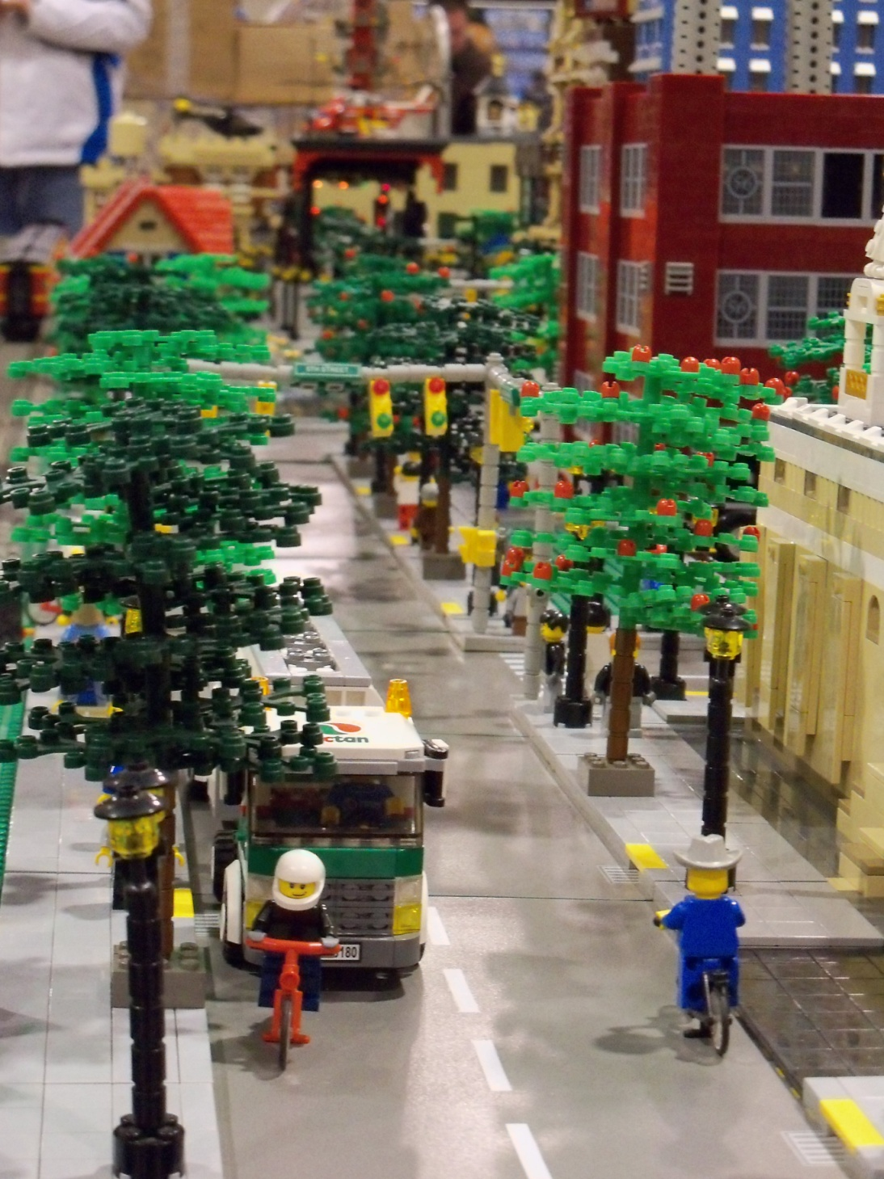
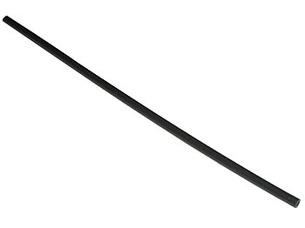
Tree
Run hose thru the tree
very flexible
easy to store
Michlug

Slide 40
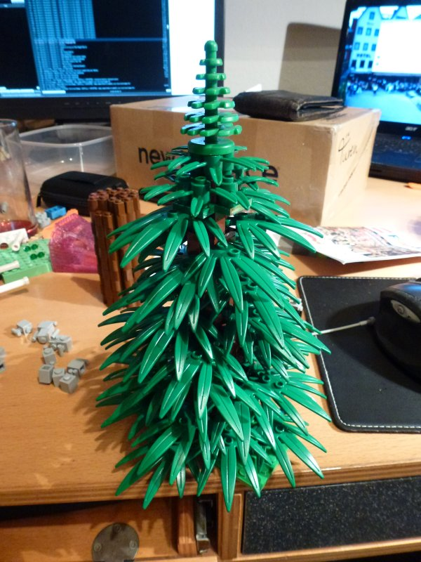
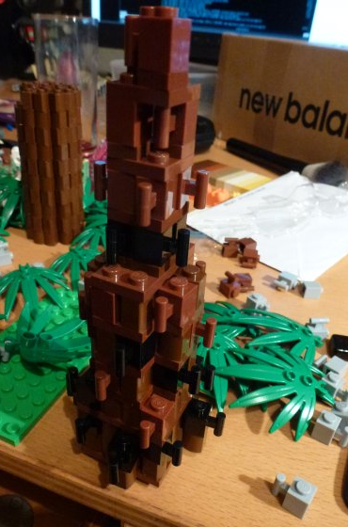
Tree
By maydayartist

Slide 41

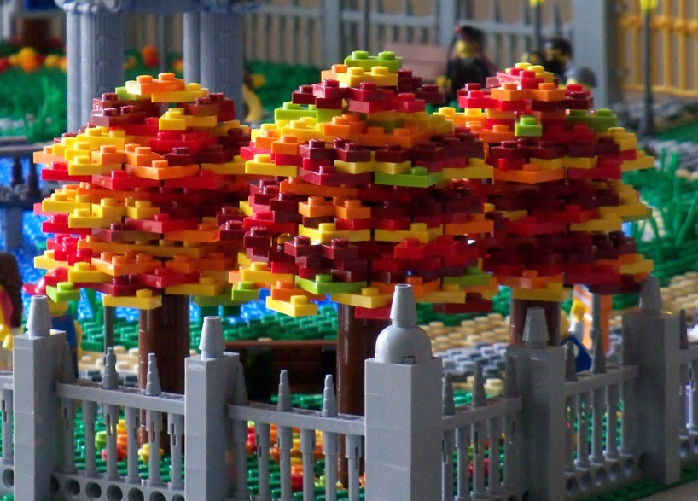
Trees
Plate tree
Rotate plates 22.5º
8 plates per layer

Slide 42
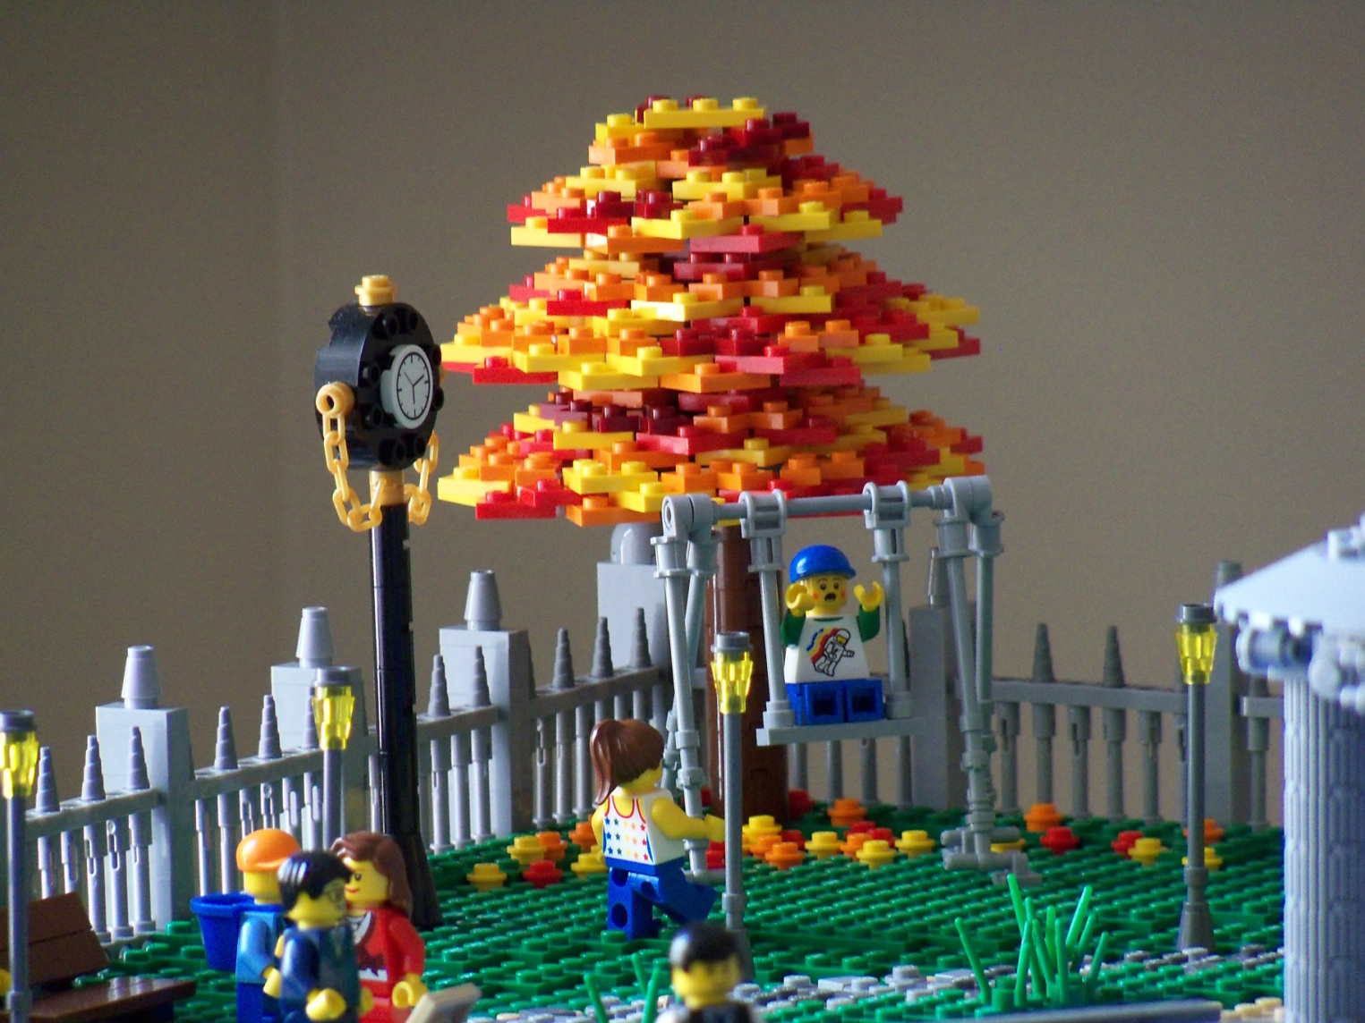
Tree
Rotate plates 11.25º for bigger tree
16 plates per layer

Slide 43
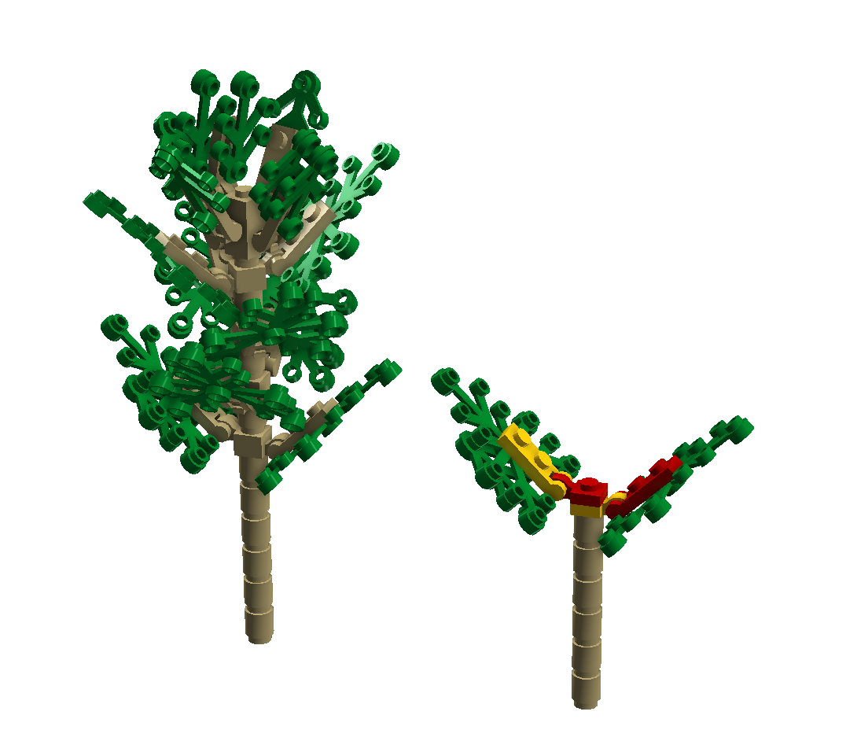
Tree

Slide 44
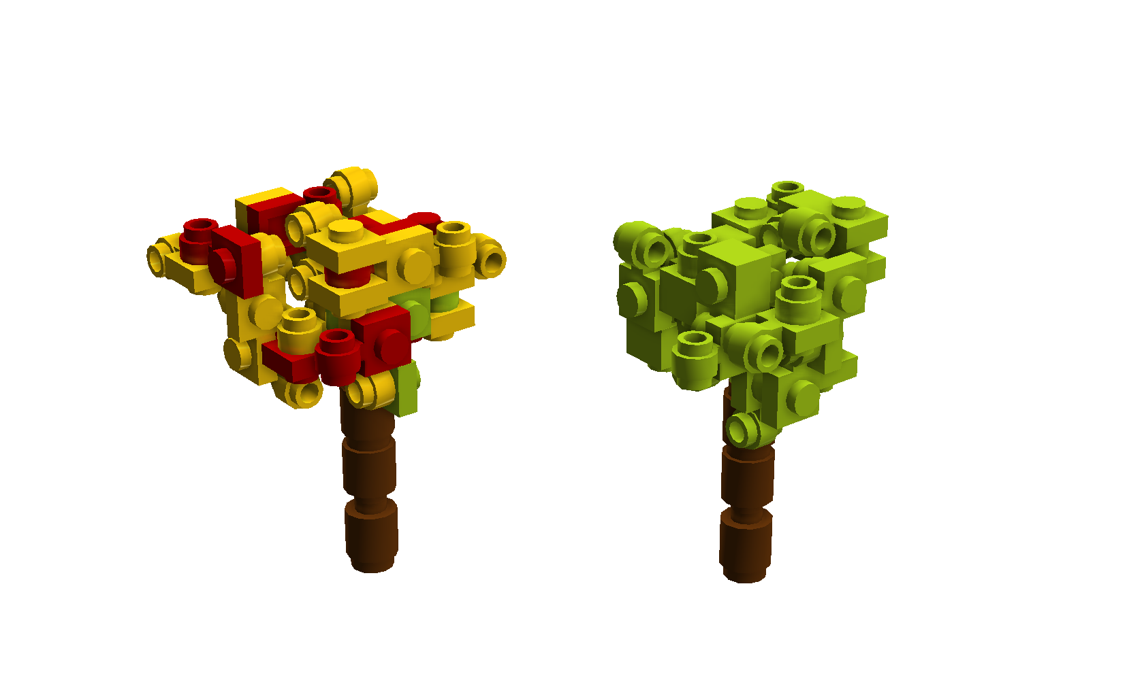
Small Bush

Slide 45
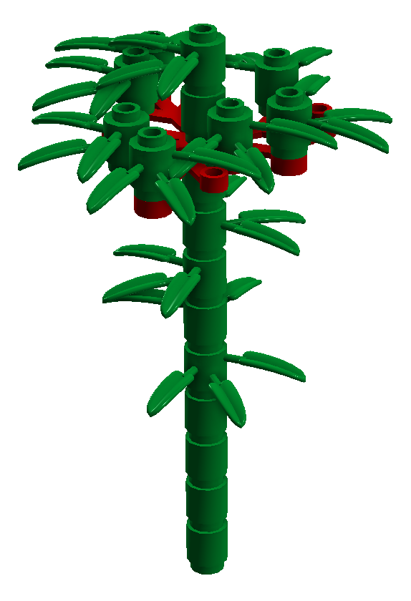
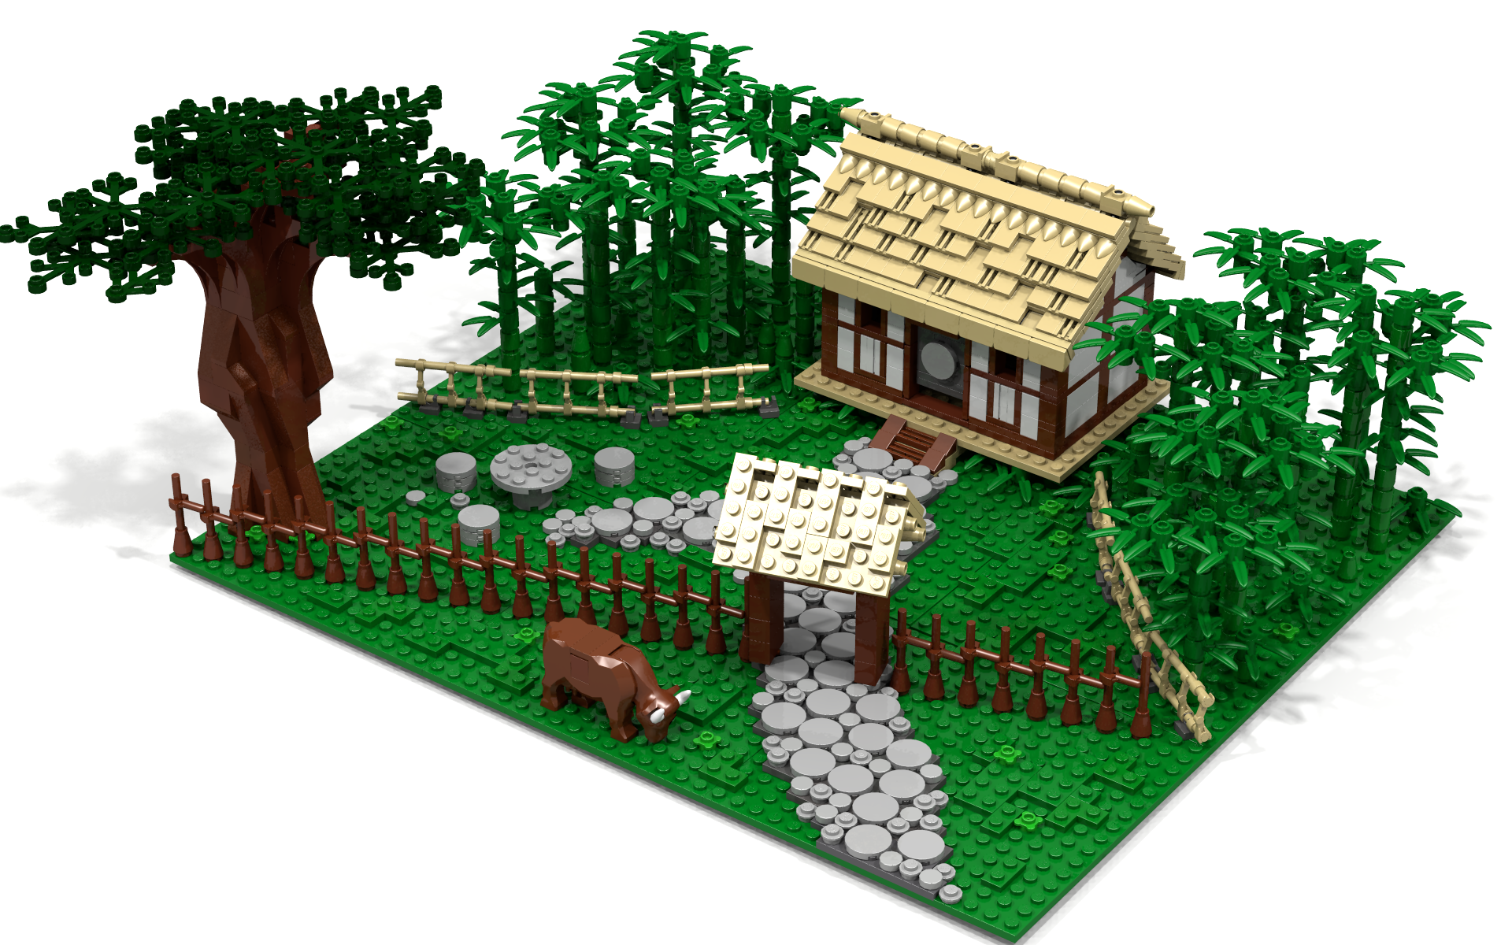
Bamboo

Slide 46
More Tree Building Resources
http://www.brickshelf.com/cgi-bin/gallery.cgi?f=266344
http://www.flickr.com/groups/lego_arboretum/

