Slide 1

Power Distribution through Brick Built Roads
By Jim Pirzyk

Slide 2
The where, what, why, and how of doing power distribution through a LEGO City layout.

Slide 3
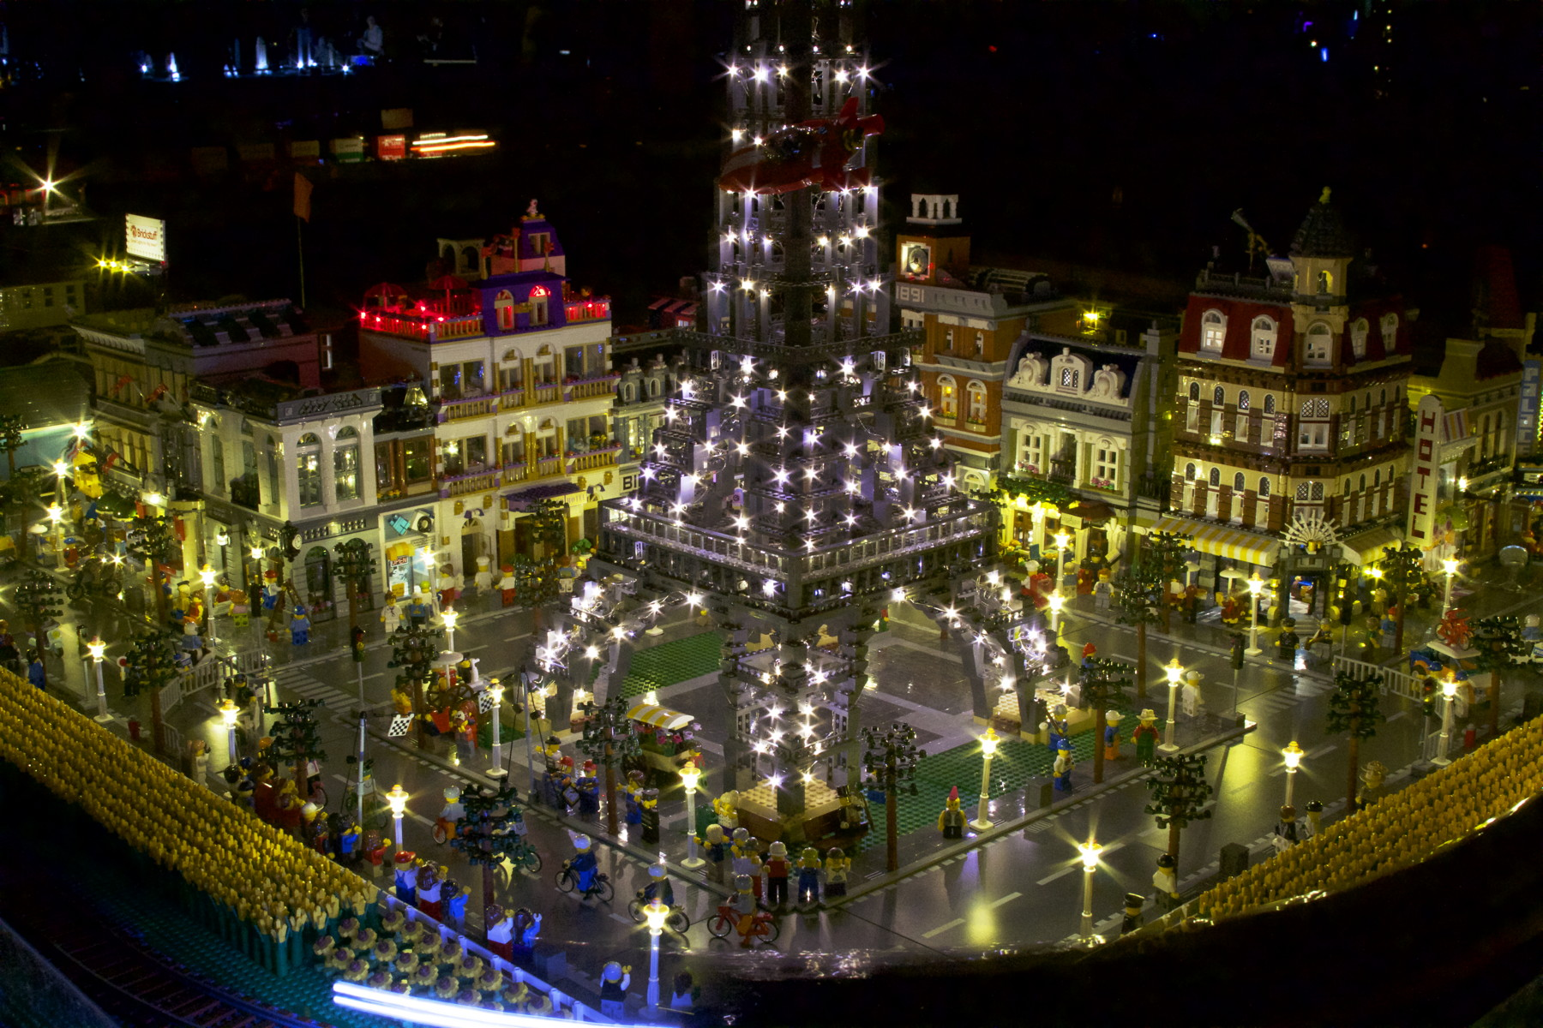
Notes:
Last years layout that took 2 days to setup.

Slide 4
Design Goals
Quick setup
Low resistance & scalable
Flexible design
Simplicity
Resilient
Reversible
Notes:
Last year at BW my layout took 2 days to wire and setup; with these new roads that is now only a few hours.
I wanted to make sure I could connect many road segments as possible in a line and not have too much voltage drop from the beginning to the end. My current max is 16 plates.
This design needed to be flexible enough for different layouts and different buildings connected to it.
It needed to be simple, just wires and connectors. No resistors, capacitors, etc. Effectively this is just a fancy extension cord.
It needs to be able to survive show setup and teardown for many years to come.
I wanted to make sure I could reuse the bricks in the future for something other than a road. Only 1 part was modified in this design, the lampposts themselves.

Slide 5
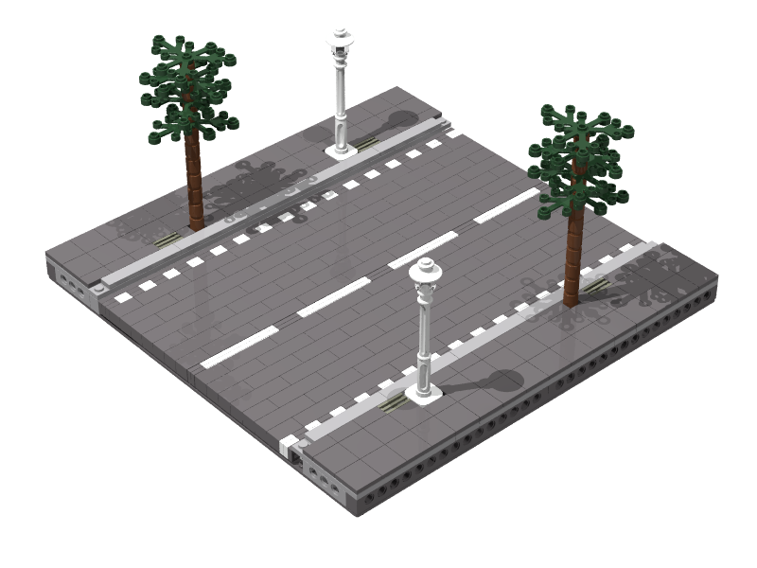
Brick Built Roads
Notes:
Note the Technic brick on the outside, important as will be seen in the next slide

Slide 6
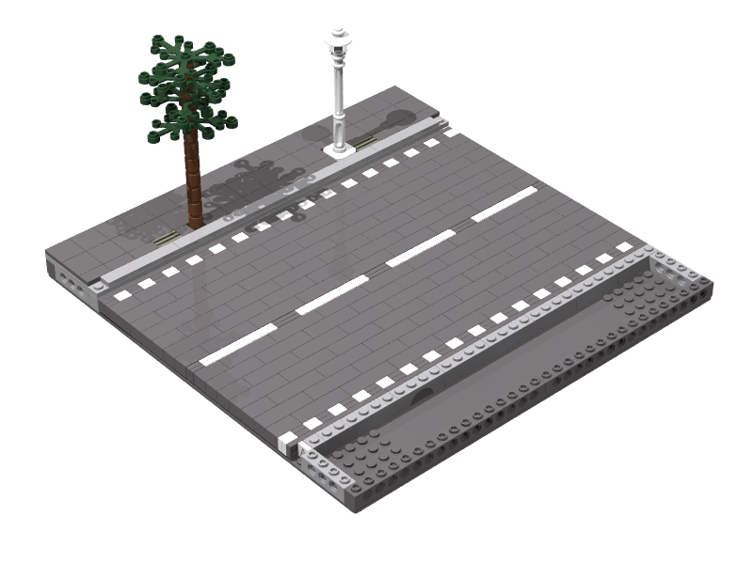
Brick Built Roads
Notes:
plenty of room to run the wires under the sidewalk

Slide 7
Tools
Jonard Adjustable Wire Strippers, ESD (mfg p/n: ST-500ESD)
Waldom Hand Crimp Tool for .062 in diameter pins (mfg p/n: W-HD-1921-P)
Waldom Extraction Tool for .062 in diameter pins (mfg p/n: W-HT-2023)
Wire cutters
Needle nose pliers, preferably bent nose.
Soldering iron
Notes:
The wire strippers are designed to handle really small wires, in the range of 20 to 30 AWG
Speciality tools were purchased at Frys

Slide 8
Tools (Cont.)
Drill - variable speed (able to turn really slowly)
1/8 in bit brand new, very sharp
Phillips screw bit
Tack hammer
Utility knife with sharp blades
X-acto X75350 Extra Fine Razor Saw
Multimeter (optional)
Notes:
The drill need to be able to turn < 100 RPM.
Multimeter is for testing the harness
X-acto knife was bought at the local craft store

Slide 9
Supplies
22 AWG Solid Wire in red and black
4x Molex Connection Terminal Male 18-24 AWG Tin (mfg p/n: 02-06-2103)
12x Molex Connection Terminal Female 18-24 AWG Tin (mfg p/n: 02-06-1103)
12x Molex Connector Receptacle Female Single position .062 in Nylon (mfg p/n: 03-06-1011)
4x Molex Connector Receptacle Male Single Position .062 in Nylon (mfg p/n: 03-06-2011)
Notes:
Supplies were bought at Frys (one offs) and DigiKey online (bulk).
I bought 100 ft of wire and still have most of the spool after about 20 baseplates.

Slide 10
Supplies (Cont.)
PAN PACIFIC 40 Pin Single Row, Straight Header Strip, 0.1" Center, Qty 5 (mfg p/n: PLS-40S-P5)
OSEPP Arduino Stackable Header - 10 Pin (mfg p/n: LS-00009)
Craft glue (perchloroethylene based)
Sharpie in red and black
Coarse (80) grit sand paper
MG Chemicals Connector Coating (Cat. No. 4229-55ml) (Optional)
Notes:
I only used 1 package of the straight and stackable header pins.

Slide 11
Supplies (Cont.)
Solder
Steel wool
Brickstuff DIY Connecting Cables (mfg p/n: DIY06-5PK)
LEDs / power pack / adapters (optional)
Notes:
I use Brickstuff lights and power adapters on both sides of the roads. As long as you are using consistent voltages on both sides of the road, it should just work. The DIY Connecting cables are used for testing and to connect my Modulars and power to the roads.
The LED lights and power pack can be used in place of the Multimeter for testing.
Use the steel wool to regularly clean the soldering iron tip.

Slide 12
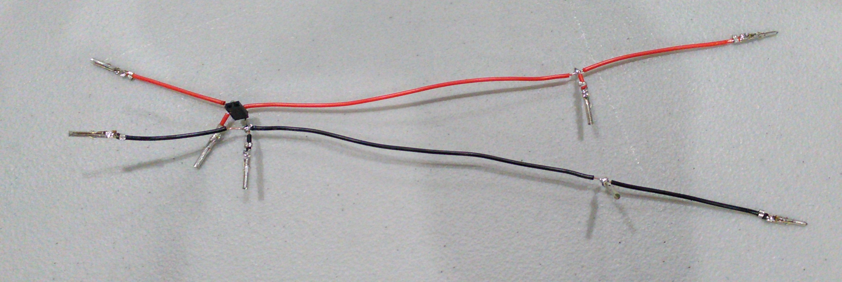
Wiring Harness
Notes:
This is what we are going to build

Slide 13
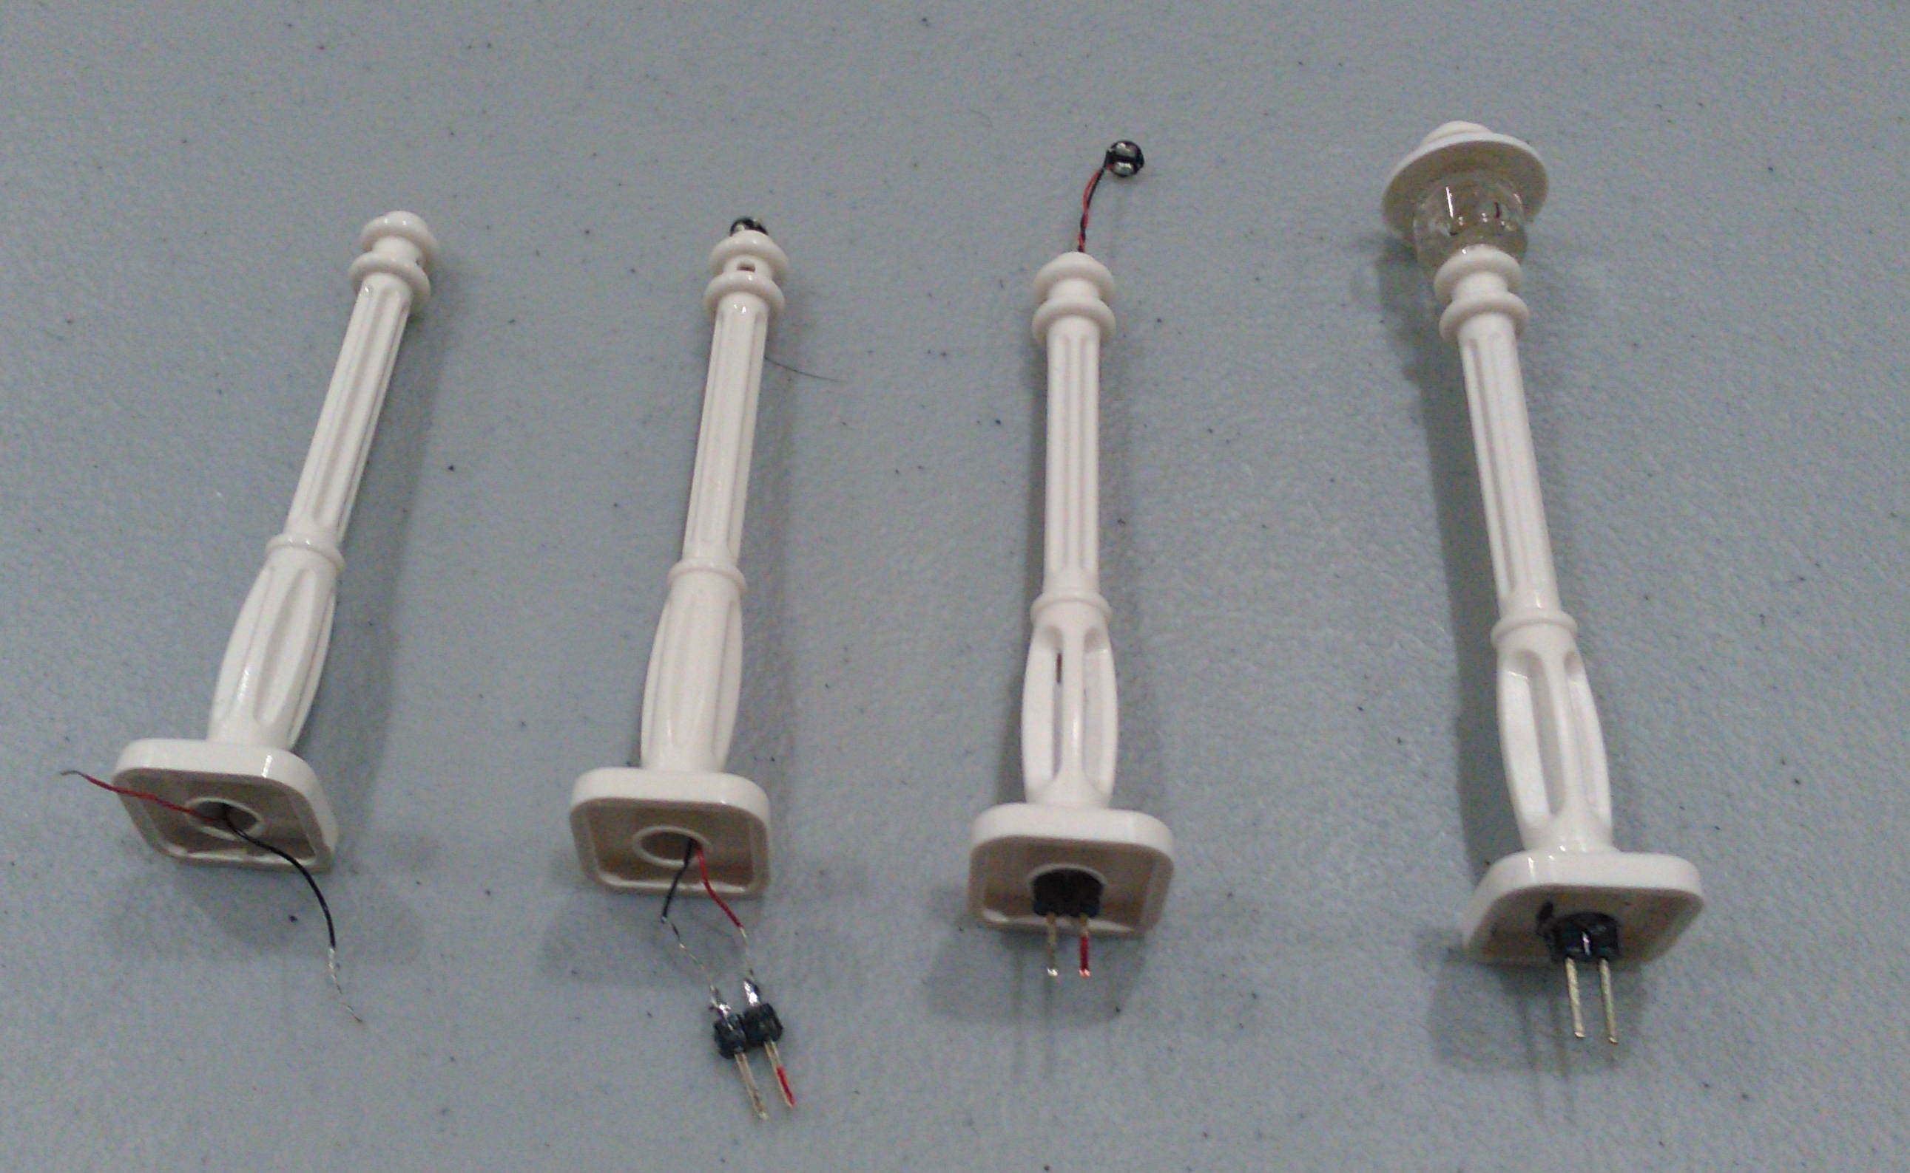
Street Lights
Notes:
These lamppost were already drilled out (for BW 2016) with the variable speed drill using the brand new 1/8in drill bit on its slowest setting. I drilled them out from both ends by just holding the lamppost in my left hand and the drill in my right. Don't go too fast or the plastic will melt, also keep a close eye on where you are to see if you blow out one of the sides.
Then run the [BrickStuff pico] LED light through the hole. If you cut the connector off first then you can use a smaller drill bit. Since I was using the pico lights intact last year I had to use the 1/8in bit.

Slide 14

Street Lights (Notes)
Break off 2 pins from the 40 pin strip and trim
Don't strip too much wire
Don't heat up the pins
Mark exposed pin red
Glue pins to lamppost
Mark underside of lamppost (matching red pin)
Make sure the glue is fully cured
Notes:
Trim the 2 pin straight header strip after breaking it off so that it will fit inside the hole of a Technic 2 x 6 plate
Don't strip too much wire before the connector as you may short the wire after you epoxy the pins in
Don't make the pins too hot when soldering otherwise they will slide in the plastic and not plug into the socket. You can fix this with the craft glue.
Mark the exposed of the pin with the red Sharpie after you soldered the red wire.
Mark the underside of the lamppost to match the pins after you glue the pins in so if the color is rubbed off you will still know the orientation. Orientation is important with LEDs (the diode part of Light Emitting Diode).
Make sure the epoxy is fully cured before testing out.

Slide 15
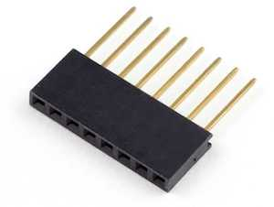
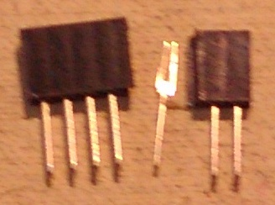
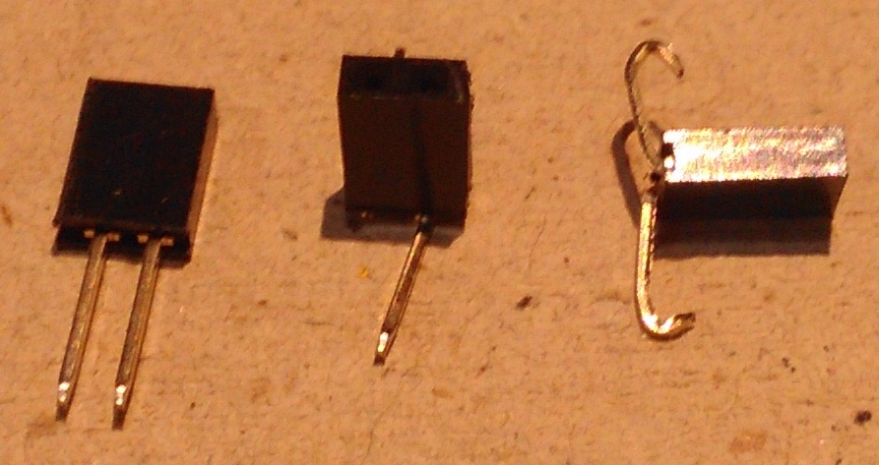
Street Light Sockets
Take 10 pin header strip and cut out 2 pin sockets using Xacto Razor Saw
May only yield 3 per 10 pin segment
Make sure resultant 2 pin socket has secured leads.
Bend left lead away from you and right lead towards you.
Put a hook on the end of each lead
Notes:
You usually lose 1 pin per cut as the adjacent socket is not secured.
You can only bend the leads once before they break off.
Be consistent in how you bend your leads as changing the order will cause your lampposts to have to be a different orientation when installing them. I have at least 2 sockets (each on a different road plate) that has the leads bent the wrong way.

Slide 16
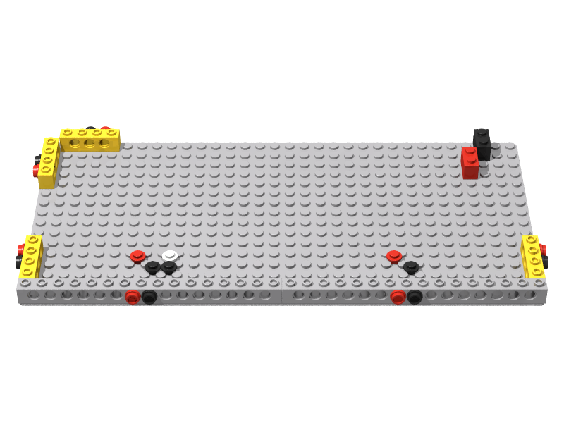
Wiring Harness Jig

Slide 17
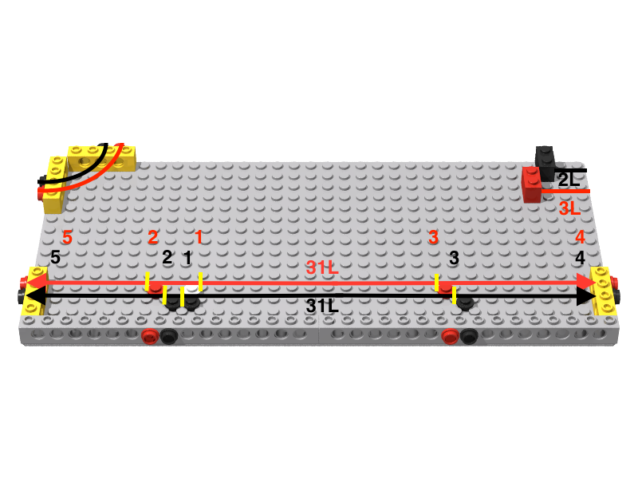
Wiring Harness Jig
Notes:
The number in red and black are the order of the locations to strip the wires. You will strip about 1/8 in long, enough to solder a second wire perpendicular to this wire.
The upper left corner is for doing T and intersection road plates. They are relatively simple wires with a single male and female connector.

Slide 18
Cutting Wires
1 red and 1 black wire 31 studs (L) long.
2 red wires 3 studs (L) long.
2 black wires 2 studs (L) long.

Slide 19
Stripping Wires
Black and red 31L wires
Strip the 3 middle sections (1/8 in long) first starting with the lamppost socket
Strip the ends
Strip the ends red 3L and black 2L wires
Hook one end of each of the red 3L and black 2L wires
Notes:
You work from the center out on the 31L wires. Create hook on one end of the 3L and 2L wires.
Make sure you keep the 31L wire orientation correct as it is asymmetrical.

Slide 20
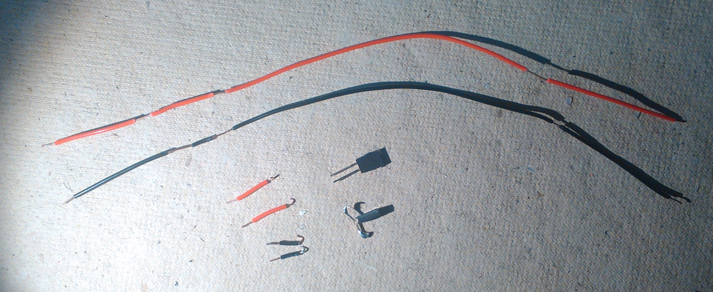
Stripped Wires
Notes:
Note 2 lamppost sockets one with the ends bent and hooked.

Slide 21
Crimp Connectors
6 female terminal connectors
Left ends of red (1) and black (1) 31L wires
Straight ends of red (2) 3L and black (2) 2L wires
2 male terminal connectors
Right ends of red (1) and black (1) 31L wires

Slide 22
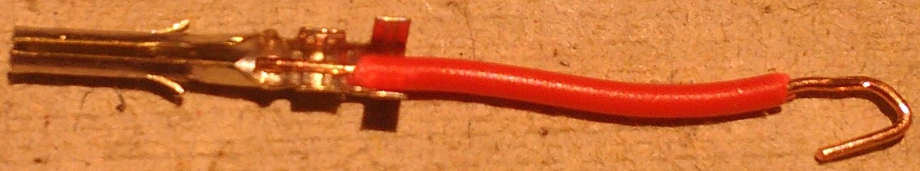
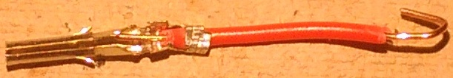
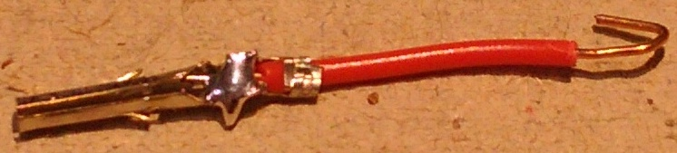
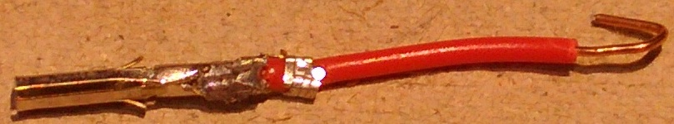
Where to Crimp
Notes:
You need to crimp the connector 1) to the insulator, 2) to solder that you add to the wire and 3) crimping soldered connection.

Slide 23
Solder Connectors
Solder each connector after you have crimped the ends to the insulator
Crimp the soldered connections once they have cooled down
Test connectivity with the multimeter
Notes:
When testing with the multimeter, I use the Ohms (Resistance) settings. You should have almost 0 resistance going through a properly soldered connection.

Slide 24
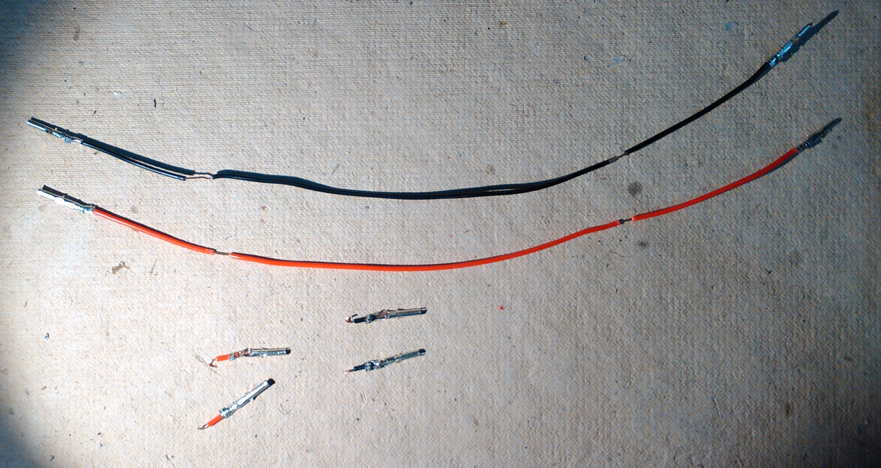
Connectors Attached

Slide 25
Harness Assembly
Solder the 2L black wires to 31L black wire
Do the same with the 3L red wires
Solder the lamppost socket to the 31L black wire
Finish up with soldering the 31L red wire to the other lamppost socket end.
Notes:
Use the hooked ends of the 2L wires, 3L wires, and lamppost socket to wrap around the exposed strip of wire on the associated 31L wire. The 2L and 3L wires will be soldered to the outer most stripped sections on each end, the lamppost socket is soldered to the innermost stripped section (white 1x1 round plate on the wiring harness jig).

Slide 26
Finished Harness
Notes:
This is a finished harness. You need 2 for each road segment: each goes under the sidewalk.

Slide 27
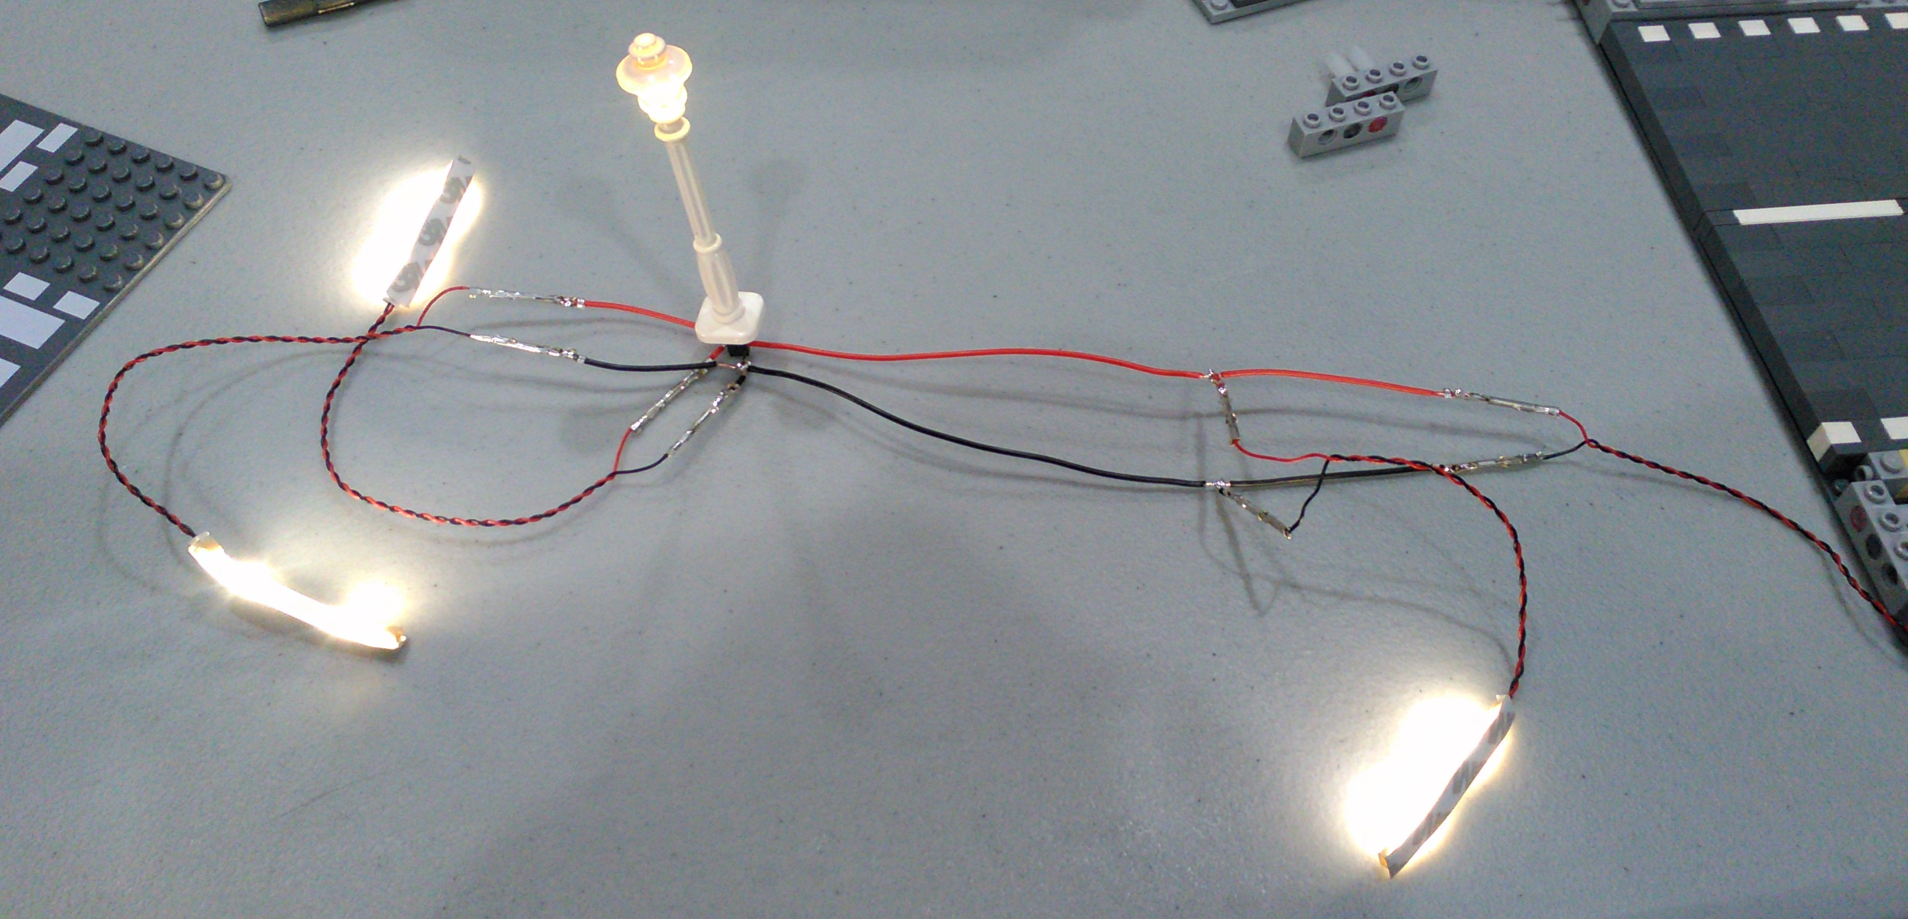
Testing Harness
Notes:
The harness passing a test after the soldering is complete.
This would be the time to coat the T connections and lamppost socket leads with connector coating.

Slide 28
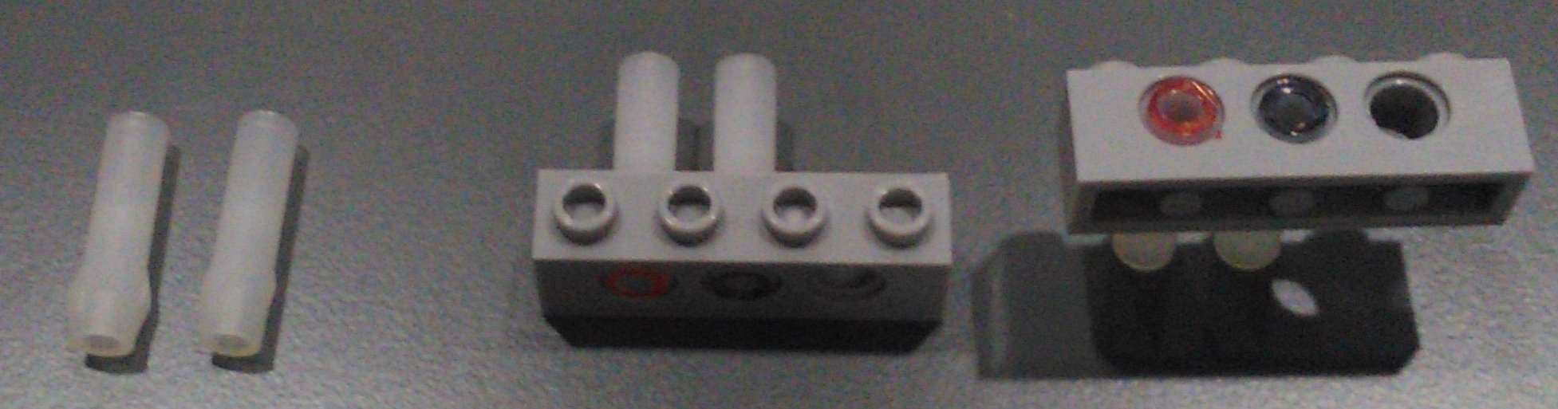
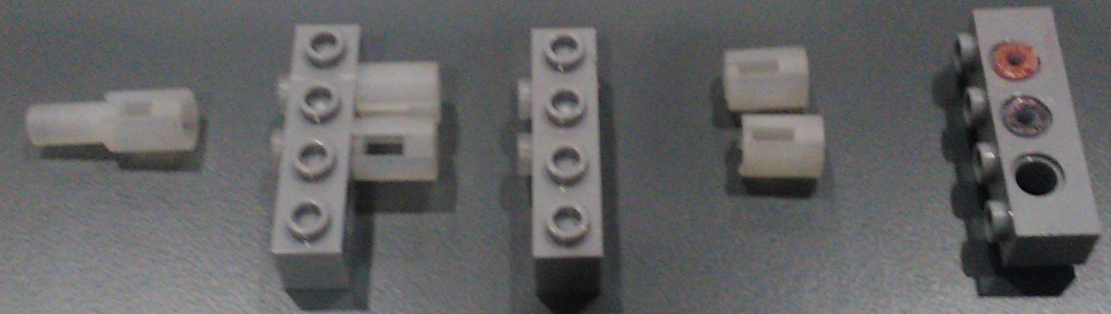
Creating sockets

Slide 29
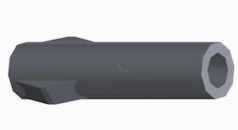
Female Sockets
Trim the tabs off
Install receptacle
Color code receptacle
Notes:
Use the sharp utility knife to trim the tabs off the 6 female nylon receptacles. When installing the receptacle into the Technic hole, place the sections that had the tabs longitudinally (parallel to the top and bottom of the brick). This position will cause less stress on the brick itself, otherwise you may wind up with some stress lines on the top of the brick.
My standard is to have the black (common) wire in the center of the 1 x 4 or 1 x 16 Technic brick. For the female receptacles, I install the red wire to the left of the black.

Slide 30
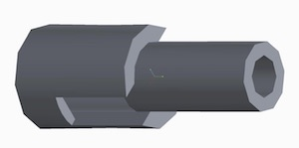
Male Sockets
Sand receptacle
Install receptacle
Trim receptacle
Color code
Notes:
I insert the male receptacle over the Phillips drill bit. The sandpaper stays still while the receptacle turns. I sand down the edge so that it will fit into the 5mm Technic hole. You need to sand down around .008 in of material (from .200 to .192). You may use the tack hammer or just pressure against the table to set it. Once it is all the way set in, cut off the end with the utility knife. I install the black receptacle in the center of the Technic brick and, this time, the red receptacle is installed on its right (i.e. the mirror image of the female receptacle).

Slide 31
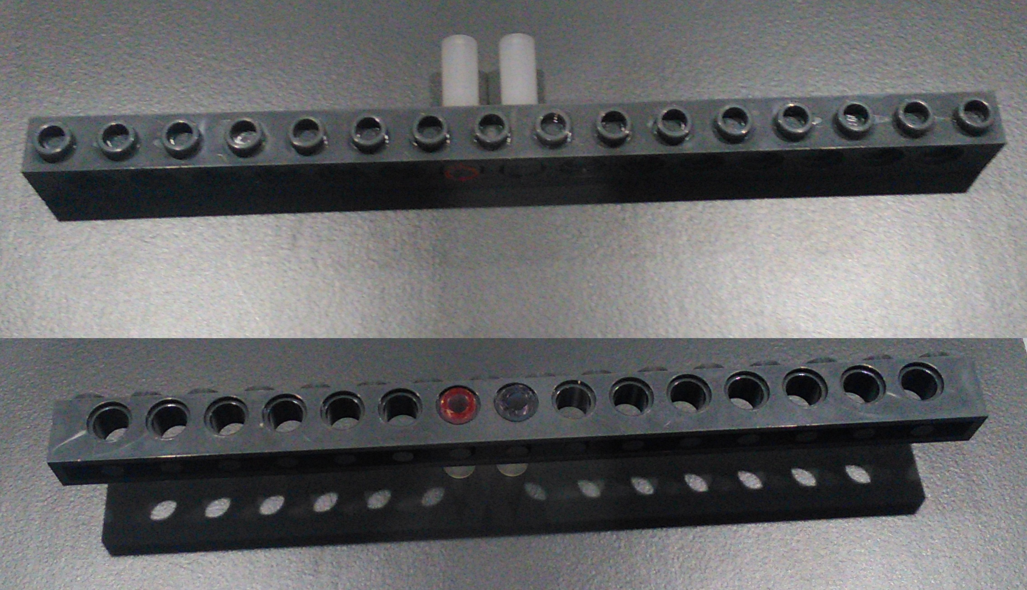
Creating sockets
Notes:
This is the same procedure as inserting the female receptacles into the 1x4 Technic brick.

Slide 32
Assemble Road
Push terminals into the sockets
Assemble bricks onto baseplate
Add sidewalks, trees, and lamppost.
Test again
Notes:
When pushing the terminals into the receptacles, insert the terminal completely into the receptacle: you should not see any part of the terminal coming out of the back side of the receptacle. You should also push both the red and black terminals into the receptacles at mostly the same time. Use the bent needle nose pliers, holding the wire just behind where the terminal is crimped to the wire.
At this time you can also test connected to another road plate.

Slide 33
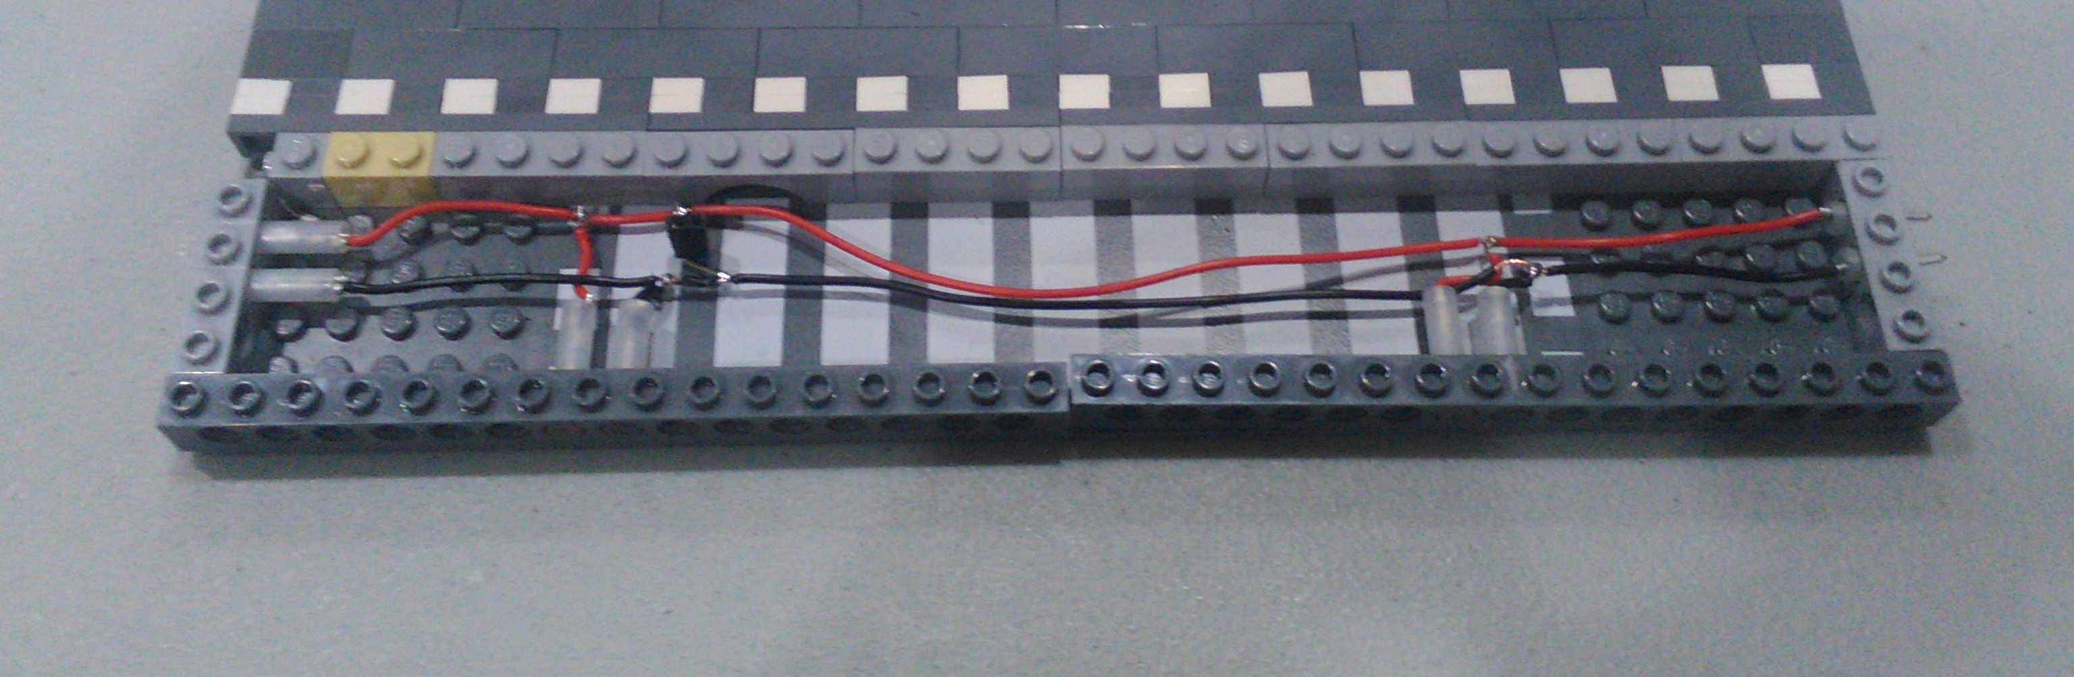
Complete

Slide 34
Errata
The terminal connector walking
Broken wires
Pins sliding in lamppost
Notes:
The terminals seem to work their way out of the receptacles. This is where the bent needle nose pliers work well. I just pop up the sidewalk and push the pin or socket back into the nylon. I have at least one loose connection at each show that needs to be pushed back in.
Sometimes I have broken wires because of the wires have been flexed too much. This is less common now that I moved to permanent male connectors in the bottom of the modulars.

Slide 35
Future Changes
Different lamppost socket
New road segments
Half roads (16 x 32)
Grade crossings
Curves
More internal connections
Traffic lights
Crossbucks
Flickering lampposts (Haunted Mansion)

