Slide 1
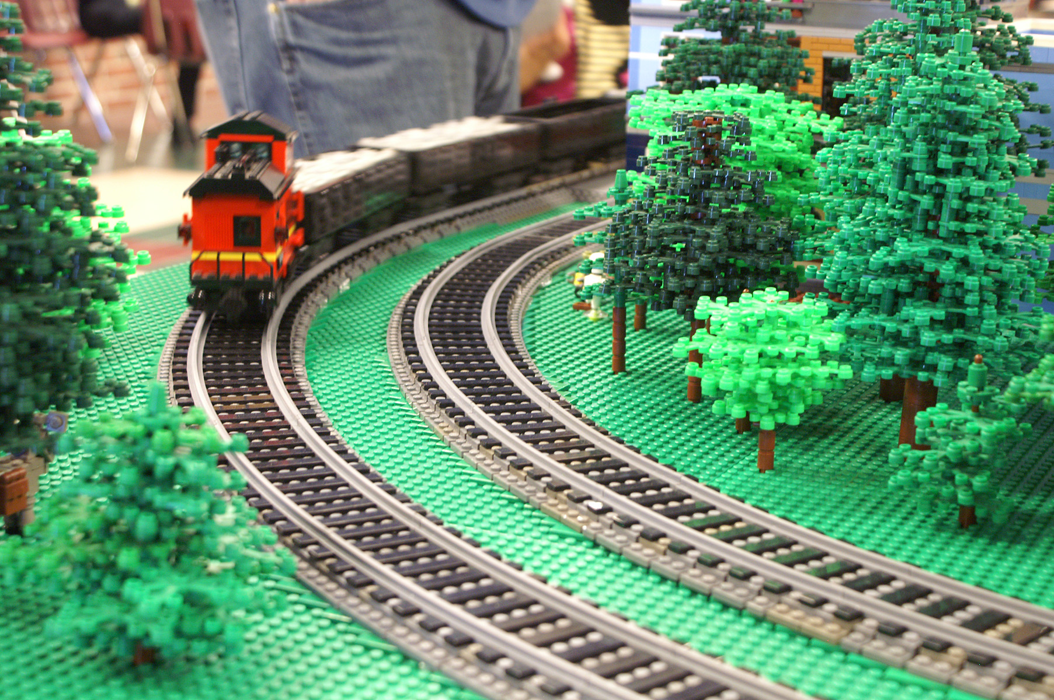
Modeling with
ME Models Track
Presented by
Tony Sava

Slide 2
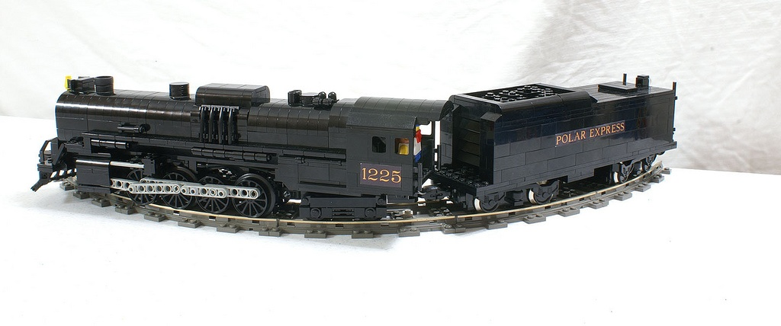
Current LEGO Track Options
Standard Curves
  Unrealistically tight radius
  Slower speeds to prevent derailment
  Difficult to articulate larger engines
    Large overhangs

Slide 3

Standard Track

Slide 4
Current LEGO Track Options
Smooth or “Grand” Curves
  ~23 pieces of straight track to make one curve
  Realistic Radius
  Possible to run full throttle with little risk
  Minimal articulation
  HUGE!
  Unarticulated steam engines “wiggle” in Grand Curves

Slide 5
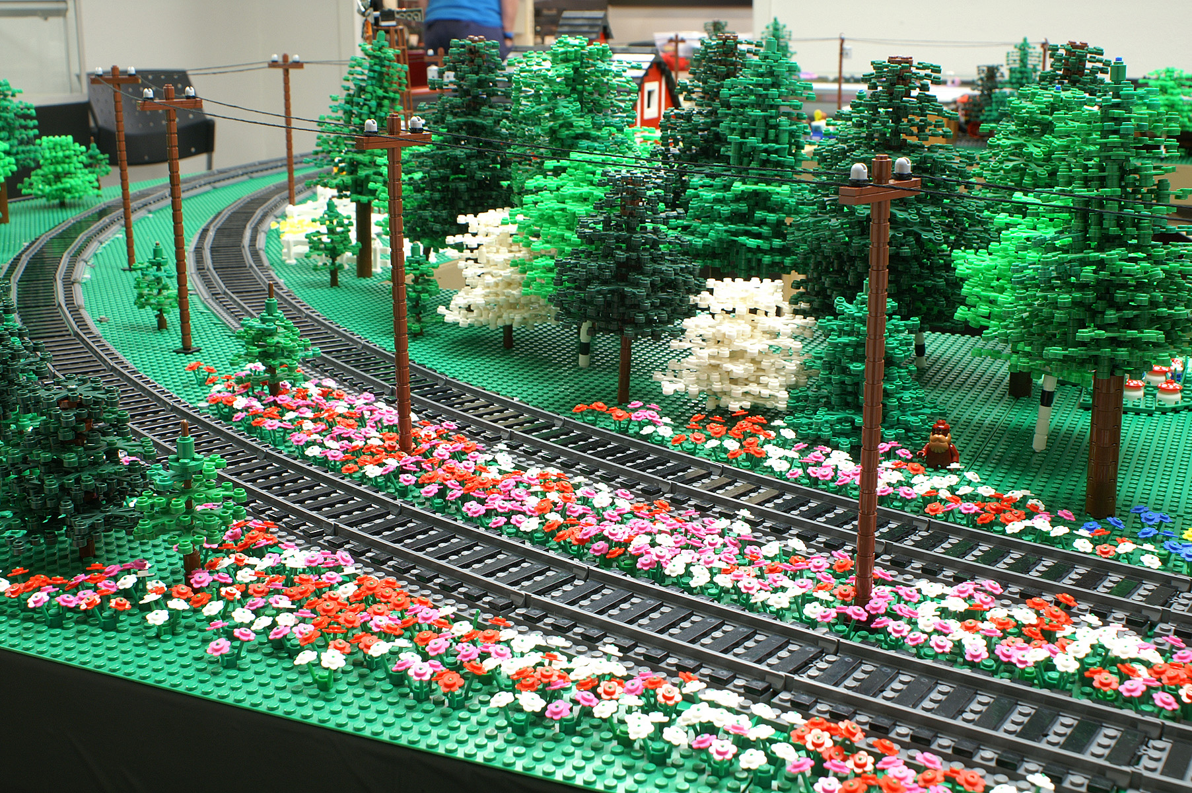
Grand Curves

Slide 6
Grand Curves

Slide 7
ME Models Track Overview
Plastic Track
  Straight Track
    ½ length
    Full Length
    Double Length
  Curved Track
    R56
    R72
    R88
    R104

Slide 8
ME Models Track Overview
Metal Track
  9v compatible
  Straight Track
    ½ length
    Full Length
    Double Length
  Curved Track
    R56

Slide 9
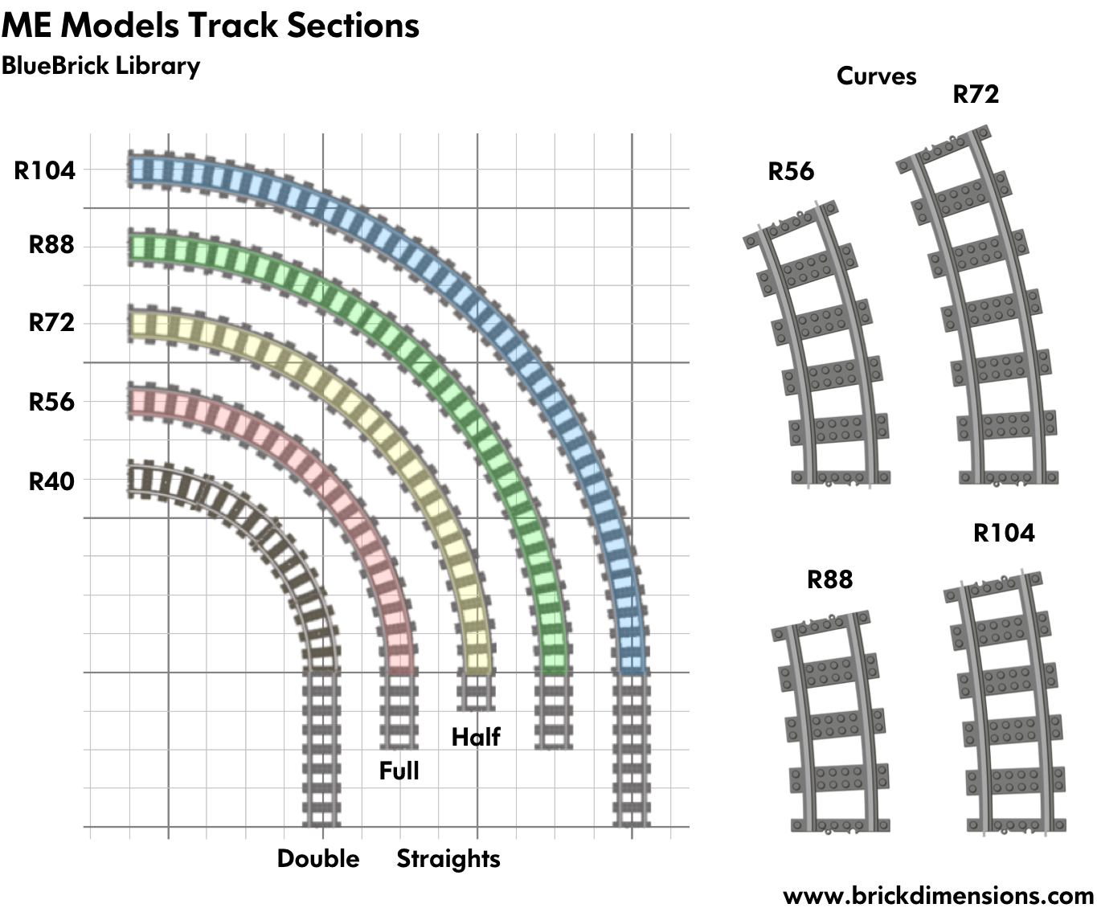
ME Models Track Overview
Credit : Michael Gale

Slide 10
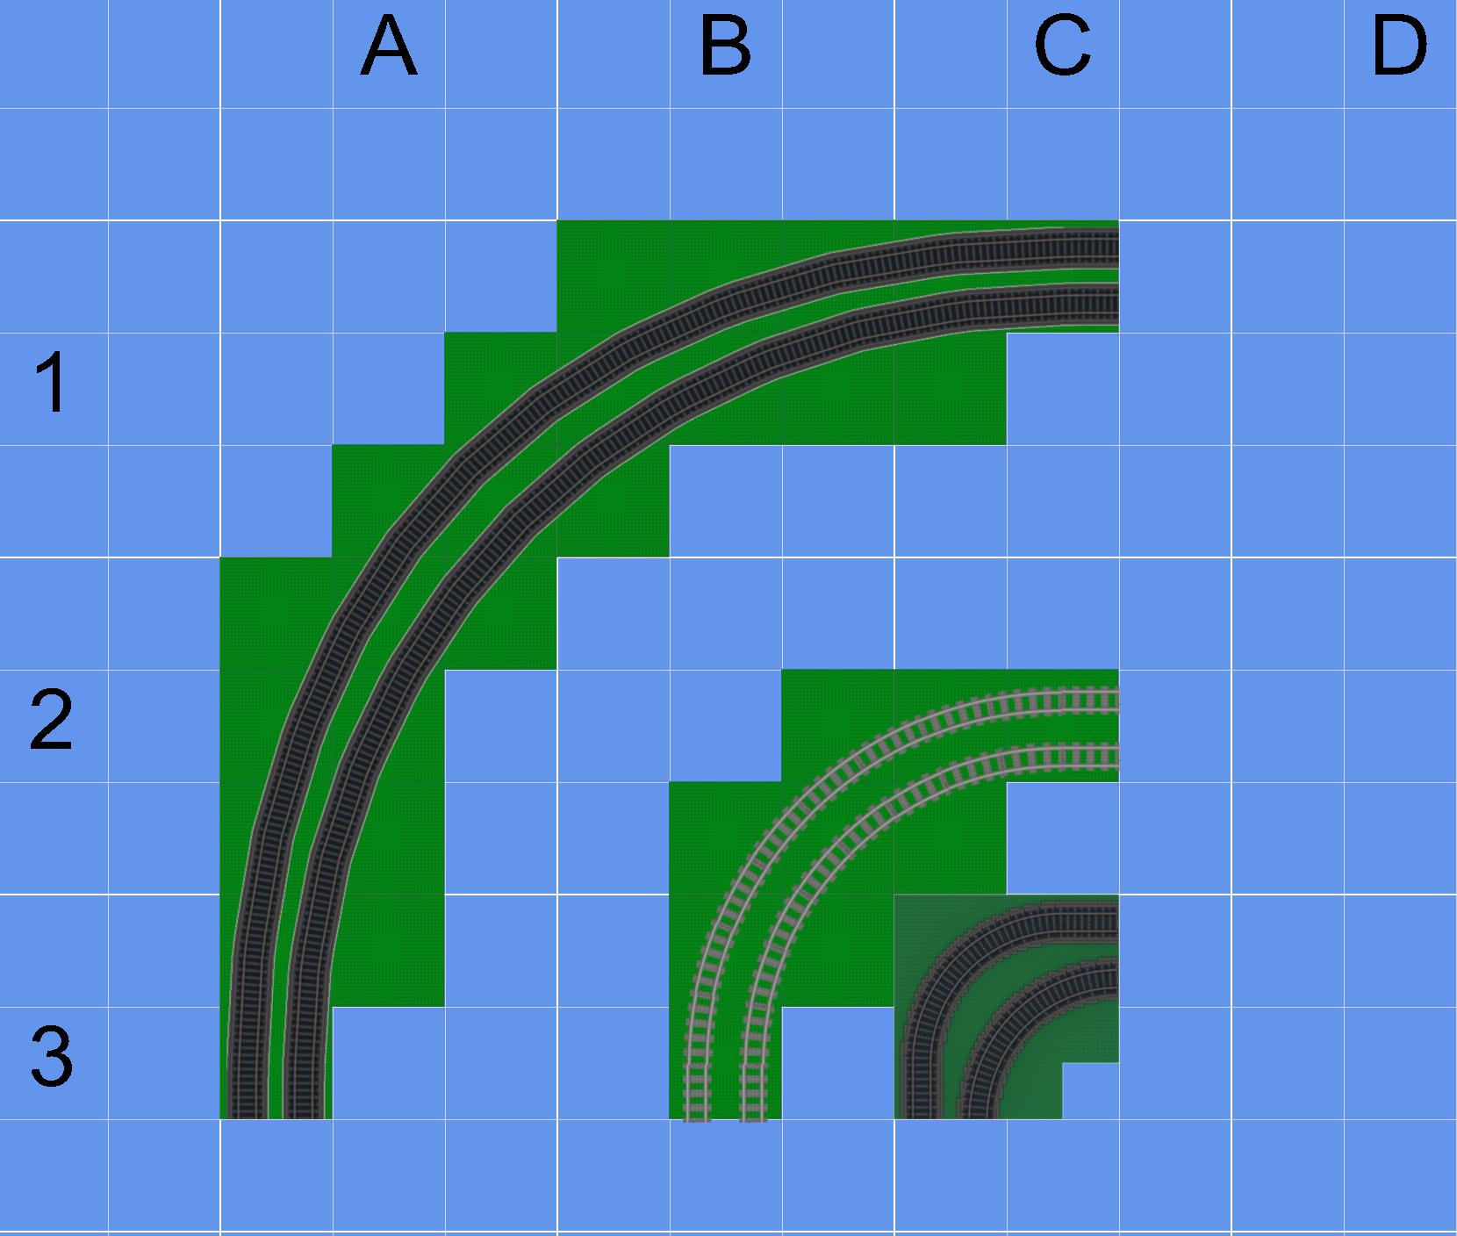
Using ME Models Track

Slide 11
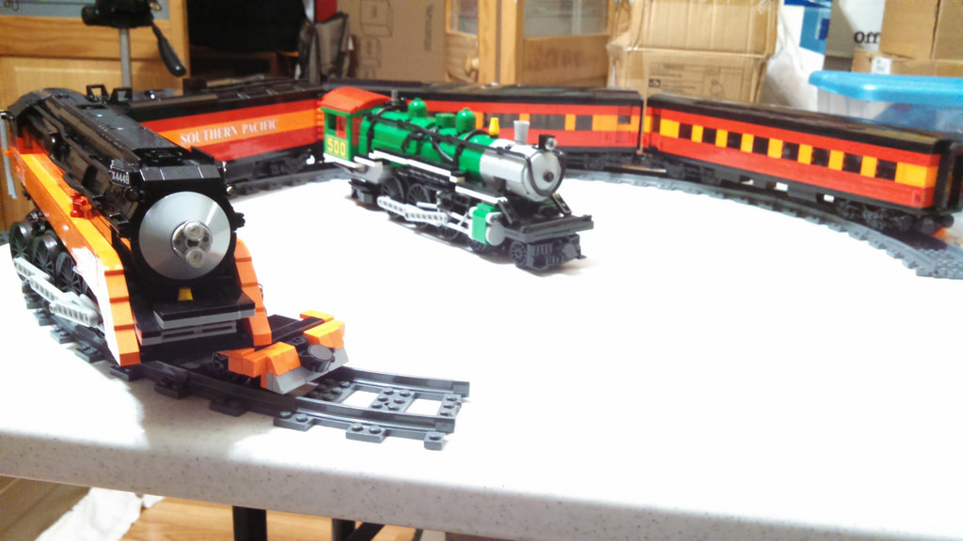
ME Models Track Overview

Slide 12
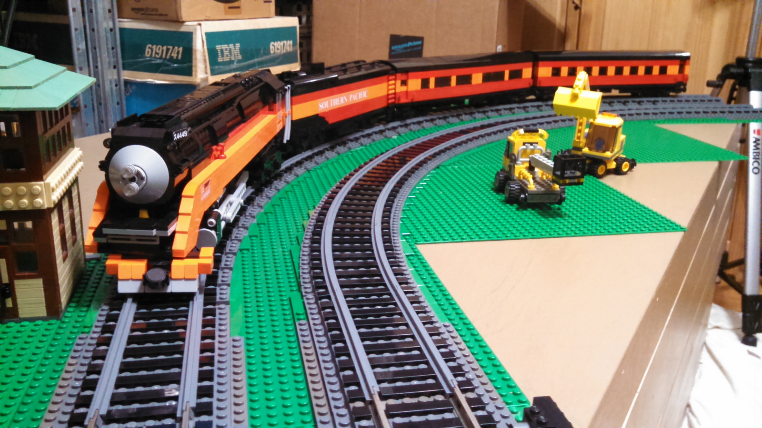
ME Models Track Overview

Slide 13
ME Models Track Overview
Colors
  Ties
    Dark Grey
    Brown
    Dark Brown
  Plastic Rails
    Dark Grey

Slide 14
ME Models Track Overview
Colors
  Ties
    Dark Grey
    Brown
    Dark Brown
  Plastic Rails
    Dark Grey
    SILVER!

Slide 15
ME Models Track Overview
Price (Plastic)
  Straights
    ½ Length - $11 – 8 sections
    Full Length - $20 – 10 sections
    Double length - $14 – 4 sections
  Curves (makes half circle)
    R56 - $19 – 8 Sections
    R72 - $22 – 8 Sections
    R88 - $29 – 16 Sections
    R104 - $34 – 16 Sections

Slide 16
ME Models Track Performance
Texas Brick Railroad has fielded ME Models curves at two shows running high speed 8-wide and ultra-weight 10-wide trains.
  No incidents involving ME Models Rails
  Track stayed in place
  Track did not “pop” free or disassemble
  Trains slowed in standard curves, accelerated in ME curves

Slide 17
ME Models Track Performance

Slide 18
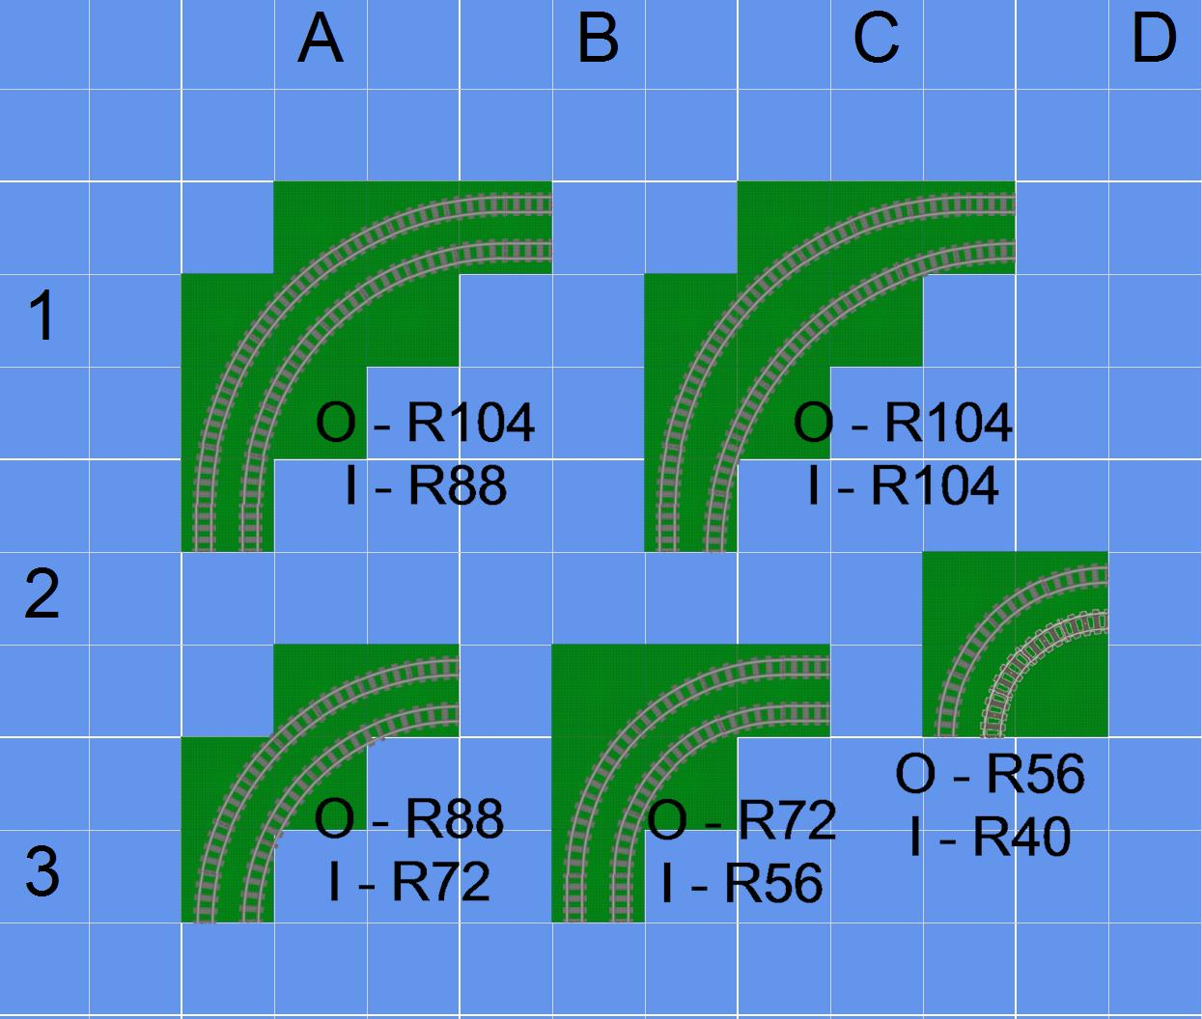
Using ME Models Track

Slide 19
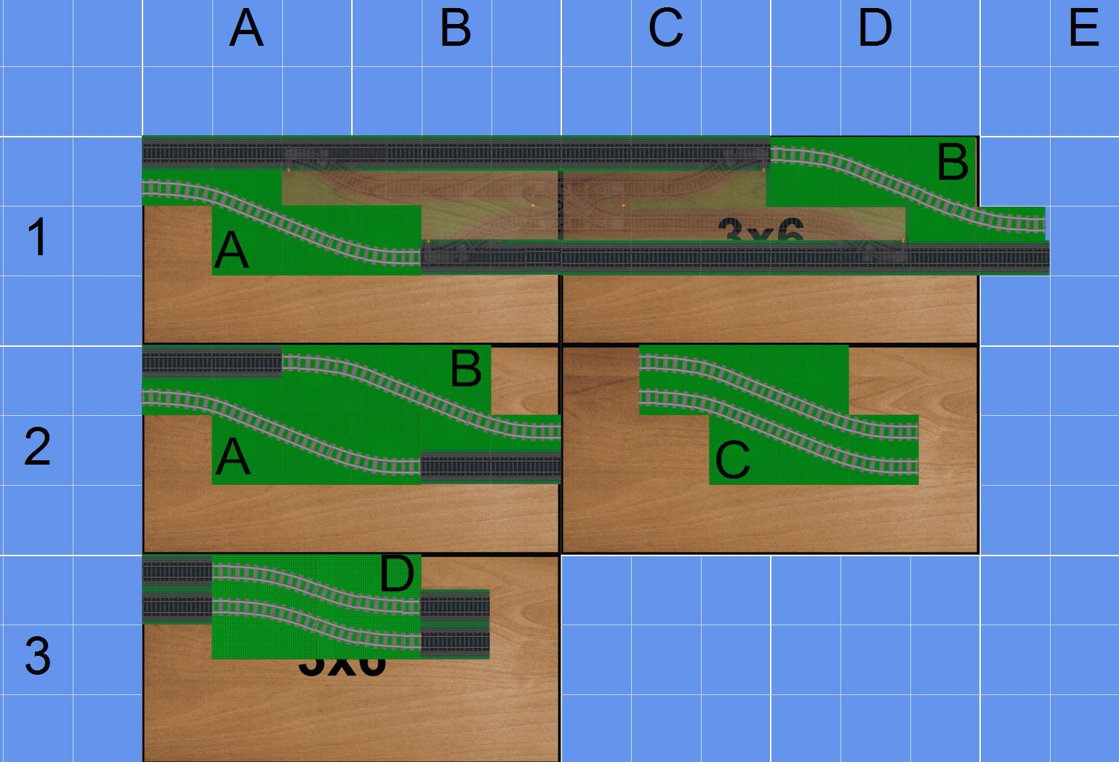
S Curves
2 R88 curves
3 straights
2 R88 curves
R104 S Curves
Doesn’t line up 100%

Slide 20
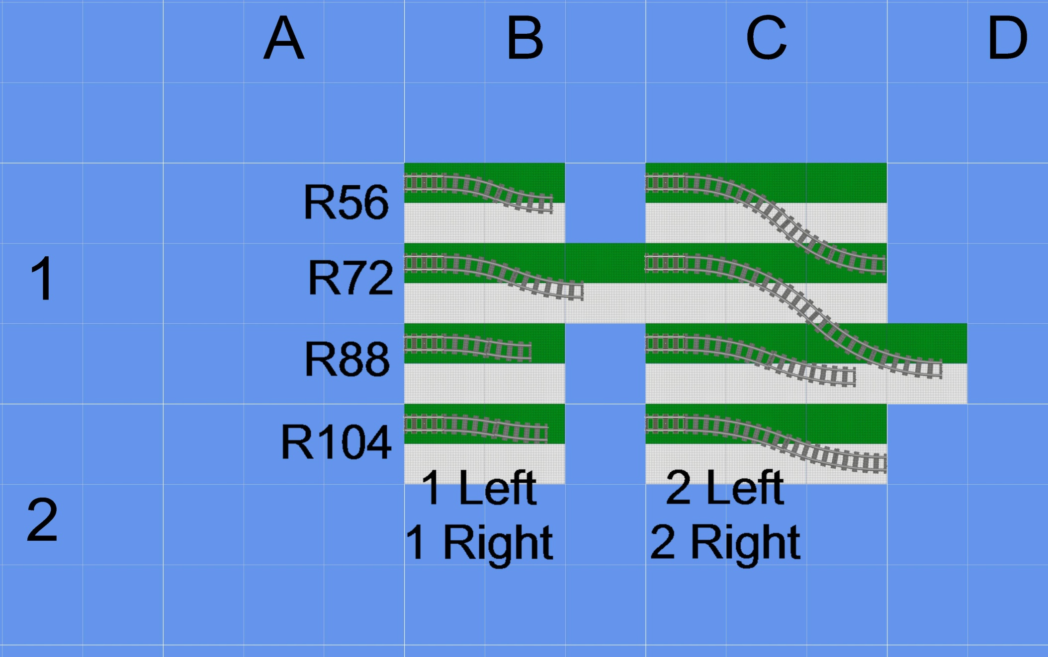
S Curves

Slide 21
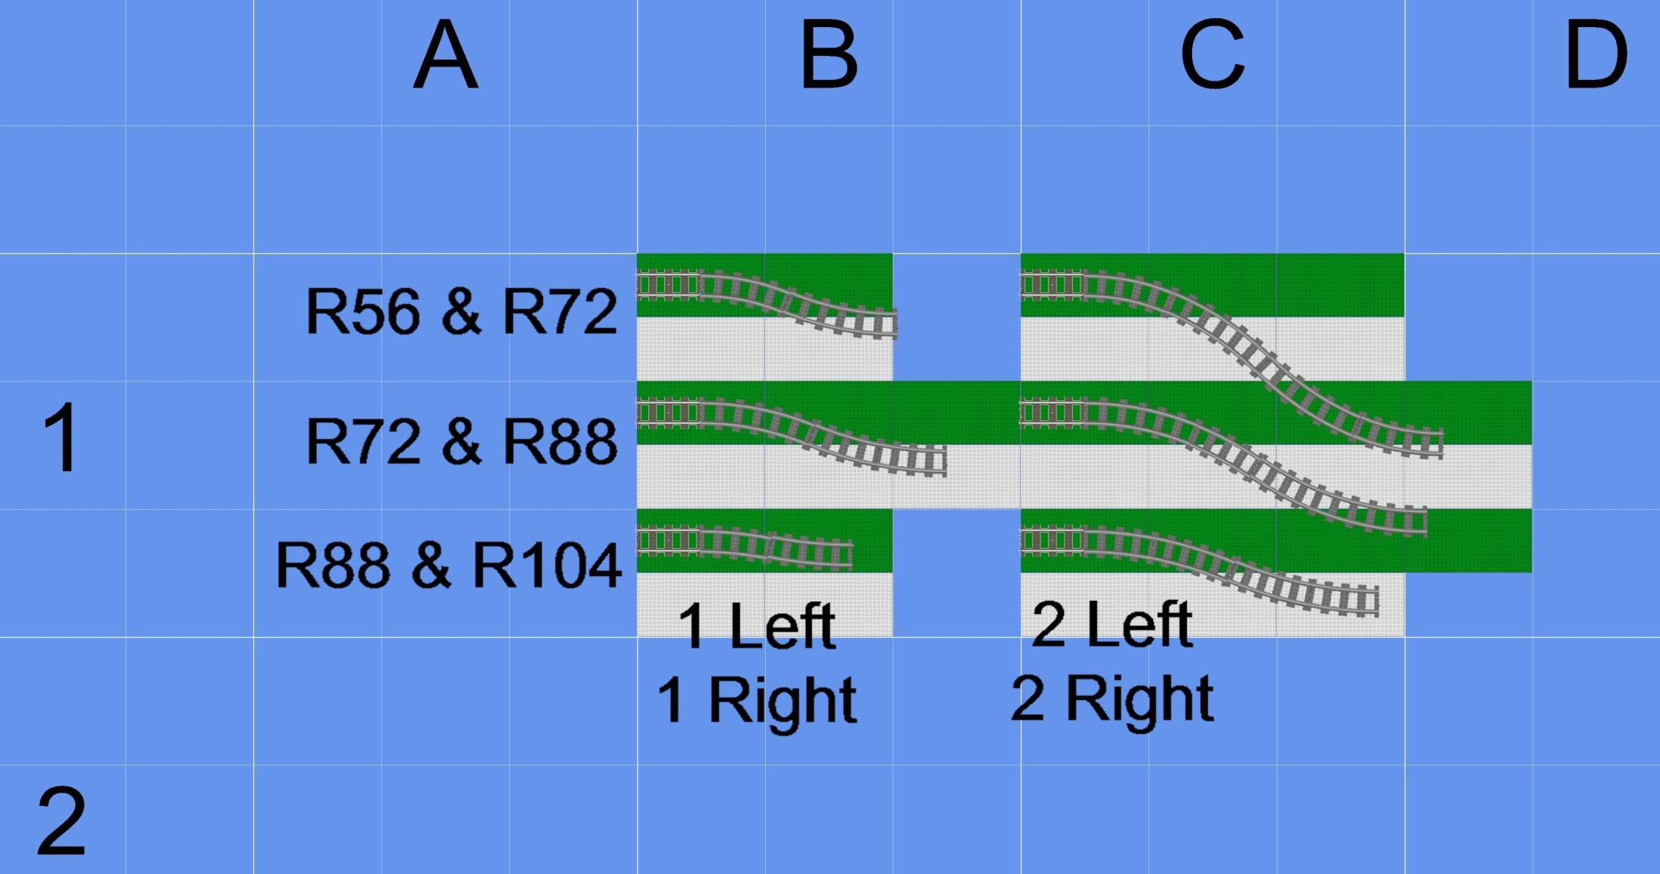
S Curves

Slide 22
Ballasting Track
Why ballast?
  Looks awesome.
  Prevents track from shifting
  Helps level track
There is no one right way to ballast track
  TBRR uses the PennLUG style, which was based on another LUG’s design, which was based on another LUG’s design, which was based on…

Slide 23
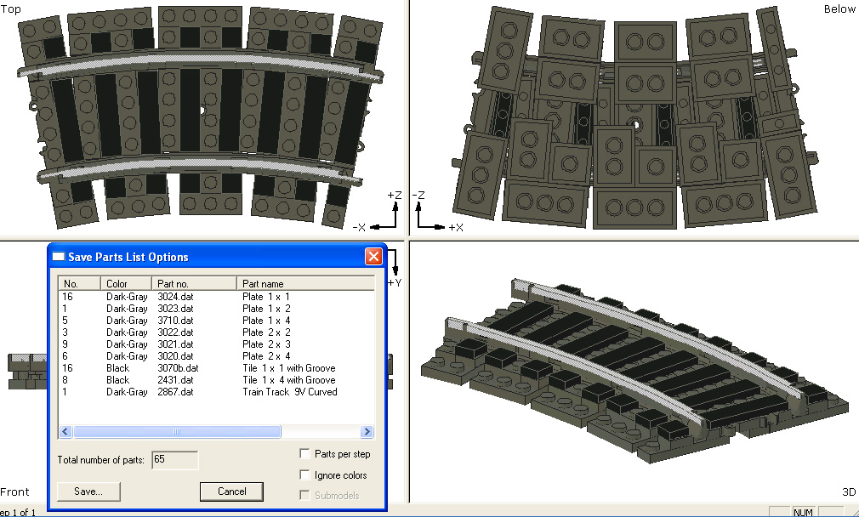
Ballasting ME Models Curves
Ballasting straight track is the same as LEGO
Ballasting any curved track is difficult

Slide 24
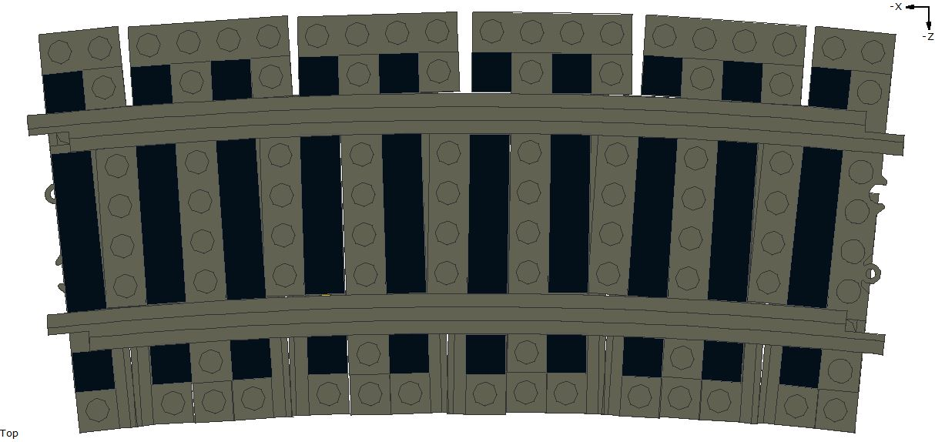
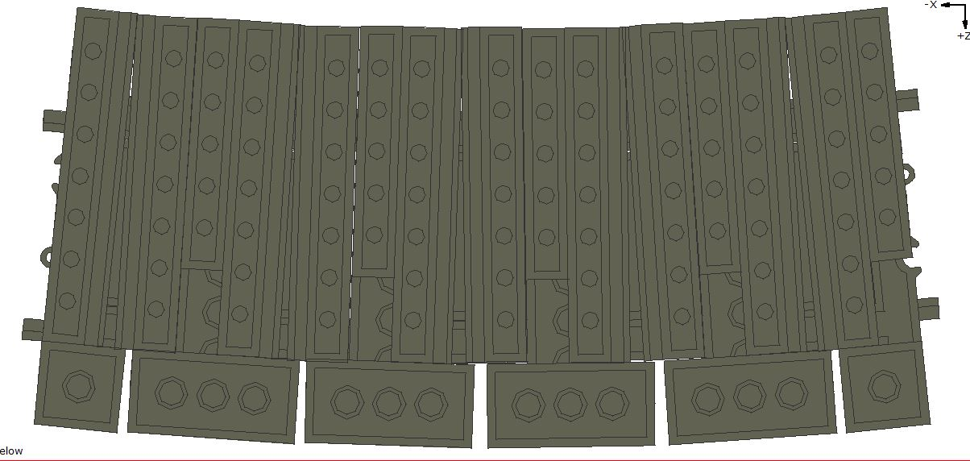
R104

Slide 25
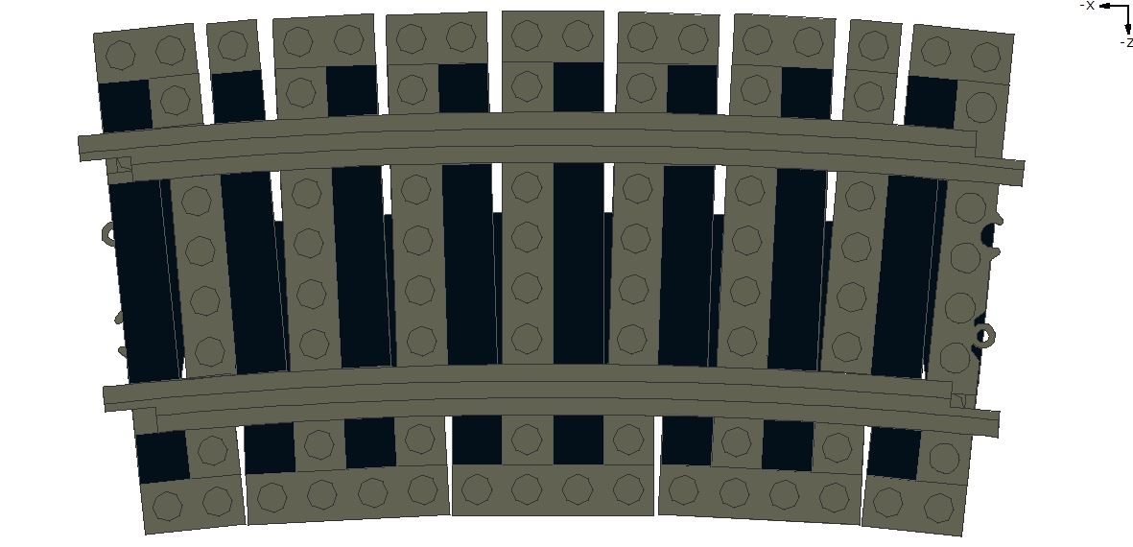
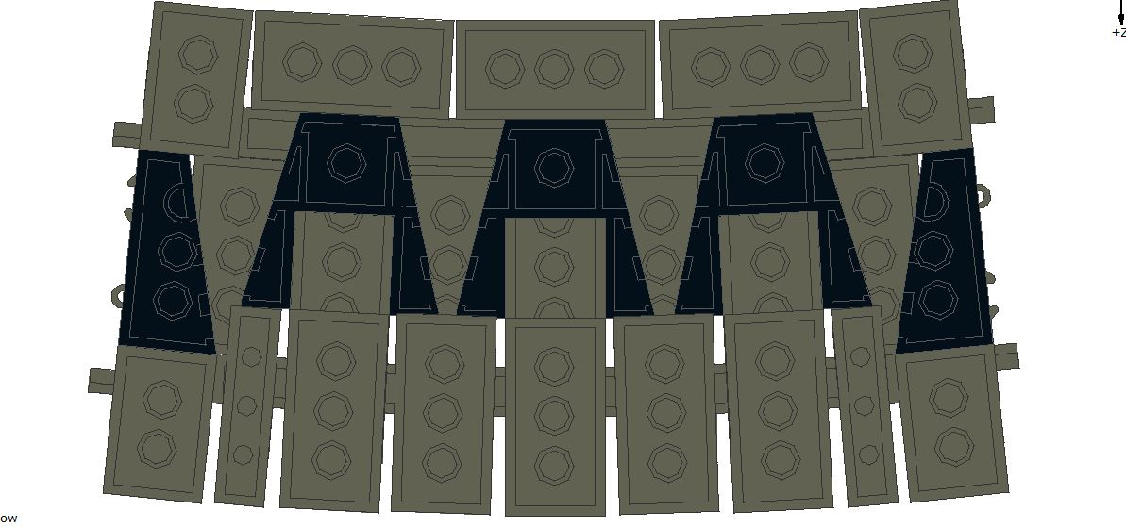
R88

Slide 26
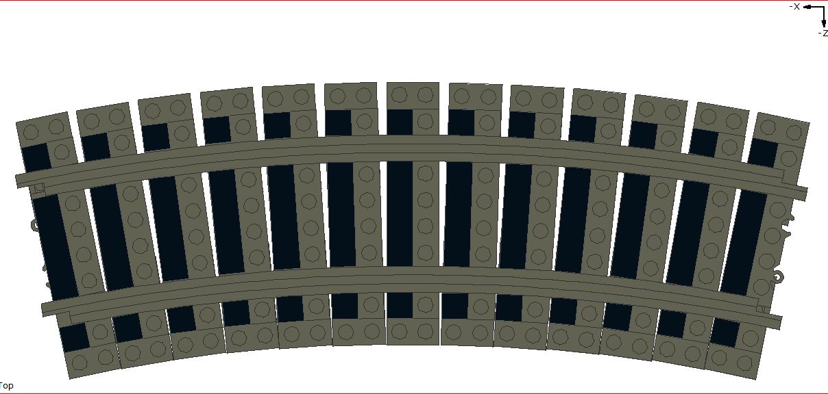
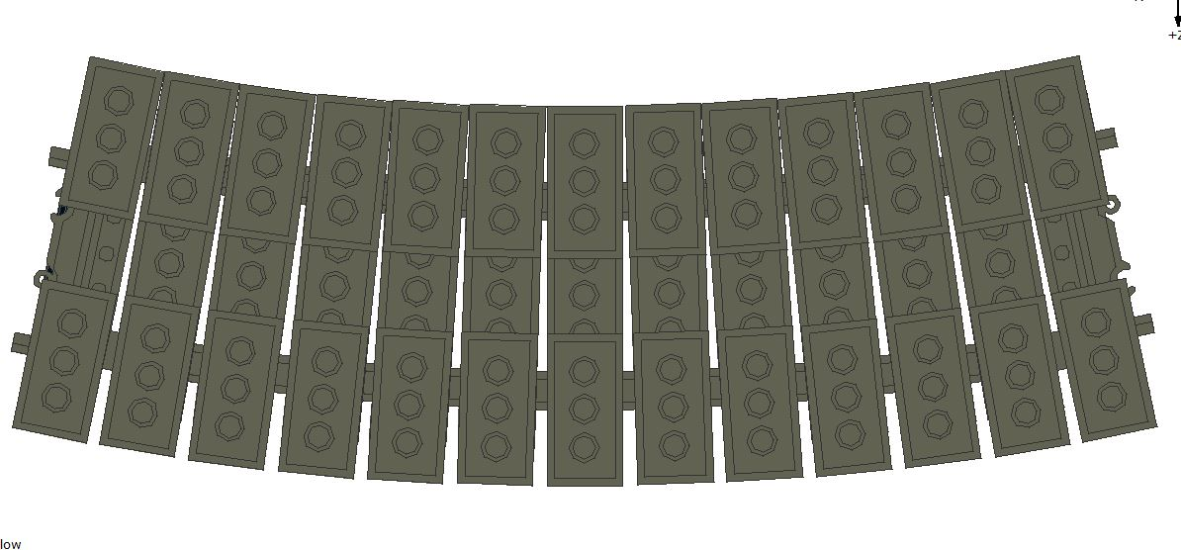
R72

Slide 27
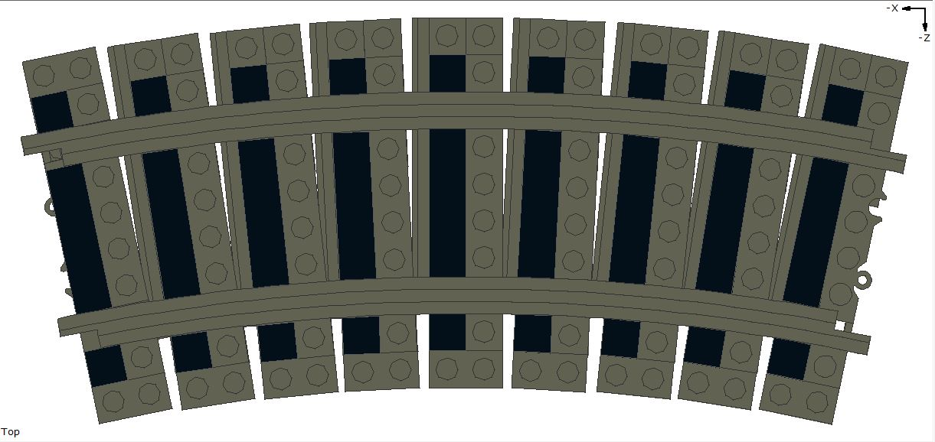
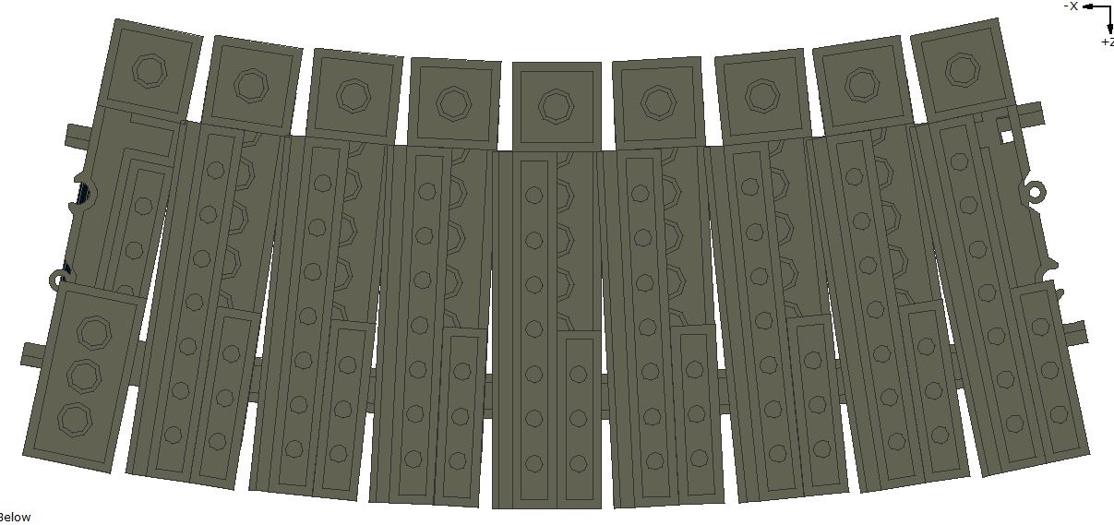
R56

Slide 28
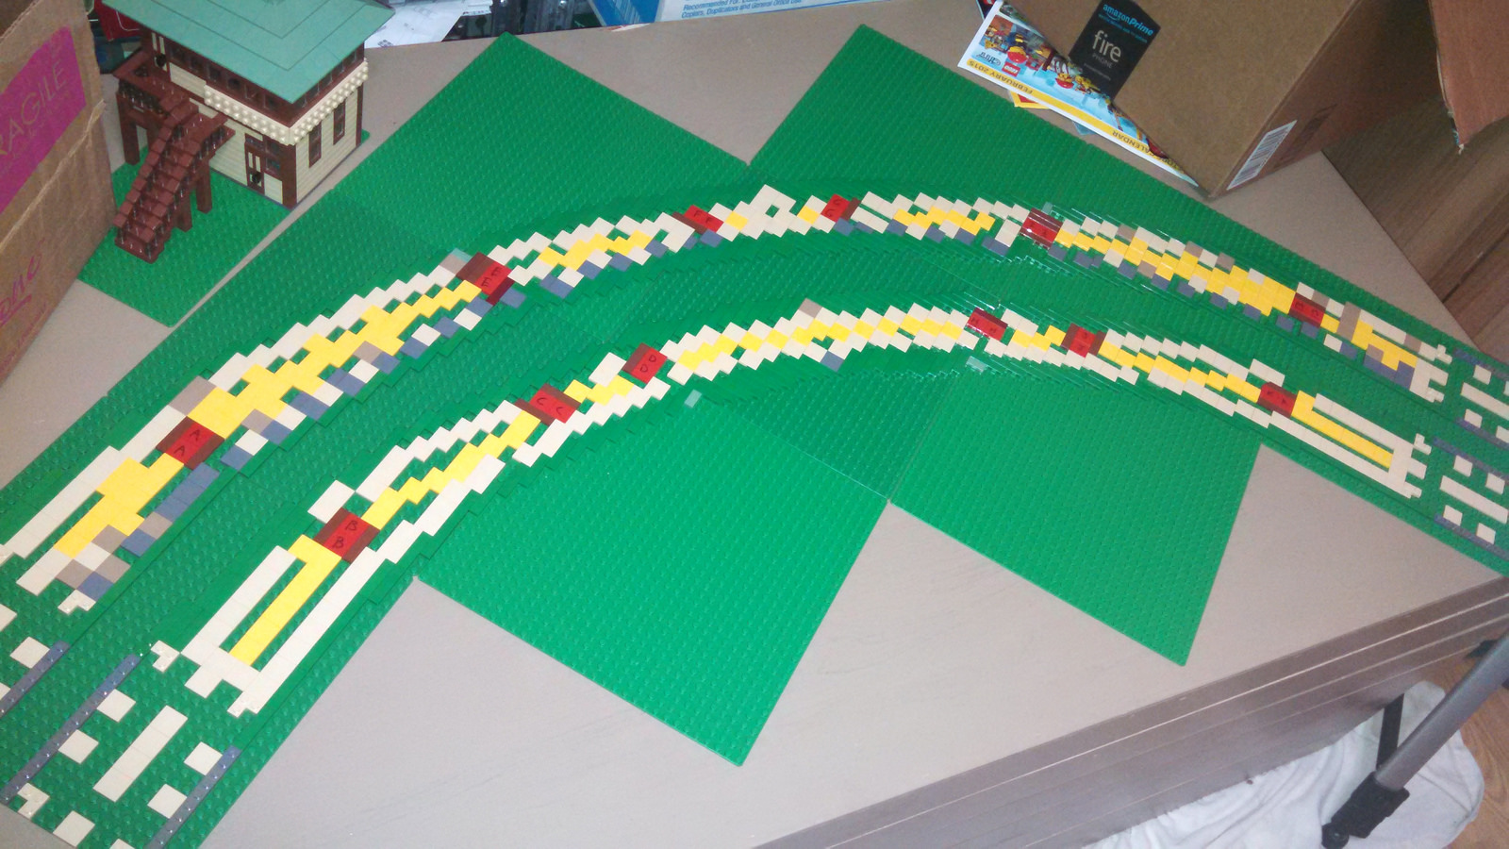
A proper foundation

Slide 29
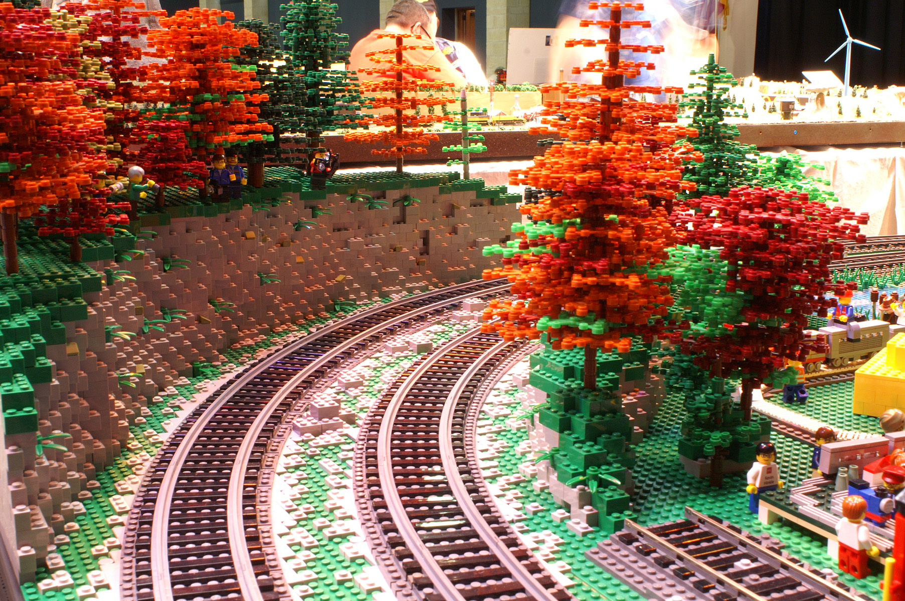
Finally Installed

Slide 30
Modeling with ME Models Rails
Questions?
  Asking a question gets another ticket!
  More tickets, better chance of winning!
Door Prize drawing!
  (one prize per person, please)

