Slide 1
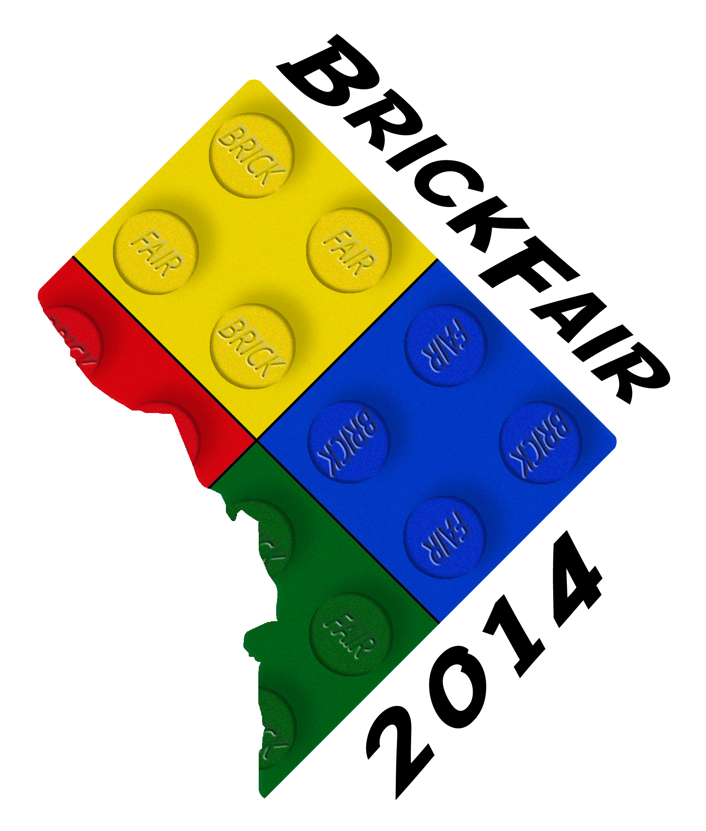
Techniques Demystified
By John Matz & Nick Vás

Slide 2
Overview
Introductions
What is a LEGO Technique?
Types of Techniques
LEGO Connectors
What makes a Good Technique?
Entrapment
Part Spamming
Multi-Part Connections
More Examples
Questions
Notes:
Quick overview of what this talk will cover
Questions at the end if we have time
Feel free to ask questions during talk as well

Slide 3
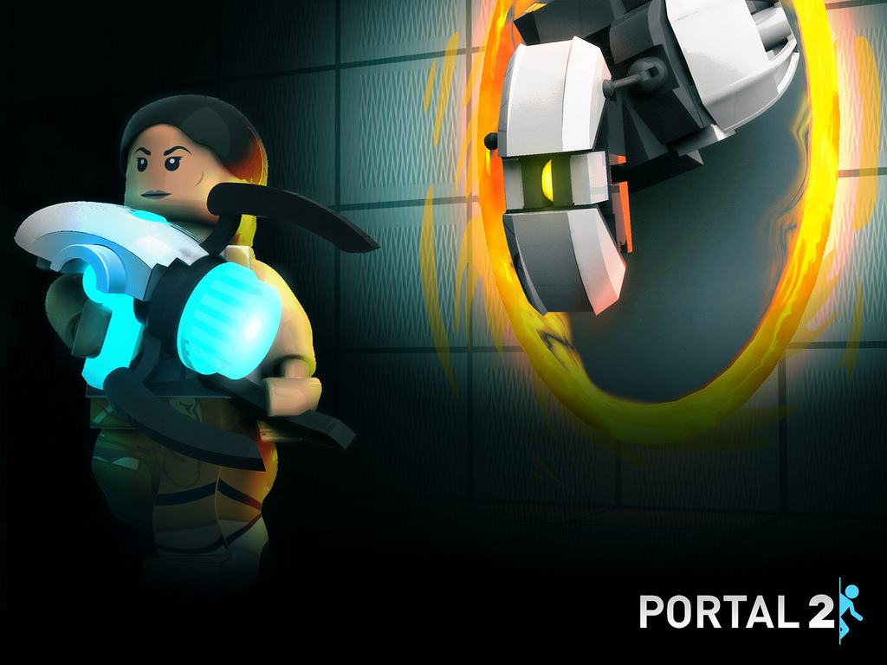
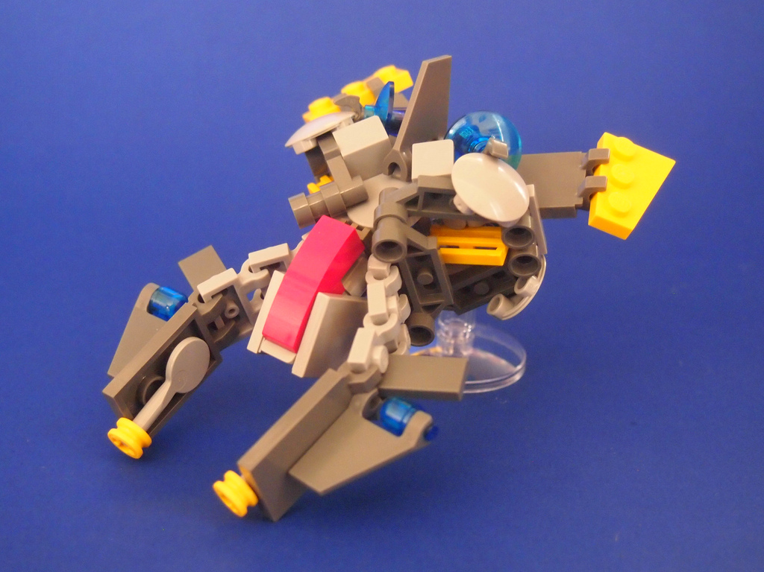
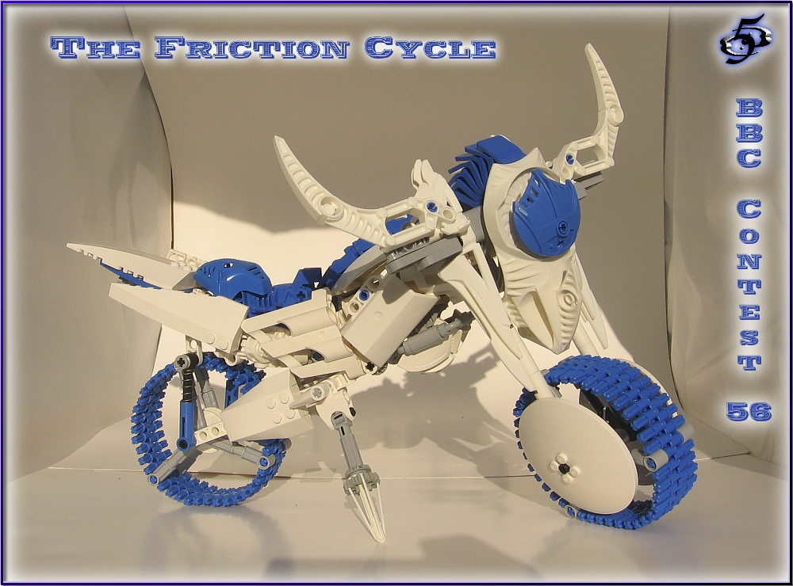
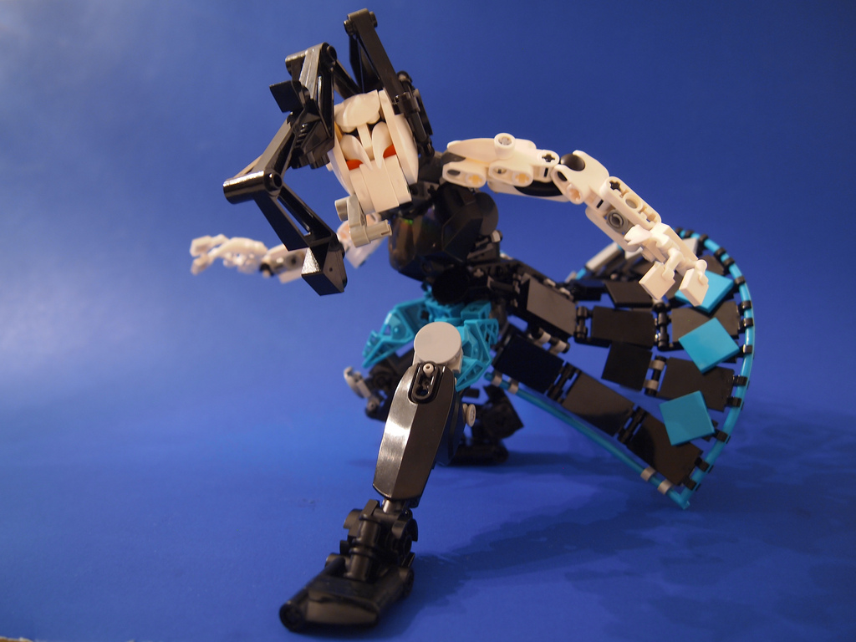
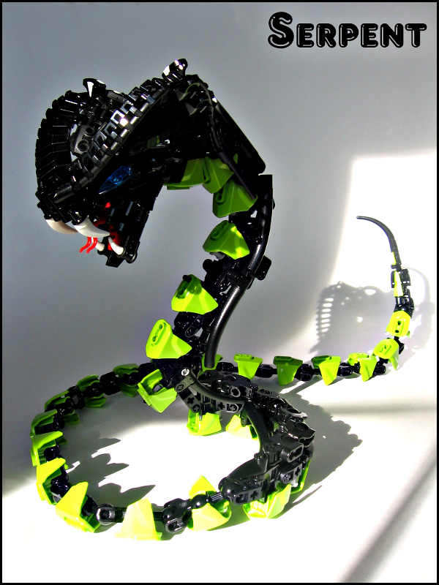
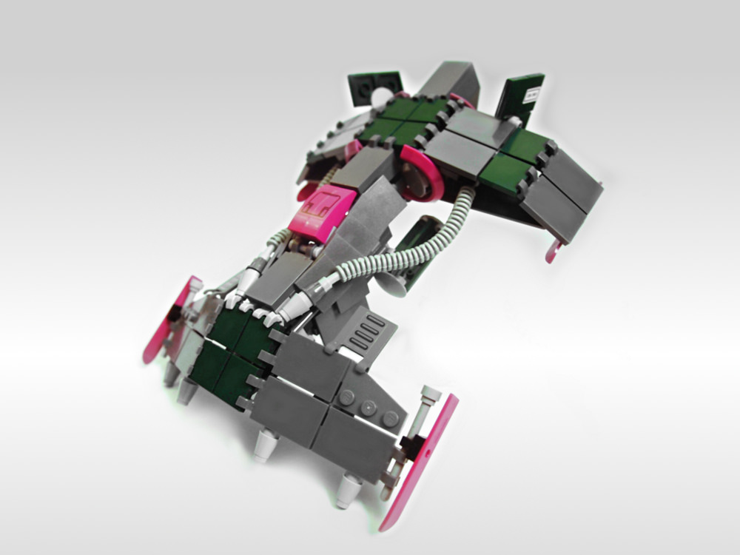
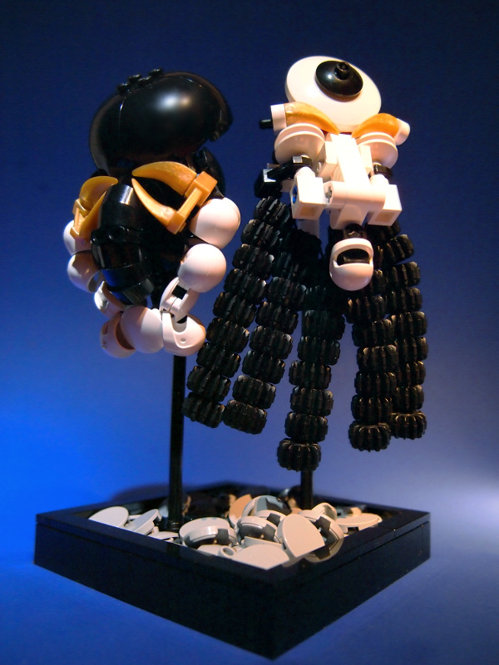
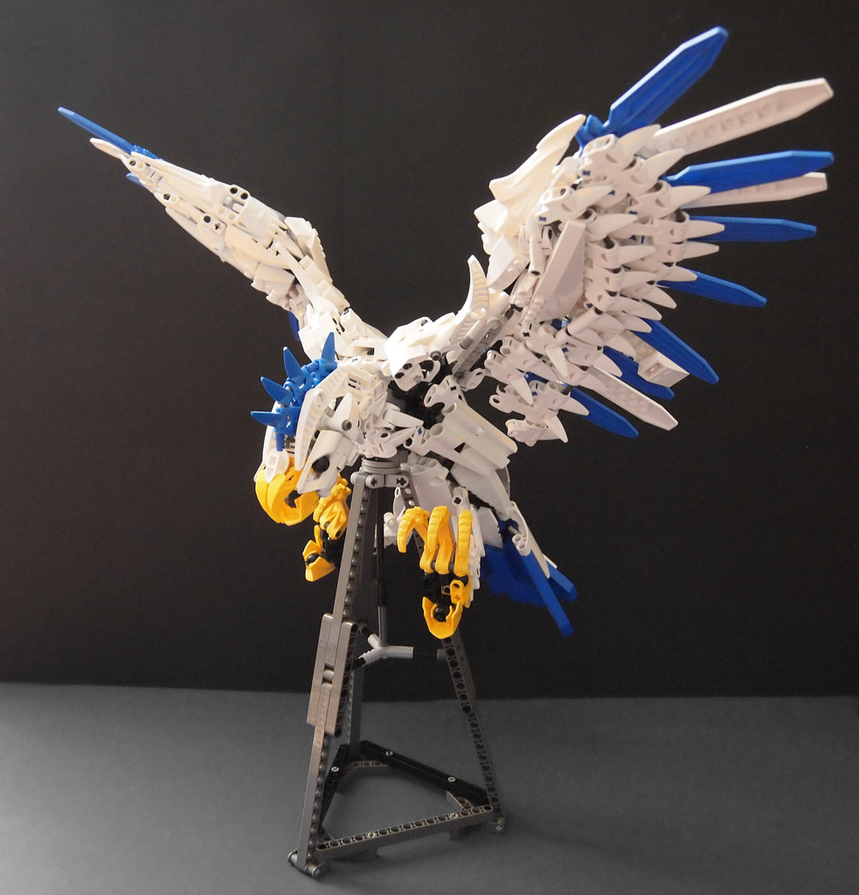
John Matz (aka 55555)
Notes:
Background
What themes do you build in?
Founding member of Team Jigsaw, competed in Mocathalons, made Thinking with Portals and Adventures of Steamrod projects.

Slide 4
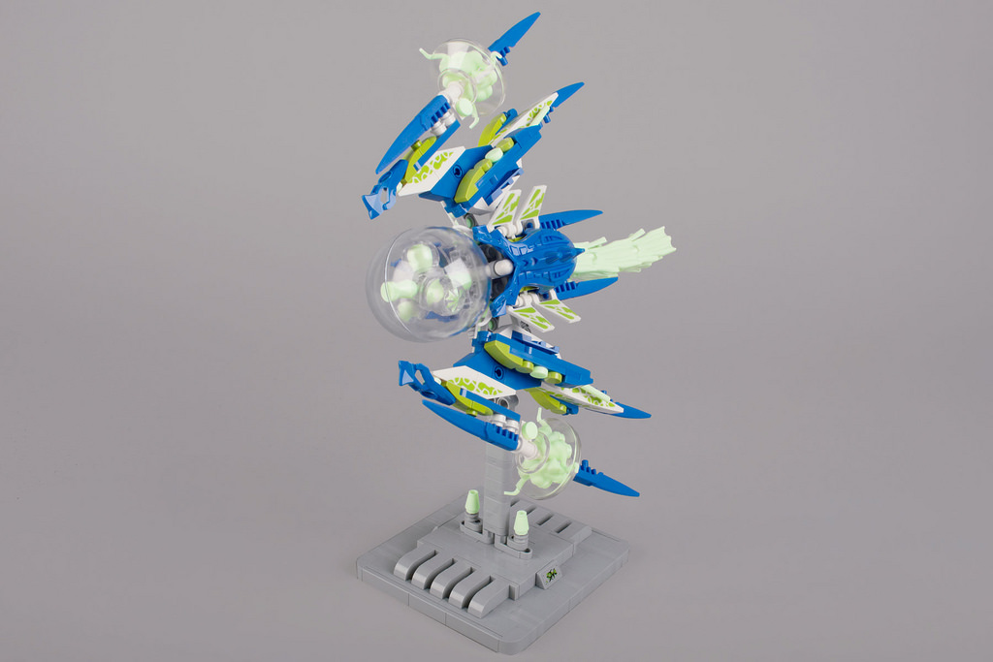
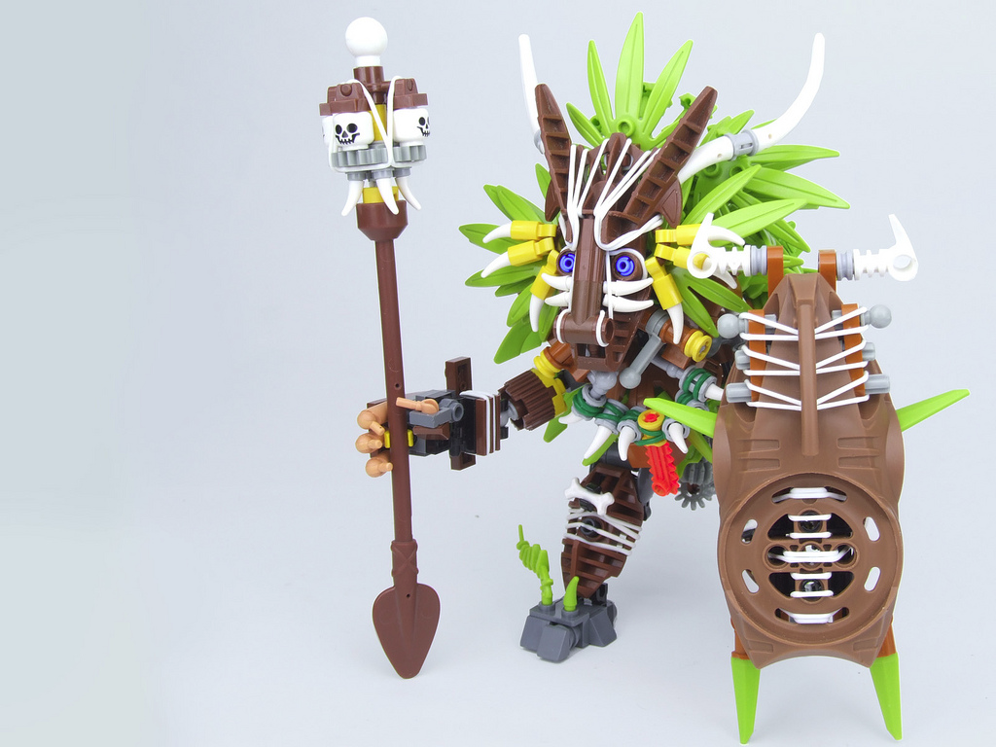
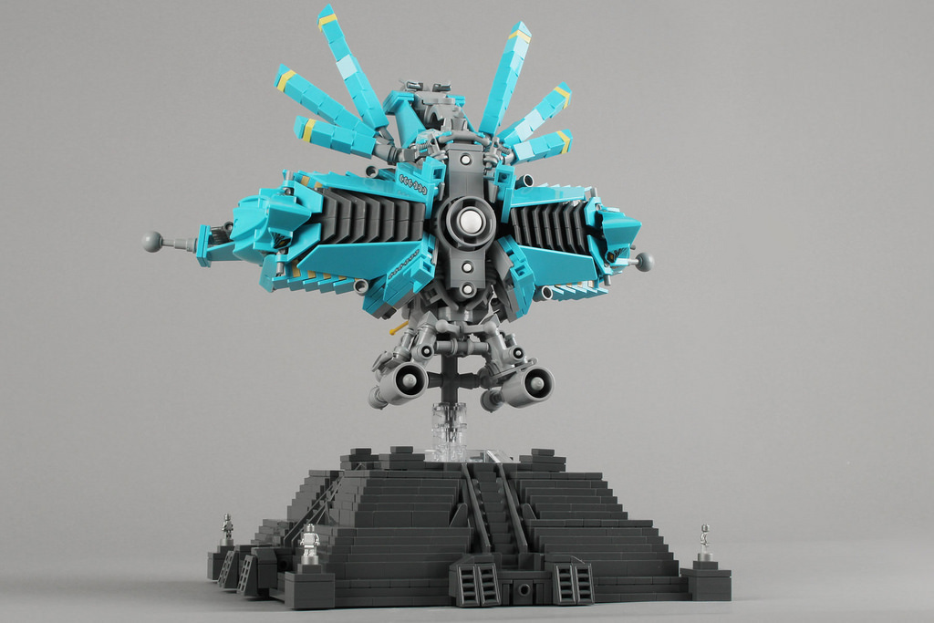
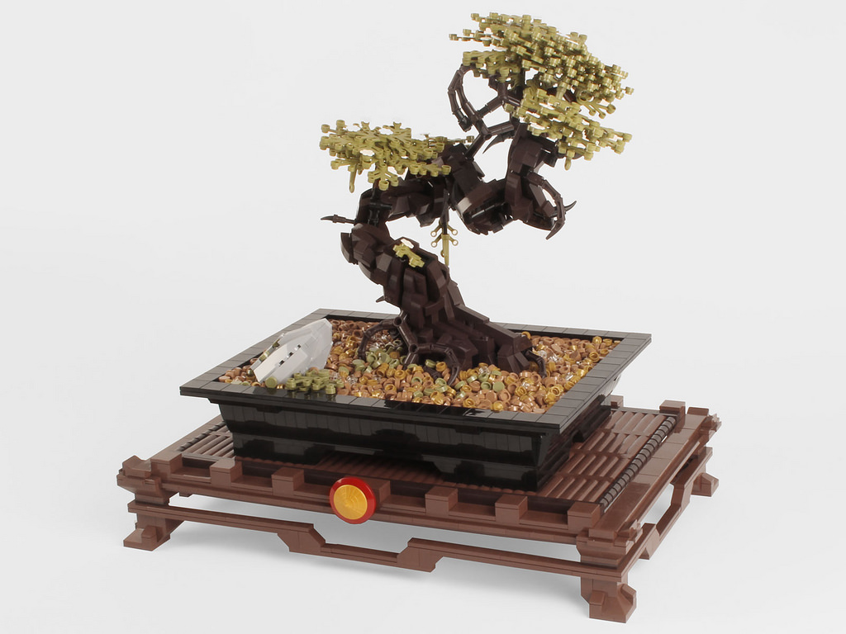
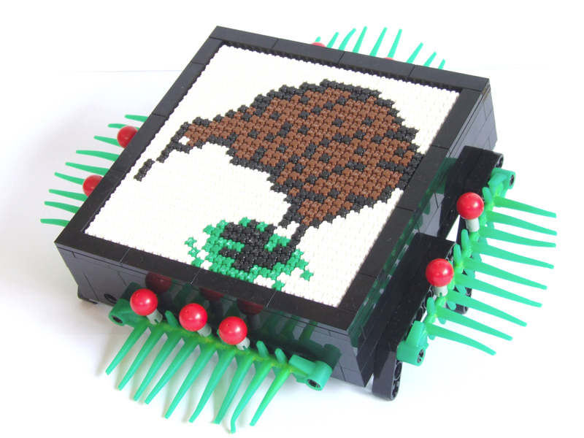
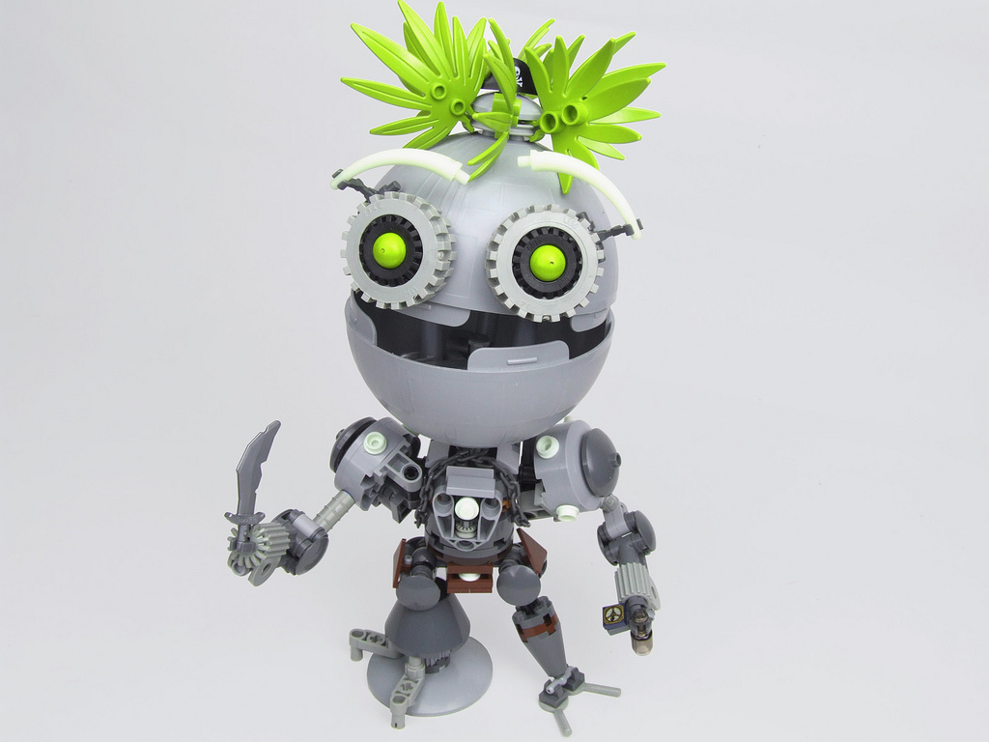
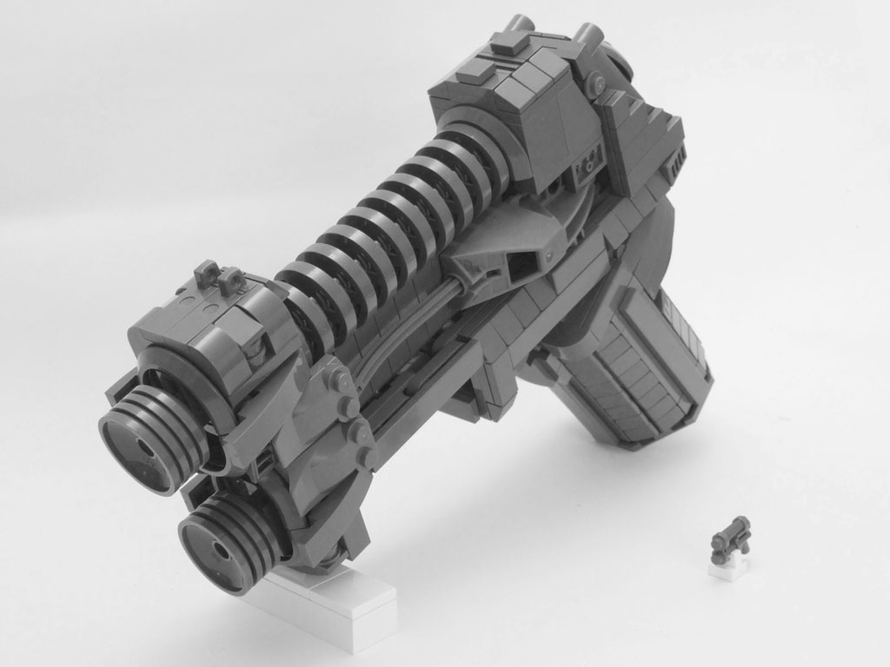
Nick Vás (aka Brickthing)
Notes:
Background
Started building with Bionicle in 2007.
Joined Team Jigsaw and building System in 2012
Builds various themes mostly life-size, space and characters.
Competed and lost in Iron Builder – seed part contest for creatively using parts

Slide 5
What is a LEGO Technique?
tech·nique (noun)
“A way of carrying out a particular task, especially the execution
or performance of an artistic work or a scientific procedure.”
Source: Google.com
A LEGO technique is a method of connecting two or more LEGO pieces together.
Two types of techniques:
Pure
Applied
Notes:
For this presentation, we will split techniques into two types; pure and applied.
Pure techniques are simply connections. Applied techniques are less abstract; they are really just simple designs for something like a tree, an architectural detail or landscaping.

Slide 6
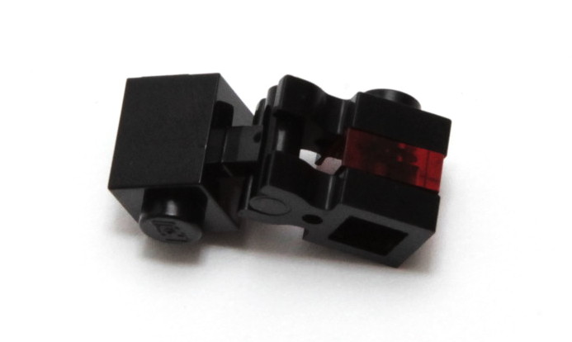
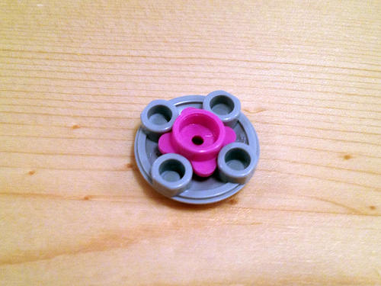
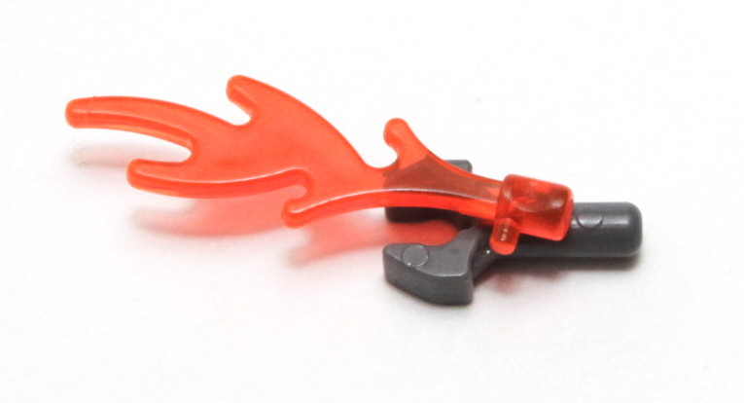
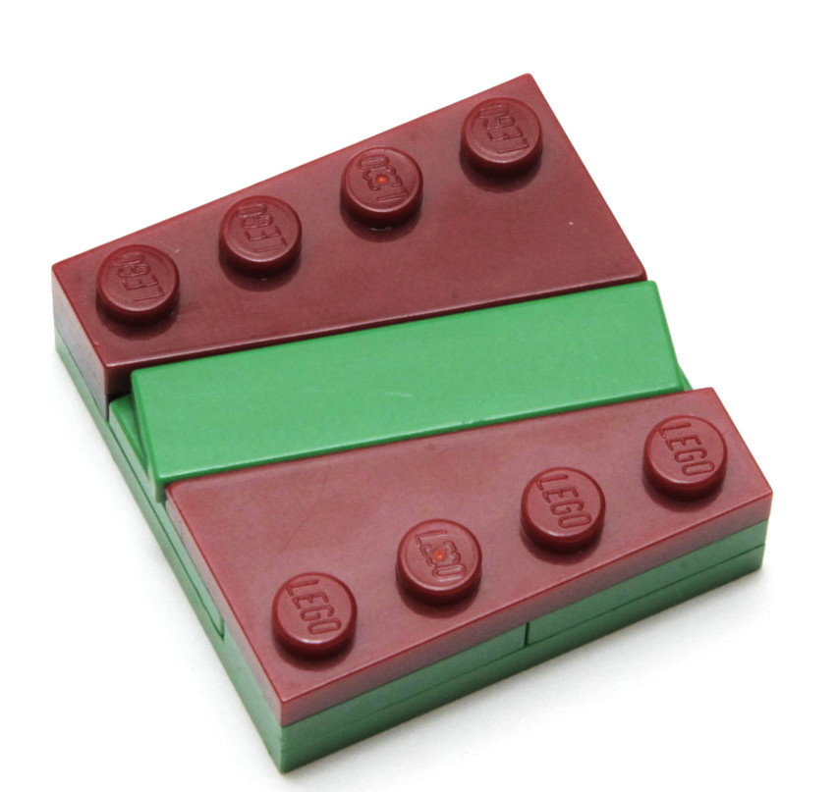
Pure Techniques
Pure techniques are ways of connecting LEGO pieces together. They are tools to achieve the
greater vision of your MOC. Often more focused on functionality rather than aesthetics.
(But it doesn't hurt for them to look good too!)
Photo courtesy of .Tromas
Notes:
Such as incorporating nice angles or changing the stud direction (SNOT).

Slide 7
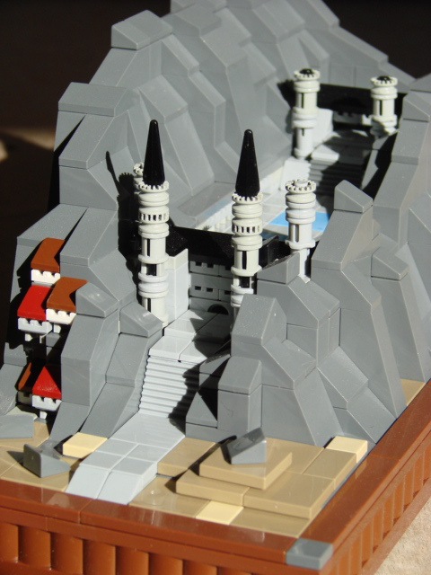
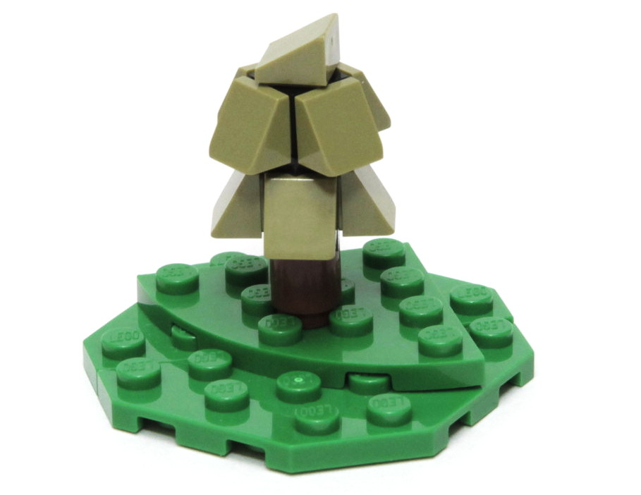
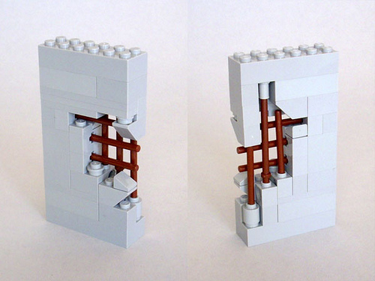
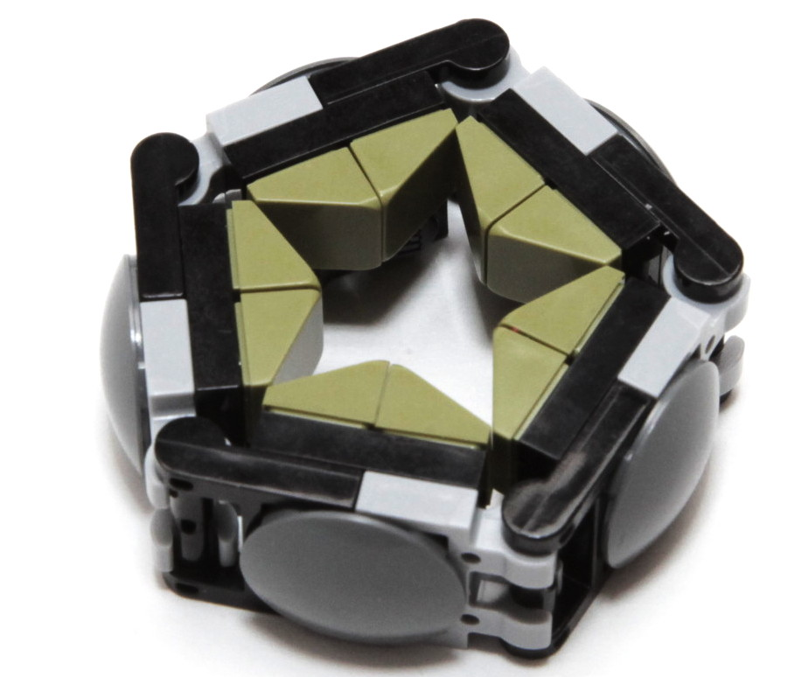
Applied Techniques
Applied techniques are used for specific purposes; they are often
clever designs for trees, architectural details or landscaping.
Useful for larger scenes and dioramas where the detail isn't
necessarily the focus of the MOC, but still needs to be there.
Can save effort and time to reuse and adapt existing techniques.
Concrete Wall by Marin Stipkovic
Mountain Hall by Avocado Butters

Slide 8
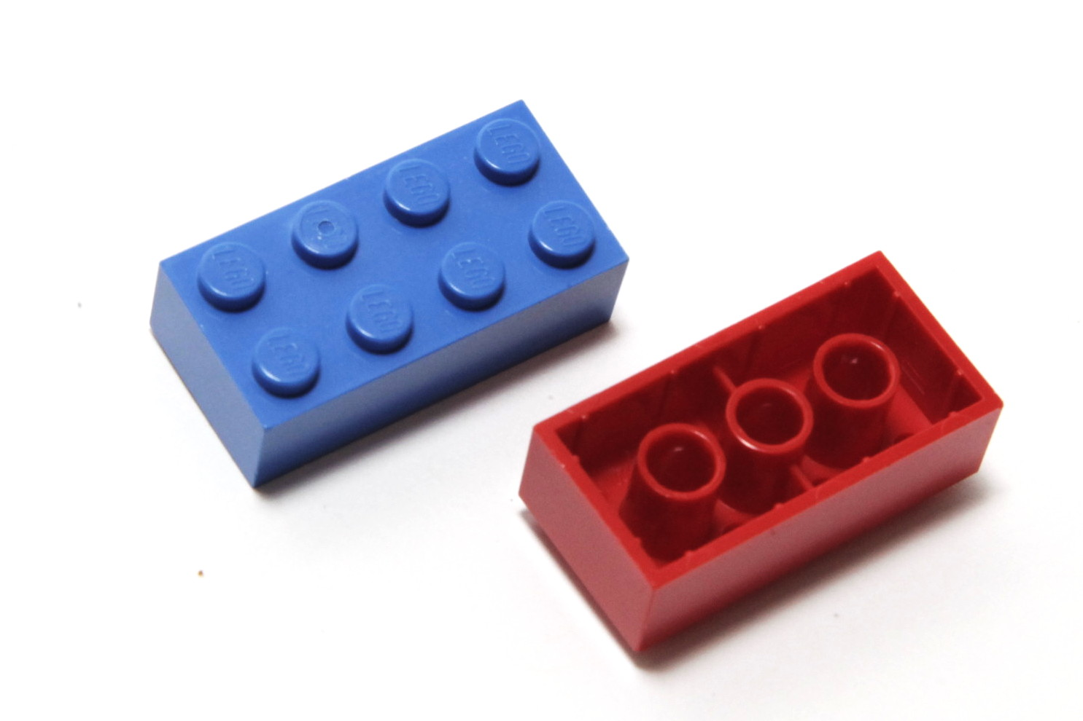
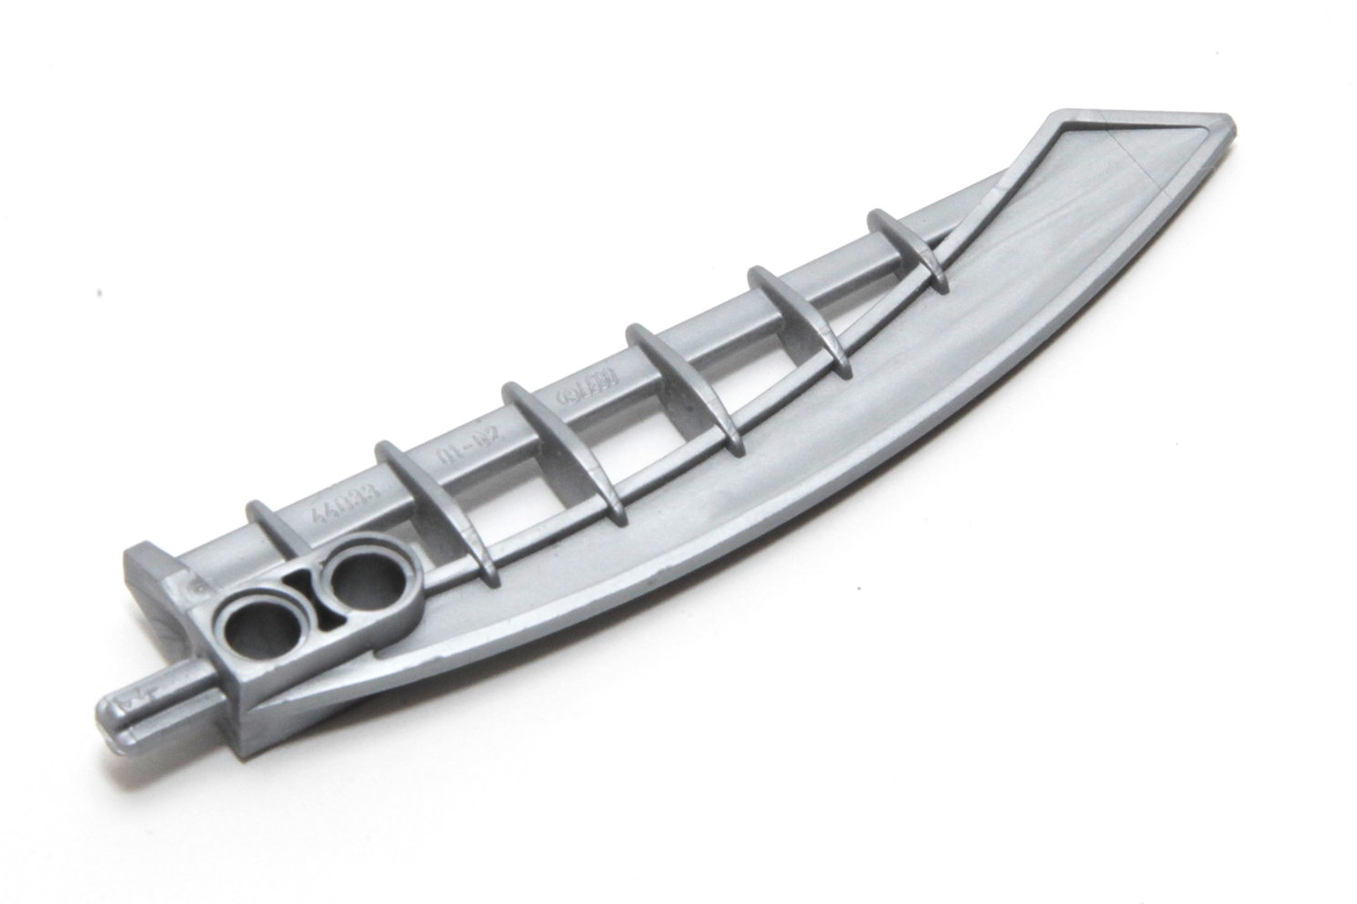
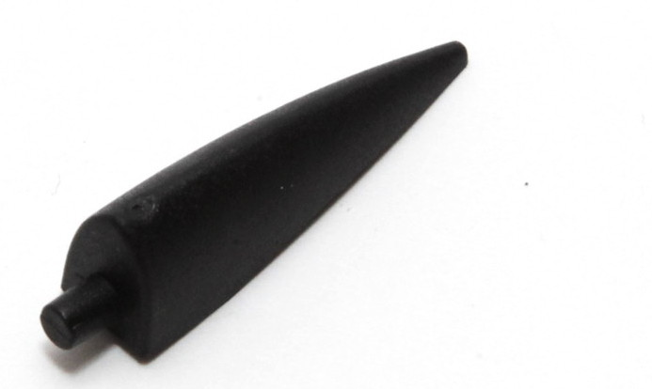
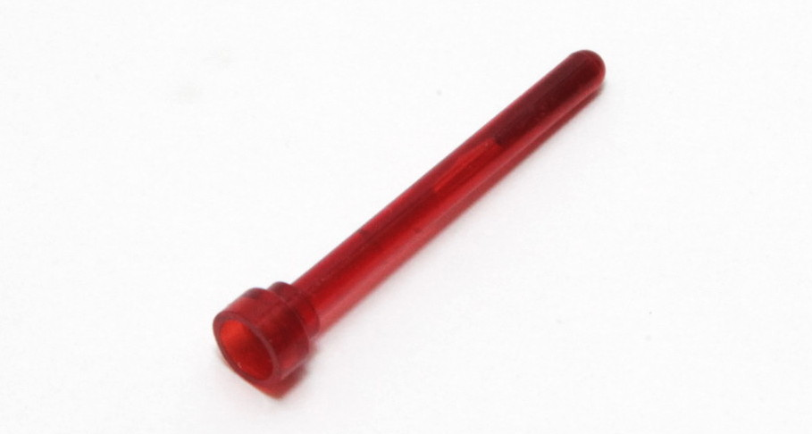
How do I connect bricks?
Pieces connect together due to friction between the element surfaces.
The LEGO system has many standard dimensions, which makes it easy for pieces from 50 years ago to connect with modern pieces.
Brick details are standardized beyond connection points.
ABS / Solid Plastic
PC / Transparent Plastic
Rubber
Soft Plastic

Slide 9
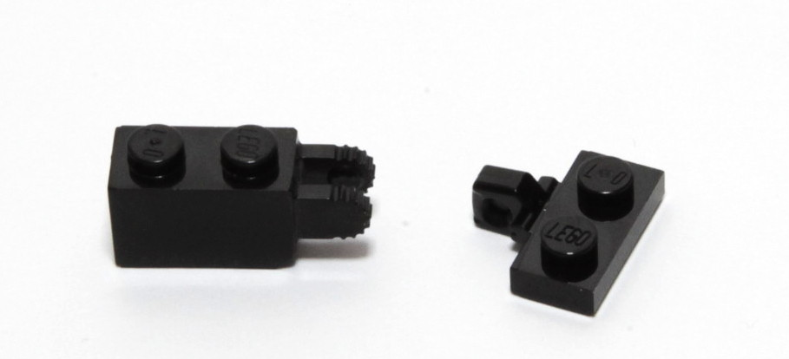
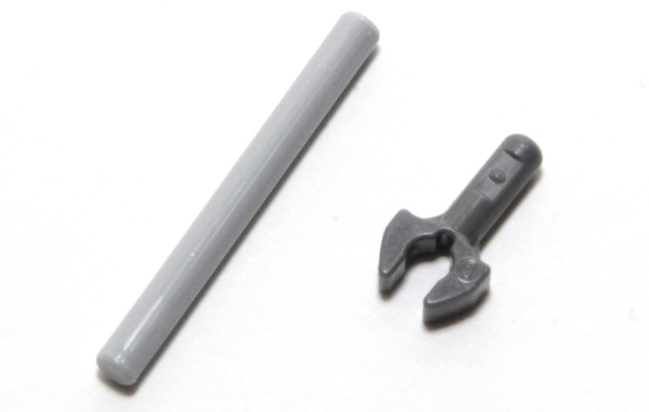
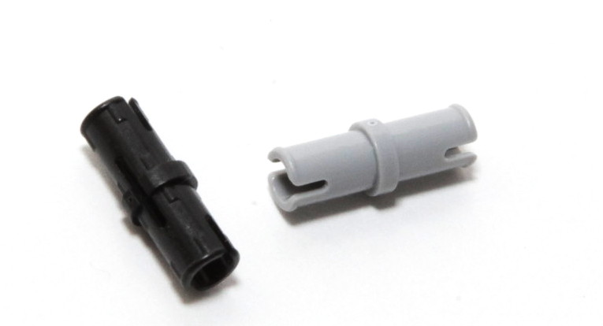
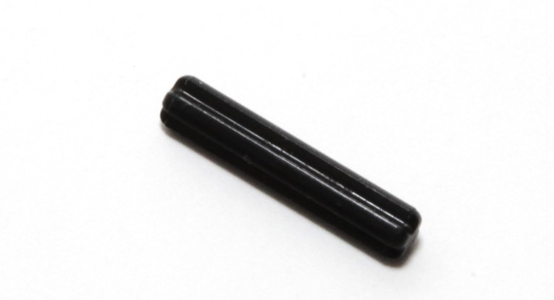
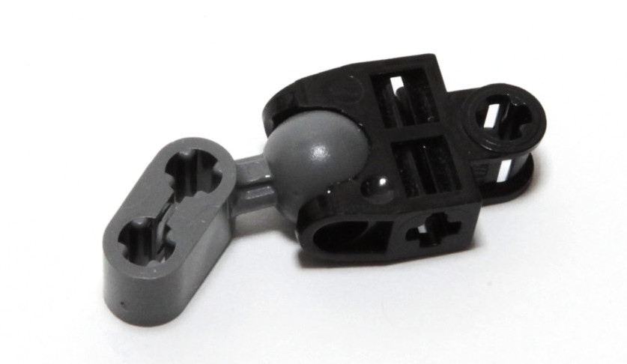
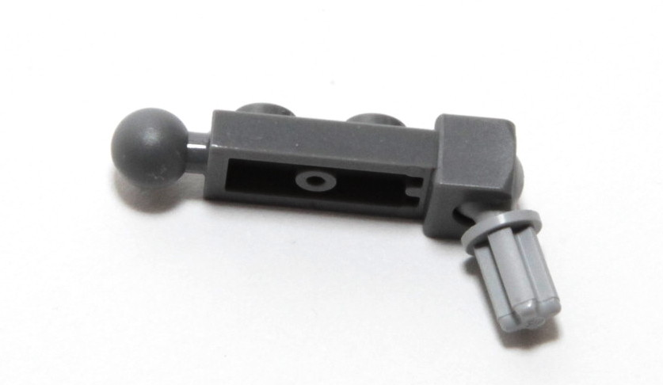
Standard Connectors
Stud
Click Hinge
Bar/Clip
Pin
Connectors
Axle
Ball Joint
Tow Ball

Slide 10
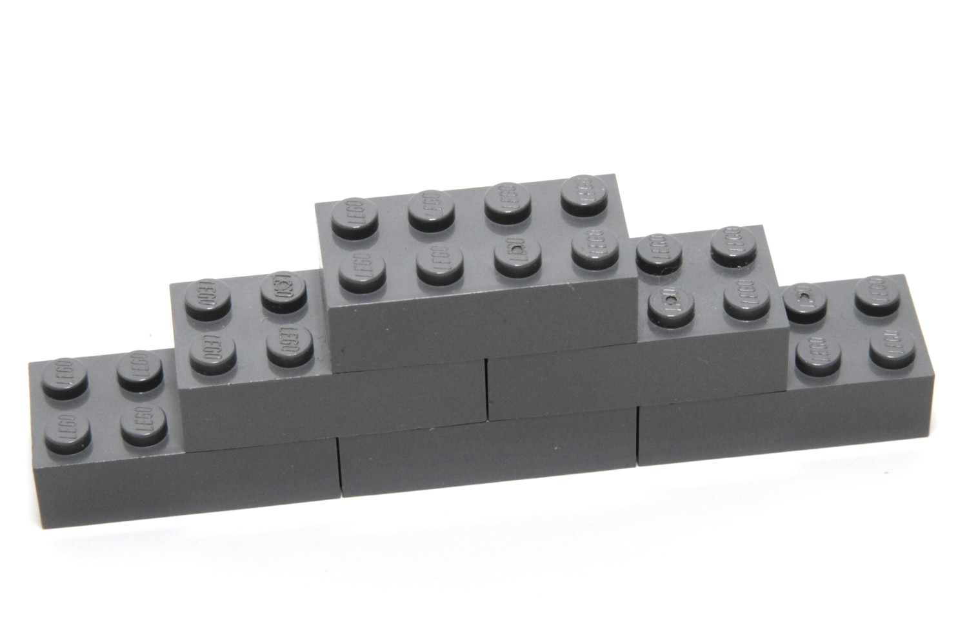
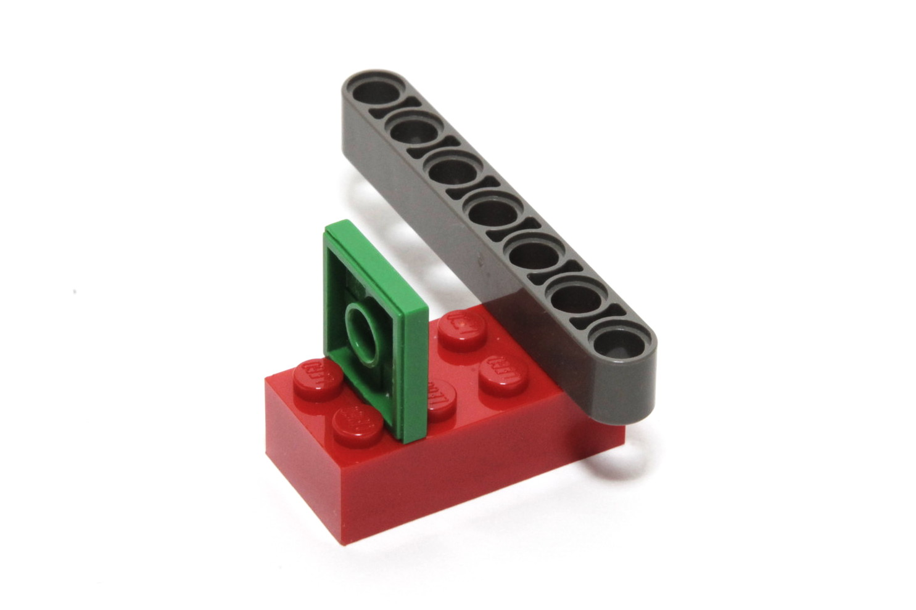
The Stud
Aliases: Knob, Brick/Plate
Dimensions: ~4mm diameter ,60% of a brick
Co-conspirators: Anti-stud

Slide 11
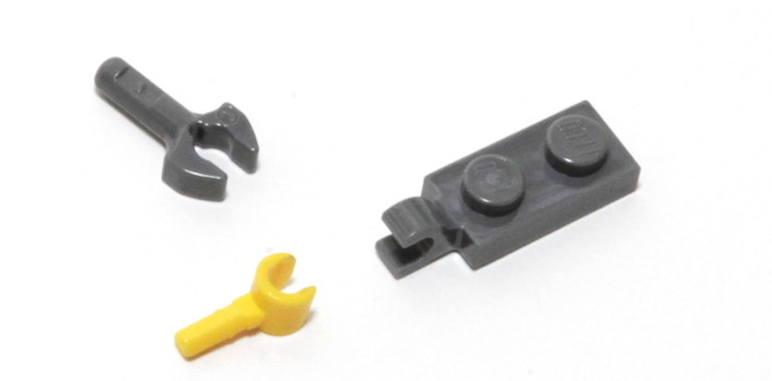
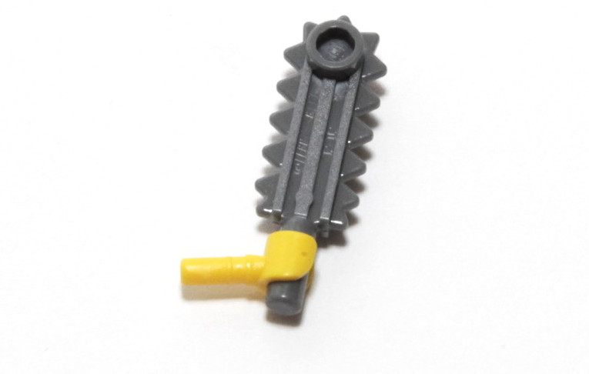
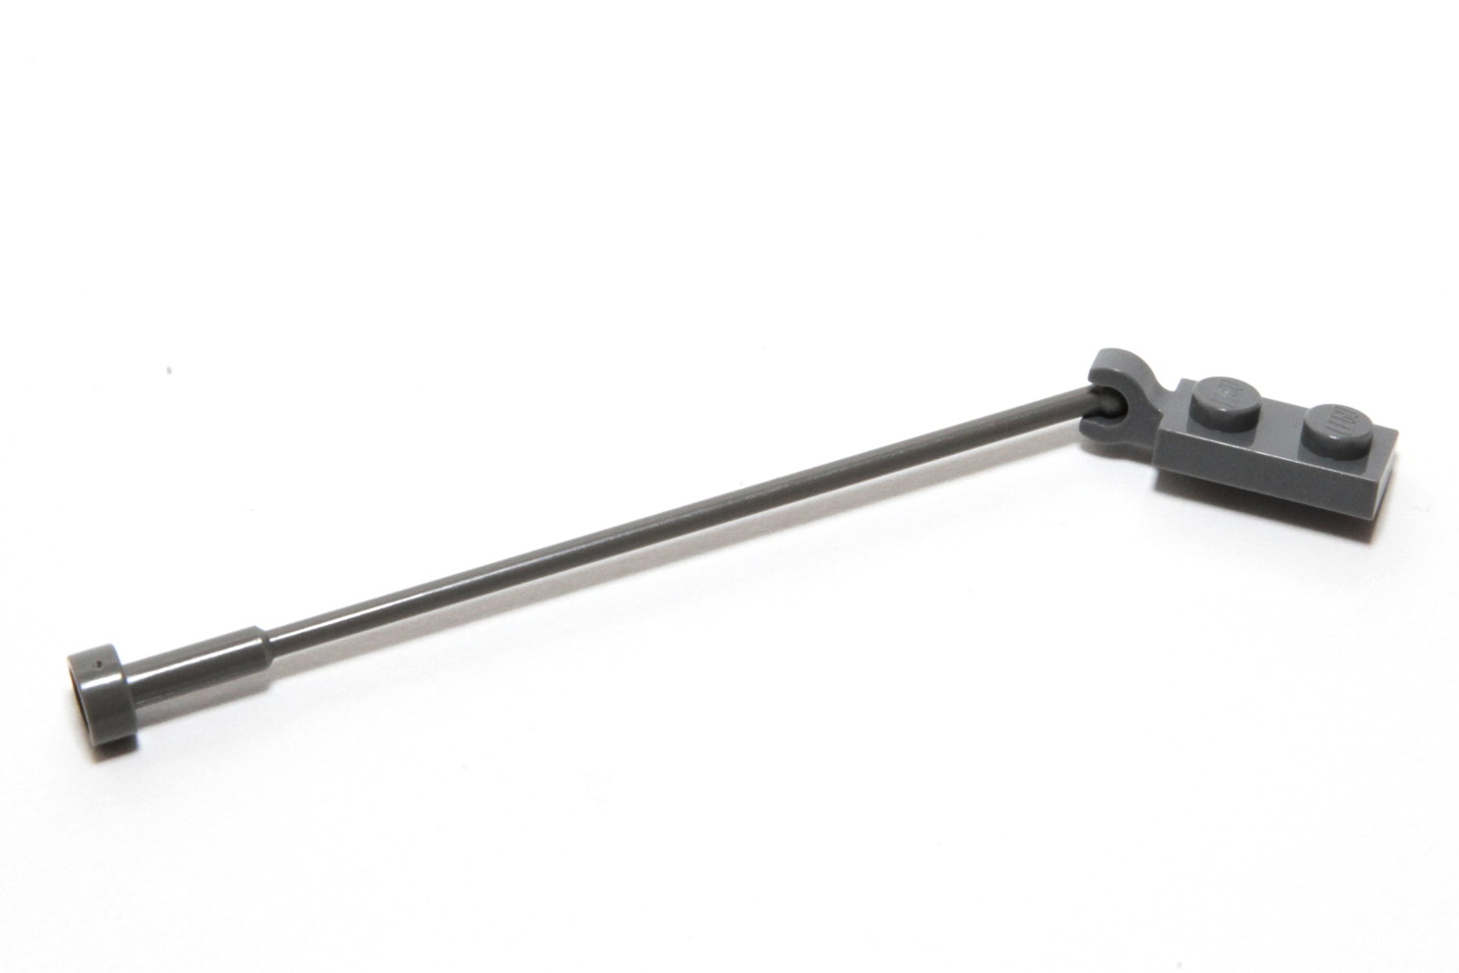
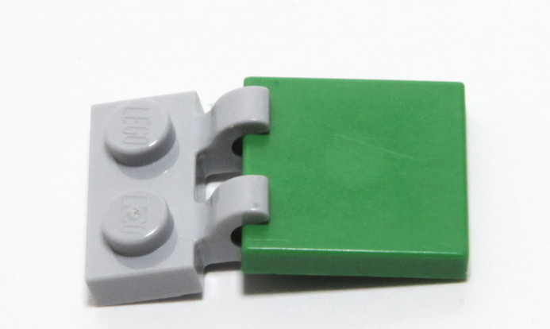
The Bar and Clip
Aliases: Lightsaber Blade, Rod, 318
Dimensions: ~3mm diameter
Co-conspirators: Clips, TECHNIC Axle Holes,
Hollow Studs

Slide 12
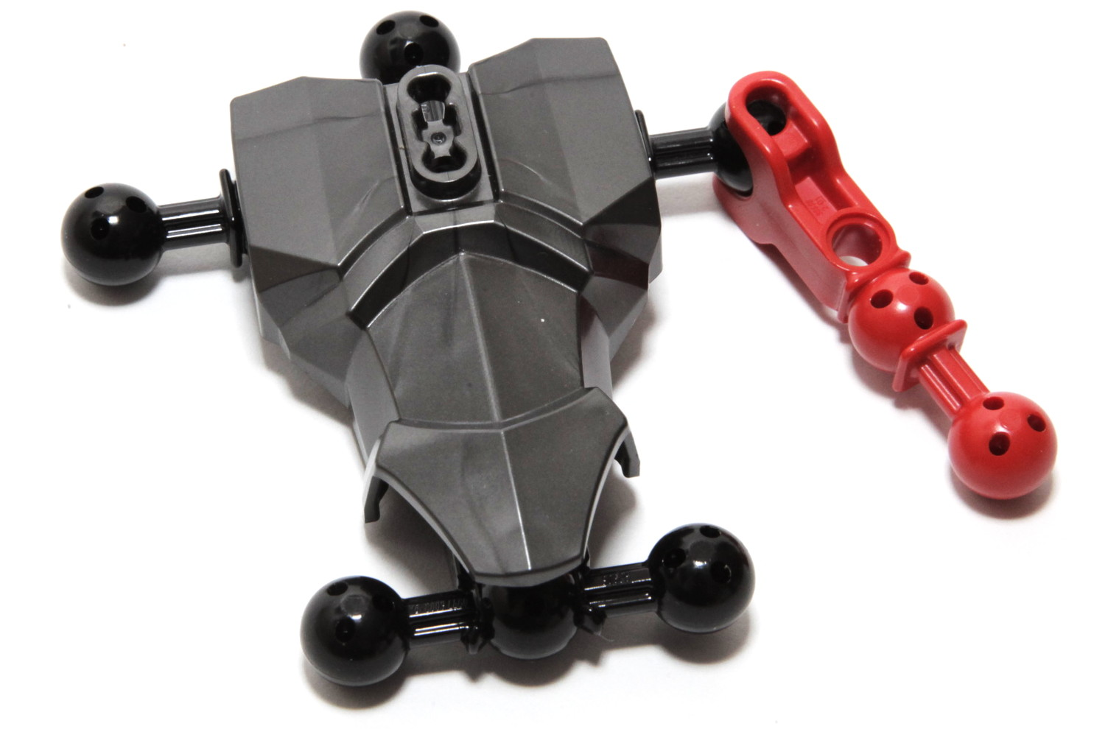
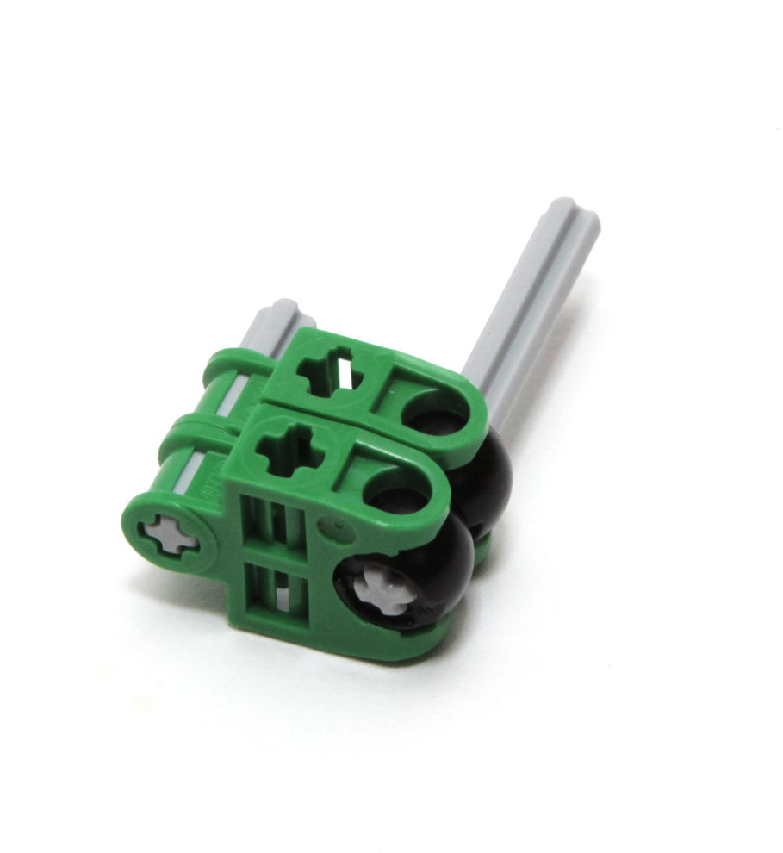
The Ball Joint
Aliases: Ball and Socket, Voodoo Ball
Dimensions: ~8mm diameter
Co-conspirators: Sockets, Shells
Notes:
Newer ball has bowling ball pattern for added consistency and strength
Socket gone through many redesigns, finally doesn't snap much

Slide 13
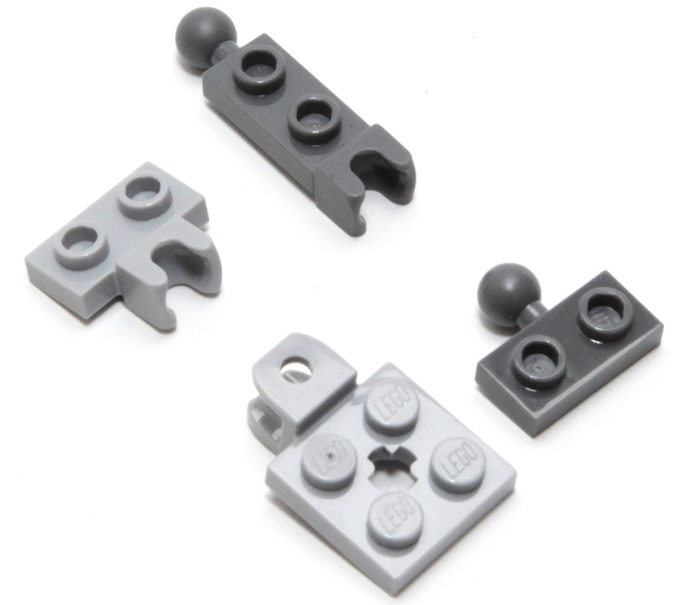
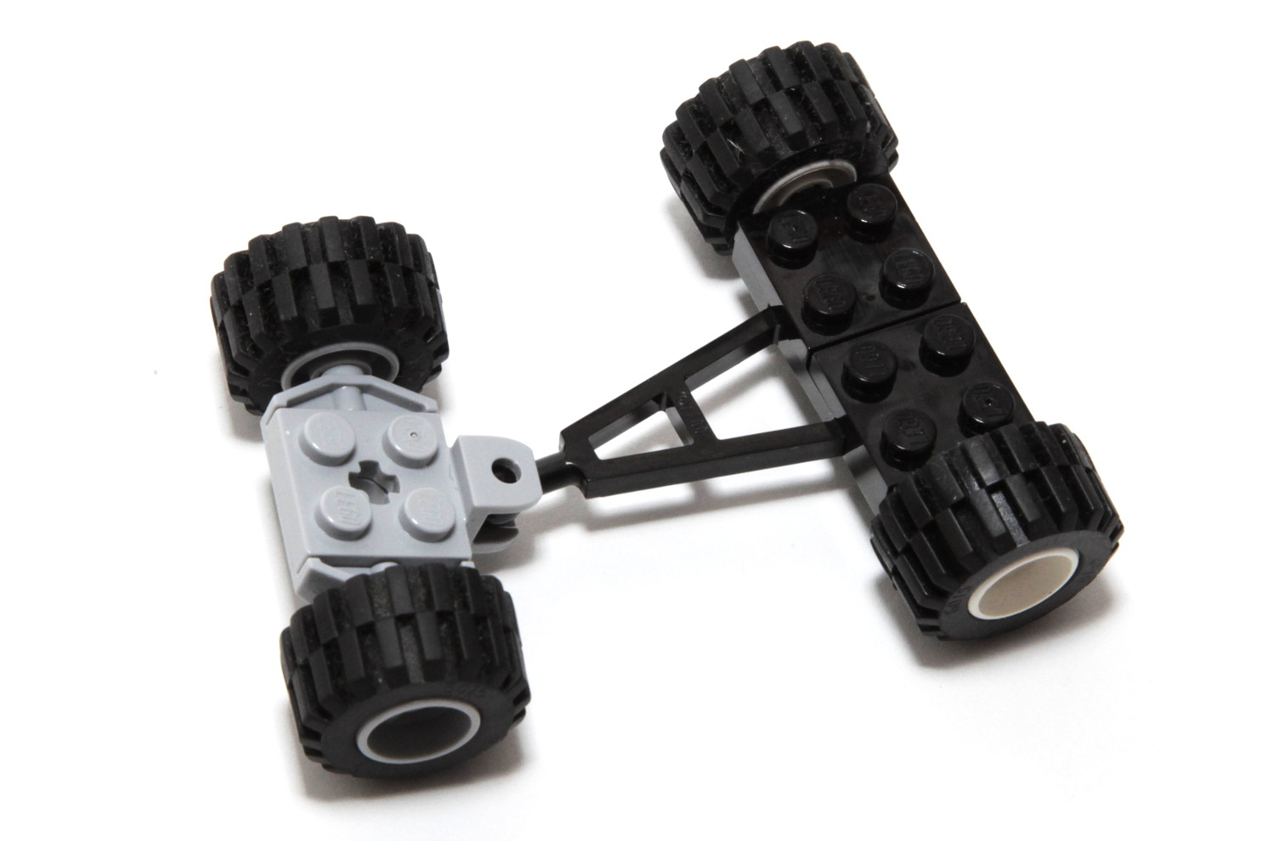
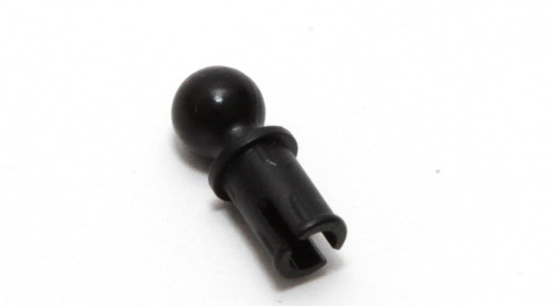
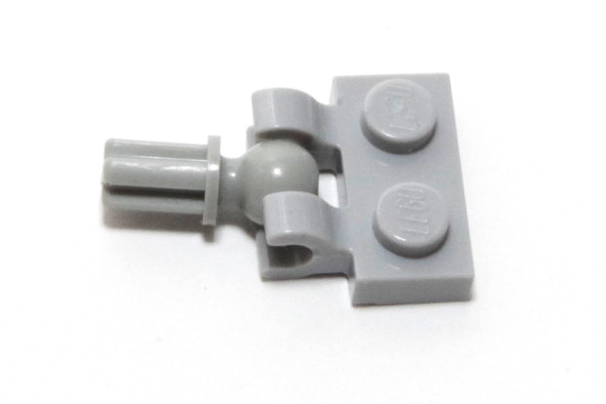
The Tow Ball
Aliases: Mini-ball Joint, Mixels Joint
Dimensions: ~5mm diameter
Co-conspirators: Loose & Friction Sockets
Double Clips

Slide 14
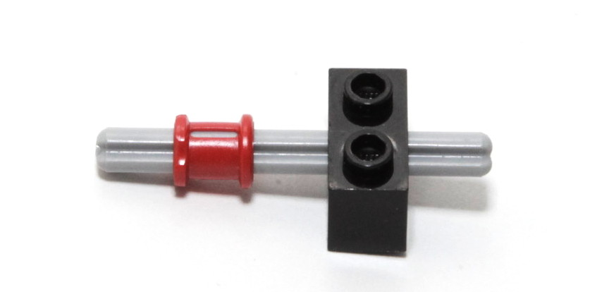
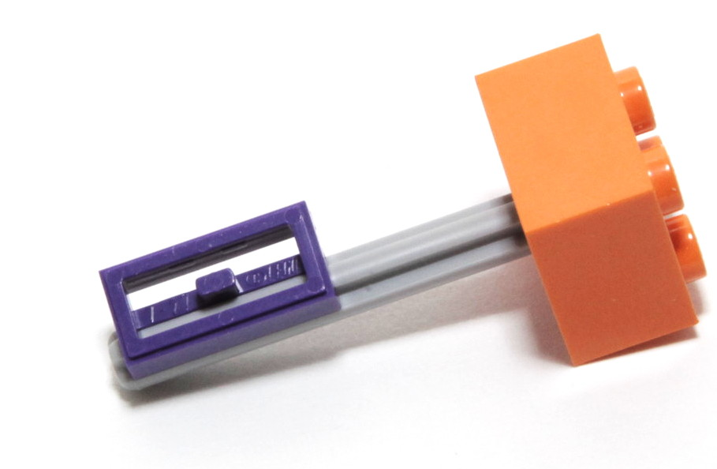
The Axle
Aliases: Cross-Axle, Firepole
Dimensions: ~4mm diameter, ½ plate ridge
Co-conspirators: TECHNIC Beams
Axle Holes

Slide 15
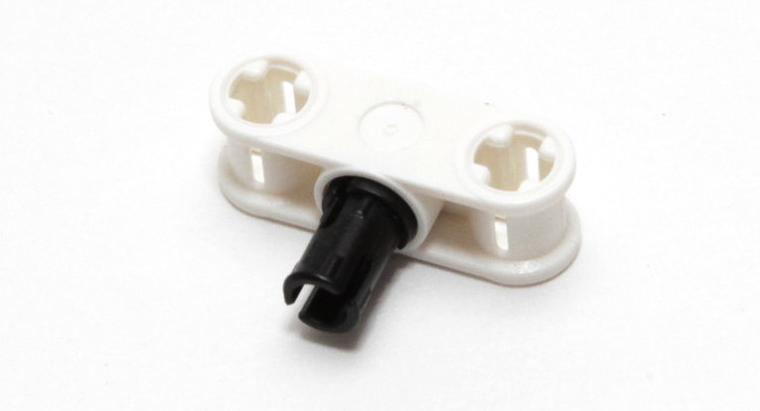
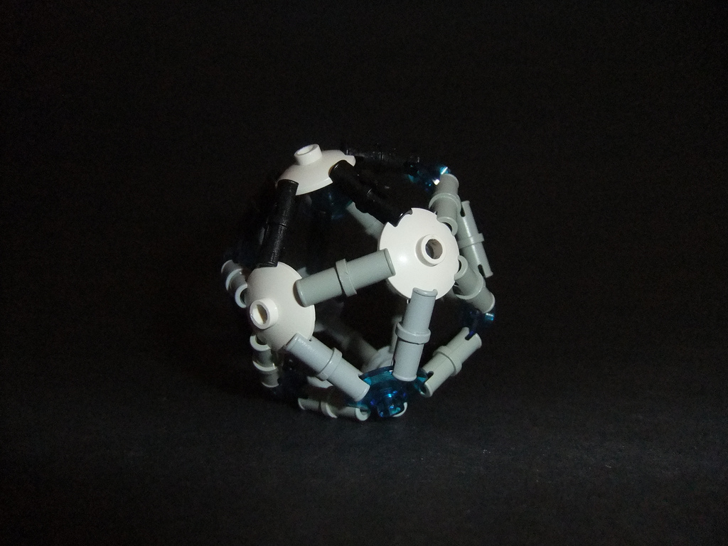

The Pin
Aliases: Connector Peg, Snap
Dimensions: ~4mm diameter, ~1mm notch, ~3mm core
Co-conspirators: TECHNIC Beam, Bar

Slide 16



The Click Hinge
Aliases: Fork, Stubs
Dimensions: 5mm width, 1mm tooth
Co-conspirators: Clips

Slide 17








Other Connectors

Slide 18
What makes a good technique?
It's important to set good groundwork for a stable model and attaching details later on.
Each project will have different requirements, so the best techniques will change every time
you build.
Stability
Difficulty
Damage to Parts
Practicality
Notes:
Also Novelty of use – new techniques are valuable contributions for the building community. Often applied techniques seem fantastic because they are new and clever, however they may be impractical to use for any of the above reasons.
Consider how common part is plus scope of project – large or small?

Slide 19

Stability
How strong is the connection? Is it likely to break if bumped or put under pressure?
Good
Okay
Bad
Notes:
Very important when still building, and for displaying on a shelf or at a show. MOC may be overall stable, but not ideal for pieces to fall off if accidentally bumped.
Better to shatter into 10 than 100 if a model accidentally falls on the floor. Stable techniques help mitigate heartbreak.

Slide 20

Difficulty
How tricky is it to assemble? Some techniques may not be suitable for internal structures
if they require open space to build.
Good
Okay
Bad
Notes:
Time consuming to assemble, especially if used in a developing MOC that is still being rearranged and handled extensively.
Nothing wrong with complex builds, but simple techniques can help a build move faster, letting you to focus more on the idea that you're trying to create, rather than the challenge of assembling it.

Slide 21



Damage to Parts
Certain connections may stress bricks, leaving white marks or minor scratches.
Bad
Bad
Extra Bad
Notes:
Consider if it's worth the cost of the brick – do you have lots of them available?
Second example is stuck together without knives.
Flex tube and rubber parts are resistant to bending, but can still have scratches and “bite” marks left in them.

Slide 22




Cost/Practicality
Some techniques require uncommon or multiple pieces. Depending on the scope of budget
of the MOC, expensive techniques may not be practical.
Floating Paradise by Tyler
Hi-Go by Milán Bikics
Good
Okay
Bad
Notes:
Spamming techniques are generally not practical, because they require a lot of the same piece. At least until the piece appears in PaB walls,then it will be economically practical!

Slide 23


More Pure Techniques

Slide 24






More Applied Techniques
Greek Pattern by Piotr Hofman
Bricklyn Borough Courthouse by Jonathan Grzywacz
Peacock Chair by Michael Jasper
Windows - Building Sideways by Larry Lars

Slide 25



Entrapment Techniques
Chain Links
Interlocking Pieces
Dish Techniques

Slide 26









Part Spamming
Radial Patterns
Chaining Fire
Chain Link Patterns
+
+
+
Link Technique by Brian Kescenovitz
Notes:
Chairs then 1x2s

Slide 27










Multi-Part Connection Techniques
Flag with Clip
Boat Stud with Bar
2x2 Round Plate with 2x2 Tile
+
+
+
Notes:
Flags with Clip involves using multiple thin pieces to create the thickness required to fit into clips. Works with 2 brick edges side by side + many strings. Usually requires flat surfaces rather than angled to fit into clip.
Boat Stud with bar good for sci-fi fuel cells or engine details.
2x2 round can be used for very thin walls and interesting floor patterns.
Multipart connections are difficult to use but can create very non-LEGO aesthetics and properties for MOCs.

Slide 28









Absurd Techniques
Pin to Pin Connection
Grass to Lever Base Connection
Complex Mosaics
+
+
+
Flower petal study by Katie Walker
Notes:
John's Friction Cycle : Wheel demonstration shows stability through complete circle
Tulip applied technique can use 3-pronged shape of flower stalk to make a Dodecahedron: Not very practical but demonstrates stability through a complete 3D solid

Slide 29

Searching for Techniques
Symbol Based Building vs. Literal Building!
Notes:
Up to John

Slide 30

Questions? (please)

