Slide 1


VPP Annual Self Evaluation
Training
Press the spacebar to continue
Notes:
Welcome to the Virginia Voluntary Protection Programs Annual Self-Evaluation Training

Slide 2
Welcome to the VPP Annual
Self Evaluation Training Program
Press the spacebar to continue
Notes:
Welcome to the Virginia Voluntary Protection Programs Annual Self-Evaluation Training

Slide 3
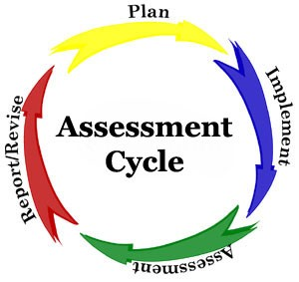
Purpose of the Self-Evaluation
A VPP participant must have a system for evaluating their S&H program annually to determine if they meet the program goals and objectives.
This helps to determine and implement changes that are needed to improve worker S&H protection.
Press the spacebar to continue
Notes:
A VPP participant site must have a system for evaluating their S&H program annually to determine if they meet the program goals and objectives.
This helps to determine and implement changes that are needed to improve worker S&H protection.

Slide 4

Purpose of the Self-Evaluation
VOSH uses the information to:
  Update records and statistics,
  To showcase successes related to implementation of the VPP requirements
  To verify that VPP participants are committed to continuously improving worker S&H at their sites.
Press the spacebar to continue
Notes:
VOSH uses the information to:
Update records and statistics,
To showcase successes related to implementation of the VPP requirements
To verify that VPP participants are committed to continuously improving worker S&H at their sites.

Slide 5
Requirements
Required each year
Due by February 15
Must be submitted in a Word© Document Format
Emailed to Milford Stern at Milford.Stern@doli.virginia.gov
Requirements
Notes:
Required each year
Due by February 15
Must be submitted in a Word© Document Format
Emailed to VPP Manager Milford Stern at Milford.Stern@doli.virginia.gov

Slide 6
Regional Coordinator
Contact Information
Central:
  Eugene.Miller@doli.virginia.gov
Northern:
  Jeremias.Cruz-corniel@doli.virginia.gov
Southwest:
  Nathanial.Griffin@doli.virginia.gov
Tidewater:
  Roy.Mason@doli.virginia.gov
Press the spacebar to complete
Notes:
Contact information of our Regional Coordinators if you need additional guidance

