Slide 1

Element Description
Press the spacebar to continue
Notes:
The effectiveness of each element and sub-element needs to be assessed briefly in narrative form.
Identify strengths and successes as well as opportunities for improvement that will translate into specific and measurable goals for the coming year.
You will need to be evaluating your program much like the VOSH VPP evaluation team does.

Slide 2
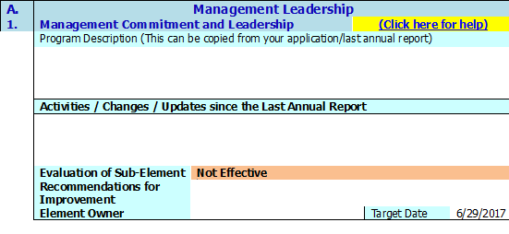
Element Description Info
The effectiveness of each element and sub-element needs to be assessed briefly in narrative form.
Identify strengths and successes as well as opportunities for improvement that will translate into specific and measurable goals for the coming year.
You will need to be evaluating your program much like the VOSH VPP evaluation team does.
Press the spacebar to continue
Notes:
The effectiveness of each element and sub-element needs to be assessed briefly in narrative form.
Identify strengths and successes as well as opportunities for improvement that will translate into specific and measurable goals for the coming year.
You will need to be evaluating your program much like the VOSH VPP evaluation team does.

Slide 3


Element Description Info
Include in each element/sub-element if the element is Effective, Needs Improvement or Not Effective, (use the drop down box) and any recommendations for improvement that you plan to monitor during the coming year.
Each element must have an element owner assigned to it who will evaluate the effectiveness again before the next annual self-evaluation is due.
Press the spacebar to continue
Notes:
Include in each element/sub-element if the element is Effective, Needs Improvement or Not Effective, (use the drop down box) and any recommendations for improvement that you plan to monitor during the coming year.
Each element must have an element owner assigned to it who will evaluate the effectiveness again before the next annual self-evaluation is due.

Slide 4
Element Info
Every element must have a Target Date of completion either for review or recommendations implemented.
Every element has a “Click here for help” link that will take you to the corresponding section in the appendix that will provide additional information for that element.
Press the spacebar to continue
Notes:
Every element must have a Target Date of completion either for review or recommendations implemented.
Every element has a “Click here for help” link that will take you to the corresponding section in the appendix that will provide additional information for that element.

Slide 5
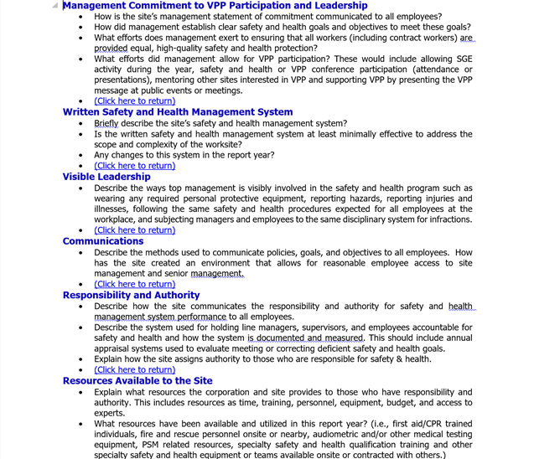
Help Links
Information and descriptions for all aspects of the evaluation.
Link will return you to your previous section of the self-evaluation.
Press the spacebar to complete
Notes:
Every element must have a Target Date of completion either for review or recommendations implemented.
Every element has a “Click here for help” link that will take you to the corresponding section in the appendix that will provide additional information for that element.

