Slide 1


Helpful Websites
Press the spacebar to continue
Notes:
Helpful reference links to aid you in your self-evaluation

Slide 2
Helpful Websites
Click here to look up BLS Industry and Illness Rates
Click here to read OSHA VPP Memo #5
Click here for Pressure Vessels Information
Click here for Virginia VPP Information
US Department of Labor and Industry VPP
OSHA Federal Register Notice, January 9, 2009(VPP SHMS and the Elements starting on Page 936)
Press the spacebar to continue
Notes:
Helpful reference links to aid you in your self-evaluation

Slide 3
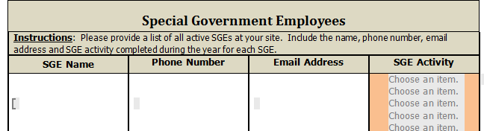
Special Government Employees (SGE)
Enter all SGE’s information at the location
Under SGE Activity, use the drop down list to select an activity that was performed during the last 12 months. (1 SGE per line / 5 activities per SGE)
Press the spacebar to continue
Notes:
Enter all SGE’s information at the location
Under SGE Activity, use the drop down list to select an activity that was performed during the last 12 months. (1 SGE per line / 5 activities per SGE)

Slide 4

Attachments
Each attachment needs to be listed in the attachment section
Attachments should be limited to 2 pages
  Exception of PSM sites
Attachments need to be numbered according to the list
Press the spacebar to continue
Notes:
Each attachment needs to be listed in the attachment section
Attachments should be limited to 2 pages
Exception of PSM sites
Attachments need to be numbered according to the list

Slide 5

Incentive Programs
Explain any incentive programs the site has.
  Examples include:
  Near Missing Reporting
  Bonus programs
  Drawings
Refer to Memo # 5 for additional information
Press the spacebar to continue
Notes:
OSHA does not prohibit incentive programs.
However, employers must take care such a program is not implemented in a manner that has the negative effect of discouraging workers from reporting an injury or illness.
Therefore, if a VPP applicant/participant chooses to use this type of program, it must be able to demonstrate what type of precautions are in place to ensure that the program does not discourage reporting.
Such an incentive program must also meet all requirements of the provisions in 29 CFR Part 1904 and Sec. 11 (c) of the Occupational Safety and Health Act of 1970.

Slide 6


Pressure Vessels
Do you have any?
  List whether they are pneumatic, hydraulic or reactor vessels
  How many and where are they located
  If you have a document you currently use to track this information – attach it
  Additional information can be found on VOSH website
Press the spacebar to continue
Notes:
Pressure Vessels
Do you have any?
List whether they are pneumatic, hydraulic or reactor vessels
How many and where are they located.
If you have a document you currently use to track this information – attach it
Additional information can be found on VOSH website

Slide 7
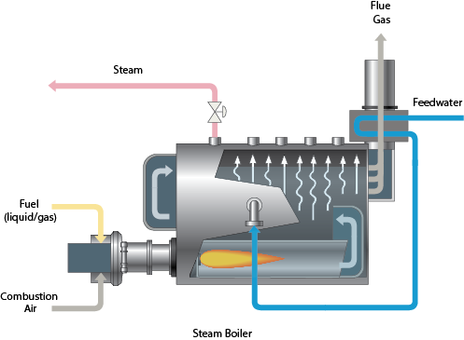
Pressure Vessels
Do you have any?
  List whether they are pneumatic, hydraulic or reactor vessels
  How many and where are they located
  If you have a document you currently use to track this information – attach it
  Additional information can be found on VOSH website
Press the spacebar to continue
Notes:
Pressure Vessels
Do you have any?
List whether they are pneumatic, hydraulic or reactor vessels
How many and where are they located.
If you have a document you currently use to track this information – attach it
Additional information can be found on VOSH website

Slide 8
Virginia Unique Standards
Standard can be found at this link: https://www.doli.virginia.gov/vosh-programs/virginia-unique/
Standards include:
  Administrative Regulations Manual,
  Reverse Signal Operation,
  Reporting Fatalities, Hospitalizations, Amputations and Losses of an Eye as a result of Work-Related incidents,
  Tree trimming Operations,
  Telecommunications,
  Confined Space Standards Telecommunications Industry,
  Overhead High Voltage Line Safety Act,
  General Approach Distance,
  Fall Protection for Subpart R – Steel Erection,
  Field Sanitation, Agriculture, and
  Construction Industry Standard for Sanitation.
Press the spacebar to complete
Notes:
The Safety and Health Codes Board has adopted occupational safety and health standards for enforcement by the Department of Labor and Industry.
There are several standards that are unique to Virginia and can be accessed by clicking the links below. They are unique in the sense that federal OSHA either does not have a comparable standard or, if it does, it differs substantively and has been superceded by the unique Virginia standard.
At minimium, the Administrative Regulations Manual & the Reporting of Fatalities will apply to all STAR sites.

