Slide 1


Site Employee Injury Data
Press the spacebar to continue
Notes:
Right Click on the Chart and select Worksheet Object then Open
Look up your facility BLS rates
Click on the Blue Link (Most recently published **BLS Rates) A web site will open with a PDF document.
Locate your NAICS Code (2nd column)
Use the Total Recordable Cases (TCIR) (3rd column)

Slide 2
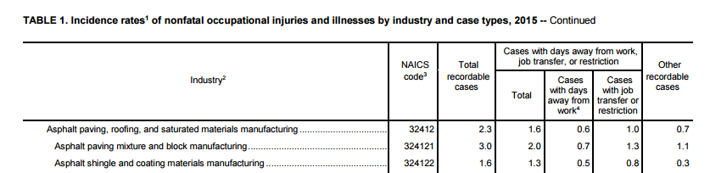
Site Employee Injury Data
Right Click on the Chart and select Worksheet Object then Open
Look up your facility BLS rates
  Click on the Blue Link (Most recently published **BLS Rates) A web site will open with a PDF document.
  Locate your NAICS Code (2nd column)
Use the Total Recordable Cases (TCIR) (3rd column)
Total Column (DART) (4th column)
Press the spacebar to continue
Notes:
Right Click on the Chart and select Worksheet Object then Open
Look up your facility BLS rates
Click on the Blue Link (Most recently published **BLS Rates) A web site will open with a PDF document.
Locate your NAICS Code (2nd column)
Use the Total Recordable Cases (TCIR) (3rd column)

Slide 3
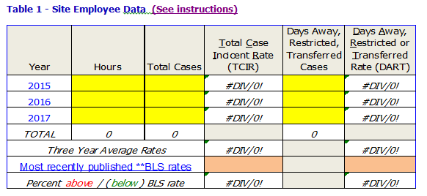
Site Employee Injury Data
  Enter your sites data in the Yellow cells
  for each year
BLS rates go in the Orange cells
(TCIR and DART)
Gray Cells are left blank
  White Cells are calculated automatically
Save before closing
Press the spacebar to continue

Slide 4

TCIR or DART Increased?
If 1 year TCIR or DART increased, you must identify & describe contributing factors and corrective actions taken.
Address these items in the related sub-element section.
If 3 year rate exceeds the highest of the last 3 published years of BLS data, you must submit a separate rate reduction plan.
Press the spacebar to continue
Notes:
TCIR or DART
If 1 year TCIR or DART increased, you must identify & describe contributing factors and corrective actions taken.
Address these items in the related sub-element section.
If 3 year rate exceeds the highest of the last 3 published years of BLS data, you must submit a separate rate reduction plan.
RT Increased?

Slide 5
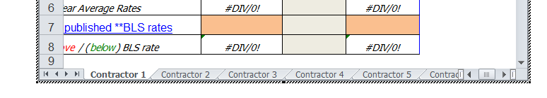
Contractor Rates
Right Click on the Chart and select Worksheet Object then Open
Enter the same information for each applicable contractor you have (contractors who work 1,000 or more in any calendar quarter that your site uses
Look up the contractors BLS rates (follow previous instructions)
Each contractor has their own tab on the chart Click on each tab to complete
Press the spacebar to complete
Notes:
Contractor Rates
Right Click on the Chart and select Worksheet Object then Open
Enter the same information for each applicable contractor you have (contractors who work 1,000 or more in any calendar quarter that your site uses
Look up the contractors BLS rates (follow previous instructions)
Each contractor has their own tab on the chart Click on each tab to complete
tor Rates

