Slide 1
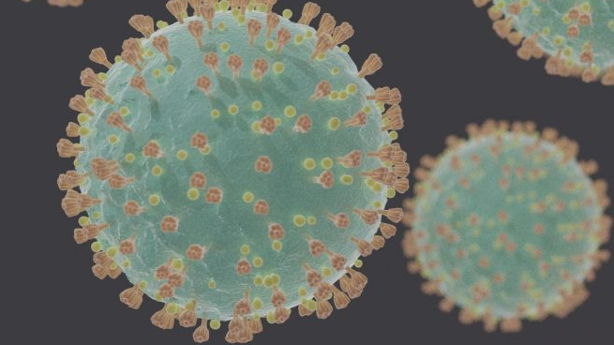

Infectious Disease Prevention:
SARS-CoV-2 Virus That Causes COVID-19
16 VAC 25-220

Slide 2
Goal and learning objectives
Goal: Increase health and safety awareness employees with potential exposure to COVID-19 as required by 16VAC25-220
Learning objectives: After attending participants will be able to:
Recognize the signs and symptoms, risk factors, and transmission of COVID-19 disease.
Understand the risk of workplace exposure to COVID-19.
Be familiar with the infection control methods used by your employer to prevent and respond to COVID-19 exposure in our workplace.
Implement the steps your employer has taken to protect you and your coworkers.

Slide 3
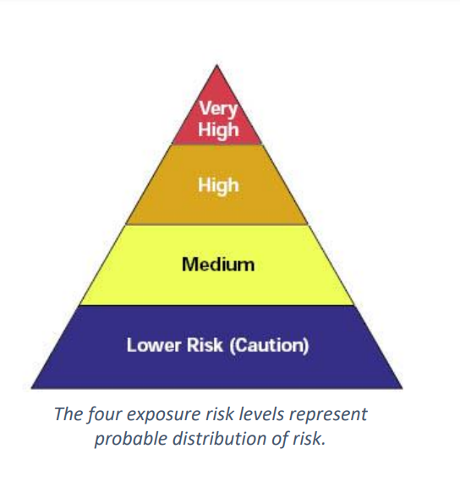
Why have a Standard and who does it apply to?
Prevent the spread of the virus
Applies to every place of employment within the jurisdiction of the VOSH program
Based on exposure risk levels based on hazards present or job tasks and defined as Very High, High, Medium, and Lower.
Notes:
No. Section 10.D states that the ETS is designed to supplement and enhance existing VOSH laws, rules, regulations, and standards applicable directly or indirectly to SARS-CoV-2 virus or COVID-19 disease-related hazards such as, but not limited to:
• personal protective equipment,
• respiratory protective equipment,
• sanitation,
• access to employee exposure and medical records,
• occupational exposure to hazardous chemicals in laboratories,
• hazard communication,
• Va. Code §40.1-51.1.A
Should the ETS conflict with an existing VOSH rule, regulation, or standard, the more stringent requirement from an occupational safety and health hazard prevention standpoint shall apply.
Yes. Section 10.E.1 specifically recognizes that “various hazards or job tasks at the same place of employment can be designated as “very high”, “high, “medium”, or “lower” exposure risk for purposes of application of the requirements of this standard”.
The ETS takes a layered approach to providing employee protection against SARS-CoV2 and COVID-19 hazards and job tasks depending on exposure risk level:
There are minimum requirements that apply to all employers (see §40, Mandatory requirements for employers in all exposure risk levels),
Enhanced requirements for “medium” exposure risks (see §60 Requirements for hazards or job tasks classified at “medium” exposure risk); and
Enhanced requirements for “very high” or “high” exposure risks (see §50 Requirements for hazards or job tasks classified at “very high” or “high” exposure risk).

Slide 4
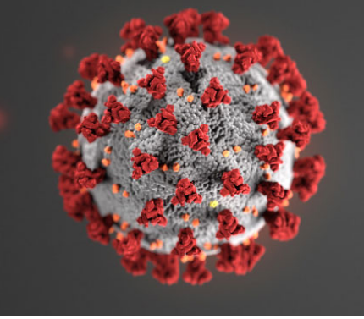
What is SARS-CoV-2?
SARS-CoV-2 is the virus that causes coronavirus disease 2019 (COVID-19)
SARS = severe acute respiratory distress syndrome
Spreads easily person-to-person particularly when someone sneezes
Little if any immunity in humans
Detailed information: https://www.cdc.gov/coronavirus/2019-ncov/index.html
Notes:
Coronaviruses are a family of viruses that can cause respiratory illness in people. Coronaviruses also circulate among animals, including camels, cattle, cats, and bats.
Just like there are different types of related viruses that cause smallpox, chickenpox, and monkeypox, different coronaviruses cause different diseases in people. The Severe Acute Respiratory Syndrome (SARS) coronavirus causes SARS and the Middle East Respiratory Syndrome (MERS) coronavirus causes MERS. The novel coronavirus responsible for the current pandemic, SARS-CoV-2, is one of seven types of known human coronaviruses. SARS-CoV-2, like the MERS and SARS coronaviruses, likely evolved from a virus previously found in animals. The remaining known coronaviruses cause a significant percentage of colds in adults and children, and these are not a serious threat for otherwise healthy adults.
Influenza (Flu) and COVID-19 are both contagious respiratory illnesses, but they are caused by different viruses. COVID-19 is caused by infection with a new coronavirus (called SARS-CoV-2) and flu is caused by infection with influenza viruses. Because some of the symptoms of flu and COVID-19 are similar, it may be hard to tell the difference between them based on symptoms alone, and testing may be needed to help confirm a diagnosis. Flu and COVID-19 share many characteristics, but there are some key differences between the two.
The SARS CoV-2 virus is a novel strain, meaning that it is new. As a result, humans have not developed immunity to COVID-19, and therefore can be infected. Acquired immunity is when humans have been exposed or vaccinated previously to an infectious agent. An example is when people have measles in childhood or are vaccinated, they develop antibodies and a certain level of protection.

Slide 5
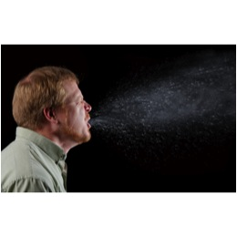
Transmission
COVID-19 is spread from person to person mainly through coughing, sneezing, and possibly talking, and breathing.
Droplet - respiratory secretions from coughing or sneezing landing on mucosal surfaces (nose, mouth, and eyes).
Aerosol - a solid particle or liquid droplet suspended in air.
Contact -Touching something with SARS CoV-2 virus on it and then touching mouth, nose or eyes.
Other possible routes: Through fecal matter.
Notes:
Instructor notes:
The spread of SARS-CoV-2 the virus that causes COVID-19, is thought to occur in the same way that seasonal flu spreads. Flu viruses are spread mainly from person to person through coughing or sneezing by people with influenza. We will not fully know how it is transmitted until later when scientists have had time to evaluate it.
Droplet transmission occurs when respiratory secretions from coughing or sneezing land on mucosal surfaces (nose, mouth, and eyes).
Contact transmission is touching something with COVID-19 virus on it and then touching your mouth, nose or eyes.
Aerosol transmission means breathing in infectious COVID-19 particles.
Keep in mind that the virus particles are not visible to the naked eye. The most harmful particles are sub micron, shorter than one millionth of a meter.
It is not likely that SARS CoV-2 is airborne like tuberculosis or measles, but there is strong evidence that it is spread by short range aerosols.

Slide 6
Increased risk factors
Those with elevated risk of exposure include:
  Close contacts of persons with COVID-19.
  Healthcare workers caring for patients with COVID-19.
  Workers providing critical services and operations.
Notes:
Instructor notes:
Essential workers with increased risk factors are those with close contact with known or unknown people who are contagious with SARS CoV-2.

Slide 7
Incubation period
The incubation period is the time between exposure to a virus and the onset of symptoms.
With COVID-19, symptoms may show 2-14 days after exposure.
CDC indicates that people are most contagious when they are the most symptomatic.
Several studies show people may be most contagious before developing symptoms.
Notes:
Most estimates of the incubation period for COVID-19 range from 1-14 days, most commonly around five days. The “incubation period” means the time between catching the virus and beginning to have symptoms of the disease.
This can be longer in some people, especially children and people with weakened immune systems and in people infected with the new COVID-19 virus.
Can someone spread the virus without being sick?
People are thought to be most contagious when they are most symptomatic (the sickest).
Some spread might be possible before people show symptoms. There have been reports of this occurring with this new coronavirus, but this is not thought to be the main way the virus spreads.

Slide 8
COVID-19 can cause mild to severe symptoms
Most common symptoms include:
Fever
Cough
Shortness of breath
Other symptoms may include:
Sore throat
Runny or stuffy nose
Body aches
Headache
Chills
Fatigue
Gastrointestinal: diarrhea, nausea
Loss of smell and taste
Notes:
People with COVID-19 have had a wide range of symptoms reported – ranging from mild symptoms to severe illness. Symptoms may appear 2-14 days after exposure to the virus. People with these symptoms may have COVID-19:
Most common symptoms
Fever or chills
Cough
Shortness of breath or difficulty breathing
Other symptoms:
Fatigue
Muscle or body aches
Headache
New loss of taste or smell
Sore throat
Congestion or runny nose
Nausea or vomiting
Diarrhea
This list does not include all possible symptoms. The CDC will continue to update this list as we learn more about COVID-19.

Slide 9
Increased risk of severe illness
COVID-19 poses a greater risk for severe illness for people with underlying health conditions:
Heart disease
Lung disease such as asthma
Diabetes
Suppressed immune systems
The elderly have higher rates of severe illness from COVID-19. Children and younger adults have had less severe illness and death. Because COVID-19 is new, there are a lot of scientific unknowns such as the impact on pregnant women and their fetuses.
Notes:
As is the case with seasonal flu, certain conditions appear to put some individuals at increased risk of complications associated with COVID-19. This includes older adults and people who have serious chronic medical conditions like:
Heart disease
Diabetes
Lung disease
If a COVID-19 outbreak happens in your community, it could last for a long time. (An outbreak is when a large number of people suddenly get sick). Depending on how severe the outbreak is, public health officials may recommend community actions to reduce people’s risk of being exposed to COVID-19. For example, the Governor has issued Executive Orders in response to the COVID-19 pandemic.
These actions can slow the spread and reduce the impact of disease.
If you are at higher risk for serious illness from COVID-19 because of your age or because you have a serious long-term health problem, it is extra important for you to take actions to reduce your risk of getting sick with the disease.
NOTE: The rates of infection may be biased higher for older people because we more easily identify infections with severe illness.

Slide 10
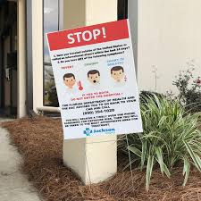
Severe symptoms – emergency warning signs for COVID-19
Most people will have mild symptoms and should recover at home and NOT go to the hospital or emergency room.
Get medical attention immediately if you have:
  Difficulty breathing or shortness of breath.
  Persistent pain or pressure in the chest.
  New confusion or inability to arouse.
  Bluish lips or face.
Notes:
This list of severe symptoms is not all inclusive. Please consult your medical provider for any other symptoms that are severe or concerning.
The reason to stay away from emergency rooms, hospitals, and family doctors is to avoid spreading SARS-CoV-2 to others. For most healthy people, the illness will be mild, and you can recover at home by drinking lots of fluids and use of over the counter medications. You should also separate yourself from other people at home and practice good personal and environmental hygiene.

Slide 11
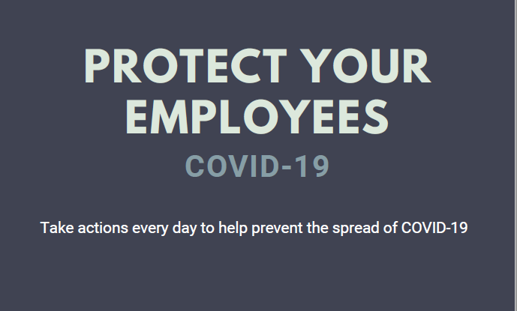

Slide 12
Protect Your Employees
Social Distancing
Self monitoring
Post signs
Offer disposable face masks
PPE
Clean and Disinfect
Training
Prohibit infected workers
Notes:
Require Social Distancing at all times
Encourage self monitoring
Post signs requesting patients and family members immediately report symptoms
Offer disposable face mask
PPE is required, used properly
Provided access to sanitizers, soap and water
Training employees
Do not permit workers known or suspected to have COVID-19 to remain at work
Including contractor workers, temporary workers and sub contractors

Slide 13
Exposure Risk Levels
LOWER RISK
Do not require contact inside six feet
Minimal occupational contact
Or can achieve minimal occupational contact
Notes:
LOWER RISK: Lower risk jobs are those that do not require contact inside six feet with persons known to be, suspected of being, or that may be infected with COVID-19. These individuals have minimal occupational contact with other employees or the general public, or could achieve minimal occupational contact through the implementation of work practice controls. (not just masks)- barriers, teleworking

Slide 14
Exposure Risk Levels
MEDIUM RISK:
Require more than minimal occupational contact inside six feet
waiters, grocery store workers, agricultural workers, construction workers, domestic service workers, hairdressers, fitness instructors, workers in poultry and meat processing facilities, manufacturing workers, and healthcare workers in settings without known or suspected sources of COVID-19
Notes:
Require more than minimal occupational contact inside six feet with other employees, other persons, or the general public that maybe but are not known or suspected to be infected with COVID-19. These may include, but are not limited to, waiters, grocery store workers, agricultural workers, construction workers, domestic service workers, hairdressers, fitness instructors, workers in poultry and meat processing facilities, manufacturing workers, and healthcare workers in settings without known or suspected sources of COVID-19.

Slide 15
Exposure Risk Levels
HIGH RISK:
high potential for employee exposure inside six feet
hospital workers, first responders, medical transport providers, correctional facilities, mortuary services workers, medical and dental staff, non-medical support staff, long term care facility staff, home healthcare workers, etc.
Notes:
HIGH RISK:
high potential for employee exposure inside six feet
to known or suspected sources of COVID-19. These include hospital workers, first responders, medical transport providers, mortuary services workers, medical and dental staff, non-medical support staff, long term care facility staff, home healthcare workers, etc.

Slide 16
Exposure Risk Levels
VERY HIGH RISK:
high potential for employee exposure inside six feet
performing specific medical (e.g., aerosol generating procedures), postmortem, or laboratory procedures with specimens from an individual
Notes:
Very high risk jobs are those with a high potential for employee exposure inside six feet to known or suspected sources of COVID-19. These include individuals performing specific medical (e.g., aerosol generating procedures), postmortem, or laboratory procedures with specimens from an individual known to or suspected of having COVID-19.

Slide 17
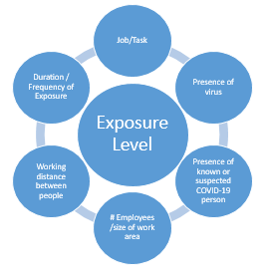
Determining Exposure Risk Level
Tasks
Work environment
Presence of the virus
# employees/size of area
Working distances
Duration and frequency of exposure
Hazards encountered
Notes:
Hazards encountered- contaminated surfaces, airborn transmisson

Slide 18
Requirements
Very high, high or medium
Training
  Requirements of the standard
  Characteristics and methods of the spread
  Risk factors
  Awareness of transmission
  Safe & Health Work Practices
PPE
Anti-discrimination
Infections Disease Preparedness and Response Plan
Notes:
Very high, high or medium exposure risk at a place of employment
the hazards and characteristics of the SARS-CoV-2 virus and COVID-19 disease.
enable each employee to recognize the hazards of SARS-CoV-2 virus and signs and symptoms of COVID-19 disease
train each employee in the procedures to be followed in order to minimize the hazards.
Must include:
Requirements of the standard
Characteristics and methods of the spread
Risk factors
Awareness of transmission
Safe & Health Work Practices
Distancing, disinfection, non contact method of greeting, etc.
PPE - When required, what is required, don, doff, adjust, use, limitation, care, maintenance, useful life, disposal
Anti-discrimination
Infections Disease Preparedness and Response Plan
The mandatory and non-mandatory recommendations in any CDC guidelines or State of Virginia guidance documents the employer is complying with, if any, in lieu of a provision of this standard as provided for in section §§16VAC25-220-10.G.1 and -10.G.2.
The ETS will take effect on the dates of its publication, July 27, 2020.
Requirements for employee training in §80, with the exception of §80.B.8 regarding training required on infectious disease preparedness and response plans, will take effect on August 26, 2020.
The requirements for §70, Infectious disease preparedness and response plan, will take effect on September 25, 2020.
The training requirements under §80.B.8 regarding training required on infectious disease preparedness and response plans will take effect on September 25, 2020.

Slide 19
Requirements
Sick leave, telework, staggered shifts
Provide policy
  Self reporting and monitoring
  Reporting positive test results
  Notification of positive test to all exposed employees
Return to work procedures
Notes:
Sick leave, telework, staggered shifts, and inform employees of policies including the Families First Coronavirus Response Act
Provide policy and procedures on:
Self reporting and monitoring
Reporting positive test results
Notification of positive test to all exposed employees
Return to work procedures
Yes. Section 40.A.7 provides that:
….the building/facility owner will notify all employer tenants in the building that one or more cases have been discovered and the floor or work area where the case was located. The identity of the individual will be kept confidential in accordance with the requirements of the Americans with Disabilities Act (ADA) and other applicable federal and Virginia laws and regulations.

Slide 20
PPE Assessment
  Assess Hazards
  Select PPE
  Uses/ Cleaning/Storage/Fit
Assessment
Job Task
Hazards Present
Hazards Likely to be Present
No Hazards
PPE Needed
PPE Needed
Notes:
To the extent feasible, employers shall…Provide face coverings to suspected to be infected with SARS-C0V-2 non-employees to contain respiratory secretions until they are able to leave the site (i.e., for medical evaluation/care or to return home).
Section 30 provides that:
“Suspected to be infected with SARS-CoV-2 virus” means a person that has signs or symptoms of COVID-19 but has not tested positive for SARS-CoV-2 and no alternative diagnosis has been made (e.g., tested positive for influenza).ersonal Protective Equipment

Slide 21
PPE Assessment
STEP 1: Inform affected employees of the process
Step 2: Review data
Step 3: Conduct a walk‐through survey
Step 4: Determine the hazard risk level
Step 5: Determine Controls to protect against COVID-19
Step 6: Make Document Accessible
Step 7: Reassess the workplace as necessary by identifying and evaluating
Notes:
Personal Protective Equipment
HAZARD ASSESSMENT INSTRUCTIONS
STEP 1: INFORM AFFECTED EMPLOYEES OF THE PROCESS:
Affected employees from each work area that is being assessed should be involved in the process. Discuss the reasons for the survey and the procedures being used for the assessment. Review the job procedures, potential hazards and the PPE currently in use.
Step 2: Review data:
Reports of work‐related injuries or illnesses, near‐miss events and reported safety concerns are sources of data that can provide helpful information for assessing hazards.
Step 3: Conduct a walk‐through survey:
The purpose of the survey is to identify sources of hazards to employees. Observe the following: layout of the workplace, location of the employees, work operations, hazards and places where PPE is currently used including the device and reason for use. Using the form, check the type of hazard(s) present within each section (organized by body part).
Step 4: Determine the hazard risk level
Use the definitions below to select the appropriate hazard risk level.
A. Very high Exposure Risk - Job tasks are those in places of employment with high potential for employee exposure to known or suspected sources of COVID-19 during specific medical, postmortem or laboratory procedures.
Examples:
Aerosol-generating procedures (e.g., intubation, cough induction procedures, bronchoscopies, some dental procedures and exams, or invasive specimen collection) on a known or suspected COVID-19 patient or person known or suspected to have COVID-19
Collecting or handling specimens from a known or suspected COVID-19 patient or person known or suspected to have COVID-19 (e.g., manipulating cultures from patients known or suspected to have COVID-19 patients)
Performing an autopsy, which generally that involves aerosol-generating procedures, on the body of a person known to have, or suspected of having, COVID-19 at the time of their death
B. High Exposure Risk – Jobs that have high potential for exposure inside six feet to known or suspected sources of COVID-19.
Examples:
i. Healthcare delivery and support staff (hospital staff who must enter patients’ rooms) exposed to known or suspected COVID-19 patients
ii. Medical transport (ambulance vehicle operators) moving known or suspected COVID-19 patients in enclosed vehicles
iii. Mortuary workers exposed to known or suspected COVID-19 patients
C. Medium Exposure Risk – Jobs that require more than minimal occupational contact inside six feet with other employees, other persons, or the general public who may be infected with SARS-CoV-2, but who are not known or suspected to be infected with the SARS-CoV-2 virus.
Examples:
i. Schools
ii. High population density work environments (e.g., poultry, meat, other food processing; manufacturing, etc.)
iii. High-volume customer facing retail settings (grocery stores, restaurants, bars, etc.)
iv. Mass gathering venues (e.g., sports, entertainment, movies, theaters, etc.)
D. Lower Exposure Risk - Jobs that do not require contact inside six feet with persons known to be, or suspected of being, or who may be infected with SARS-CoV-2. Employees in this category have minimal occupational contact with other employees, other persons, or the general public, such as in an office building setting; or are able to achieve minimal occupational contact through the implementation of engineering, administrative and work practice controls.
Examples:
i. Remote workers (i.e., those working from home during the pandemic)
ii. Office workers who do not have contact inside 6 feet with coworkers, customers, or the public
iii. Manufacturing and industrial facility workers who do not have inside 6 feet with coworkers, customers, or the public
Step 5: Determine Controls to protect against COVID-19:
After considering and/or planning for engineering and administrative controls, select the PPE which provides at least the minimum level of protection required to protect employees from the hazards. Using the form, note the appropriate controls in the boxes.
Step 6: Make Document Accessible:
Once completed, signed and dated, store the form either electronically or as a hard copy in a location easily accessible to employees and inspectors.
Step 7: Reassess the workplace as necessary by identifying and evaluating:
New equipment and processes
Accident records
Suitability of previously selected PPE
See the attached Hazard Assessment

Slide 22
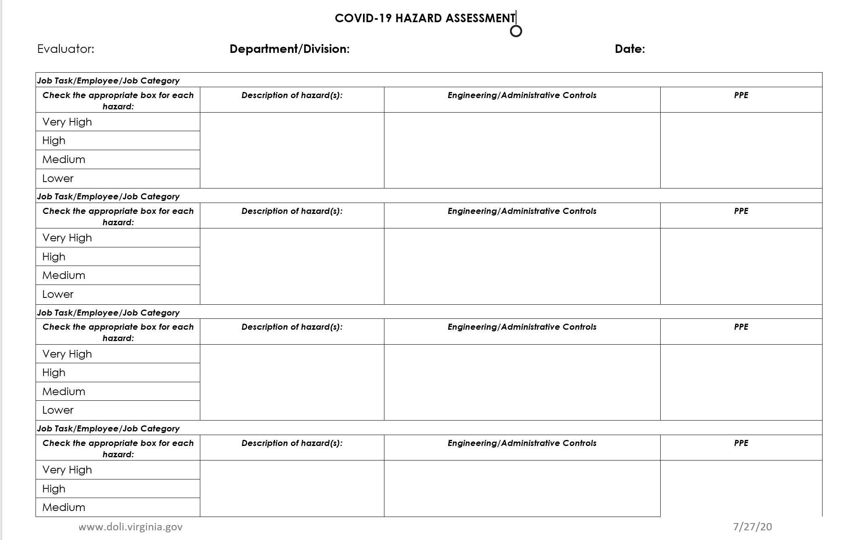
PPE Assessment
Notes:
Personal Protective Equipment
HAZARD ASSESSMENT INSTRUCTIONS
STEP 1: INFORM AFFECTED EMPLOYEES OF THE PROCESS:
Affected employees from each work area that is being assessed should be involved in the process. Discuss the reasons for the survey and the procedures being used for the assessment. Review the job procedures, potential hazards and the PPE currently in use.
Step 2: Review data:
Reports of work‐related injuries or illnesses, near‐miss events and reported safety concerns are sources of data that can provide helpful information for assessing hazards.
Step 3: Conduct a walk‐through survey:
The purpose of the survey is to identify sources of hazards to employees. Observe the following: layout of the workplace, location of the employees, work operations, hazards and places where PPE is currently used including the device and reason for use. Using the form, check the type of hazard(s) present within each section (organized by body part).
Step 4: Determine the hazard risk level
Use the definitions below to select the appropriate hazard risk level.
A. Very high Exposure Risk - Job tasks are those in places of employment with high potential for employee exposure to known or suspected sources of COVID-19 during specific medical, postmortem or laboratory procedures.
Examples:
Aerosol-generating procedures (e.g., intubation, cough induction procedures, bronchoscopies, some dental procedures and exams, or invasive specimen collection) on a known or suspected COVID-19 patient or person known or suspected to have COVID-19
Collecting or handling specimens from a known or suspected COVID-19 patient or person known or suspected to have COVID-19 (e.g., manipulating cultures from patients known or suspected to have COVID-19 patients)
Performing an autopsy, which generally that involves aerosol-generating procedures, on the body of a person known to have, or suspected of having, COVID-19 at the time of their death
B. High Exposure Risk – Jobs that have high potential for exposure inside six feet to known or suspected sources of COVID-19.
Examples:
i. Healthcare delivery and support staff (hospital staff who must enter patients’ rooms) exposed to known or suspected COVID-19 patients
ii. Medical transport (ambulance vehicle operators) moving known or suspected COVID-19 patients in enclosed vehicles
iii. Mortuary workers exposed to known or suspected COVID-19 patients
C. Medium Exposure Risk – Jobs that require more than minimal occupational contact inside six feet with other employees, other persons, or the general public who may be infected with SARS-CoV-2, but who are not known or suspected to be infected with the SARS-CoV-2 virus.
Examples:
i. Schools
ii. High population density work environments (e.g., poultry, meat, other food processing; manufacturing, etc.)
iii. High-volume customer facing retail settings (grocery stores, restaurants, bars, etc.)
iv. Mass gathering venues (e.g., sports, entertainment, movies, theaters, etc.)
D. Lower Exposure Risk - Jobs that do not require contact inside six feet with persons known to be, or suspected of being, or who may be infected with SARS-CoV-2. Employees in this category have minimal occupational contact with other employees, other persons, or the general public, such as in an office building setting; or are able to achieve minimal occupational contact through the implementation of engineering, administrative and work practice controls.
Examples:
i. Remote workers (i.e., those working from home during the pandemic)
ii. Office workers who do not have contact inside 6 feet with coworkers, customers, or the public
iii. Manufacturing and industrial facility workers who do not have inside 6 feet with coworkers, customers, or the public
Step 5: Determine Controls to protect against COVID-19:
After considering and/or planning for engineering and administrative controls, select the PPE which provides at least the minimum level of protection required to protect employees from the hazards. Using the form, note the appropriate controls in the boxes.
Step 6: Make Document Accessible:
Once completed, signed and dated, store the form either electronically or as a hard copy in a location easily accessible to employees and inspectors.
Step 7: Reassess the workplace as necessary by identifying and evaluating:
New equipment and processes
Accident records
Suitability of previously selected PPE
See the attached Hazard Assessment

Slide 23
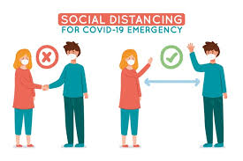
Social Distancing

Slide 24
Physical Distancing Requirements
Announcements, signage, or visual cues
Decrease worksite density
Controlled Access
Notes:
Ensure that employees observe physical distancing at all times on the employer’s property, including policies and procedures that:
Use verbal announcements, signage, or visual cues to promote physical distancing;
Decrease worksite density by limiting non-employee access to the place of employment or restricted access to only certain workplace areas to reduce the risk of exposure.
Access to common areas, breakrooms or lunchrooms shall be closed or controlled.
Common Areas:
Employees required to clean and disinfect the immediate area in which they were located, or employer may provide cleaning and disinfection at regular intervals
Hand washing, sanitizer available

Slide 25

Common Areas - Physical Distancing
Entrance Posting
  Occupancy of the space;
  physical distancing;
  washing/hand sanitizing;
  Cleaning and disinfecting of shared surfaces.
Notes:
Page 20

Slide 26

Cleaning
Clean and disinfect high touch areas
https://www.epa.gov/pesticide-registration/list-n-disinfectants-use-against-sars-cov-2-covid-19

Slide 27
What to Do If You Are Sick
Stay home. Most people with COVID-19 have mild illness and can recover at home without medical care. Do not leave your home, except to get medical care. Do not visit public areas.
Take care of yourself. Get rest and stay hydrated. Take over-the-counter medicines, such as acetaminophen, to help you feel better.
Stay in touch with your doctor. Call before you get medical care. Be sure to get care if you have trouble breathing, or have any other emergency warning signs, or if you think it is an emergency.
Avoid public transportation, ride-sharing, or taxis.
Notes:
Elimination is essentially physically removing the hazard from the work place. We obviously cannot eliminate people, but by removing them from the workplace if they are sick, the closer we can reach that ideal and prevent otherwise health individuals from becoming infected with SARS-CoV-2.
If you are sick with COVID-19 or think you might have COVID-19, follow these steps below to care for yourself and to help protect other people in your home and

Slide 28
When to Quarantine
Stay home and monitor your health
What counts as close contact?
You were within 6 feet of someone who has COVID-19 for a total of 15 minutes or more
You provided care at home to someone who is sick with COVID-19
You had direct physical contact with the person (hugged or kissed them)
You shared eating or drinking utensils
They sneezed, coughed, or somehow got respiratory droplets on you
Stay home for 7-14 days after your last contact with a person who has COVID-19, following return to work policies required in the standard.
Watch for fever (100.4◦F), cough, shortness of breath, or other symptoms of COVID-19
If possible, stay away from others, especially people who are at higher risk for getting very sick from COVID-19
Notes:
Quarantine is used to keep someone who might have been exposed to COVID-19 away from others. Quarantine helps prevent spread of disease that can occur before a person knows they are sick or if they are infected with the virus without feeling symptoms. People in quarantine should stay home, separate themselves from others, monitor their health, and follow directions from their state or local health department.

Slide 29
Who needs to isolate?
Steps to take
Stay home except to get medical care
Monitor your symptoms. If you have an emergency warning sign (including trouble breathing), seek emergency medical care immediately
Stay in a separate room from other household members, if possible
Use a separate bathroom, if possible
Avoid contact with other members of the household and pets
Don’t share personal household items, like cups, towels, and utensils
Wear a mask when around other people, if you are able to
People who have COVID-19
People who have symptoms of COVID-19 and are able to recover at home
People who have no symptoms (are asymptomatic) but have tested positive for infection with SARS-CoV-2
Notes:
On the other hand, Isolation keeps someone who is infected with the virus away from others. People who are in isolation should stay home until it’s safe for them to be around others. In the home, anyone sick or infected should separate themselves from others by staying in a specific “sick room” or area and using a separate bathroom (if available).

Slide 30
When you can be around others after you had or likely had COVID-19
I think or know I had COVID-19, and I had symptoms
You can be with others after
At least 10 days since symptoms first appeared and
At least 24 hours with no fever without fever-reducing medication and
Other symptoms of COVID-19 are improving
**Loss of taste and smell may persist for weeks or months after recovery and need not delay the end of isolation​
Notes:
If think or know you had COVID-19 and you had symptoms, you can be with others after
At least 10 days since symptoms first appeared and
At least 24 hours with no fever without fever-reducing medication and
Other symptoms of COVID-19 are improving. Loss of taste and smell may persist for weeks or months after recovery and need not delay the end of isolation​
If you had severe illness from COVID-19 (you were admitted to a hospital and needed oxygen), your healthcare provider may recommend that you stay in isolation for longer than 10 days after your symptoms first appeared (possibly up to 20 days) and you may need to finish your period of isolation at home. If testing is available in your community, your healthcare provider may recommend that you undergo repeat testing for COVID-19 to end your isolation earlier than would be done according to the criteria above. If so, you can be around others after you receive two negative tests results in a row, from tests done at least 24 hours apart.
If you tested positive for COVID-19 and you continue to have no symptoms, you can be with others after:
10 days have passed since the date you had your positive test
If testing is available in your community, your healthcare provider may recommend that you undergo repeat testing for COVID-19 to end your isolation earlier than would be done according to the criteria above. If so, you can be around others after you receive two negative test results in a row, from tests done at least 24 hours apart.
If you develop symptoms after testing positive, follow the guidance above for “I think or know I had COVID, and I had symptoms.”
If you have a weakened immune system (immunocompromised) due to a health condition or medication, you might need to stay home and isolate longer than 10 days. Talk to your healthcare provider for more information.

Slide 31
Return to Work
Symptomatic employees known or suspected to be infected with the SARS-CoV-2 virus employees the symptom-based strategy excludes an employee are excluded from returning to work until all three of the following have been met:
at least three days since the employee is fever-free (less than 100.0° F) for at least 24 hours have passed since recovery, defined as resolution of fever without the use of fever-reducing medications
improvement in Respiratory symptoms, such as (e.g., cough, and shortness of breath) have improved, and
at least 10 days have passed since symptoms first appeared.

Slide 32
Infectious Disease Preparedness & Response Plan
Very high, and high
Medium with 11 or more employees
Person responsible for implementing
Webpage Guidance Document
Notes:
Employers in exposure risk levels very high, and high, shall develop and implement a written Infectious Disease Preparedness and Response Plan.
Medium with 11 or more employees shall develop and implement a written Infectious Disease Preparedness and Response Plan.
The plan and training requirements tied to the plan shall only apply to those employees classified as “very high,” “high,” and “medium” covered by this section.
Employers shall designate a person to be responsible for implementing their plan.

Slide 33
Infectious Disease Preparedness & Response Plan
The plan shall contain:
The name(s) or titles(s) of the person(s) responsible for administering the Plan
Provide for employee involvement
Exposure Risk Level
Notes:
The plan shall contain:
The name(s) or titles(s) of the person(s) responsible for administering the Plan. This person shall be knowledgeable in infection control principles and practices as they apply to the facility, service or operation.
Provide for employee involvement in development and implementation of the plan.
Consider and address the level(s) of risk associated with various places of employment, the hazards employee are exposed to and job tasks employees perform at those sites.

Slide 34
Infectious Disease Preparedness & Response Plan
The plan shall contain:
Where, how, and what sources
Engineering Controls
Administrative Controls
Work practices
PPE
Notes:
The plan shall contain:
Where, how, and to what sources of SARS-CoV-2 or COVID-19 might employees be exposed at work, including:
The general public, customers, other employees, patients, and other persons;
Known or suspected to be infected persons or those at high risk; and
Situations where employees work more than one job with different employers and encounter hazards or engage in job task that present a “very high,” “high,” or “medium” level of exposure risk.
As permitted by law, including HIPPA, employees’ individual risk factors
Engineering, administrative, work practices, and personal protective equipment controls necessary to address those risks.

Slide 35
Infectious Disease Preparedness & Response Plan
The plan shall contain:
Contingency plans for outbreaks
  Employee absenteeism;
  Control Measures
  Reduced workforce
  Suplly Chains Interrupted
Notes:
The plan shall contain:
Consider contingency plans for situations that may arise as a result of outbreaks, such as:
Increased rates of employee absenteeism;
The need for physical distancing, staggered work shifts, downsizing operations, delivering services remotely, and other exposure-reducing workplace control measures such as elimination/substitution, engineering controls, administrative and work practice controls, personal protective equipment, e.g., respirators, surgical/medical procedure masks, etc.
Options for conducting essential operations with a reduced workforce, including cross-training employees across different jobs in order to continue operations or deliver surge services; and
Interrupted supply chains or delayed deliveries.

Slide 36
Infectious Disease Preparedness & Response Plan
The plan shall contain:
Infection prevention
  Hand washing
  Housekeeping
  Visitor education
Notes:
The plan shall contain:
Identify Basic infection prevention measures to be implemented:
Promote frequent and thorough hand washing, including by providing employees, customers, visitors, the general public, to the place of employment with a place to wash their hands. If soap and running water are not immediately available, provide hand sanitizers.
Maintain regular housekeeping practices, including routine cleaning and disinfecting of surfaces, equipment, and other elements of the work environment.
Establish policies and procedures for managing and educating visitors to the place of employment.

Slide 37
Infectious Disease Preparedness & Response Plan
The plan shall contain:
Identification and isolation
Reporting when they are experiencing symptoms of COVID-19.
Subcontractors
Notes:
The plan shall contain:
Provide for the prompt identification and isolation of known or suspected to be infected with SARS-CoV-2 employees away from work, including procedures for employees to report when they are experiencing symptoms of COVID-19.
Address Infectious disease preparedness and response with outside businesses, including but not limited to subcontractors that enter the place of employment, business that provide or contract or temporary employees to the employer, as well as other persons accessing the place of employment to comply with the requirements of this standard and the employer’s plan.

Slide 38
Infectious Disease Preparedness & Response Plan
The plan shall contain:
CDC guidelines or Commonwealth of Virginia guidance documents
Virginia Executive Orders
Notes:
The plan shall contain:
Identify the mandatory and non-mandatory recommendations in any CDC guidelines or Commonwealth of Virginia guidance documents the employer is complying with, if any, in lieu of a provision of this standard, as provided for in section §§16VAC25-220-10.G.1 and -10.G.2.
Ensure compliance with mandatory requirements of any applicable Virginia executive order or order of public health emergency related to the SARS-CoV-2 virus or COVID-19 disease.

Slide 39
Questions?
VOSH Consultation
https://www.doli.virginia.gov/vosh-programs/consultation/
Outreach Documents
https://www.doli.virginia.gov/covid-19-outreach-education-and-training/
Reporting
https://redcap.vdh.virginia.gov/redcap/surveys/?s=LRHNP89XPK
Questions
covid19questions@doli.virginia.gov

